Slide 1
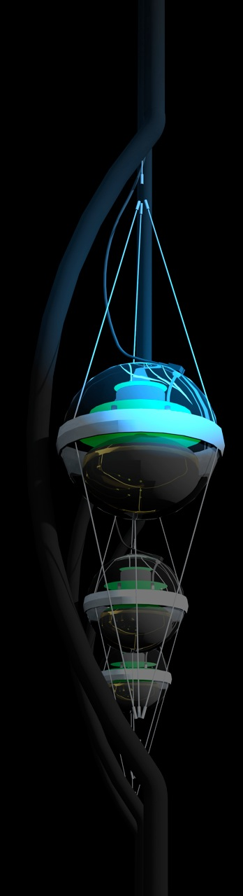
IceCube
francis halzen
cosmogenic neutrinos
the energetics of cosmic ray sources
neutrinos associated with cosmic rays
a cubic kilometer detector
evidence for extraterrestrial neutrinos
conclusions
IceCube.wisc.edu

Slide 2

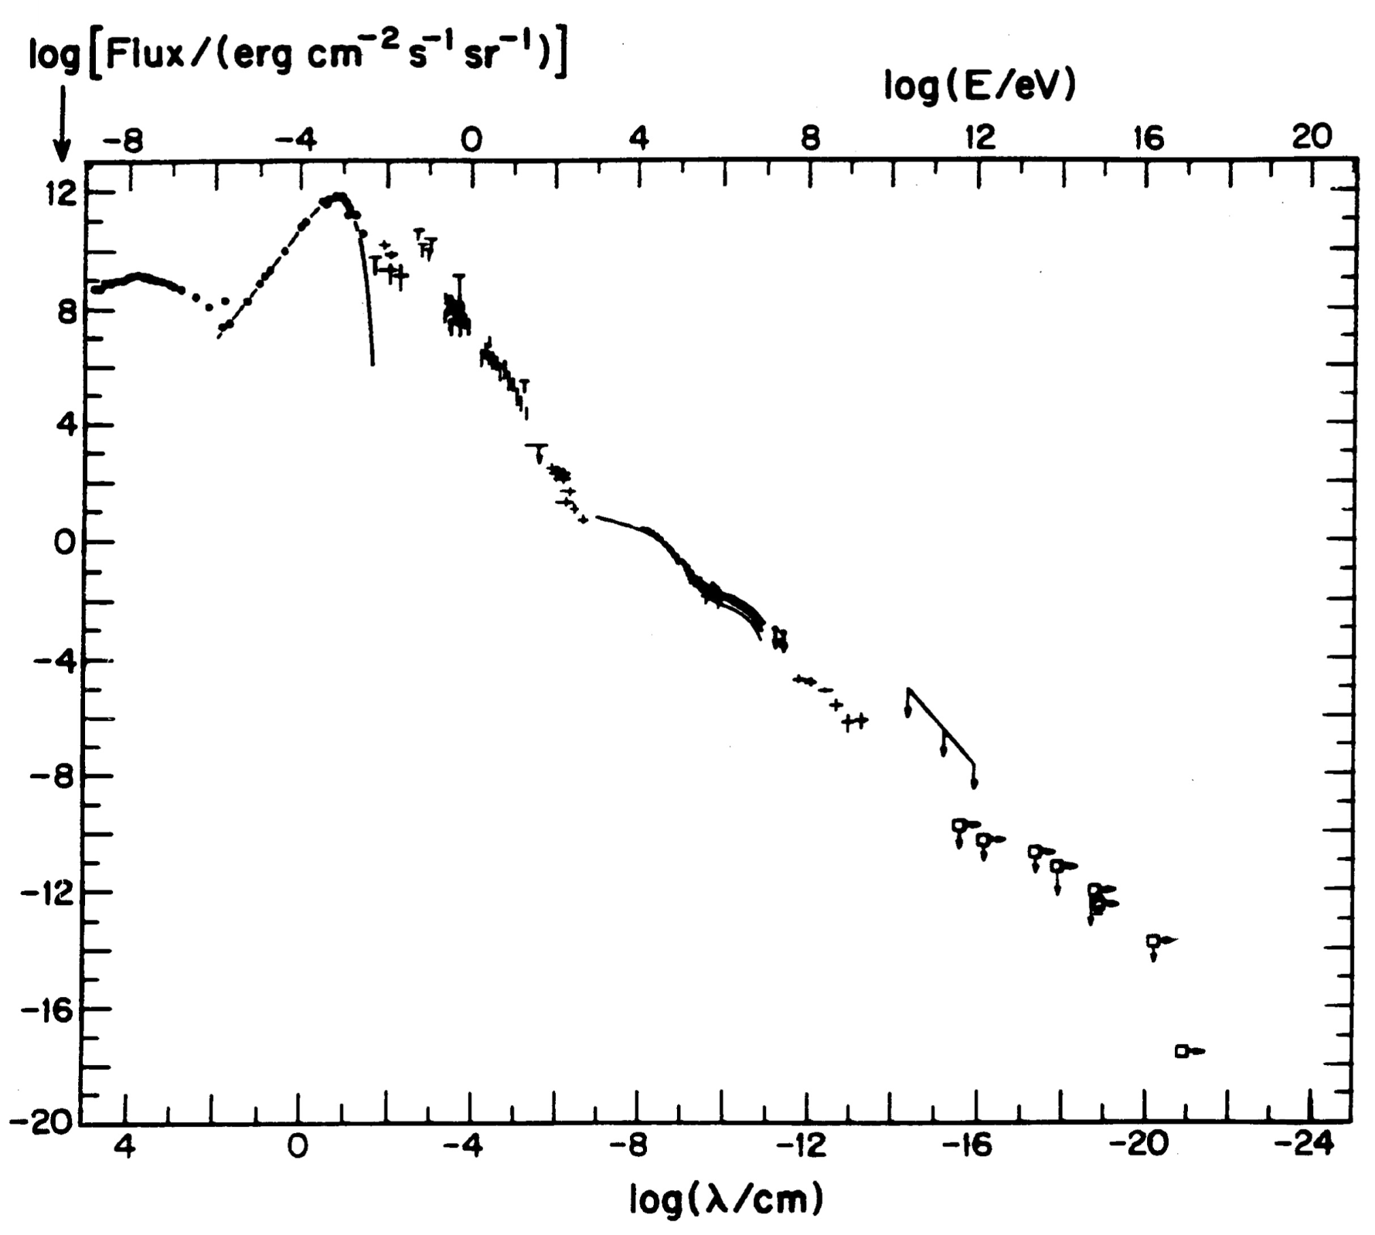
energy (eV)
ν
Radio
CMB
flux
Visible
TeV sources
cosmic
rays
GeV γ-rays
particle flux
in the Universe

Slide 3
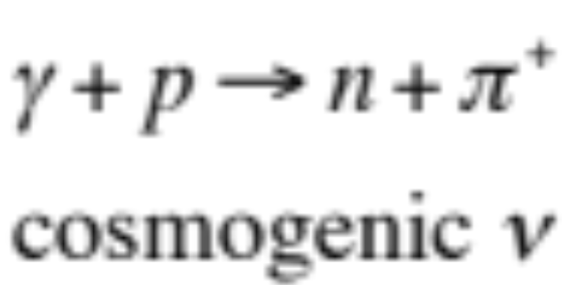
energy (eV)
ν
Radio
CMB
flux
Visible
cosmic
rays
GeV γ-rays

Slide 4

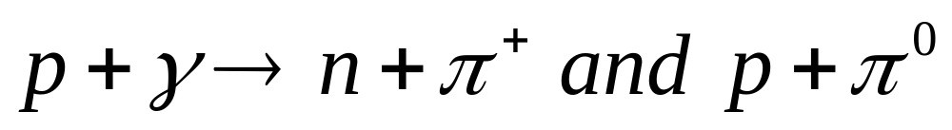
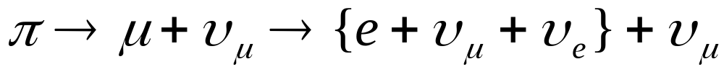
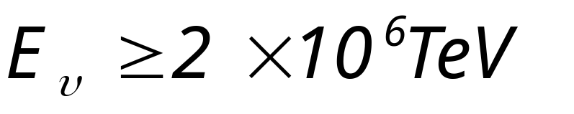
cosmic rays interact with the microwave background
cosmic rays disappear, neutrinos with
EeV (10¹⁸ eV) energy appear
1 event per cubic kilometer per year
...but it points at its source!

Slide 5
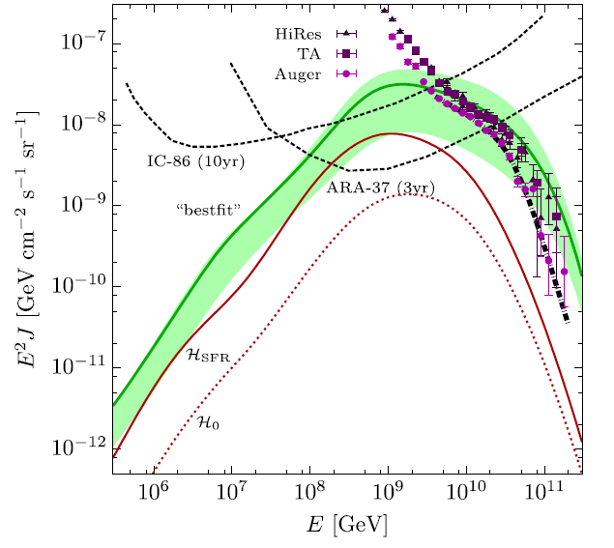
cosmic rays
neutrinos produced in
interactions with
microwave photons
~1 event per year in
IceCube, PAO and ARA

Slide 6
IceCube
francis halzen
cosmogenic neutrinos
the energetics of cosmic ray sources
neutrinos associated with cosmic rays
a cubic kilometer detector
evidence for extraterrestrial neutrinos
conclusions
IceCube.wisc.edu

Slide 7
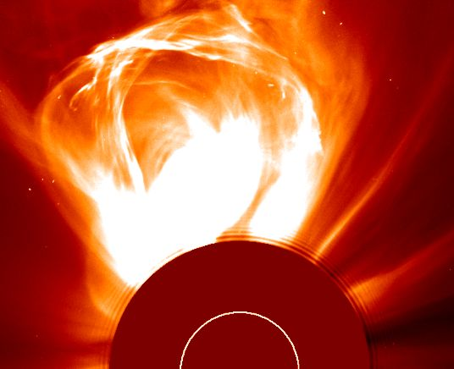
the sun constructs an accelerator
coronal mass
ejection
09 Mar 2000

Slide 8
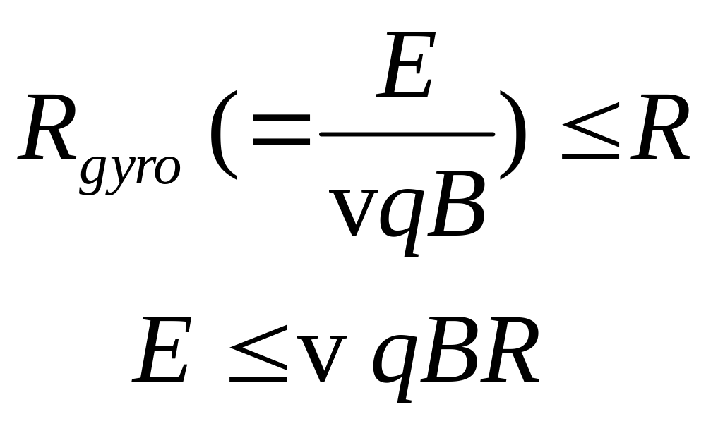
Hillas formula :
accelerator must contain the particles
dimensional analysis, difficult to satisfy

Slide 9
galactic
cosmic rays
10-41 erg/cm3
energy (eV)
galactic
cosmic rays
10⁻¹² erg cm⁻³
Radio
CMB
Visible
extragalactic
cosmic rays
3x10⁻¹⁹ erg cm⁻³
flux
410 photons
of 2.7 K per cm³
or
10⁻¹² erg cm⁻³
~ 0.5 eV cm⁻³
GeV γ-rays

Slide 10
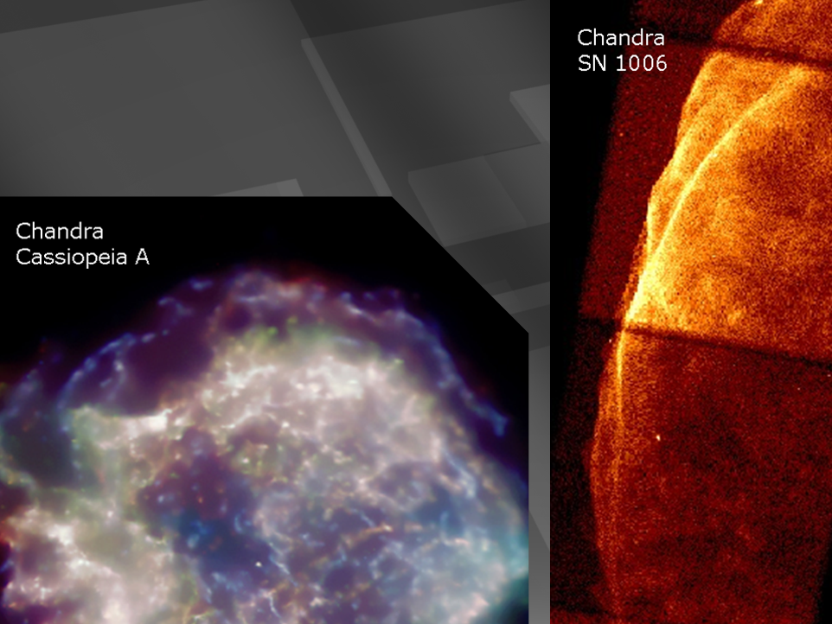
supernova remnants

Slide 11
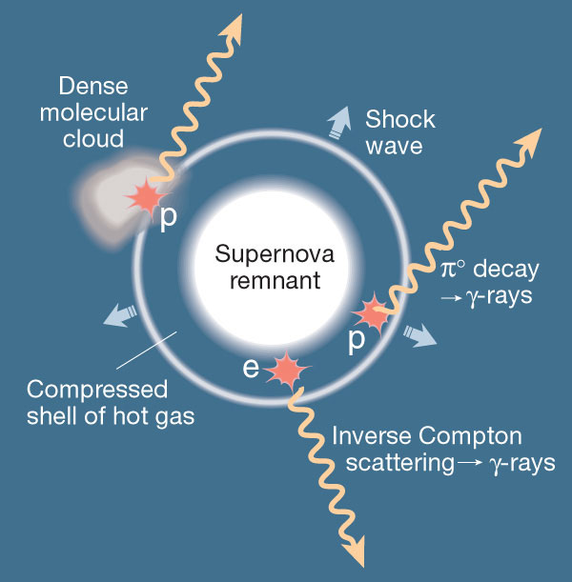
neutrinos
from supernova
remnants :
molecular
clouds in star-forming regions where super-nova explode: beam dumps!

Slide 12

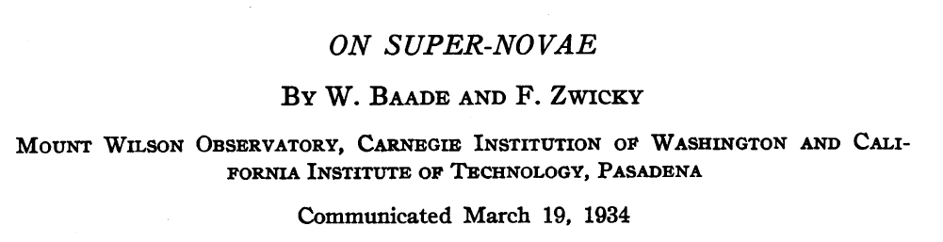
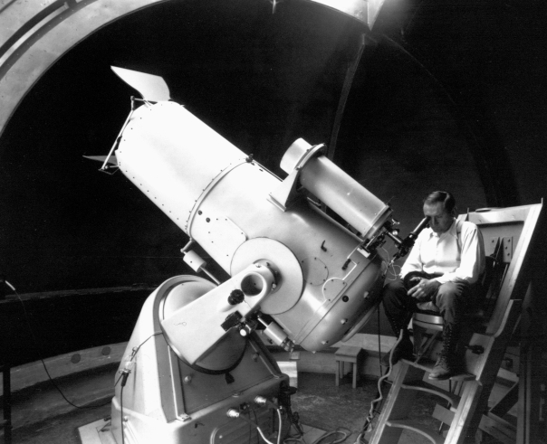
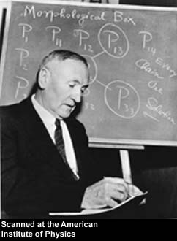
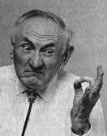

Slide 13
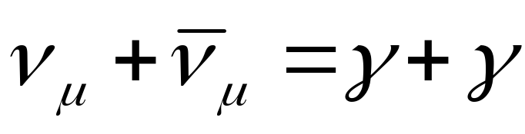
neutral pions
are observed as
gamma rays
charged pions
are observed as
neutrinos
π⁰
π⁺
π⁻
γ
γ
ν_{μ} μ⁺
ν μ⁻
e⁺ e⁻
e⁺
γ
e⁻
μ⁺
e⁺
γ
e⁺
ν_{e}
ν_{μ}
Notes:
13

Slide 14
supernova remnants

Slide 15
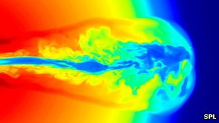
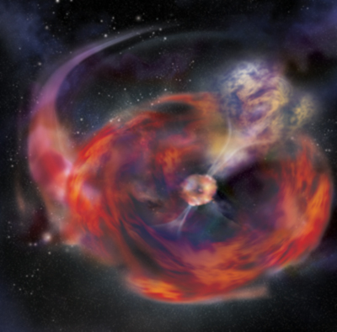
…and if the star collapses to
a black hole…
gamma ray burst
happens in seconds
not thousands of year
beamed along the spin
axis of the black hole
simulation not image

Slide 16
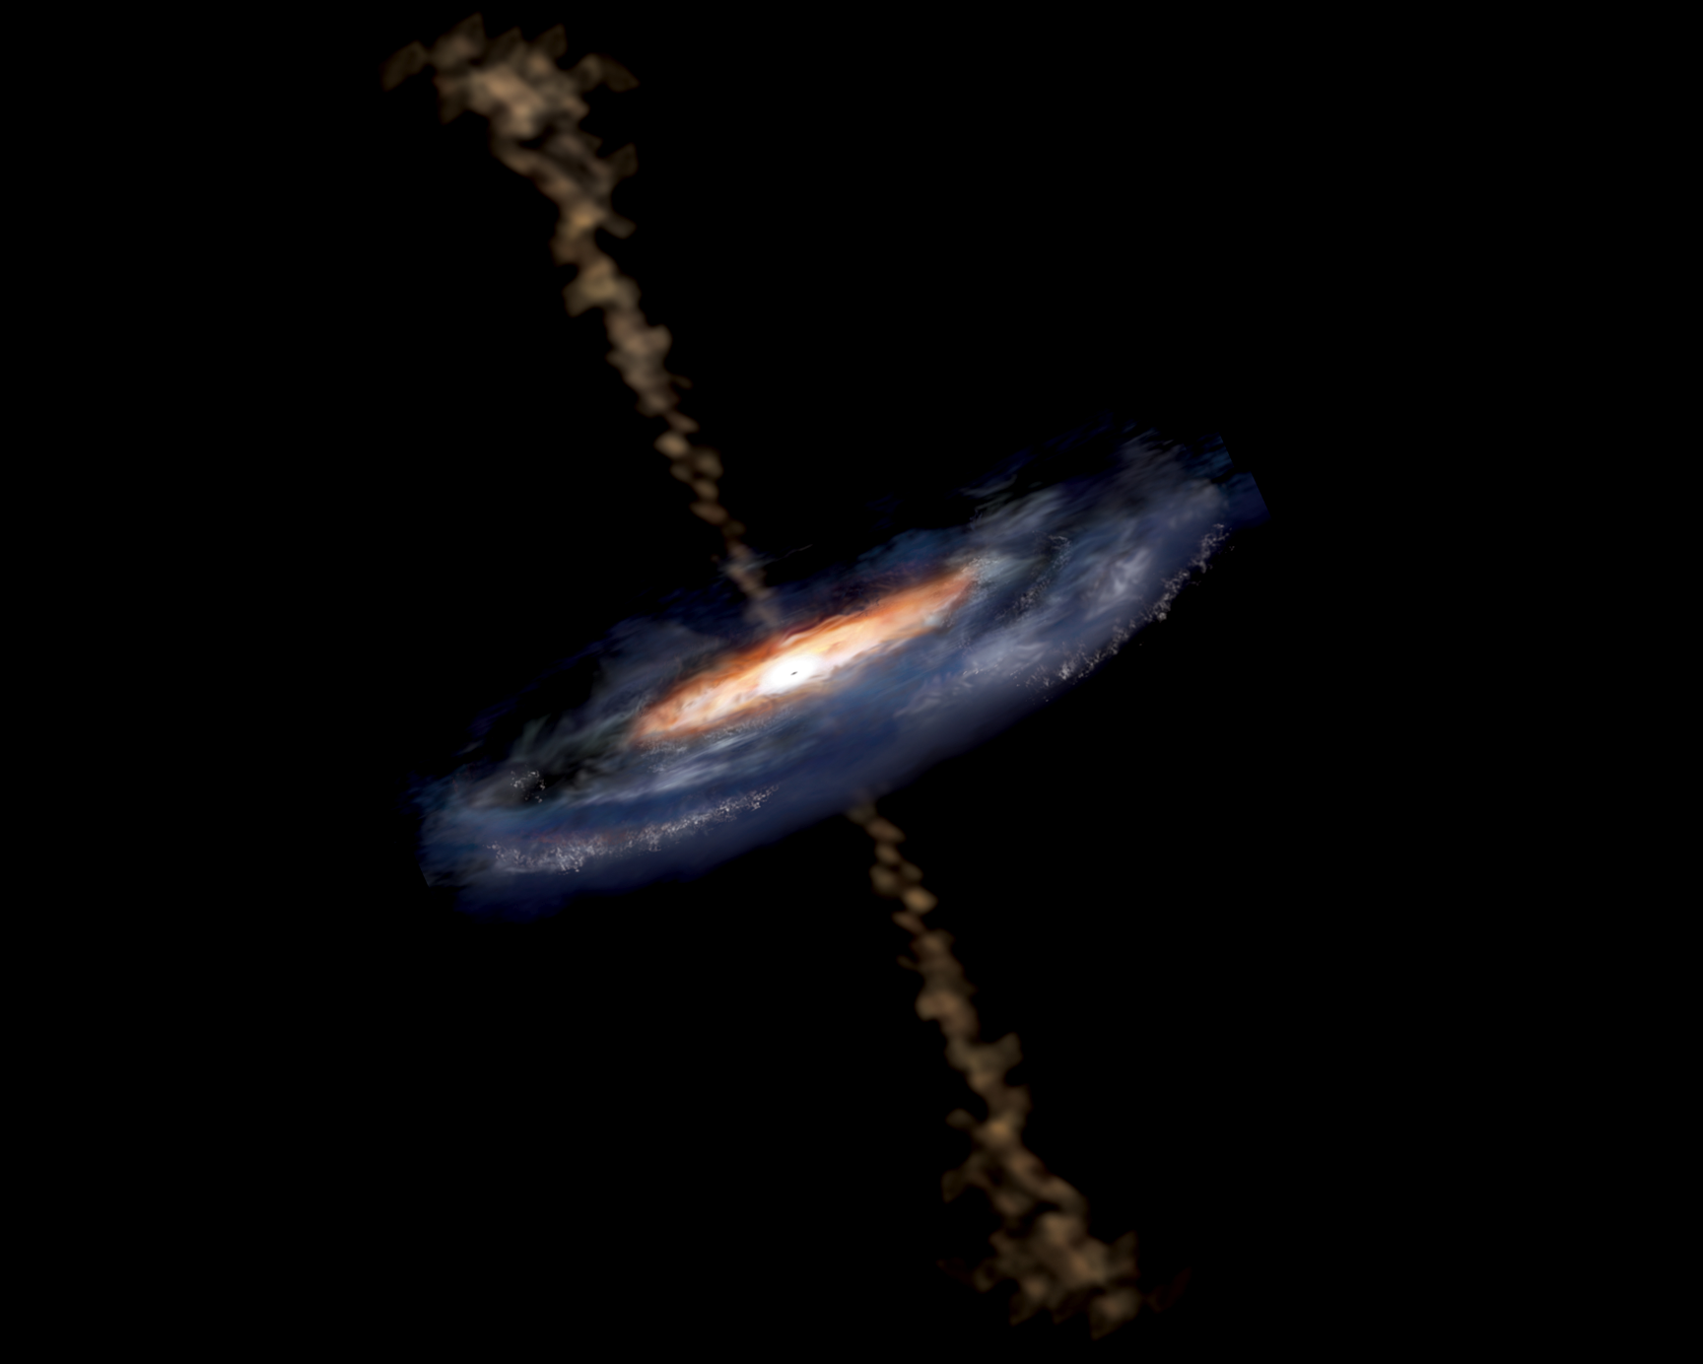
active galaxy particle flows near supermassive black hole

Slide 17
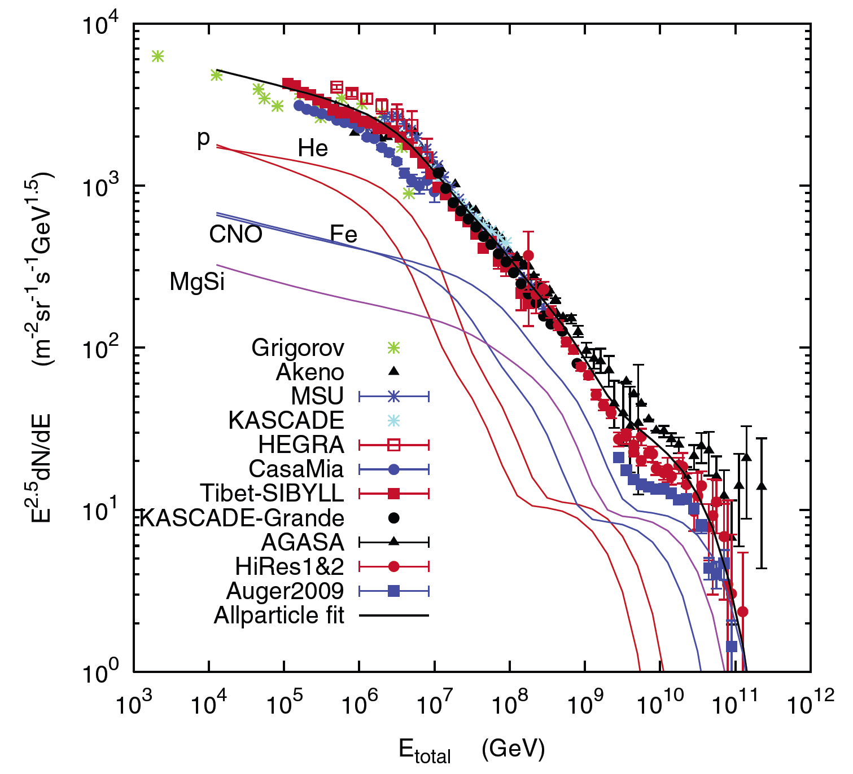
sources accommodating the observed energy budget
Galactic:
supernova
remnants?
extragalactic:
gamma ray
bursts??
active
galaxies?

Slide 18
IceCube
francis halzen
cosmogenic neutrinos
the energetics of cosmic ray sources
neutrinos associated with cosmic rays
a cubic kilometer detector
evidence for extraterrestrial neutrinos
conclusions
IceCube.wisc.edu

Slide 19
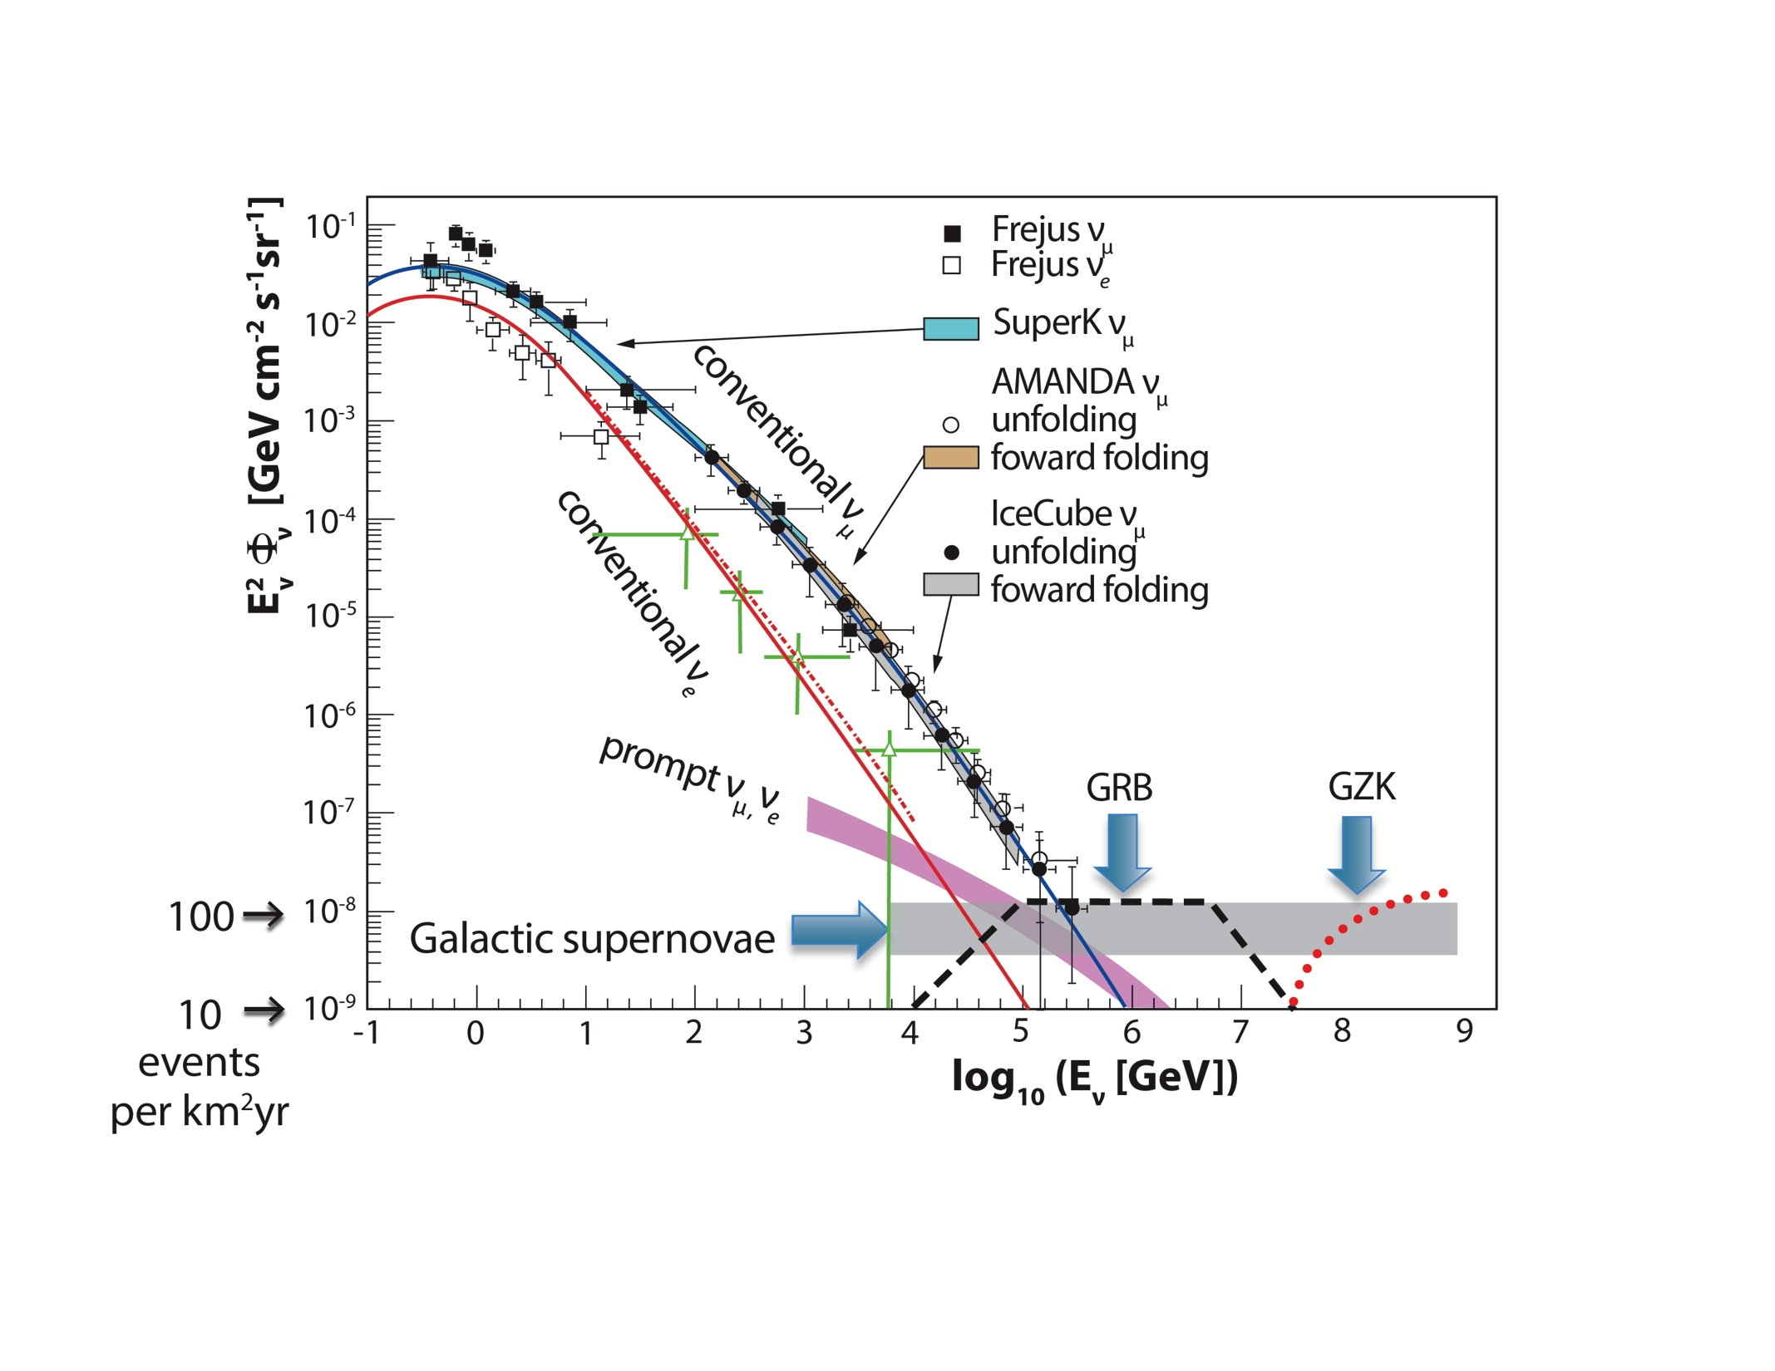

Slide 20
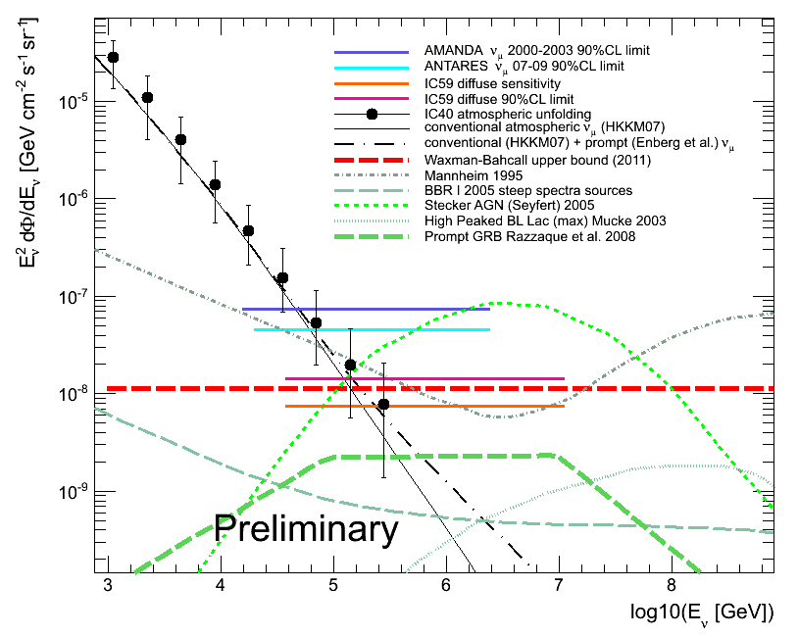
before
AMANDA
59 strings, 1 year
sensitivity
“limit”

Slide 21
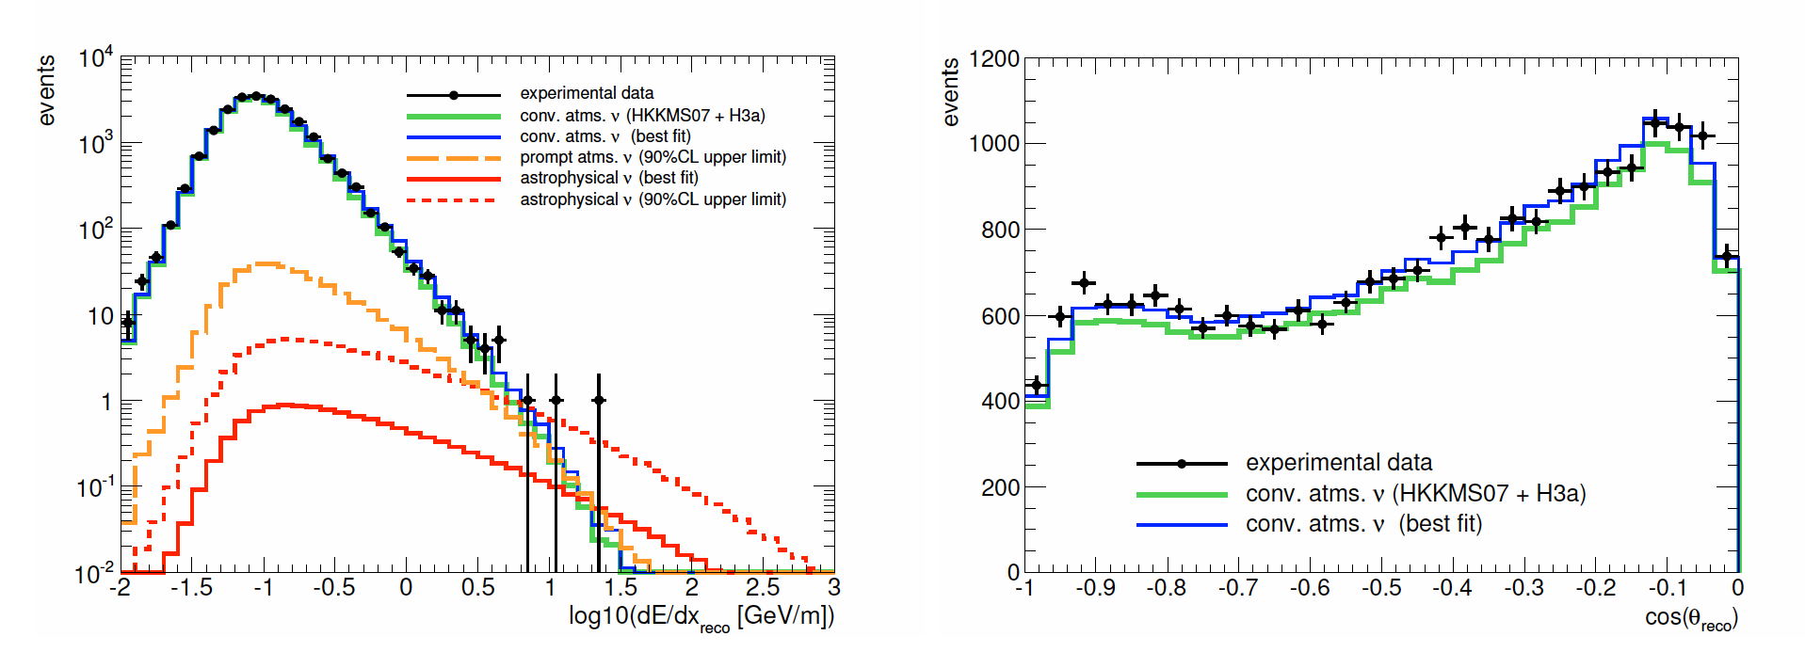
IceCube 59: the last limit ?
sterile neutrinos?

Slide 22
IceCube
francis halzen
cosmogenic neutrinos
the energetics of cosmic ray sources
neutrinos associated with cosmic rays
a cubic kilometer detector
evidence for extraterrestrial neutrinos
conclusions
IceCube.wisc.edu

Slide 23
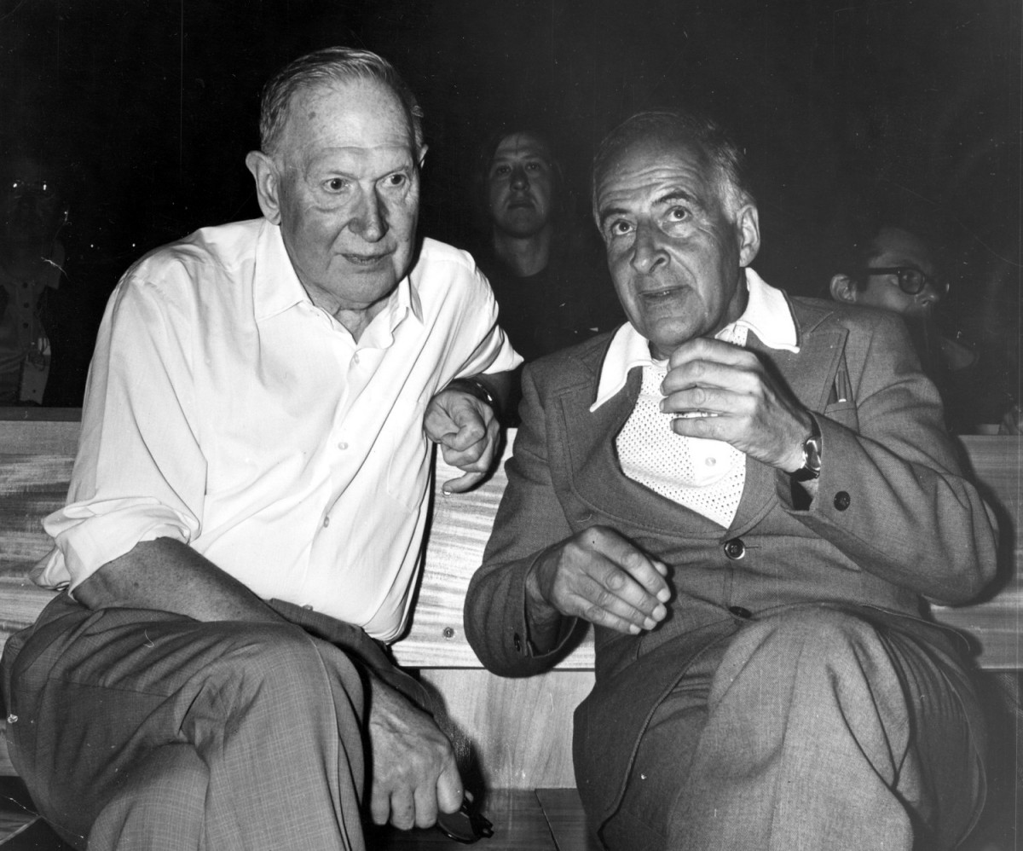
M. Markov
1960
B. Pontecorvo
M.Markov :
we propose to install detectors
deep in a lake or in the sea and
to determine the direction of
charged particles with the help
of Cherenkov radiation.

Slide 24
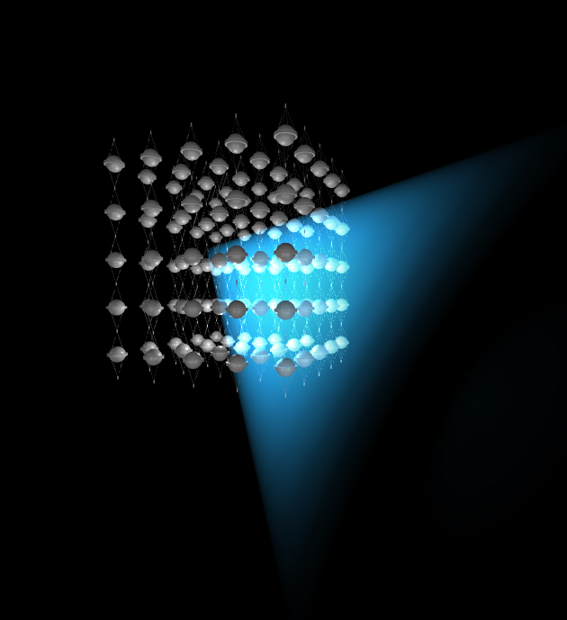
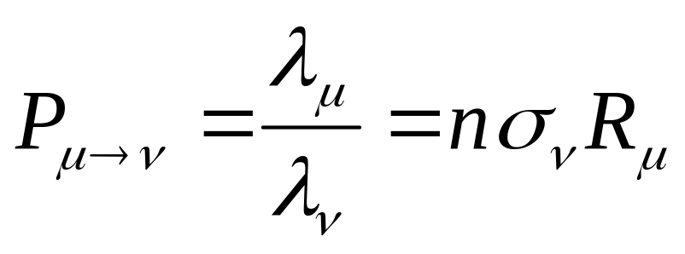
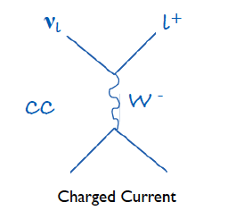
shielded and optically
transparent medium
μ
ν
lattice of photomultipliers

Slide 25
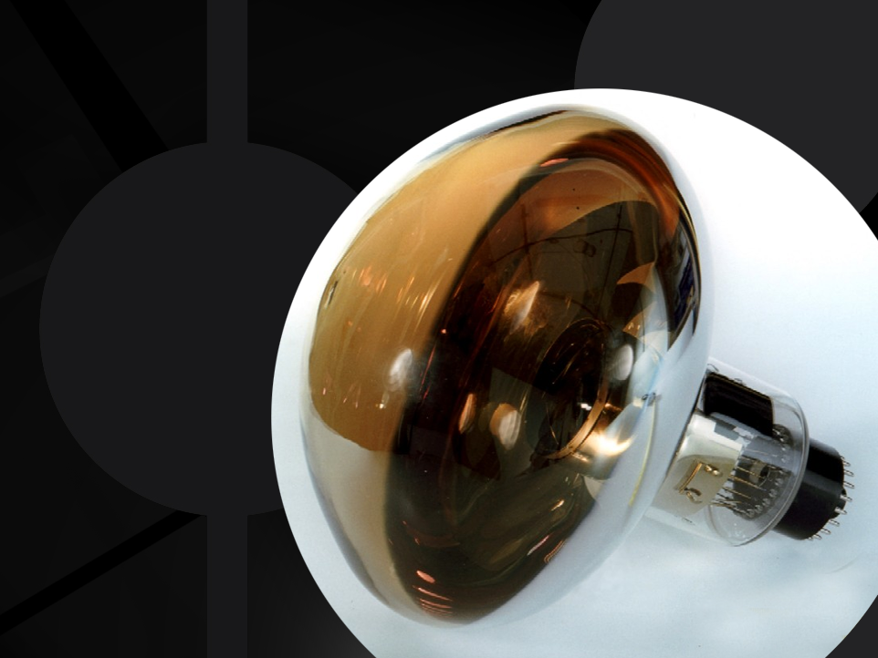
photomultiplier
tube

Slide 26
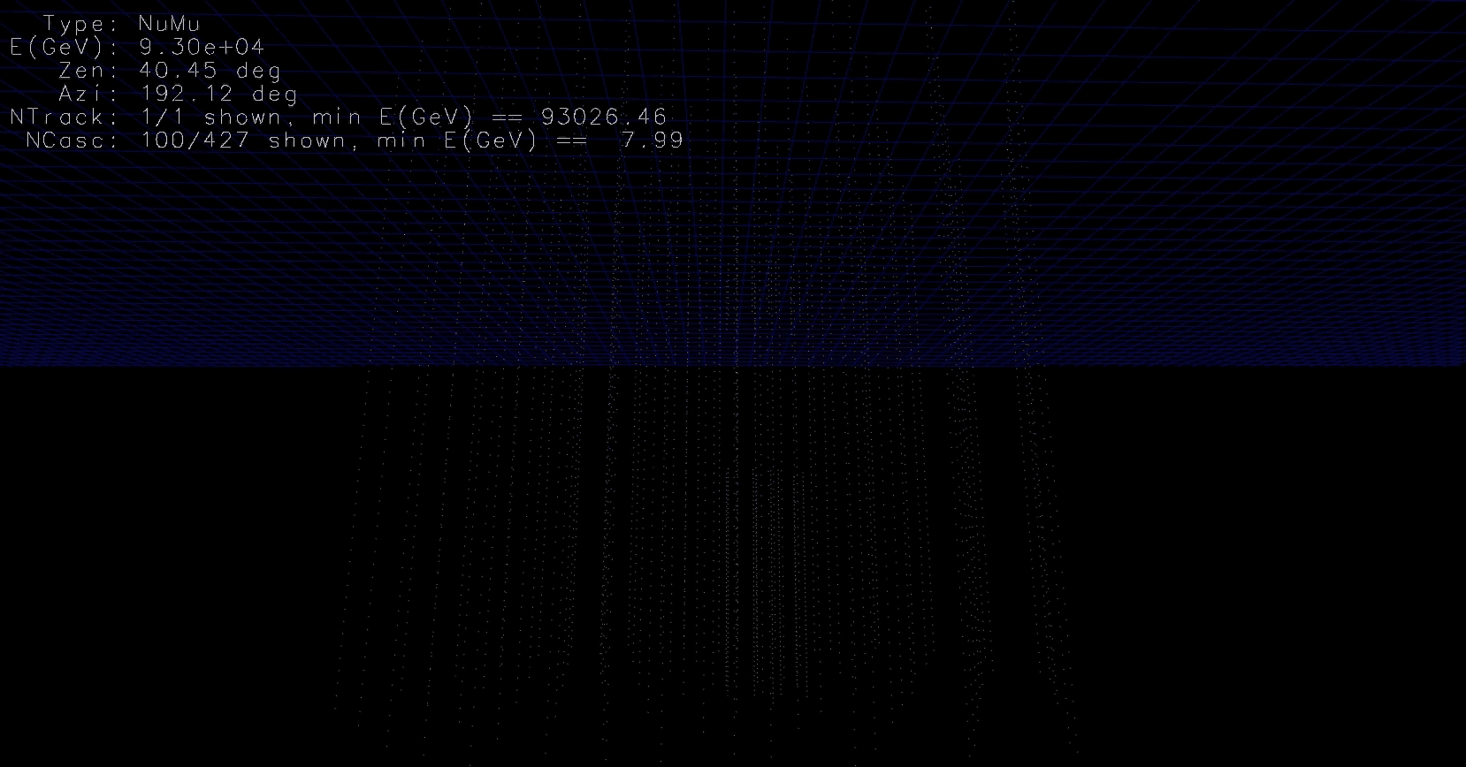
93 TeV muon

Slide 27
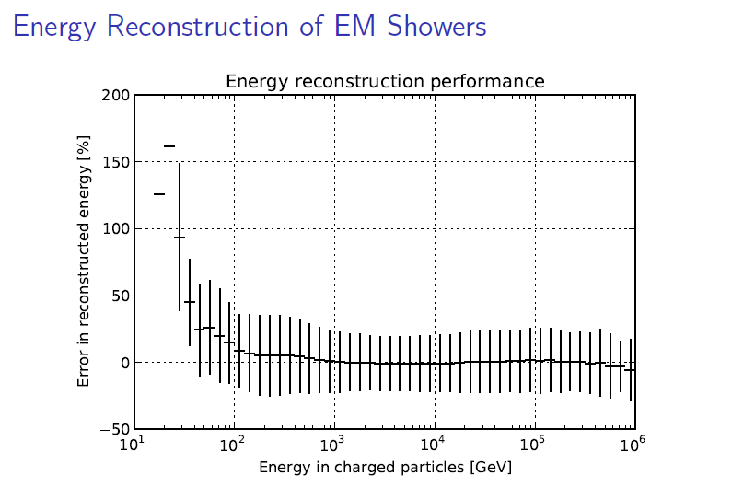
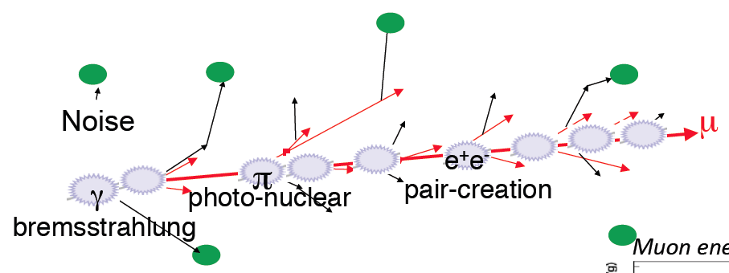
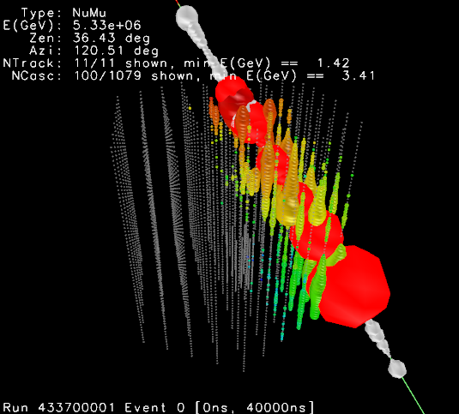
energy measurement ( > 1 TeV )
convert the amount of light emitted
to measurement of the muon
energy (number of optical modules,
number of photons, dE/dx, …)

Slide 28
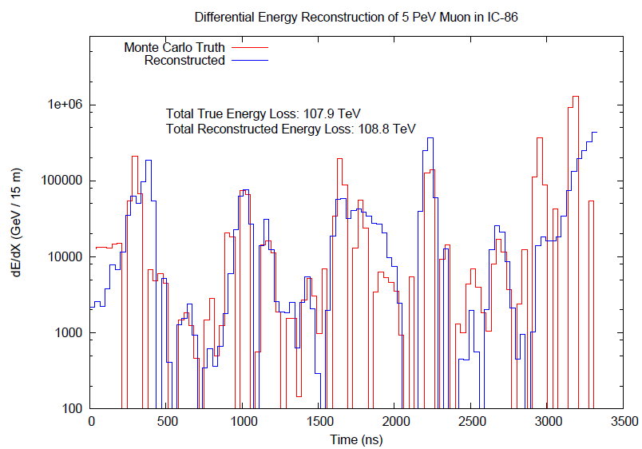
improving angular and energy resolution

Slide 29
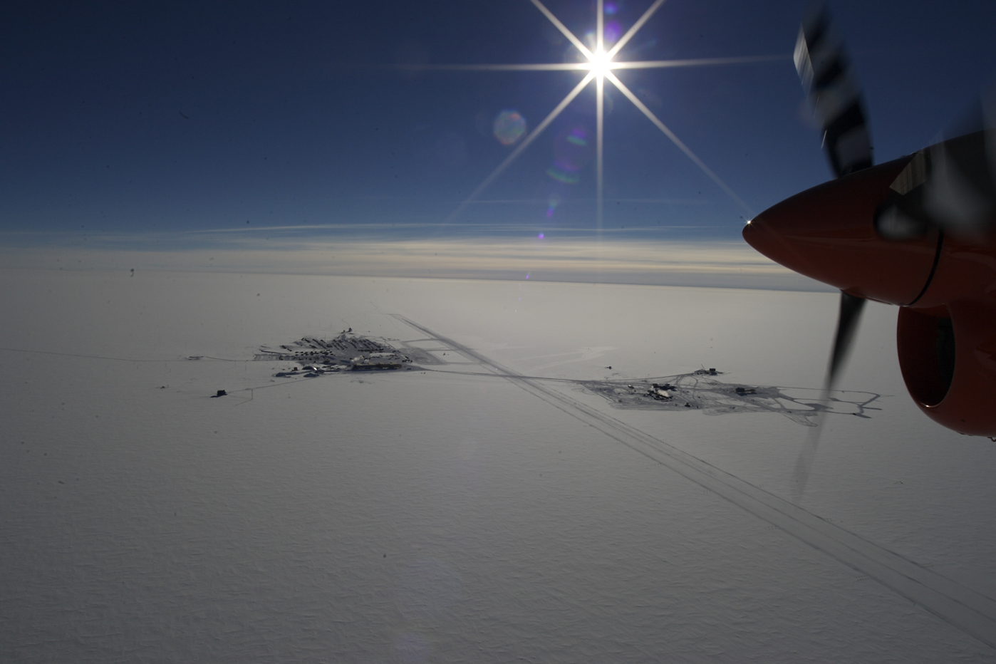
why did it take so long ?

Slide 30
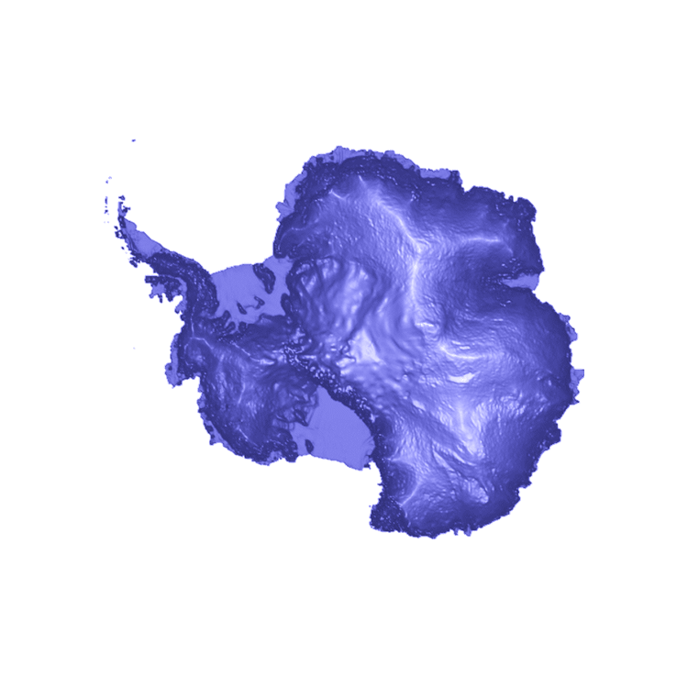
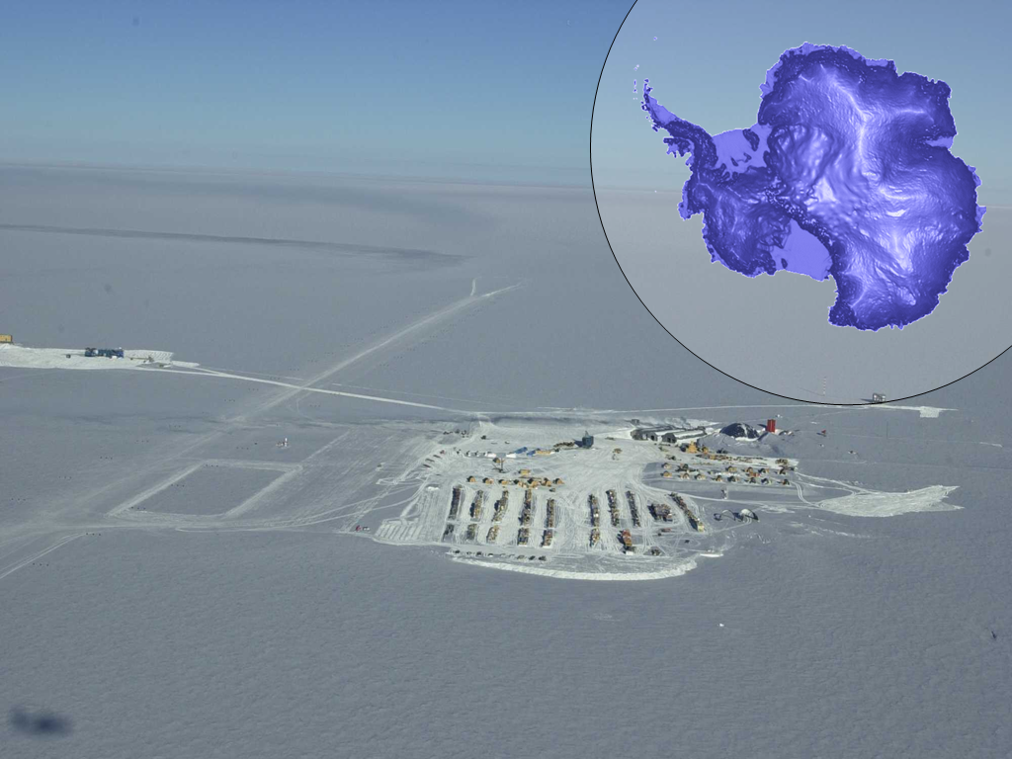
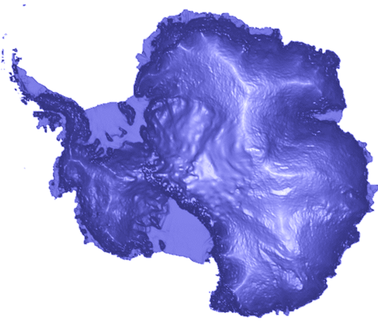
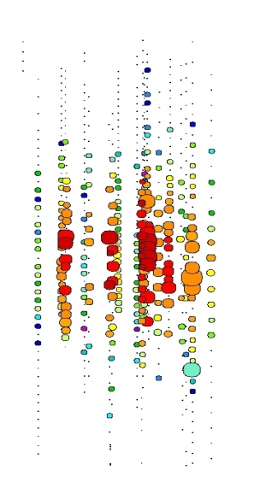
south pole 2000
AMANDA
South Pole
Dome
1500 m
2000 m
Amundsen-Scott south pole station
[not to scale]

Slide 31
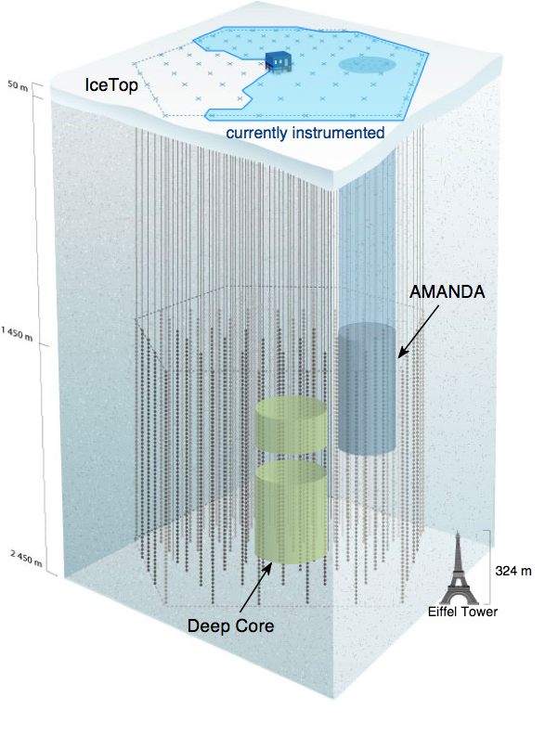
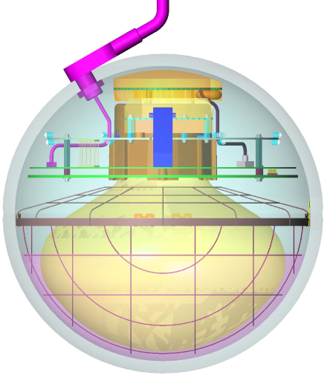
IceCube / Deep Core
completed December 2010
5160 optical sensors
between 1.5 ~ 2.5 km
10 GeV to infinity
< 0.5 degree on-line
< 0.3 degree off line
for muons
(10~15 degrees for
showers)
< 15% energy resolution
Digital Optical Module (DOM)

Slide 32
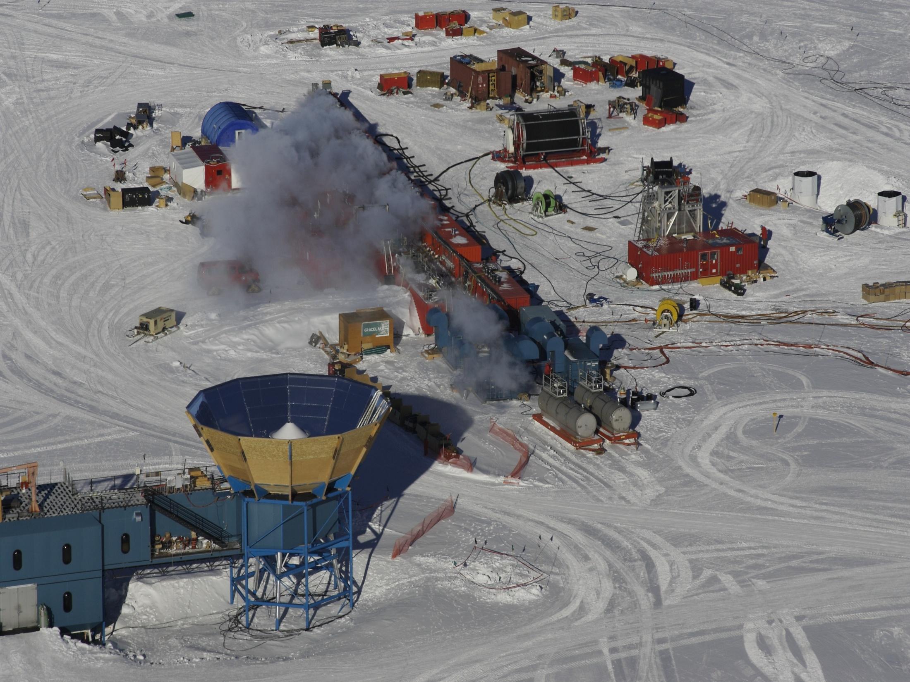
IceCube Site
nozzle delivers →
  200 gallons per minute
  7 Mpa
  90 degree C
  → 4.8 megawatt heating plant

Slide 33
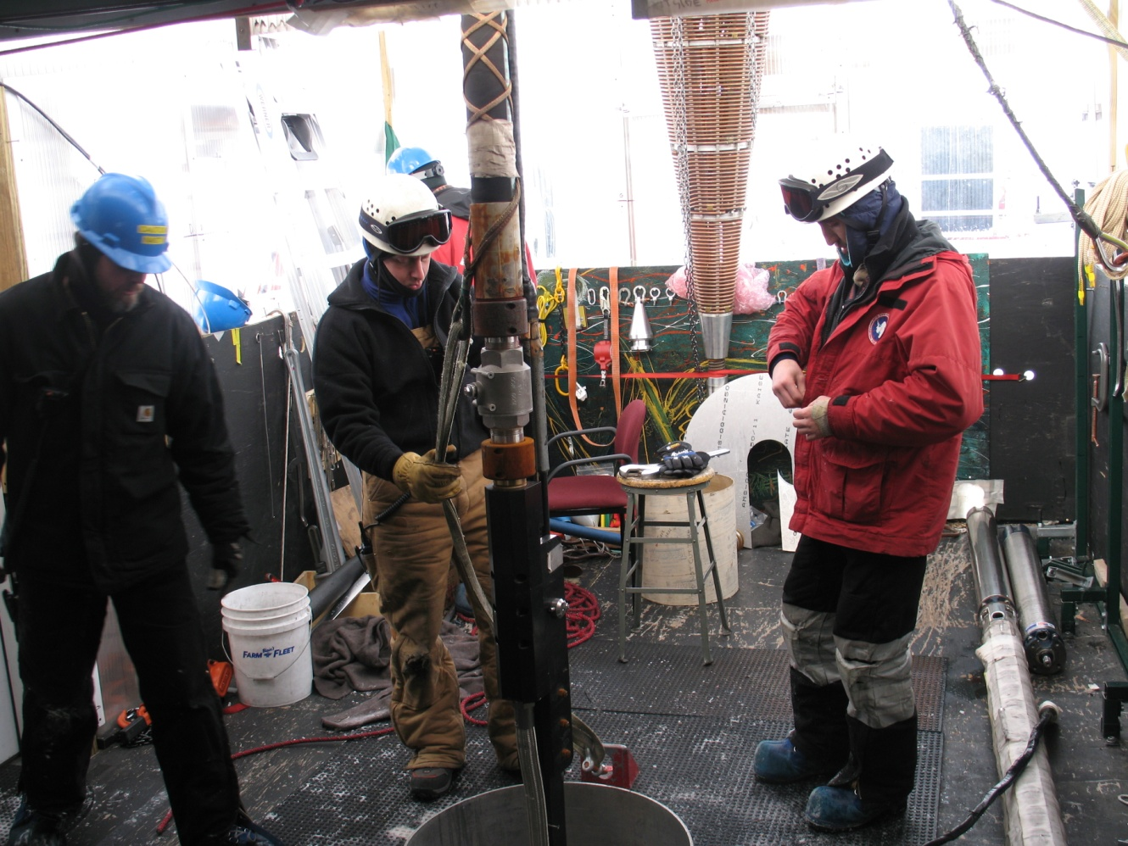
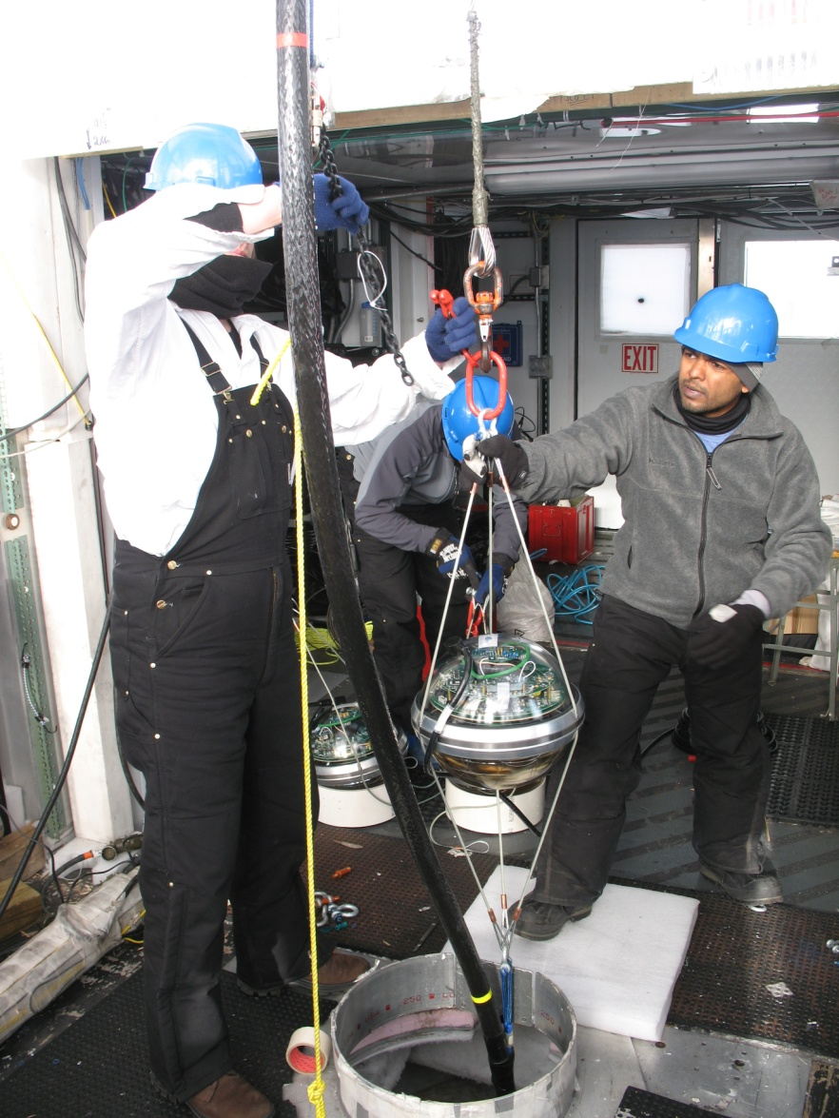
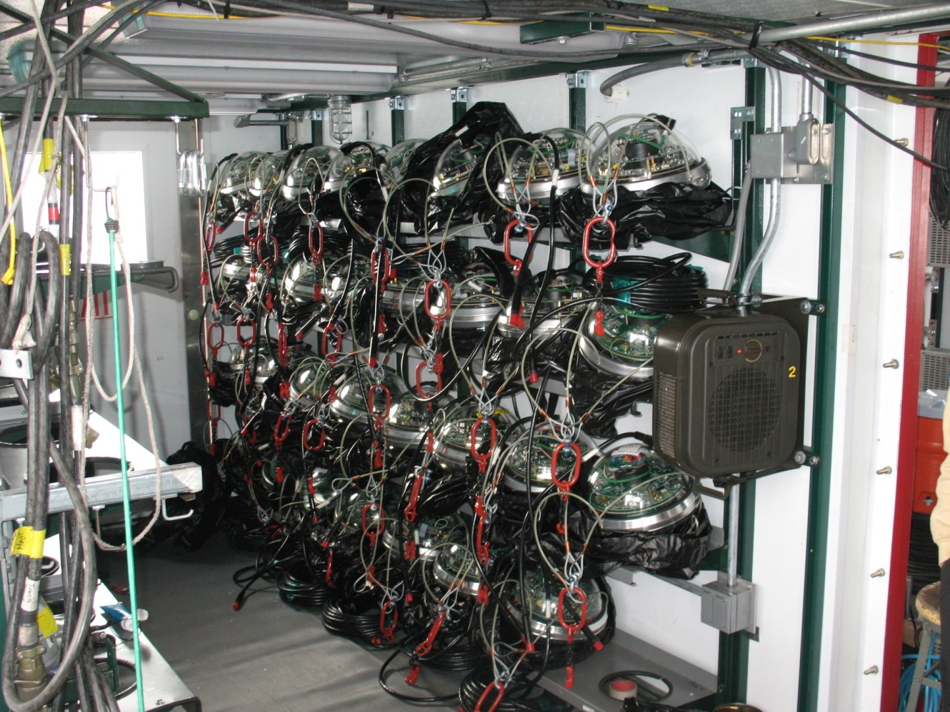
drilling and deployment
2 days per hole
3.5 cm/second
33

Slide 34
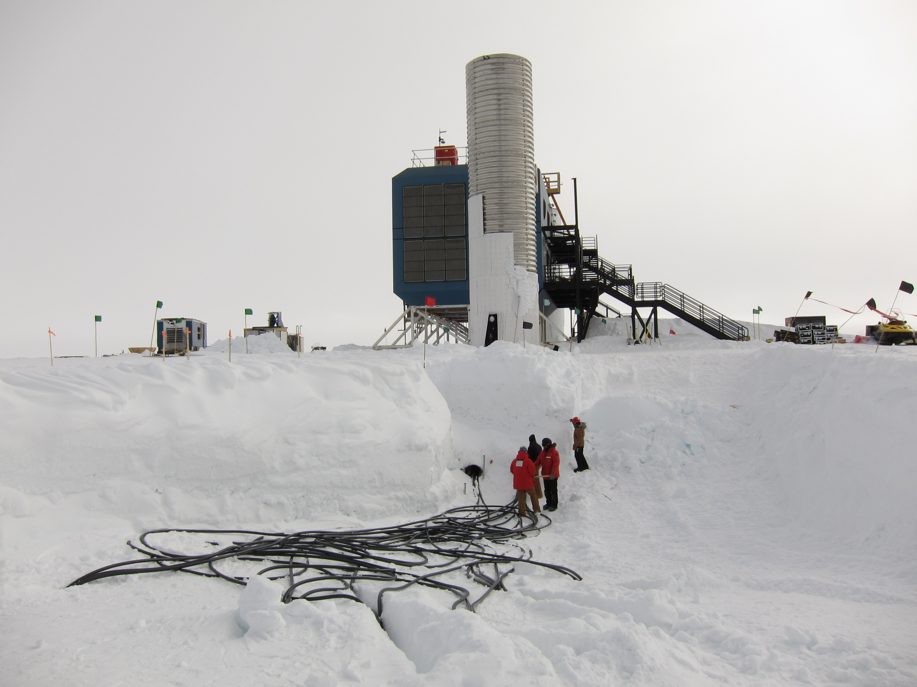

Slide 35
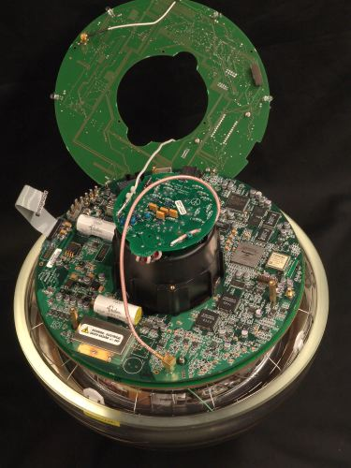
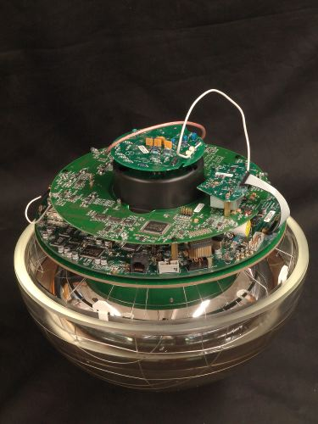
architecture of independent DOMs
LED flasher board
HV board
main board

Slide 36
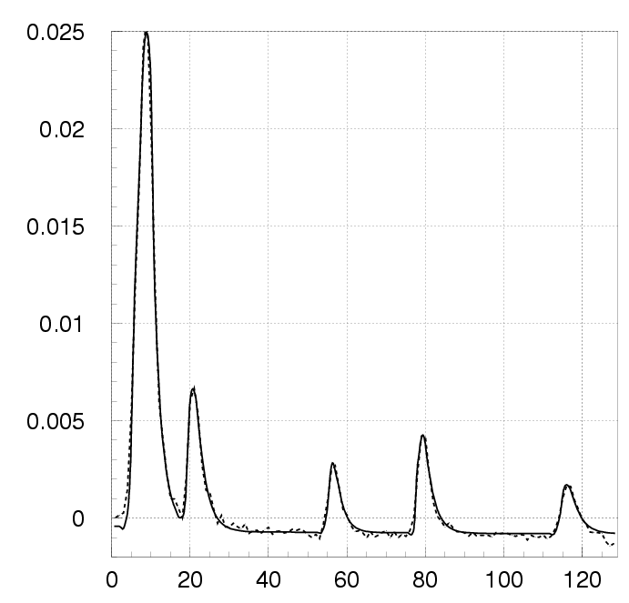
Digital Optical Module (DOM)
… each DOM independently collects light signals like this…
…time stamps them with 2 nanoseconds precision and sends them to a computer that sorts them into muon and neutrino events…
Digitized Waveform
Notes:
36

Slide 37
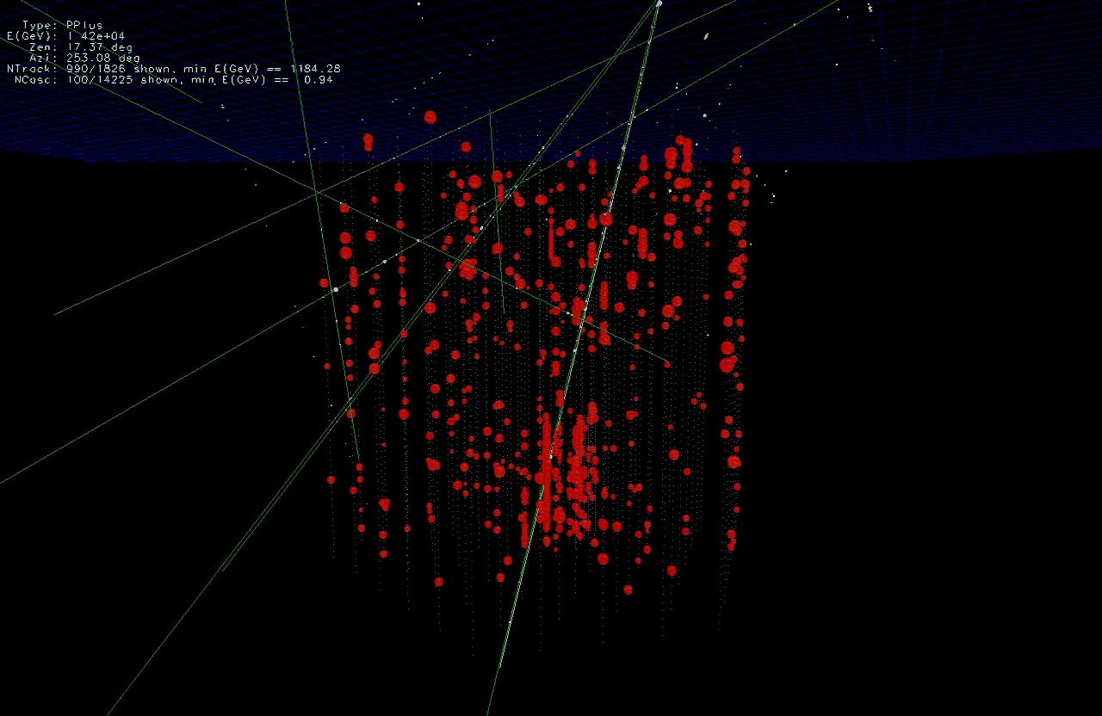

Slide 38
… you looked at 10msec of data !
muons detected per year:
atmospheric* μ ~ 10¹¹
atmospheric** ν → μ ∼ 10⁵
cosmic ν → μ ∼ 10
* 2700 per second ** 1 every 6 minutes

Slide 39
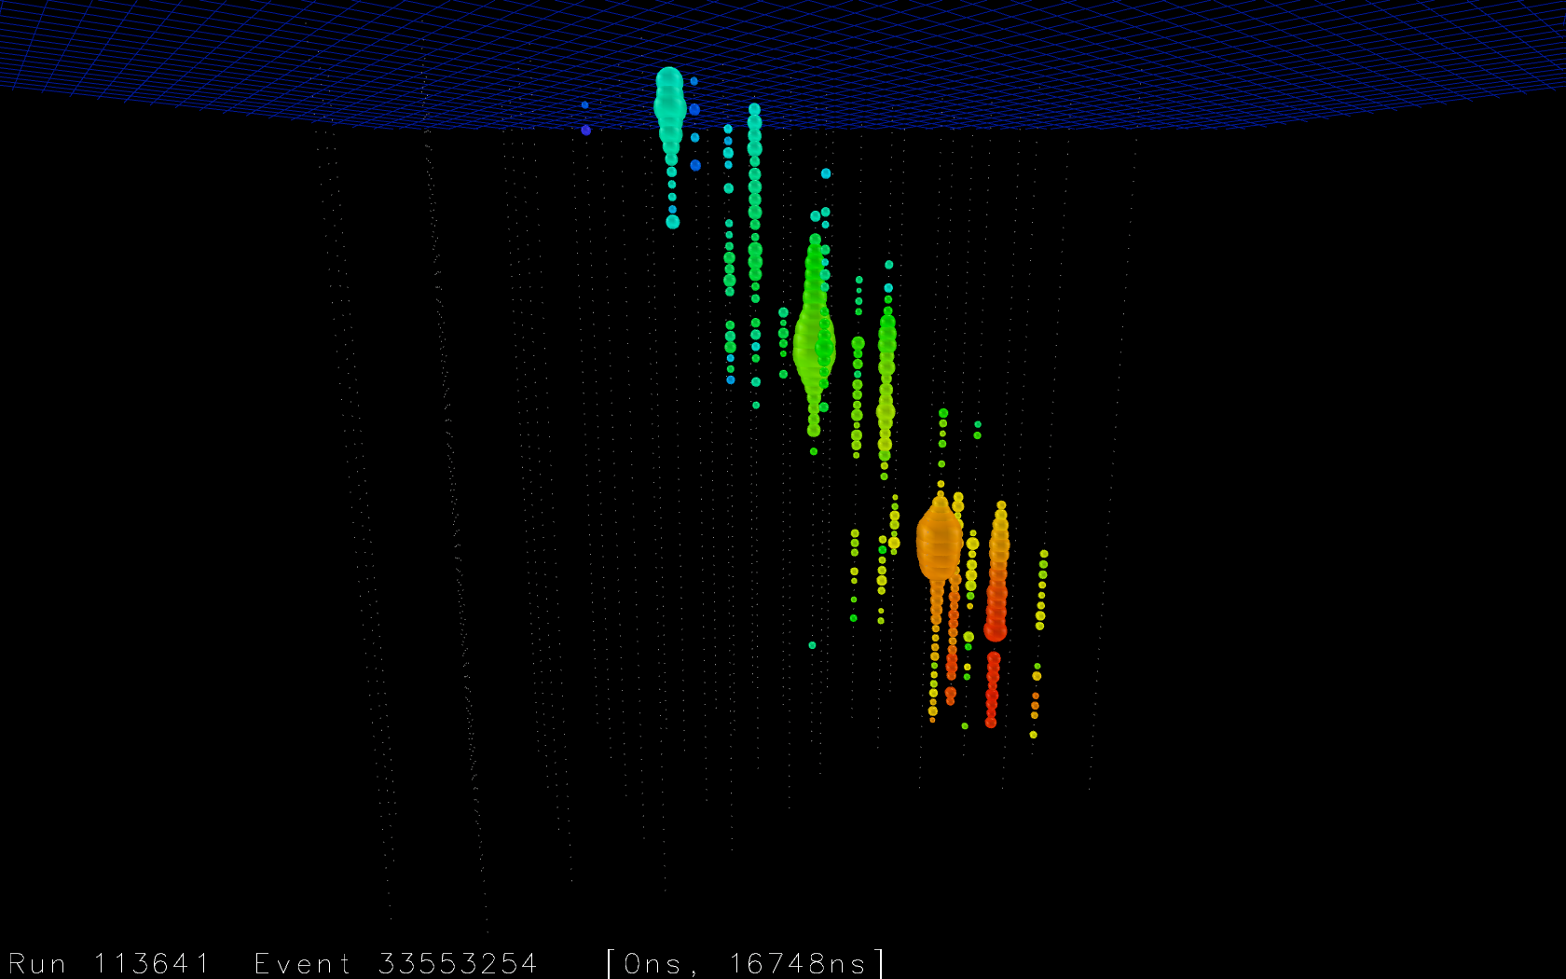

Slide 40
IceCube
francis halzen
cosmogenic neutrinos
the energetics of cosmic ray sources
neutrinos associated with cosmic rays
a cubic kilometer detector
evidence for extraterrestrial neutrinos
conclusions
IceCube.wisc.edu

Slide 41


Slide 42

cosmic
neutrinos:
energy
> 100 TeV
atmospheric
background:
1~2 events
per year
atmospheric neutrino spectrum

Slide 43

cosmic rays interact with the microwave background
cosmic rays disappear, neutrinos with
EeV (10¹⁸ eV) energy appear
1 event per cubic kilometer per year
...but it points at its source

Slide 44



GZK neutrinos: > 41,000 photons near the horizon
number of
channels
> 300
unblinding: 2 events in the signal region

Slide 45

Notes:
Ernie-2.mp4

Slide 46



tracks and showers

Slide 47


mostly showers ✓
PeV showers:
volume ~ 5 m³
isotropic after 25~ 50 m

Slide 48



Slide 49

Notes:
Photons from an electromagnetic shower in South Pole ice [1080p]-2.mp4

Slide 50


Slide 51

digital optical module 44 on string 20 only

Slide 52

energy
1,041 TeV
1,141 TeV
(15% resolution)
not atmospheric:
probability of
no accompanying
muon is 10⁻³ per
event
→ flux at present
level of diffuse
limit

Slide 53


find more contained
events (420 Mton)
total calorimetry
complete sky coverage
flavor determined
some will be muon
neutrinos with good
angular resolution
loss in statistics is compensated by event definition

Slide 54


atmospheric neutrinos are
accompanied by muons from
the shower that produced them:
none seen
(no signals in IceTop)

Slide 55

…and then there
were 26 more…
data: 86 strings one year

Slide 56


total charge collected
by PMTs of events with
interaction inside the
detector
E²Φ(E) =
(3.6±1.2)·10⁻⁸ GeVcm⁻²s⁻¹sr⁻¹
atmospheric ν
and μ

Slide 57


preliminary
> 100 TeV (50 em equivalent): 18 events
28 events
significance > 4 sigma
atm. Background
:
up
down

Slide 58

26 more: 19 showers and 7 muon tracks

Slide 59


too few ν_{μ} ?
no, in an all flavor search ν_{μ} tracks are rare
a muon track is relatively rare

Slide 60

mostly from South (not through the Earth) ✓
PeV ν’s absorbed
background
signal

Slide 61
too many from the northern hemisphere? no, events have properties of a cosmic flux
atmospheric background:
mostly from North (through the Earth, insufficient target to produce neutrinos from the South)
mostly muons (muon neutrinos and cosmic ray muons from the South)
cosmic flux:
mostly from the South (PeV neutrinos absorbed by the Earth)
mostly showers (1:1:1 flavor composition and only CC muon neutrinos produce a track)

Slide 62
not neutrinos from production and prompt
decay of charmed particles in the atmosphere
IceCube data do not fit the energy dependence
required by a charm signal.
same for the zenith angle dependence.
rate required to explain the data exceeds
our own experimental limit by more than a factor
of 2.
level of charm background allowed by the
data (actually, no evidence yet) is consistent
with expectations.
no evidence for the air shower that would have
produced the charmed particle (no muons!).

Slide 63

some interesting events

Slide 64

Notes:
13 Snuffleupagus-1_1.mp4

Slide 65


atmospheric muon (blue) + neutrino (red) background
+ astrophysical E²Φ(E) =(3.6±1.2)·10⁻⁸ GeVcm⁻²s⁻¹sr⁻¹
energy deposited in the detector
zenith angle

Slide 66


Slide 67

Galactic coordinates

Slide 68

Galactic coordinates
arXiv 1309.4077
boundary with no gamma ray
observations in Southern sky
PeV events
hottest spot in IceCube
PeV gamma ray map
c.o.g of 5-event cluster

Slide 69

the energy range of cosmic accelerators producing PeV neutrinos
Galactic or extragalactic?

Slide 70
conclusions
first evidence for cosmic neutrinos
origin not revealed yet, but…
one more year of data ready for
unblinding, more being taken
better and different (more ν_{μ})
analyses soon
IceCube.wisc.edu

Slide 71

10% of data taken during year 2 of IceCube unblinded

Slide 72


71 events/yr
E_{ν}> 45 TeV
(point source effective area)
energy of the muon inside the detector (GeV)
V. Niro et al.

Slide 73

increase in threshold not important
(in the region where atmospheric background dominates)
DecaCube (1/2/3)
IceCube
DeepCore
Spacing 1 (120m): IceCube (1 km³)
+ 98 strings (1,3 km³)
= 2,3 km³
Spacing 2 (240m):
IceCube (1 km³)
+ 99 strings (5,3 km³)
= 6,3 km³
Spacing 3 (360m):
IceCube (1 km³)
+ 95 strings (11,6 km³)
= 12,6 km³

Slide 74

IceCube & PINGU collaborations

