Slide 1
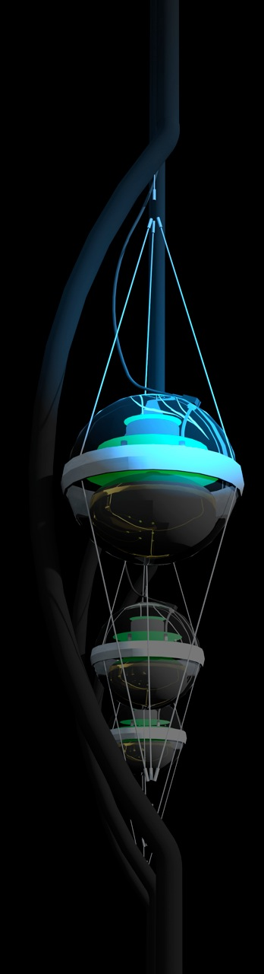
Beyond IceCube
francis halzen
the discovery of high-energy cosmic neutrinos
where do they come from?
neutrino stars?
cosmogenic neutrinos
beyond IceCube
low threshold frontier (PINGU)
IceCube.wisc.edu

Slide 2

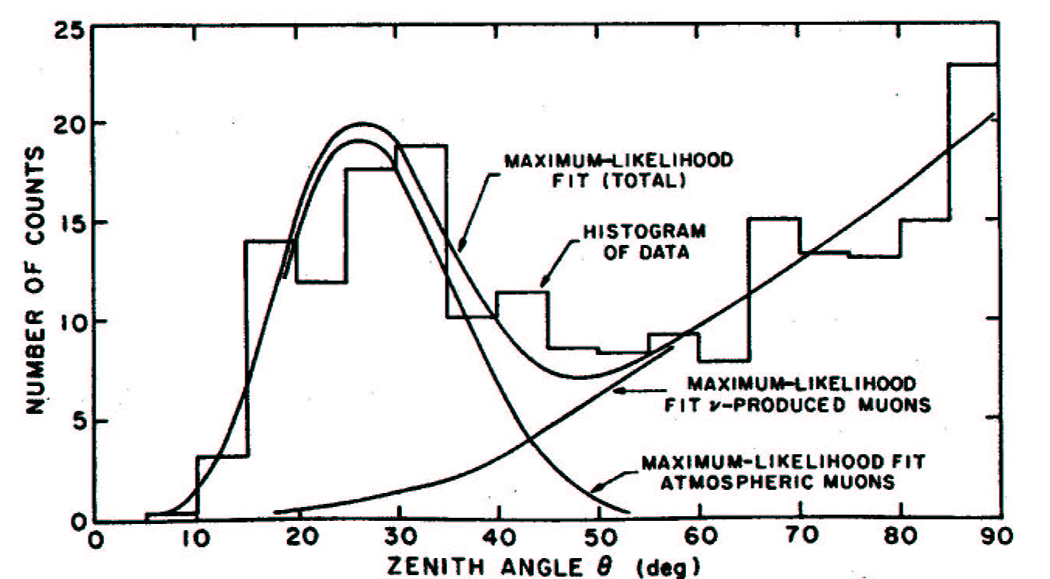
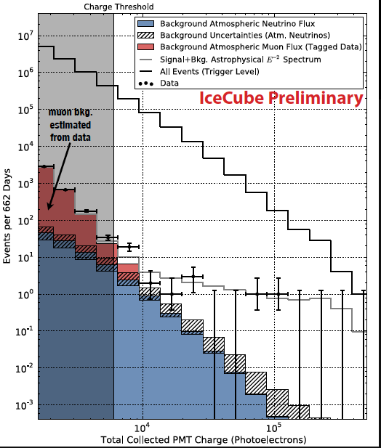
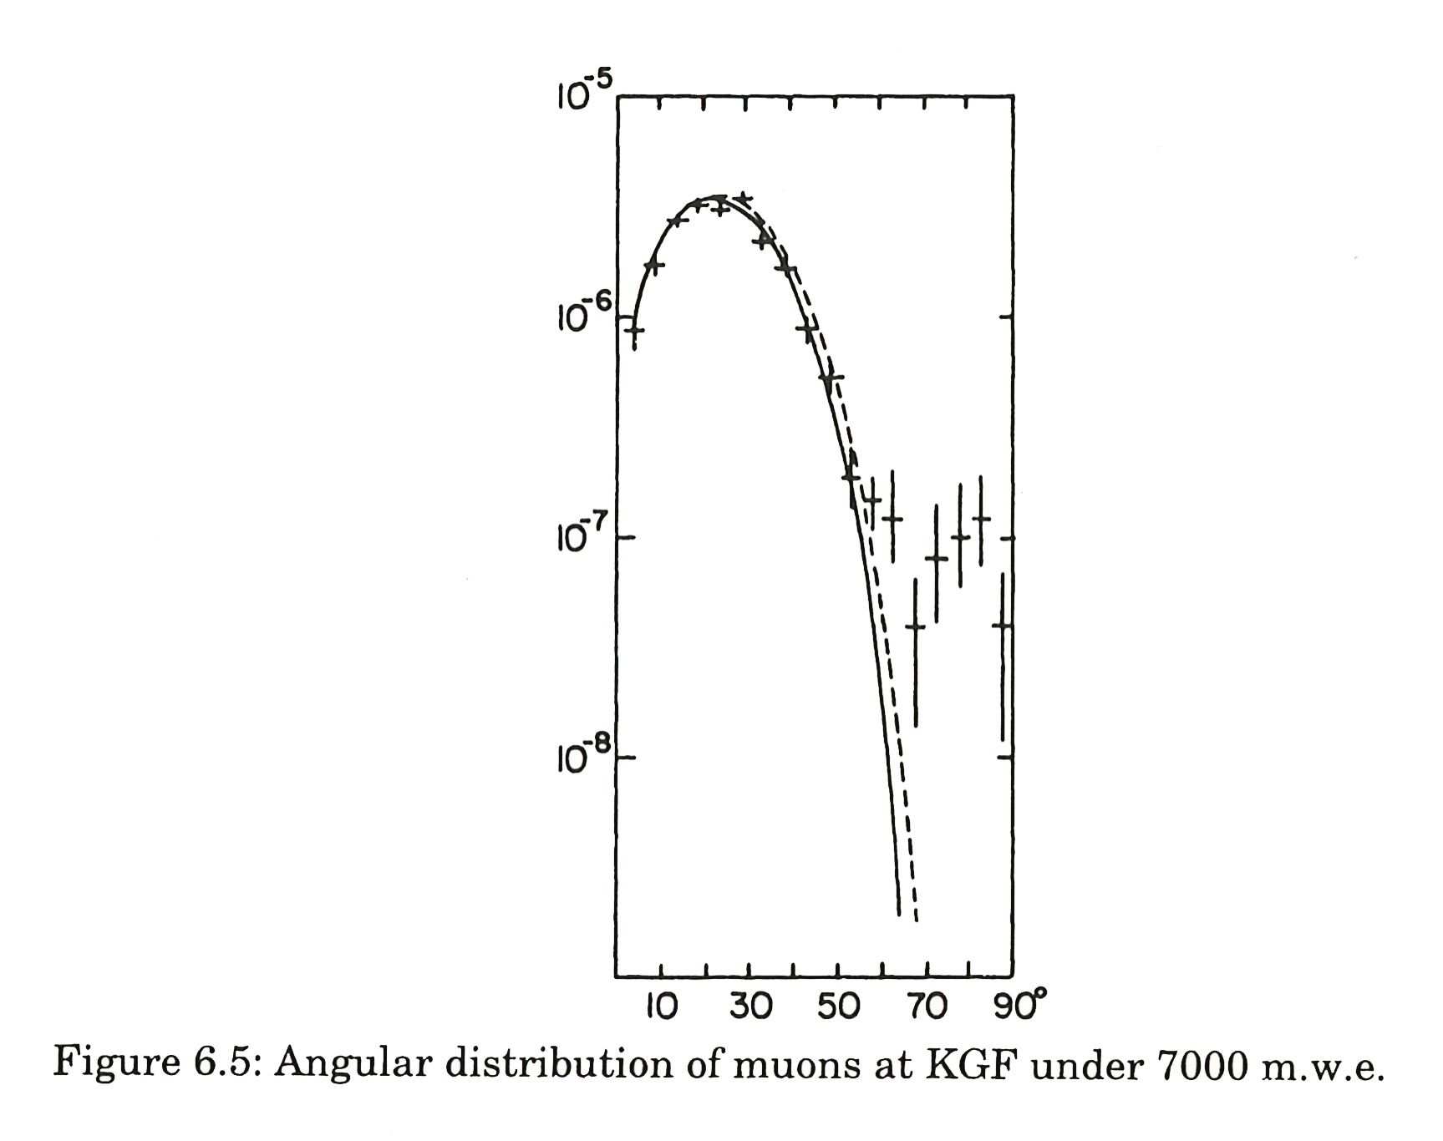
2013 atmospheric and
cosmic neutrinos
CWI
1965
cosmic ray
muons
and
atmospheric
neutrinos
KGF

Slide 3
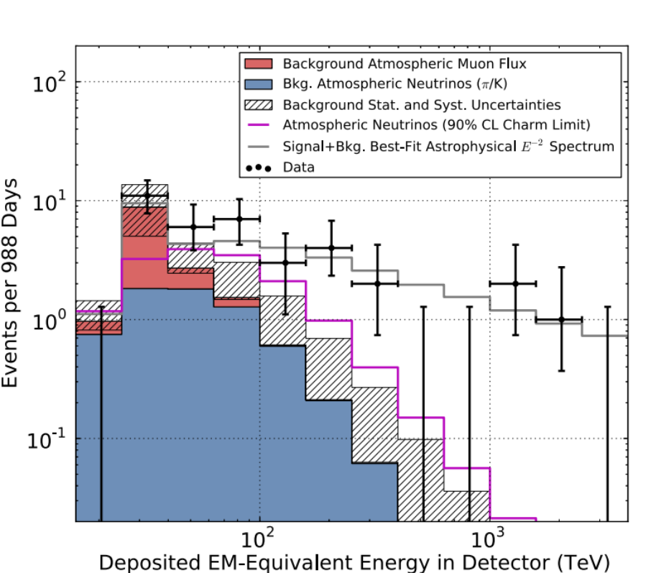
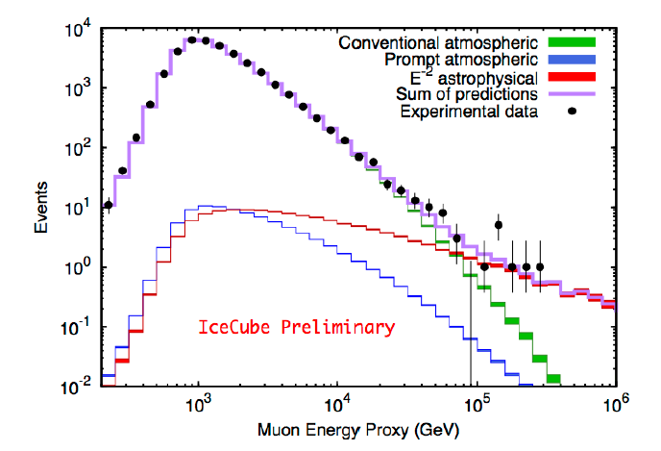
confirmation!
flux of muon neutrinos
through the Earth
neutrinos of all flavors
interacting inside
IceCube

Slide 4
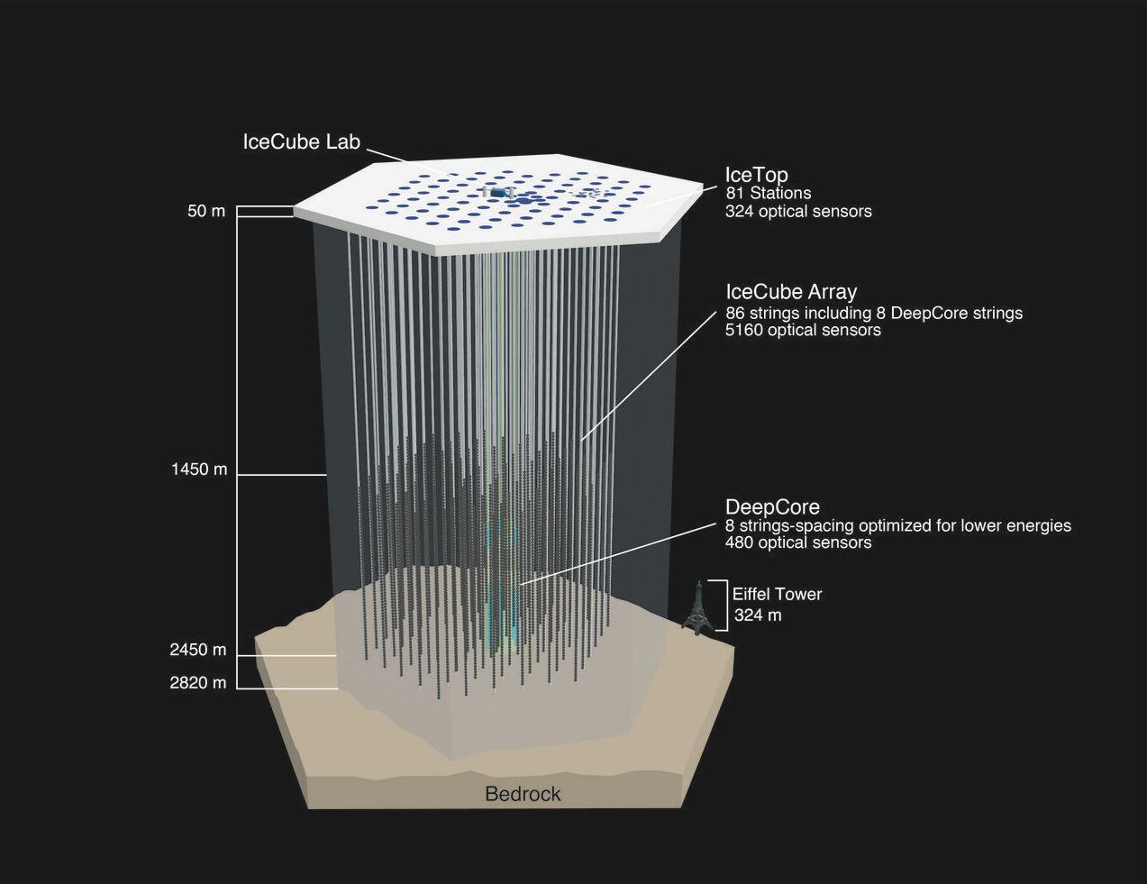
IceCube: transforms 1 km3 of natural
Antarctic ice into a Cherenkov detector

Slide 5
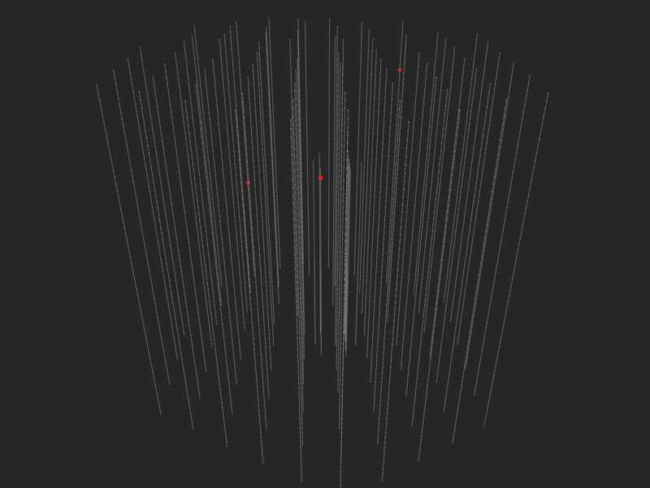
Notes:
cherenkov.mp4

Slide 6
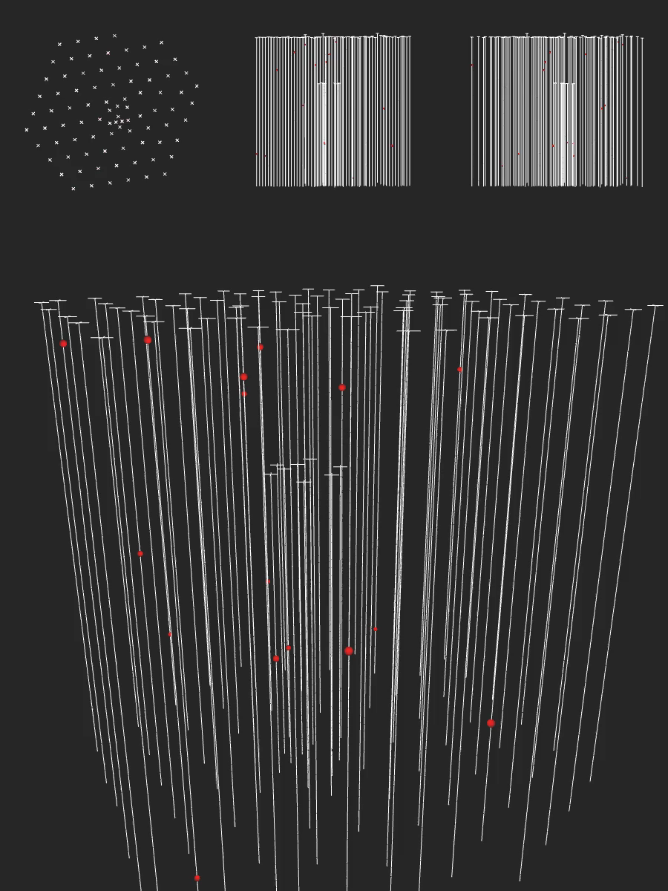

Slide 7
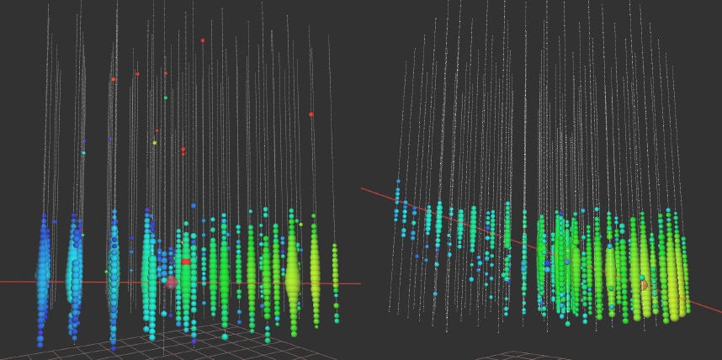

Slide 8
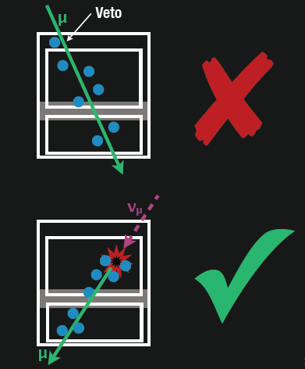
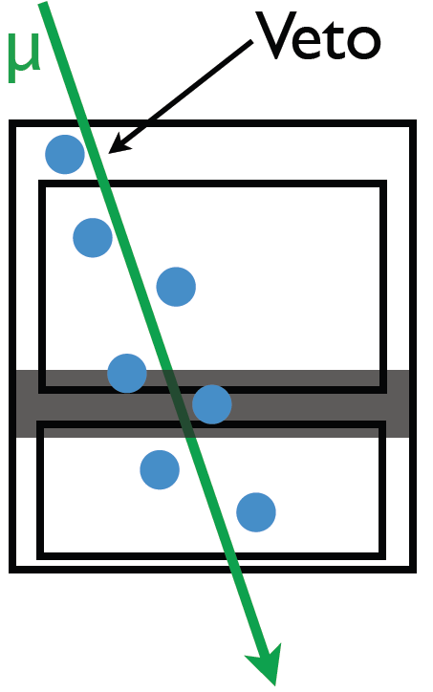
find contained
events (420 Mton)
total calorimetry
complete sky coverage
flavor determined
some will be muon
neutrinos with good
angular resolution
loss in statistics is compensated by event definition

Slide 9
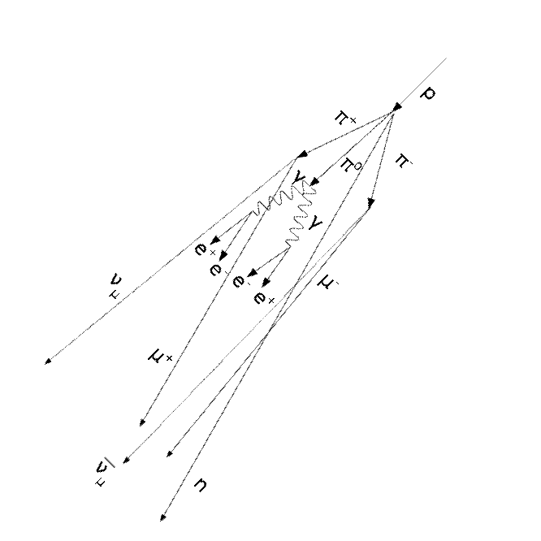
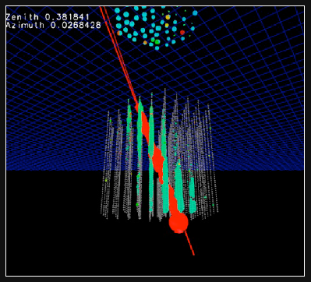
atmospheric neutrinos are
accompanied by muons from
the shower that produced them:
none seen
(no signals in IceTop)

Slide 10
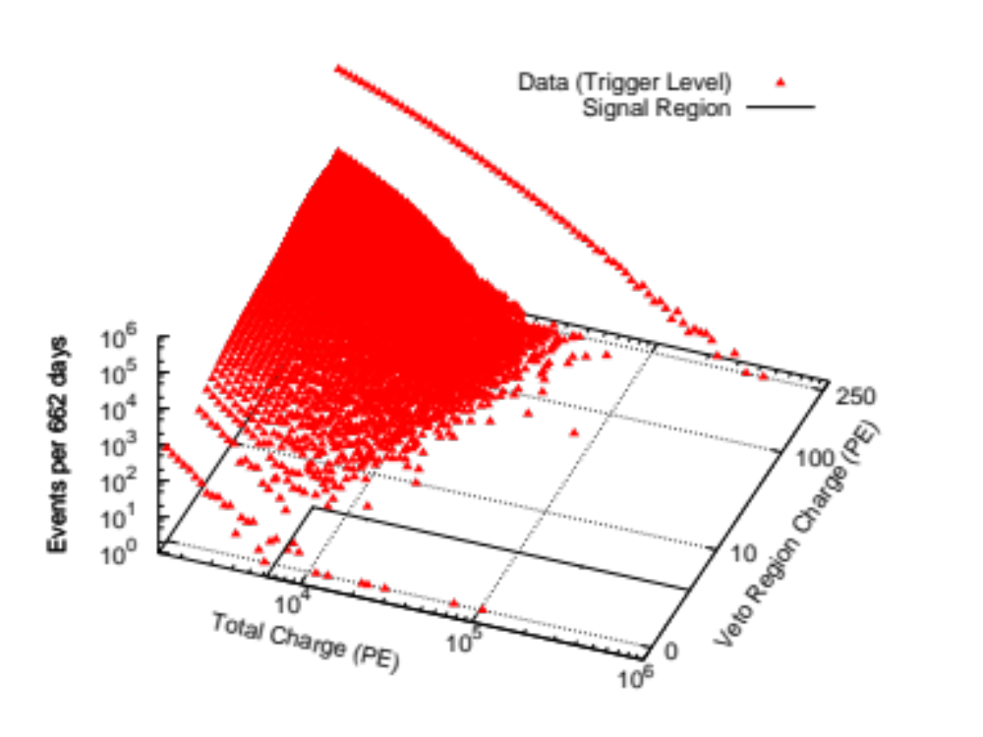
…and then there
were 26 more…
data: 86 strings one year

Slide 11
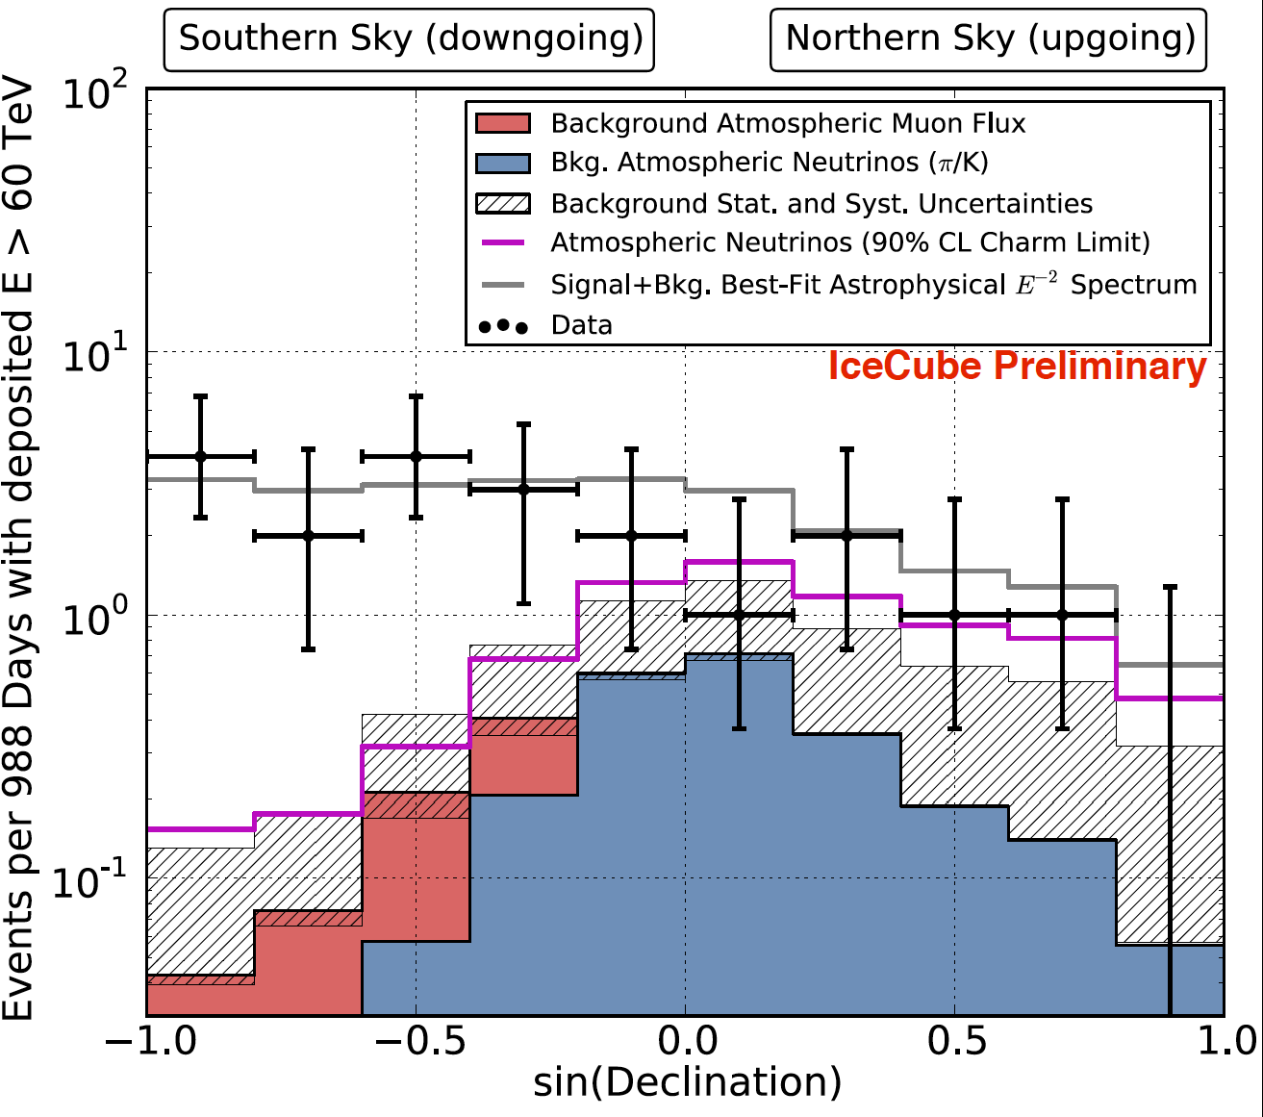
3 years

Slide 12
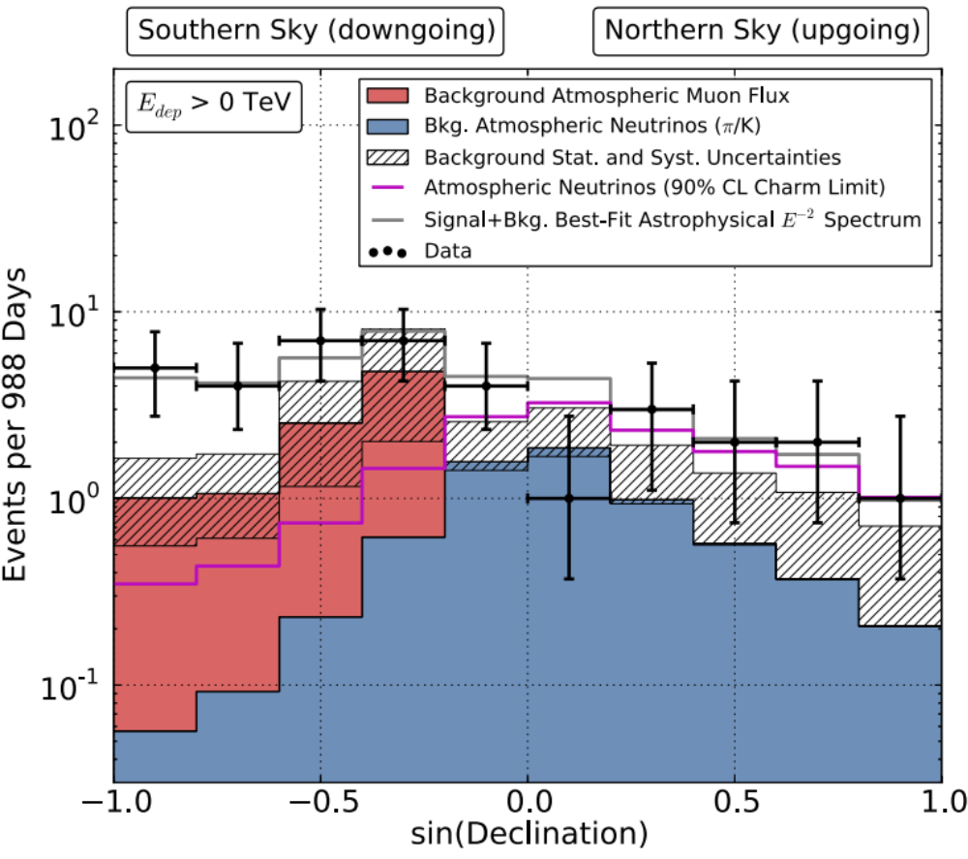
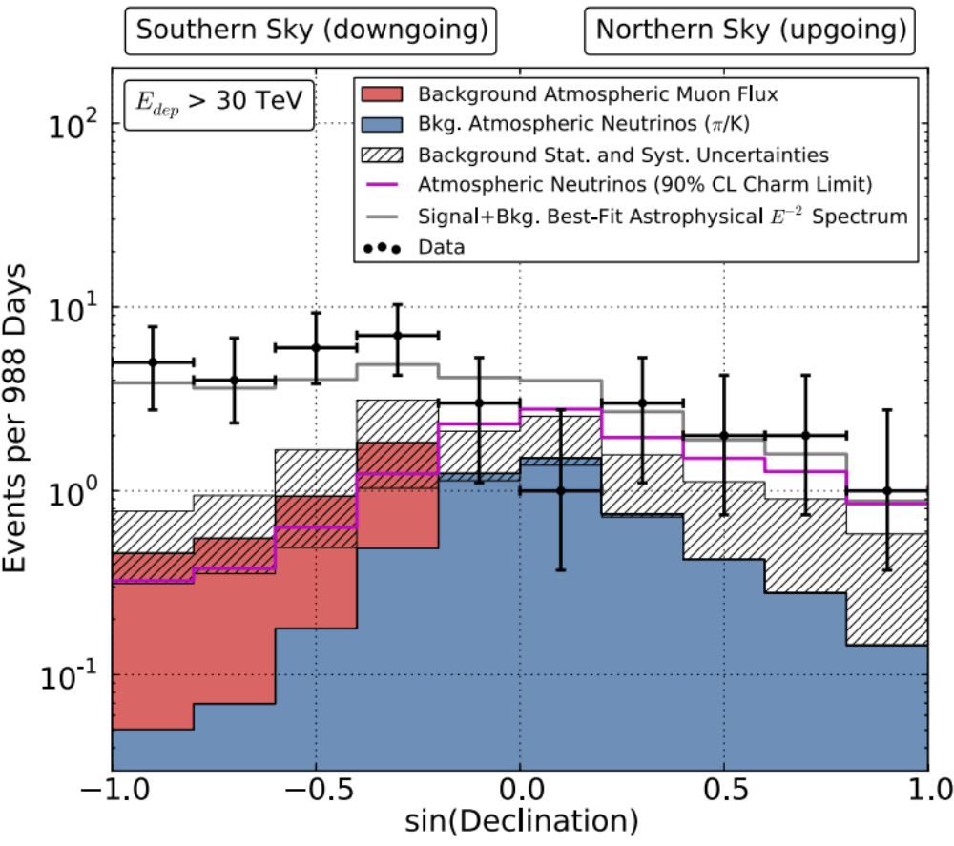
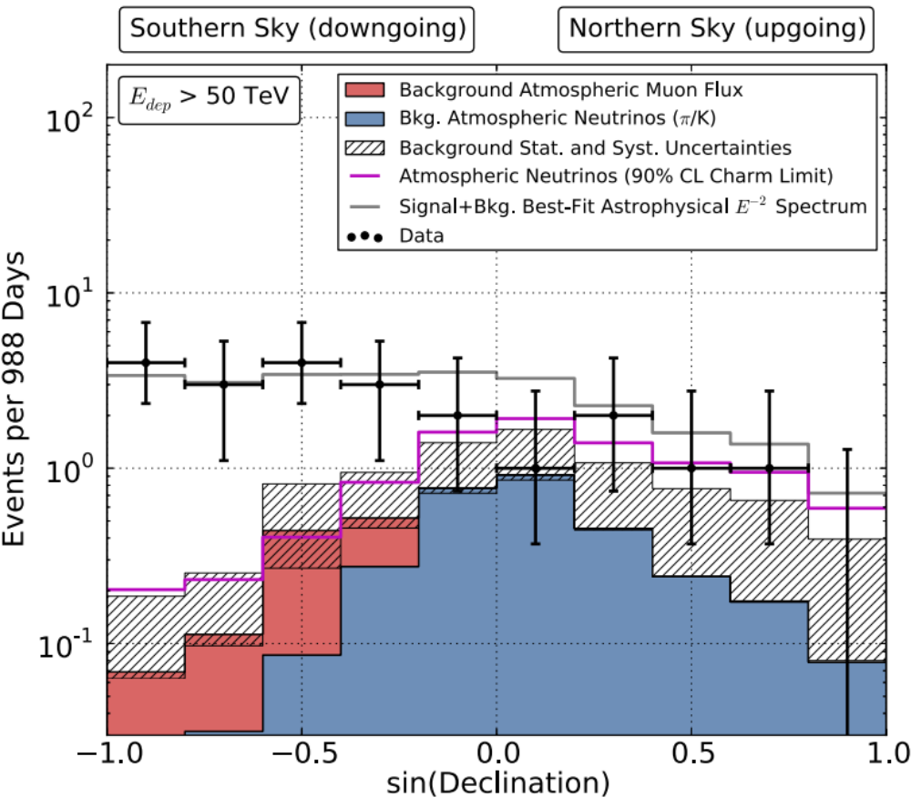
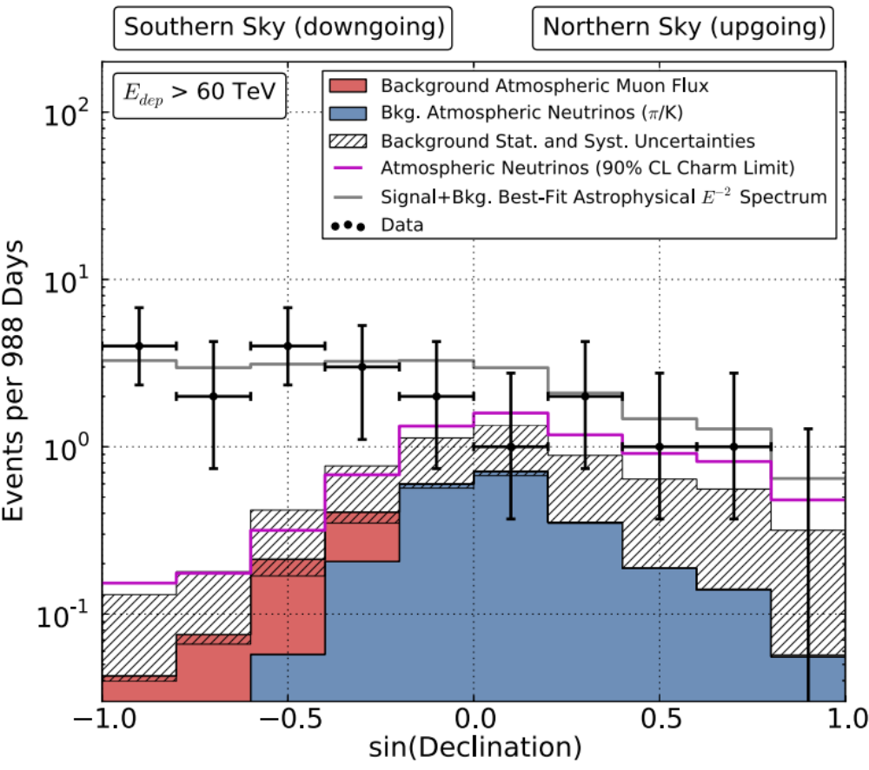
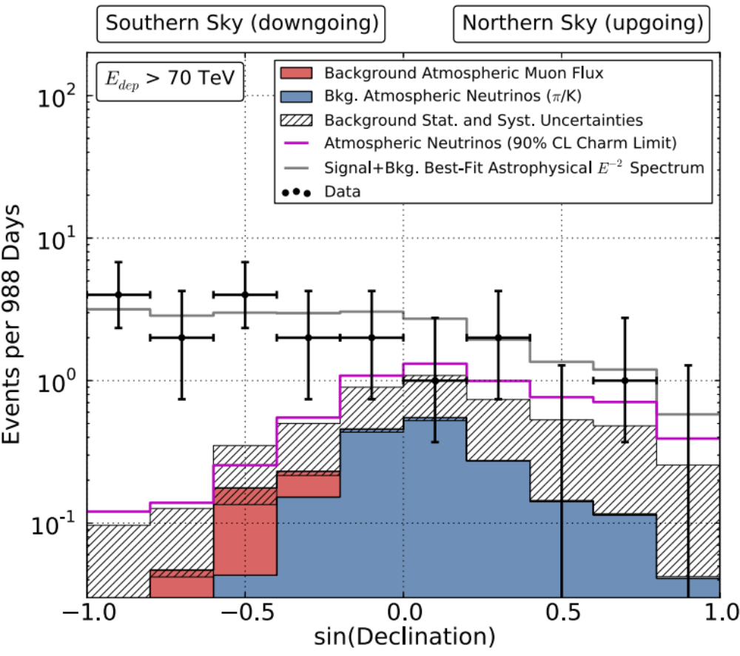
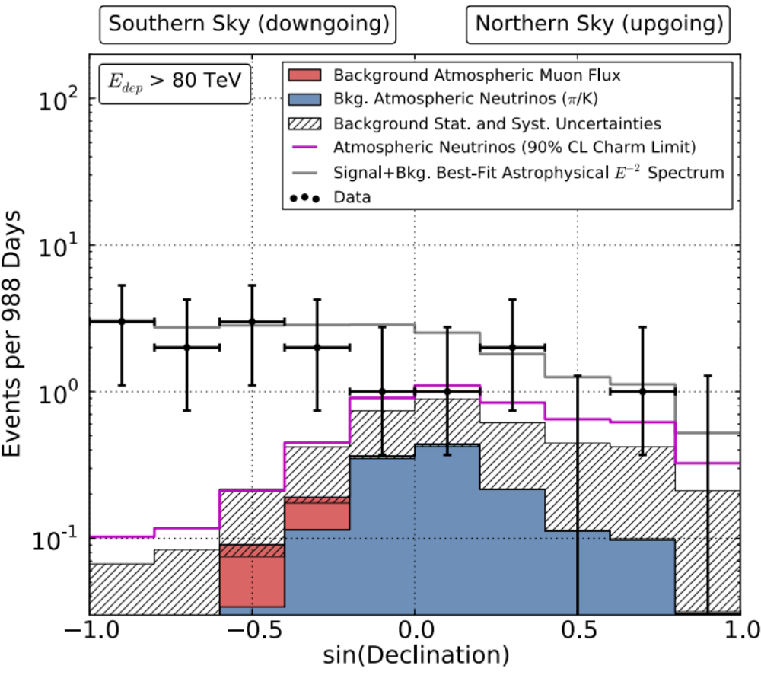
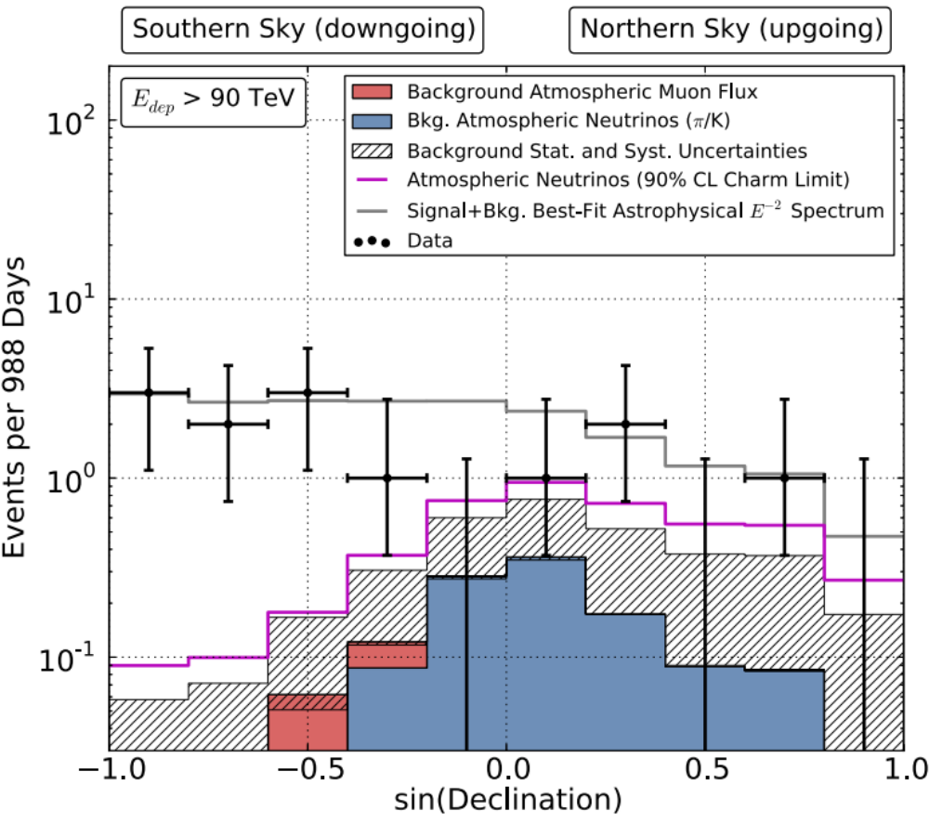
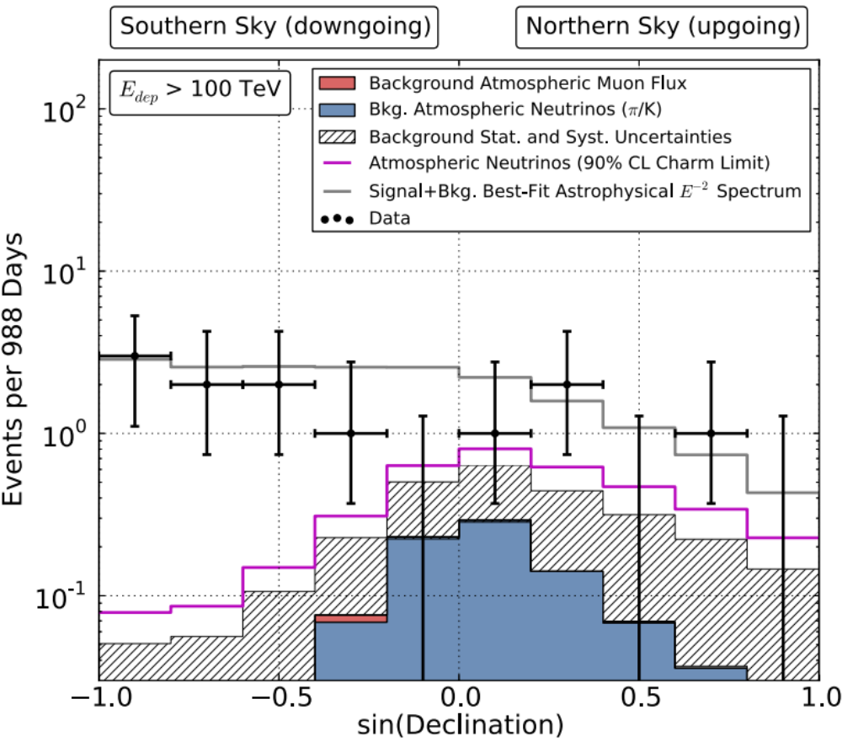
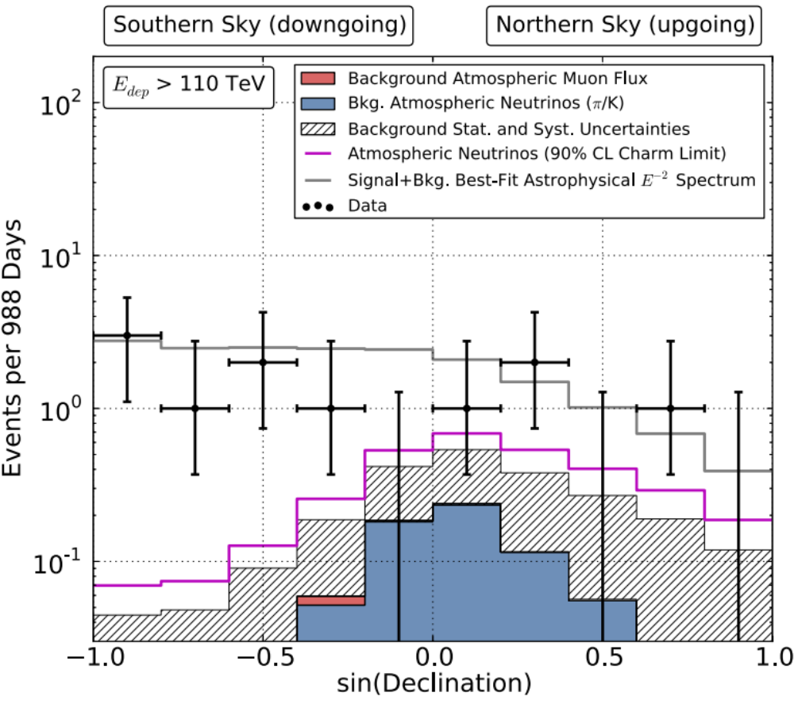
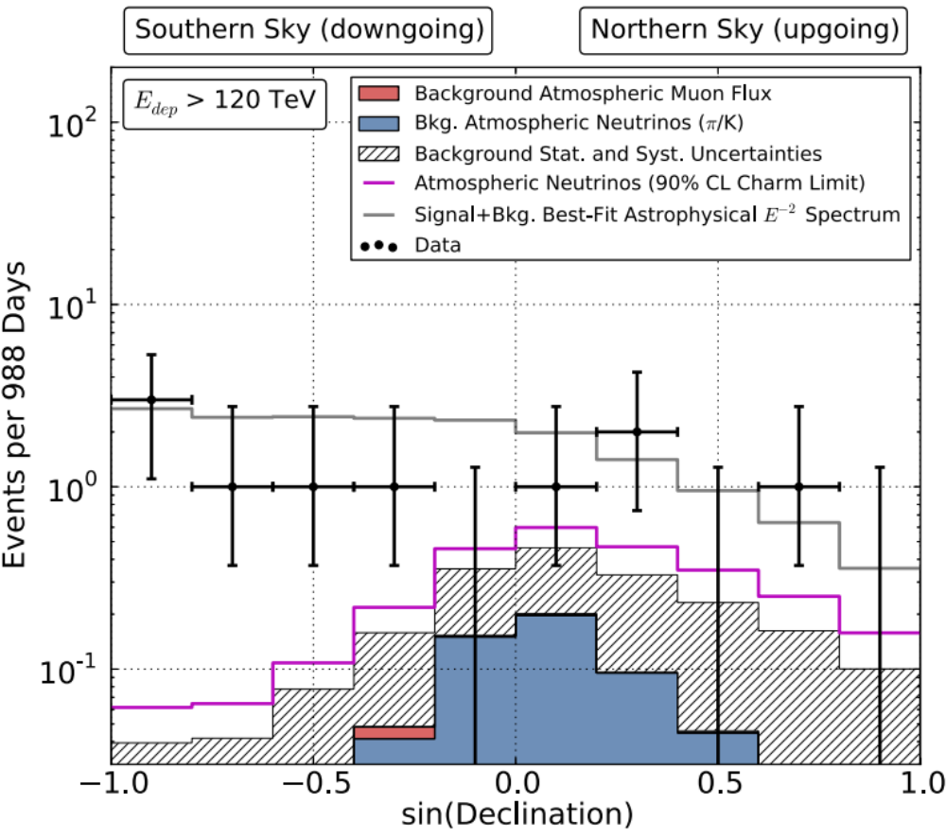
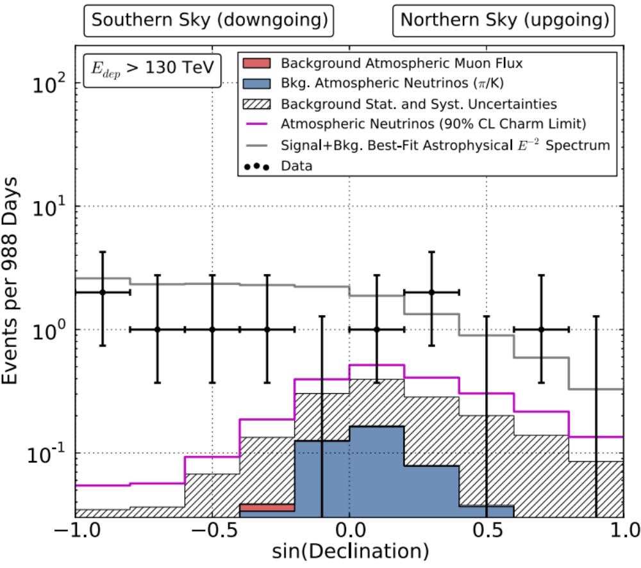
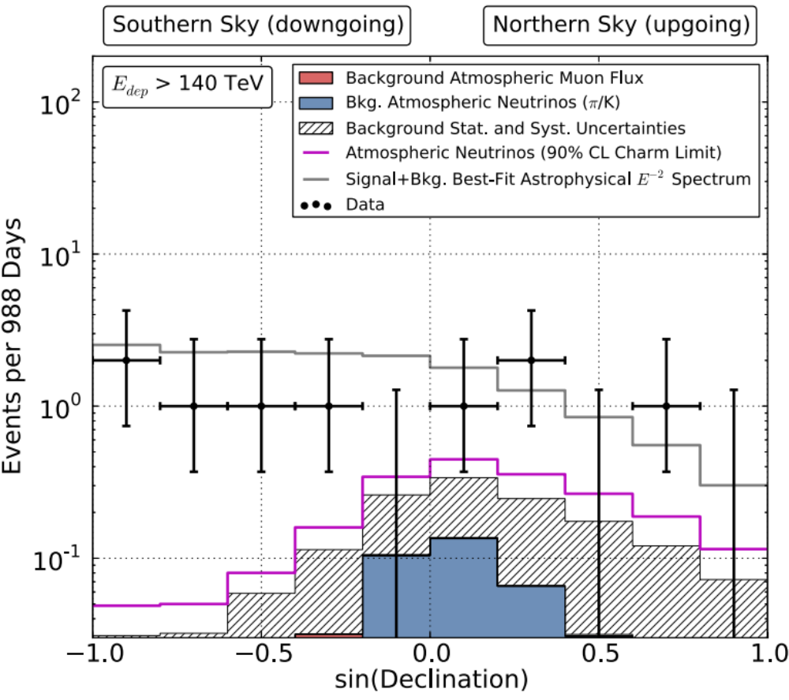
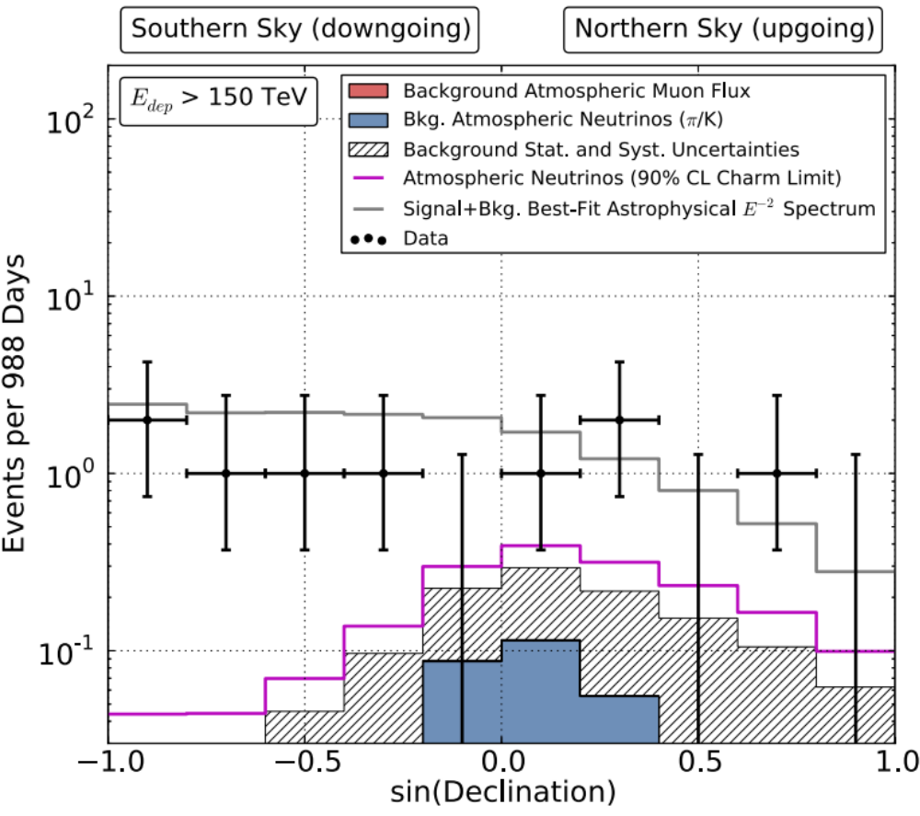
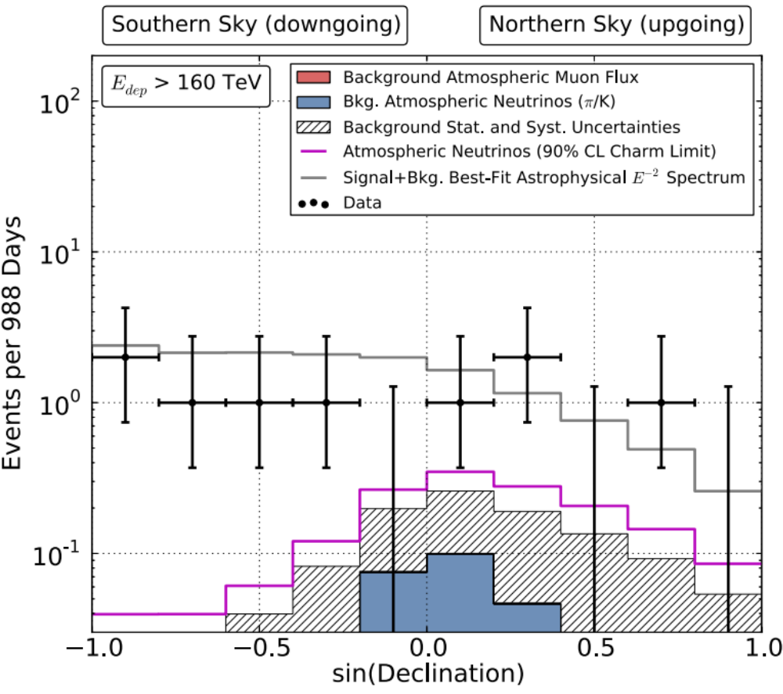
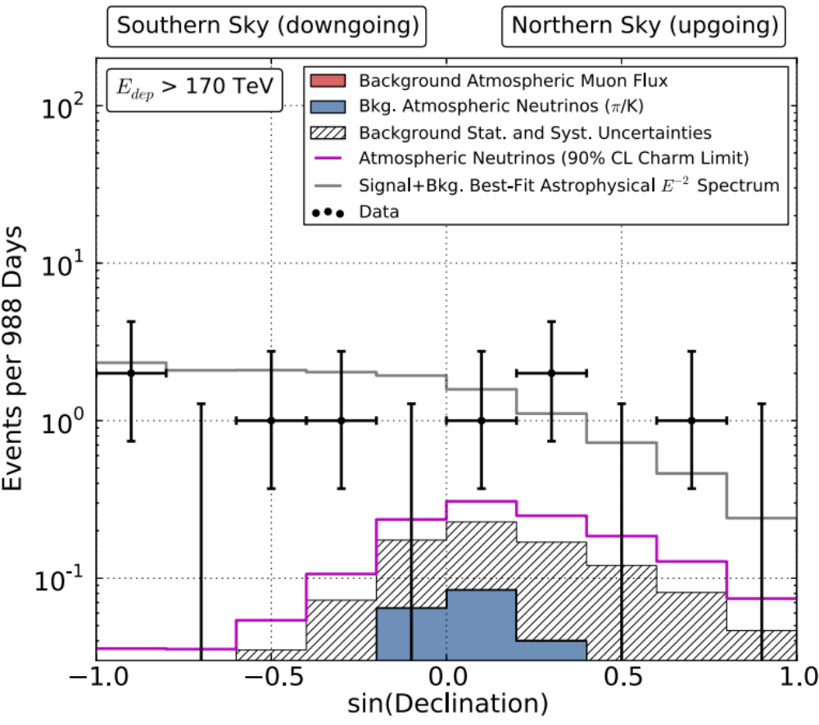
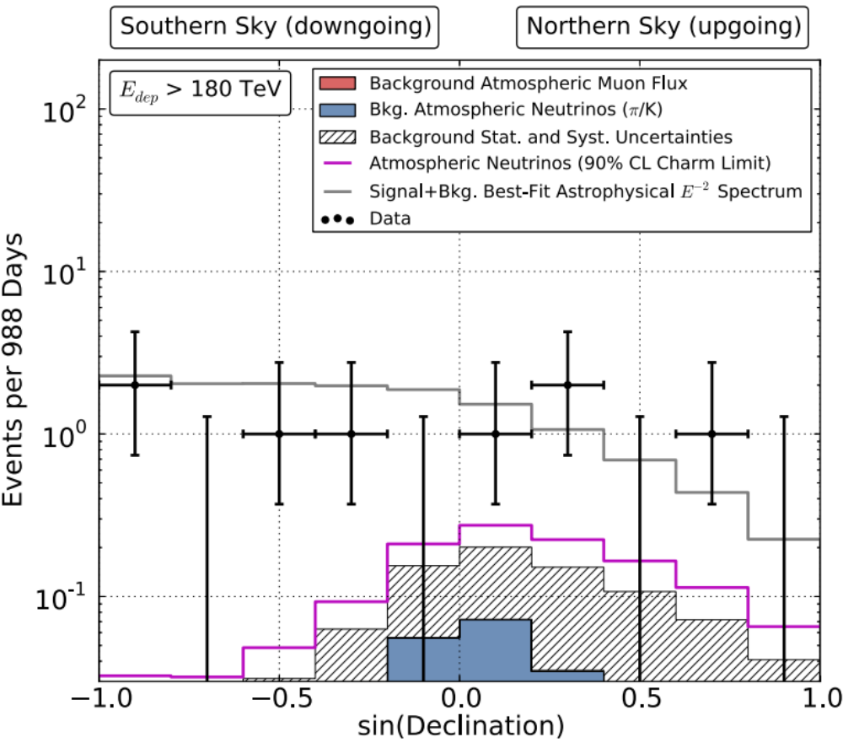
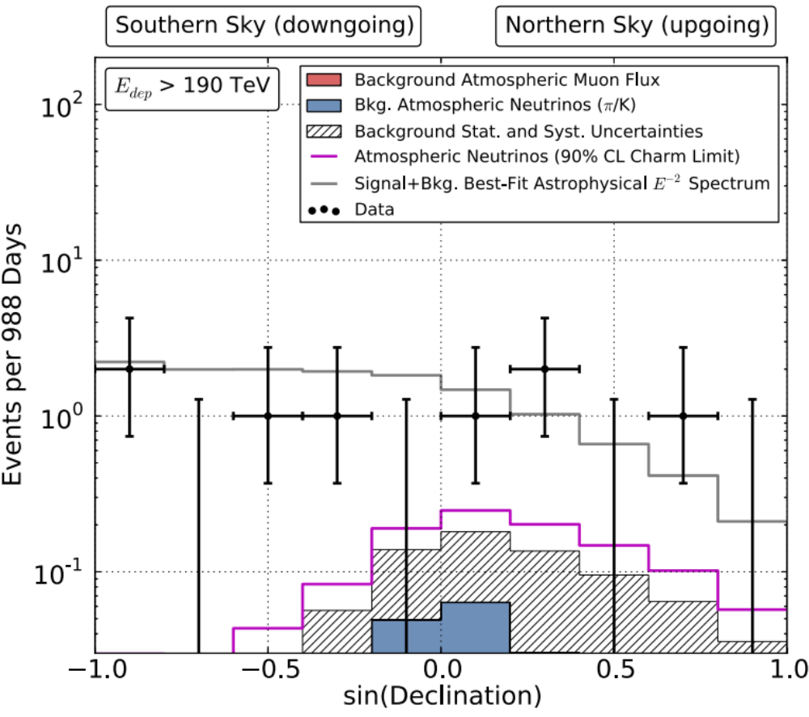
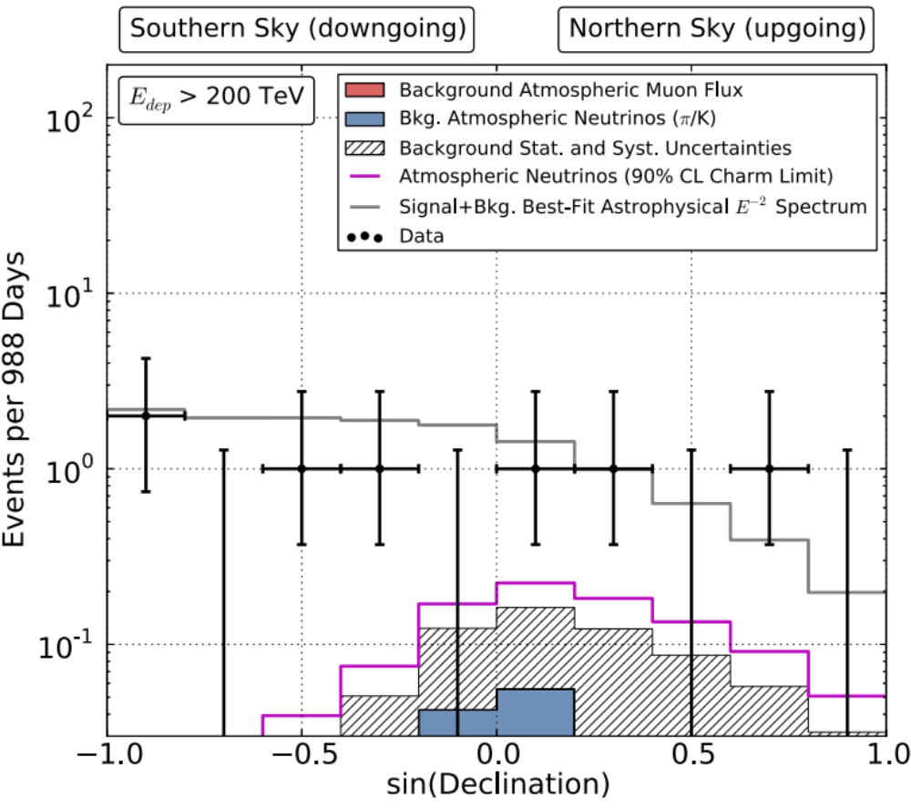
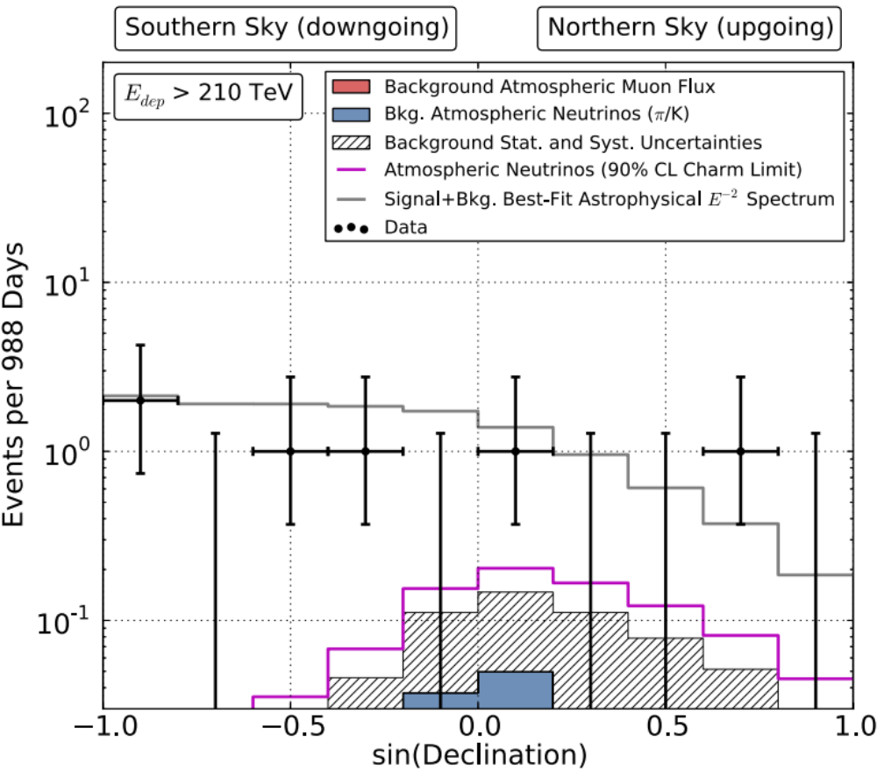
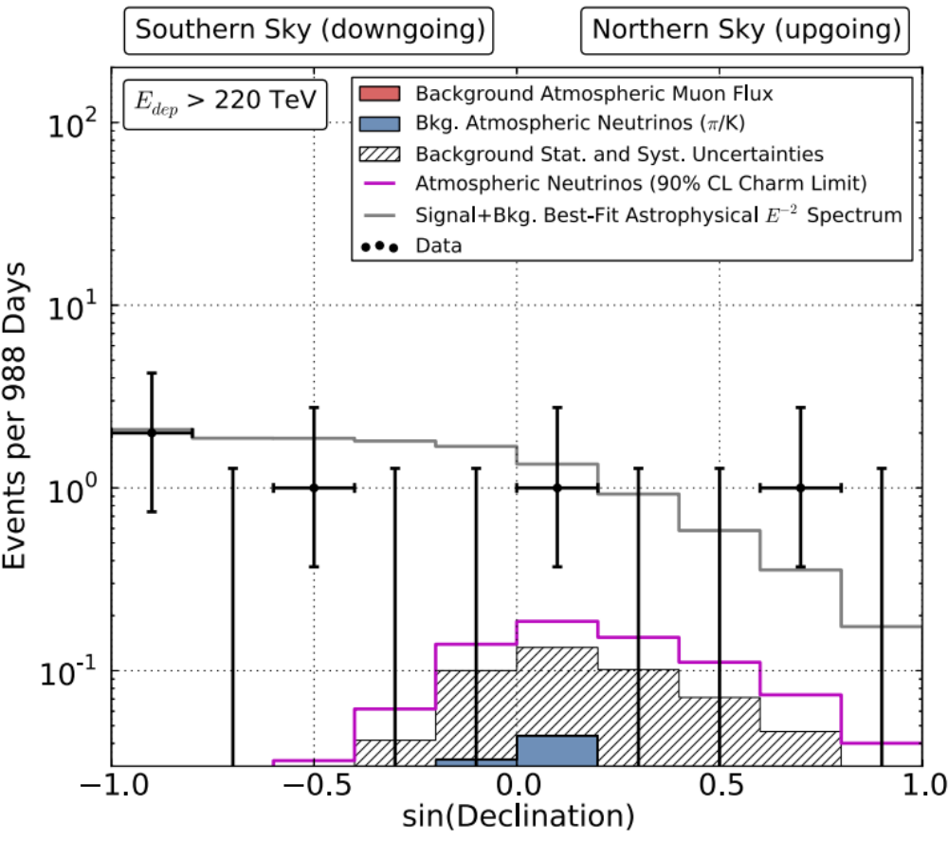
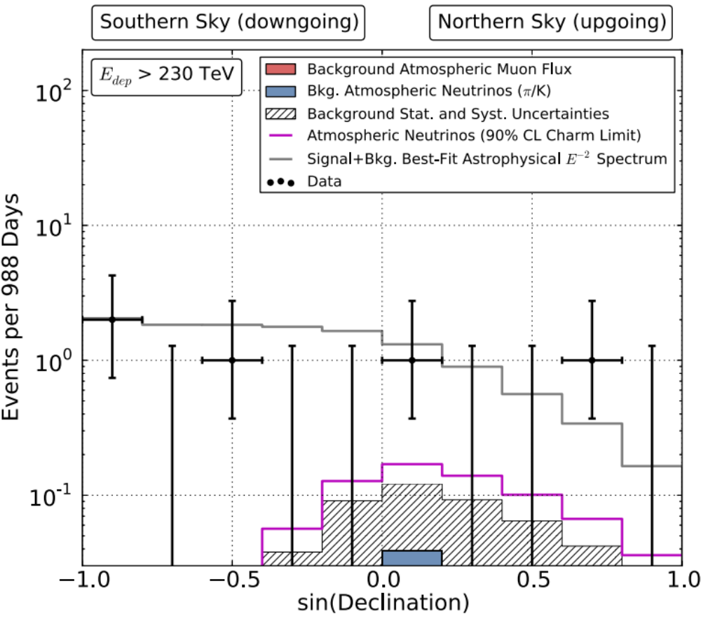
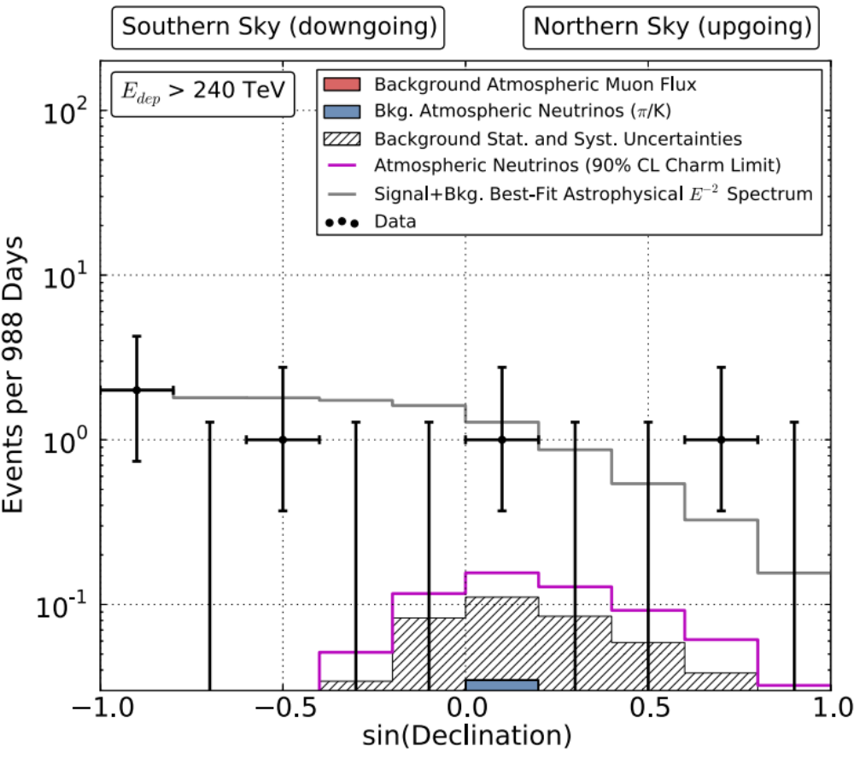
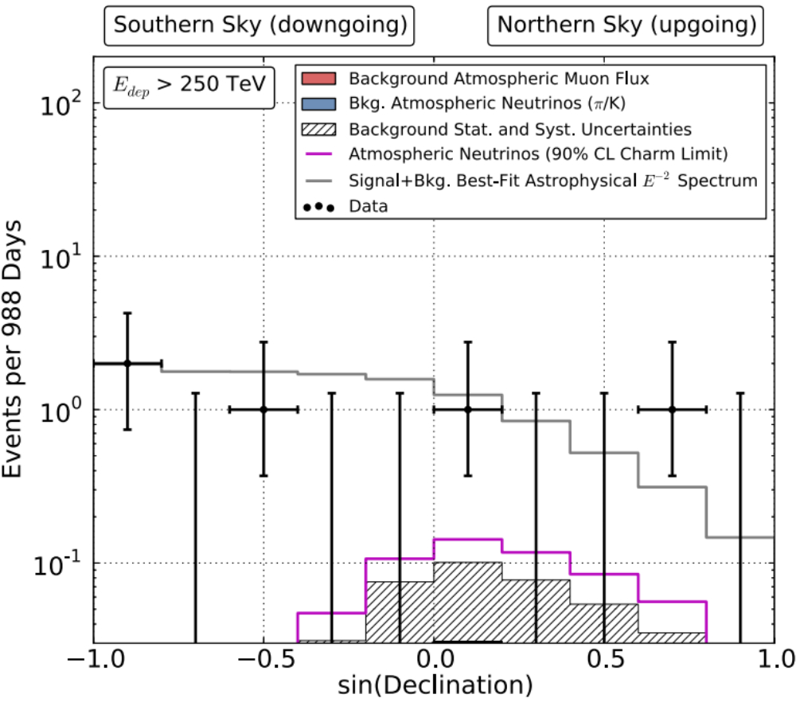
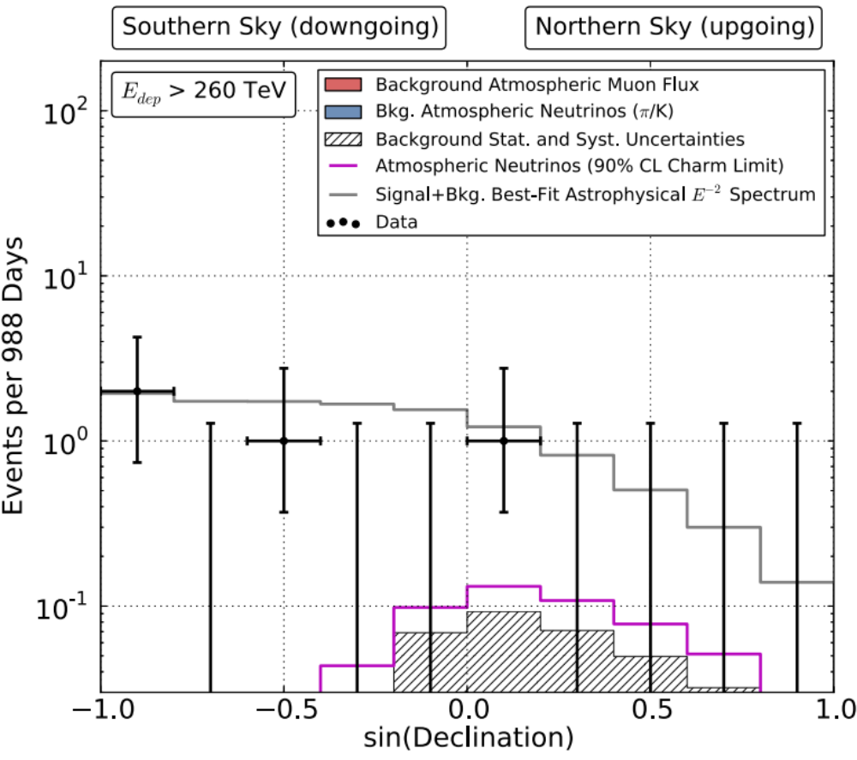

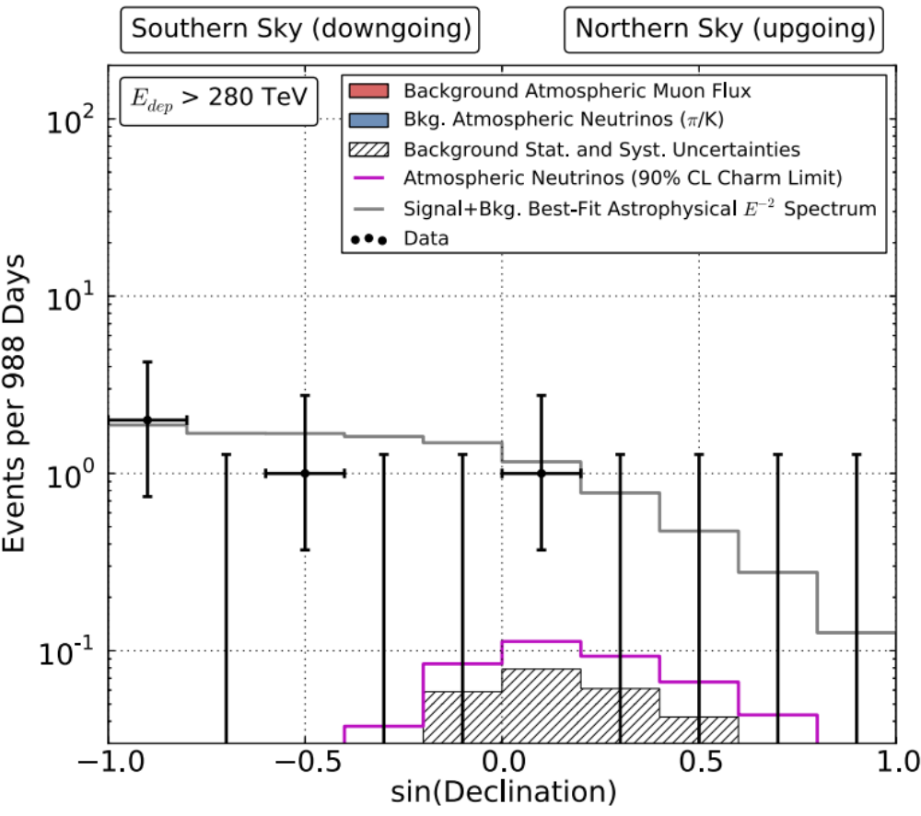
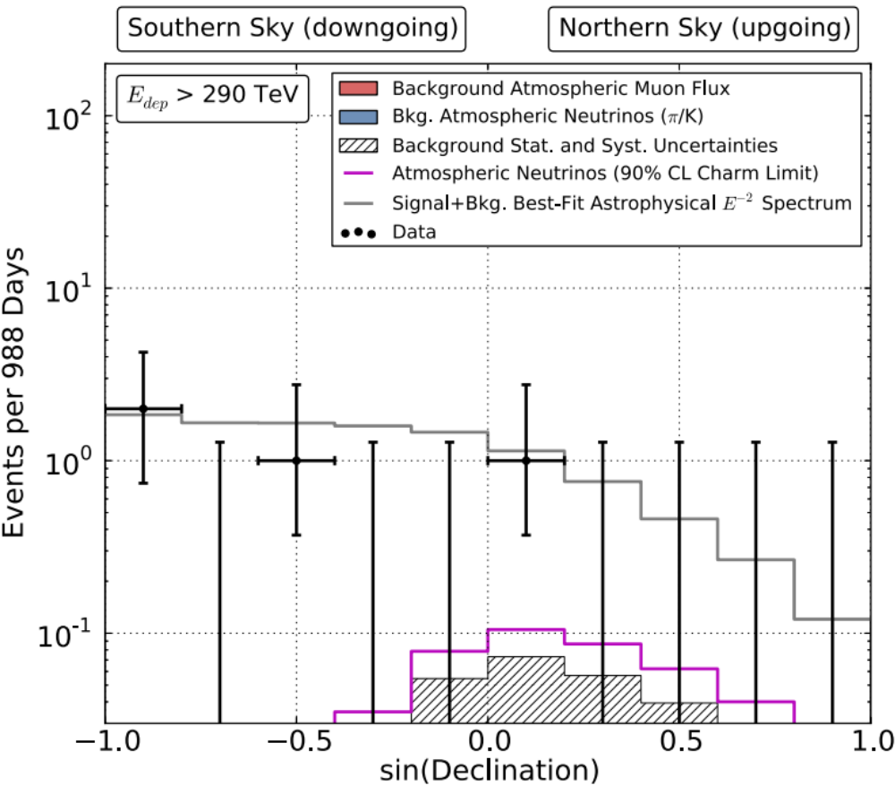
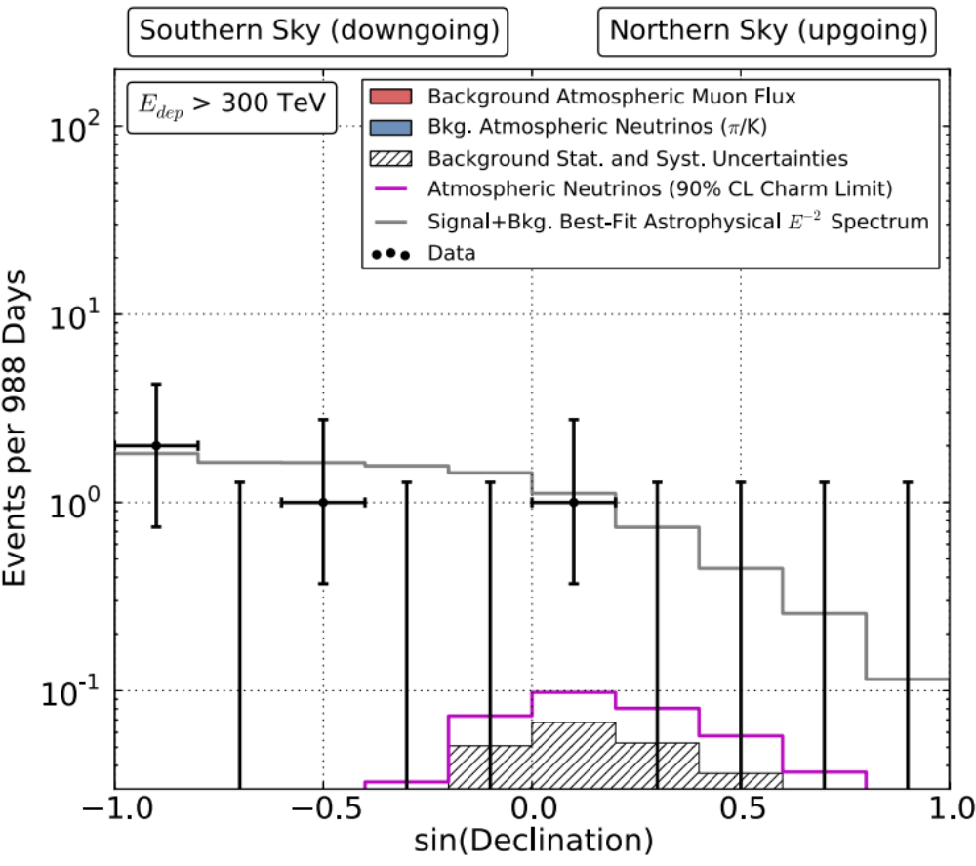

Slide 13
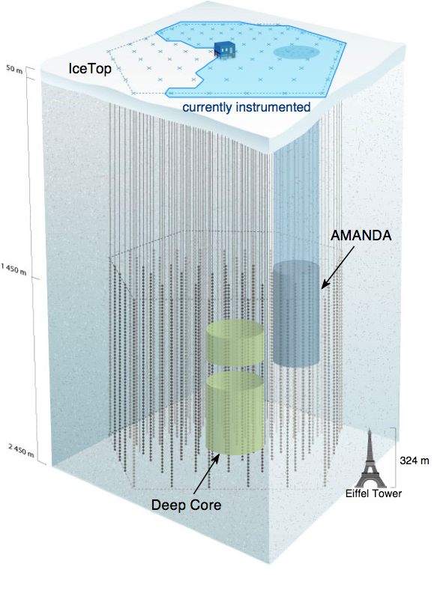
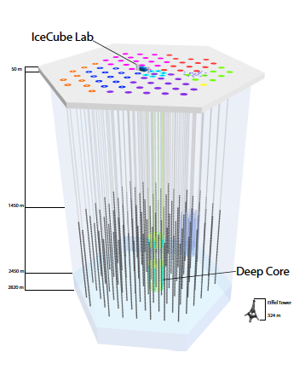
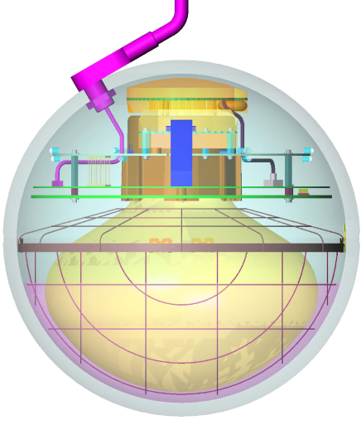
IceCube performance
completed December 2010
5160 optical sensors
between 1.5 ~ 2.5 km
10 GeV to infinity
< 0.5 degree on-line
< 0.3 degree off line
for muon tracks
(10~15 degrees for
showers)
< 15% energy resolution
Digital Optical Module (DOM)

Slide 14
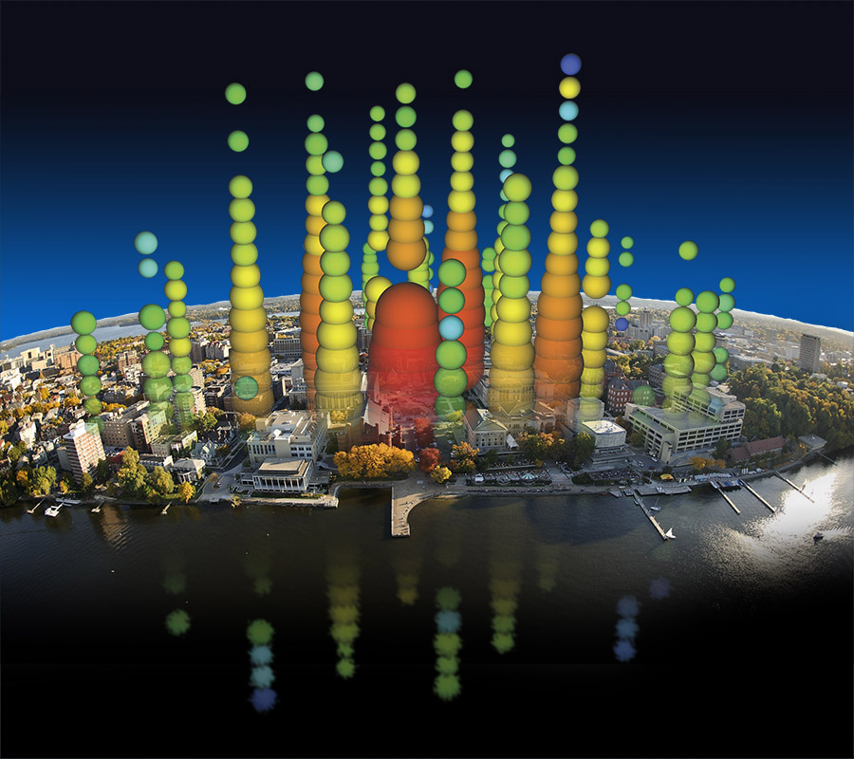
Notes:
IceCube has allowed scientists to launch a hunt for some of the most elusive particles in our universe, neutrinos. These high-energy neutrinos give us an exclusive way to study powerful cosmic engines like exploding stars and black holes. This illustration shows one of the highest energy neutrino events ever measured super-imposed on the Mendota lakefront to give a sense of the enormous size of the IceCube detector.

Slide 15
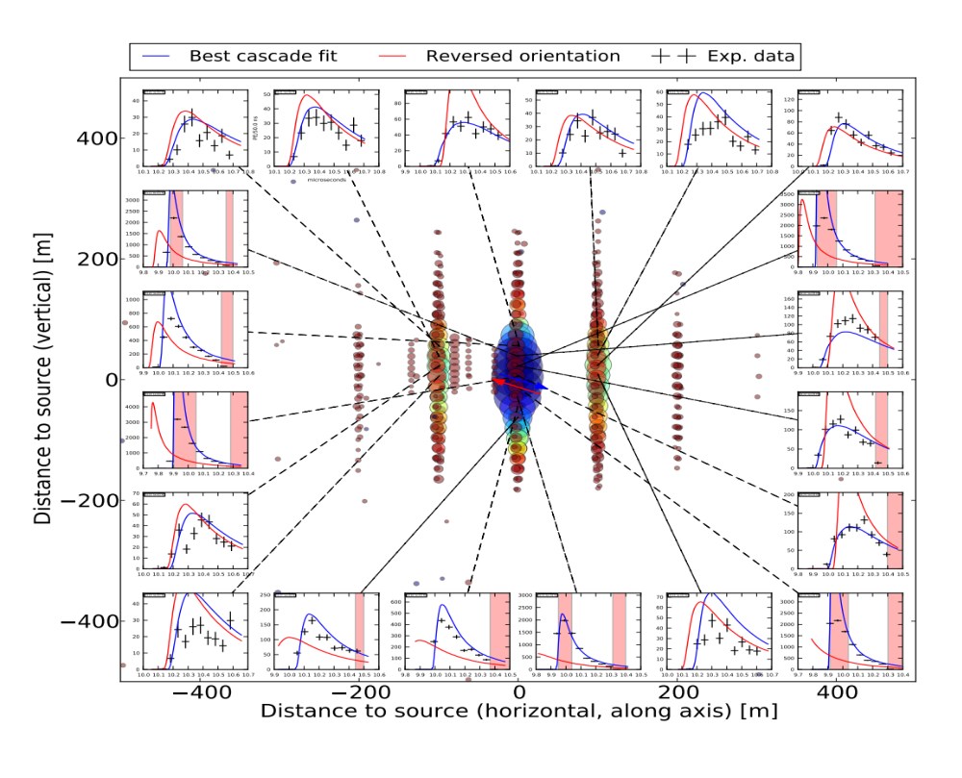

Slide 16
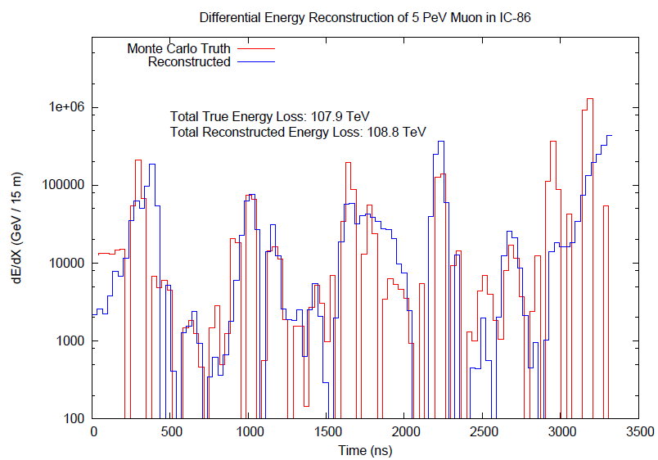
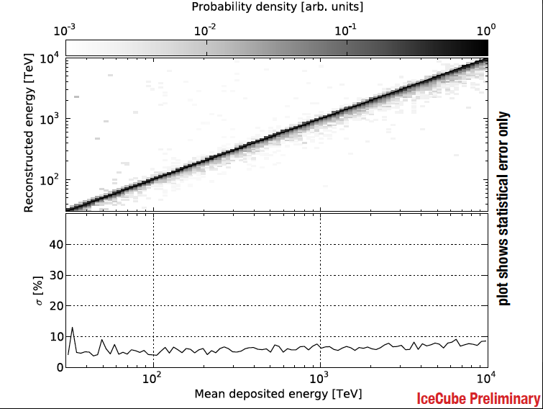

improving angular and energy resolution

Slide 17

… for science and for the experimental accomplishment of building IceCube …

Slide 18
Beyond IceCube
francis halzen
the discovery of high-energy cosmic neutrinos
where do they come from?
neutrino stars?
cosmogenic neutrinos
beyond IceCube
low threshold frontier (PINGU)
IceCube.wisc.edu

Slide 19


rationale for a kilometer-scale detector

Slide 20

sources that
accommodate
the observed
energy budget
solar
Galactic:
supernova
remnants?
extragalactic:
gamma ray
bursts??
active
galaxies?

Slide 21
cosmic
neutrinos:
energy
> 100 TeV
atmospheric
background:
1~2 events
per year
atmospheric neutrino cosmic

Slide 22

where do they come from?

Slide 23

where do they come from (3 year data)?

Slide 24

Galactic

Slide 25

Galactic coordinates
arXiv 1309.4077
boundary with no gamma ray
observations in Southern sky
PeV events
hottest spot in IceCube
PeV gamma ray map
c.o.g of 5-event cluster

Slide 26

the energy range of cosmic accelerators producing PeV neutrinos
Galactic or extragalactic?

Slide 27

you have one guess: starburst galaxies

Slide 28

expect surprises: produced by Galactic dark matter halo?

Slide 29
where do they come from?
not all Galactic
structure of the spectrum applies directly to the accelerator, no cascading like for photons
where are the PeV photons?
we may be surprised, it happened before
need more events: no SCO-X1, more like Martin Ryle’s radio stars

Slide 30
Beyond IceCube
francis halzen
the discovery of high-energy cosmic neutrinos
where do they come from?
neutrino stars?
cosmogenic neutrinos
beyond IceCube
low threshold frontier (PINGU)
IceCube.wisc.edu

Slide 31

search for point sources of neutrinos

Slide 32



auto correlation: detect association with known sources
total number of events required to observe
n events from the closest sources is
for a observed diffuse cosmic flux and 0.5 degrees
angular resolution
examples of local source densities (per Mpc³):

Slide 33

cross correlation with catalogues:
for 100 local sources (e.g. Auger and TA)
a total of 20~50 events are required
time dependence for flaring sources!

Slide 34
a next-generation IceCube with a volume of 10 km³
and an angular resolution of < 0.5 degrees will
identify the sources of a “diffuse” flux in several years
and guarantee astronomy.

Slide 35
Beyond IceCube
francis halzen
the discovery of high-energy cosmic neutrinos
where do they come from?
neutrino stars?
cosmogenic neutrinos
beyond IceCube
low threshold frontier (PINGU)
IceCube.wisc.edu

Slide 36

energy (eV)
ν
Radio
CMB
flux
Visible
TeV sources
cosmic
rays
GeV γ-rays
particle flux
in the Universe

Slide 37

energy (eV)
ν
Radio
CMB
flux
Visible
cosmic
rays
GeV γ-rays

Slide 38




cosmic rays interact with the microwave background
cosmic rays disappear, neutrinos with
EeV (10¹⁸ eV) energy appear
1 event per cubic kilometer per year
...but it points at its source!

Slide 39

cosmic rays: protons
neutrinos produced in
interactions with
microwave photons
~1 event per year in
IceCube, PAO and ARA

Slide 40


cosmogenic neutrinos: an event

Slide 41

Livingston plot :
energy versus year
(Salzberg)
~ 5 events per year in next-generation IceCube
ARA - IceCube
coincidences
joint PeV-EeV
search
ultimate beyond the SM measurement

Slide 42


Slide 43
Beyond IceCube
francis halzen
the discovery of high-energy cosmic neutrinos
where do they come from?
neutrino stars?
cosmogenic neutrinos
beyond IceCube
low threshold frontier (PINGU)
IceCube.wisc.edu

Slide 44

absorption length ← 220m →
most transparent solid
in Nature...or laboratory

Slide 45

scattering length ← 47m →

Slide 46

measured optical properties → twice the string spacing
(increase in threshold not important: only eliminates energies where atmospheric background dominates)
NGIceCube (1/2/3)
IceCube
DeepCore
Spacing 1 (120m): IceCube (1 km³)
+ 98 strings (1,3 km³)
= 2,3 km³
Spacing 2 (240m):
IceCube (1 km³)
+ 99 strings (5,3 km³)
= 6,3 km³
Spacing 3 (360m):
IceCube (1 km³)
+ 95 strings (11,6 km³)
= 12,6 km³

Slide 47


Slide 48

Toba eruption

Slide 49
Beyond IceCube
francis halzen
the discovery of high-energy cosmic neutrinos
where do they come from?
neutrino stars?
cosmogenic neutrinos
beyond IceCube
low threshold frontier (PINGU)
IceCube.wisc.edu

Slide 50









neutrinos: the sun and the Earth
Symmetry Magazine
3
◉
◉
◉
◉
1

Slide 51


oscillations in DeepCore [> 5 sigma]
Vertical
Horizontal

Slide 52


Slide 53
hierarchy: sign Δ₁₃?

Slide 54



Slide 55

~ 8 GeV : hierarchy revealed by
“large” matter effects in the Earth
(mostly) neutrino + antineutrino -
sign Δ₁₃ : hierarchy !

Slide 56

low energy infill:
PINGU

Slide 57


PINGU:
low-mass dark matter

Slide 58
Next-Generation IceCube
build on discovery
~ 120 strings: more sensors per string with higher
quantum efficiency
proven techniques, low risk
flexibility of deployment per seasons: optimization
cost similar to original detector

Slide 59


Slide 60
Overflow slides

Slide 61

neutrino oscillations in Deep Core
hierarchy
sin²(2θ₁₃)=0.1
ν_{τ} appearance
ν_{μ} disappearance
resonance in effective θ13 angle traversing the Earth diameter at 10 GeV

Slide 62







3+1 neutrinos?
without oscillations
with oscillations
~20σ
IceCube
science

Slide 63


Slide 64


Discovery of atmospheric neutrinos
February 23, 1965
East Rand Proprietary Mine, South Africa, Depth = 3200 meters
Case-Witwatersrand Collaboration
(later Case-Wits-Irvine)
F. Reines et al.
(J.Sellshop, U. Witwatersrand)
Fred Reines
CWI experiment
Long liquid
scintillation
counters
Nearly horizontal track

