Slide 1
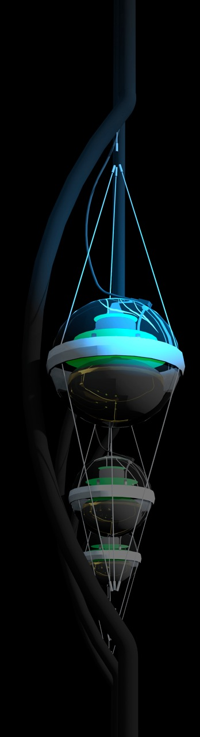
Beyond IceCube
francis halzen
the discovery of high-energy cosmic neutrinos
where do they come from?
neutrino stars?
cosmogenic neutrinos
beyond IceCube
low threshold frontier (PINGU)
IceCube.wisc.edu

Slide 2
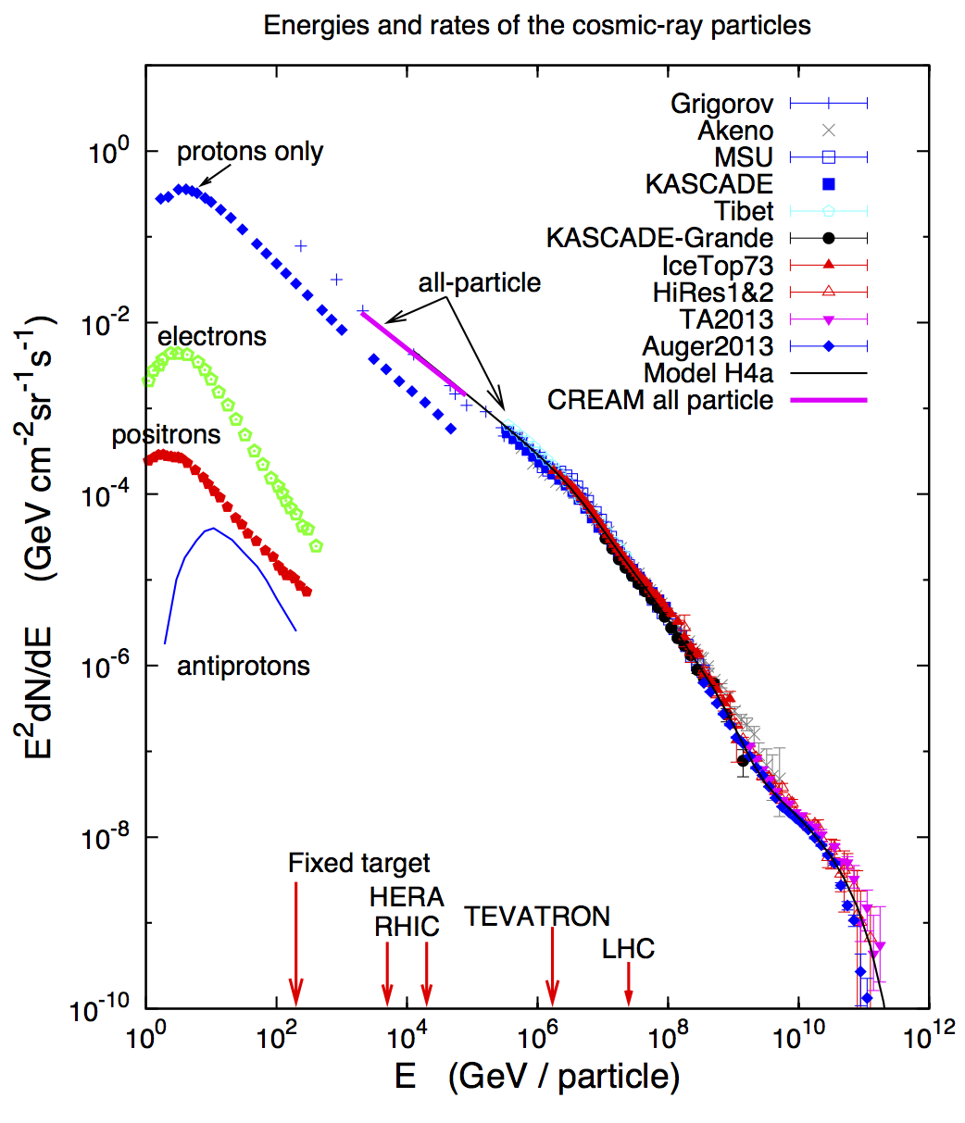
Atmospheric
neutrinos:
AMANDA, IceCube
Galactic neutrino
flux model:
(Ingelman & Thunman)
cosmogenic
neutrino flux
cosmic neutrino flux

Slide 3
Beyond IceCube
francis halzen
cosmic ray physics in 20 slides
IceCube.wisc.edu

Slide 4
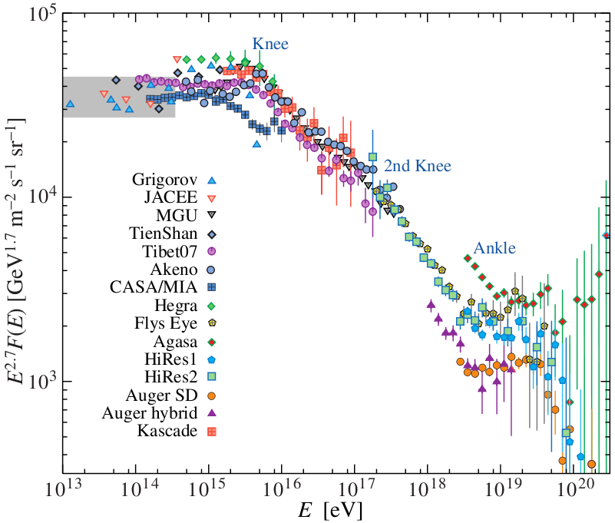
cosmic rays
falls short of the knee
by a factor of 10
Extragalactic
PDG 2008

Slide 5
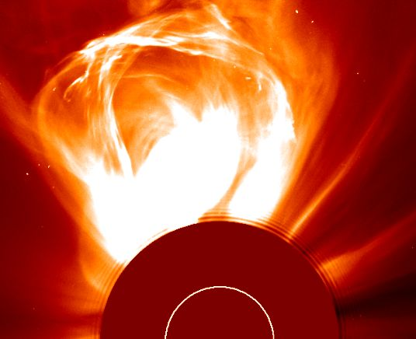
the sun constructs an accelerator
coronal mass
ejection→
10 GeV protons

Slide 6

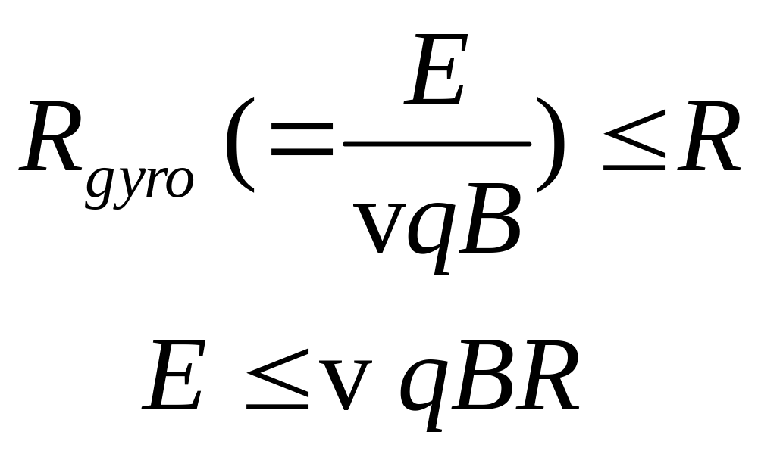
Hillas formula :
accelerator must contain the particles
dimensional analysis, difficult to satisfy

Slide 7
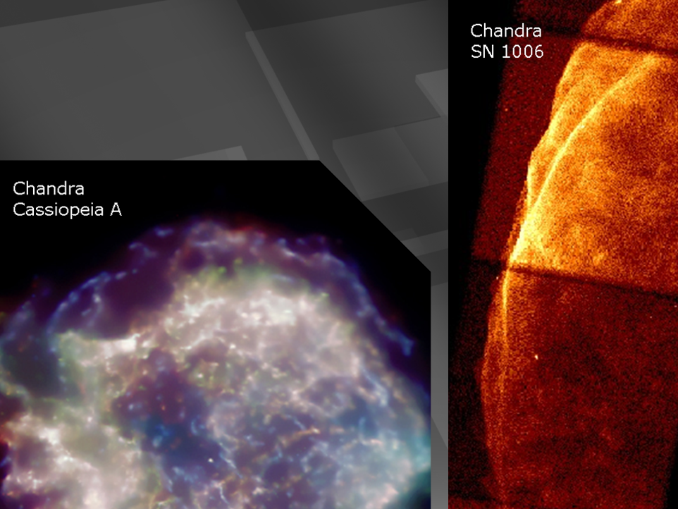
supernova remnants HESS

Slide 8
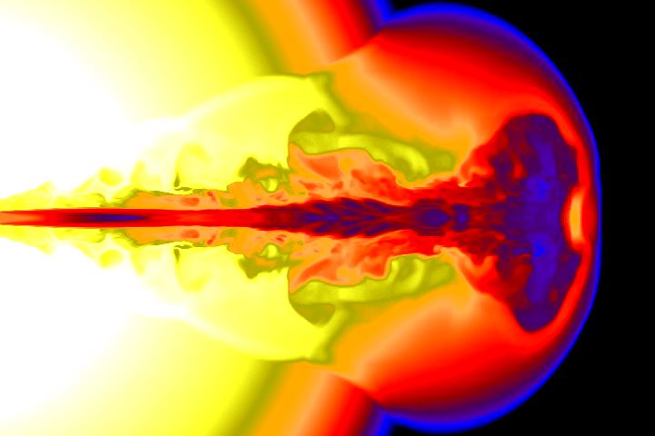
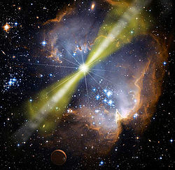
…and if the star collapses to
a black hole…
gamma ray burst
happens in seconds
not thousands of year
beamed along the spin
axis of the black hole
simulation not image
? IceCube, Nature 2011

Slide 9
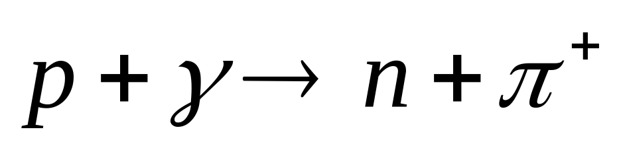
neutrinos and neutrons are
produced in the
interactions of
fireball protons
(trapped in the magnetic field)
with synchrotron
photons
decays to a PeV neutrino
decays to cosmic ray
GRB: one neutrino per cosmic ray observed
ruled out by IceCube

Slide 10
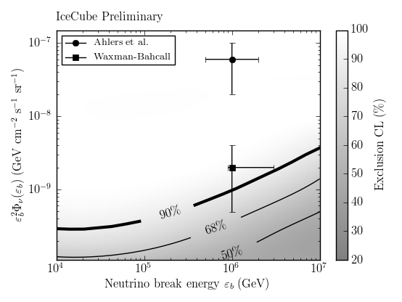

Slide 11
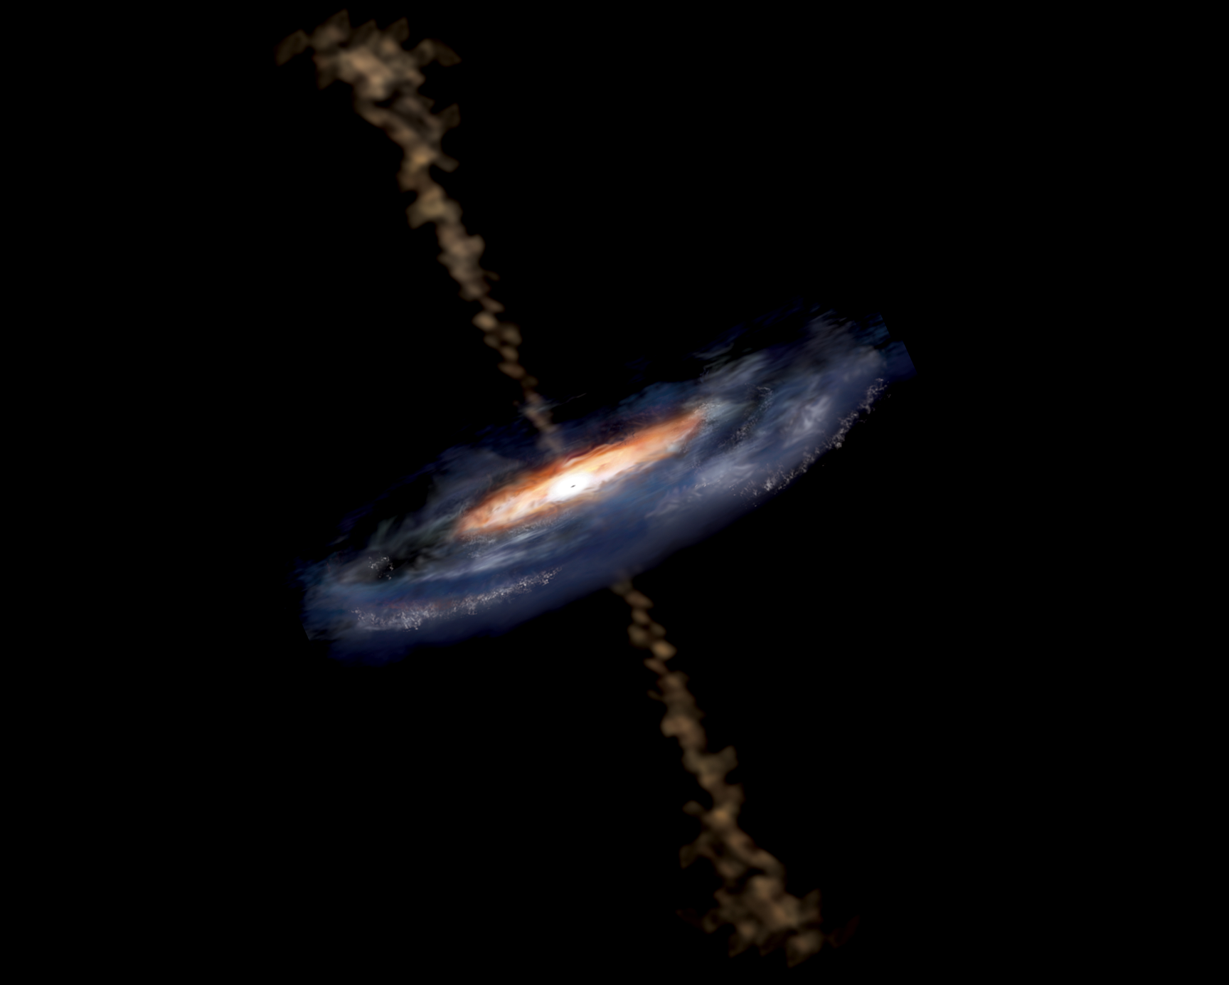
active galaxy particle flows near supermassive black hole

Slide 12

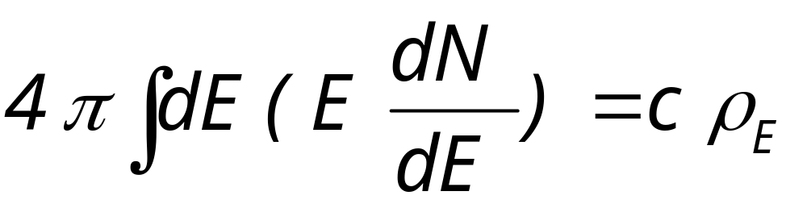
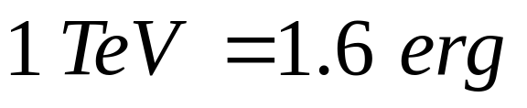
total flux = velocity x density
energy density is the key !

Slide 13
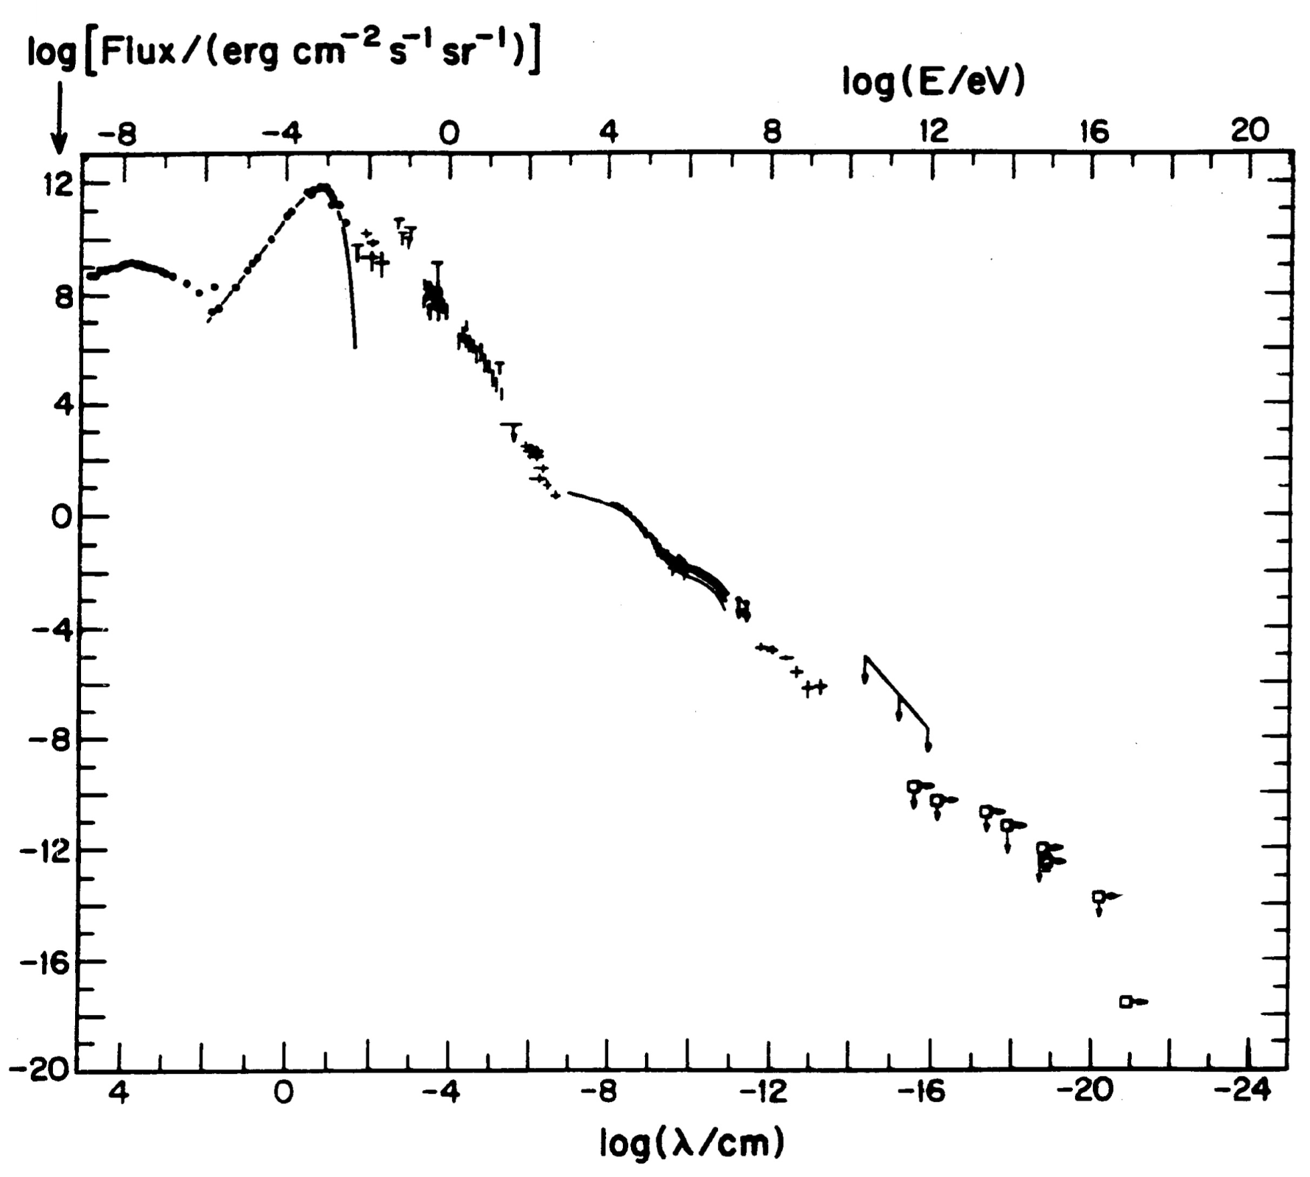
galactic
cosmic rays
10-41 erg/cm3
energy (eV)
galactic
cosmic rays
10⁻¹² erg/cm³
/
/
/
/
/
/
/
/
/
/
/
/
/
/
/
/
/
Radio
CMB
Visible
extragalactic
cosmic rays
3x10⁻¹⁹ erg/cm³
flux
410 photons
of 2.7 K
or 10⁻¹² erg/cm³
GeV γ-rays

Slide 14

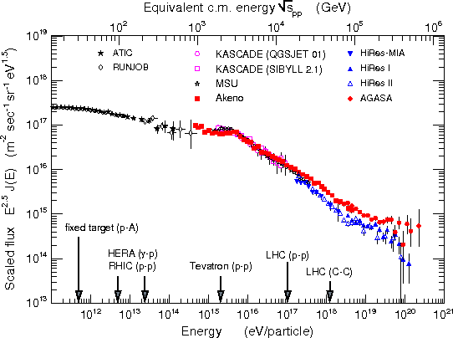
Cosmic Rays & SNRs
observed energy density of galactic CR:
~ 10⁻¹² erg/cm³
galactic
supernova remnants:
10⁵⁰ ergs every 30 years
~10⁻¹² erg/cm³
for steady state of CR
with lifetime 10⁶ years
SNRs provide the environment and energy
to explain the galactic cosmic rays!

Slide 15

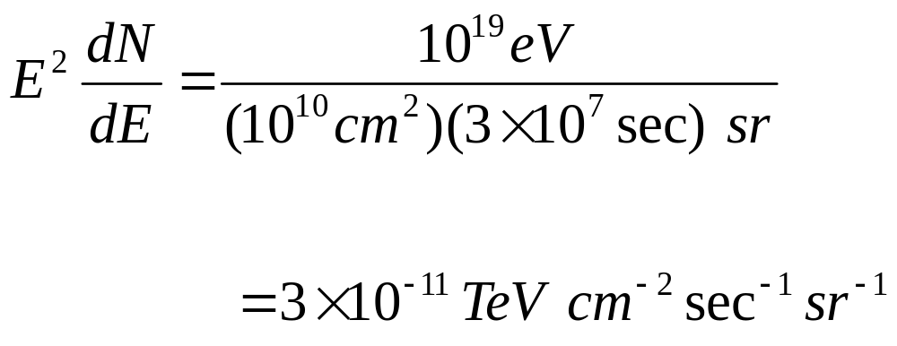
flux of extragalactic
cosmic rays
ankle → one 10¹⁹ eV particle
per km squared per year per sr

Slide 16
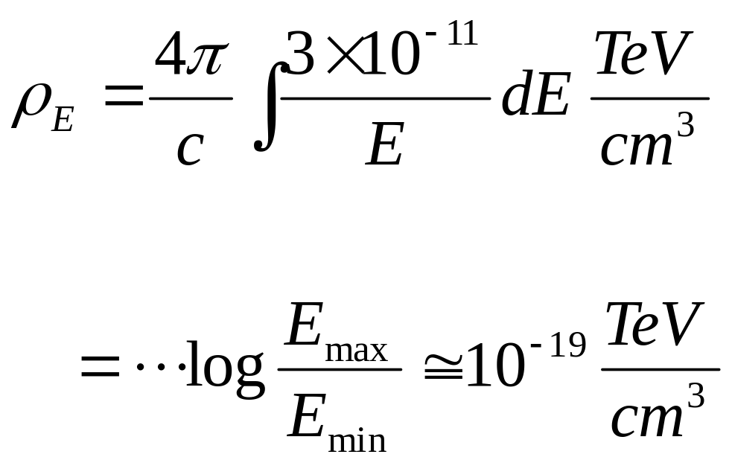

total flux = velocity x density

Slide 17
galactic
cosmic rays
10-41 erg/cm3
energy (eV)
galactic
cosmic rays
10⁻¹² erg/cm³
/
/
/
/
/
/
/
/
/
/
/
/
/
/
/
/
/
Radio
CMB
Visible
extragalactic
cosmic rays
3x10⁻¹⁹ erg/cm³
flux
410 photons
of 2.7 K
or 10⁻¹² erg/cm³
GeV γ-rays

Slide 18
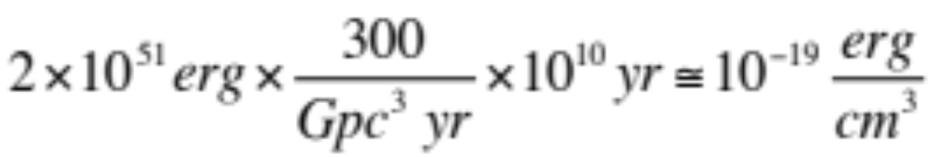
300 GRB per Gigaparsec³ per year for 10¹⁰ years (Hubble time)
correct cosmology: same answer
Fermi: photon (electron) energy less than this ?

Slide 19
Cosmic Rays & GRBs
observed energy density of extragalactic CR:
~ 10⁻¹⁹ erg / cm³
Extragalactic
Gamma-Ray Bursts:
2x10⁵¹ ergs x 300/Gpc³
x 10¹⁰ yr
~ 10⁻¹⁹ erg / cm³
GRBs provide environment and energy
to explain the extragalactic cosmic rays!

Slide 20
Cosmic Rays & SNRs
observed energy density of galactic CR:
~ 10⁻¹² erg/cm³
galactic
supernova remnants:
10⁵⁰ ergs every 30 years
~10⁻¹² erg/cm³
for steady state of CR
with lifetime ~10⁶ years
SNRs provide the environment and energy
to explain the galactic cosmic rays!

Slide 21
energy in extra-galactic cosmic rays is ~ 3x10⁻¹⁹ erg/cm³
2x10⁵¹ erg per gamma ray burst
energy in cosmic rays ~ photons
Notes:
21

Slide 22
energy in extra-galactic cosmic rays is ~ 3x10⁻¹⁹ erg/cm³
3x10⁴⁴ erg/s per active galaxy
2x10⁵¹ erg per gamma ray burst
energy in cosmic rays ~ photons
Notes:
22

Slide 23
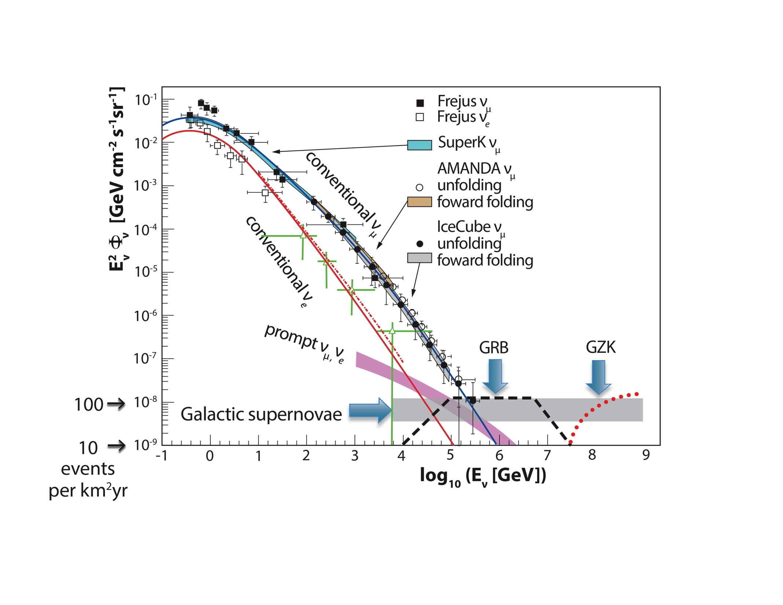
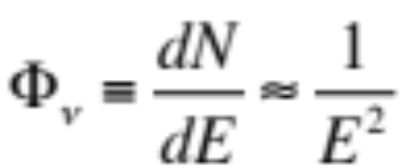
rationale for a kilometer-scale detector

Slide 24
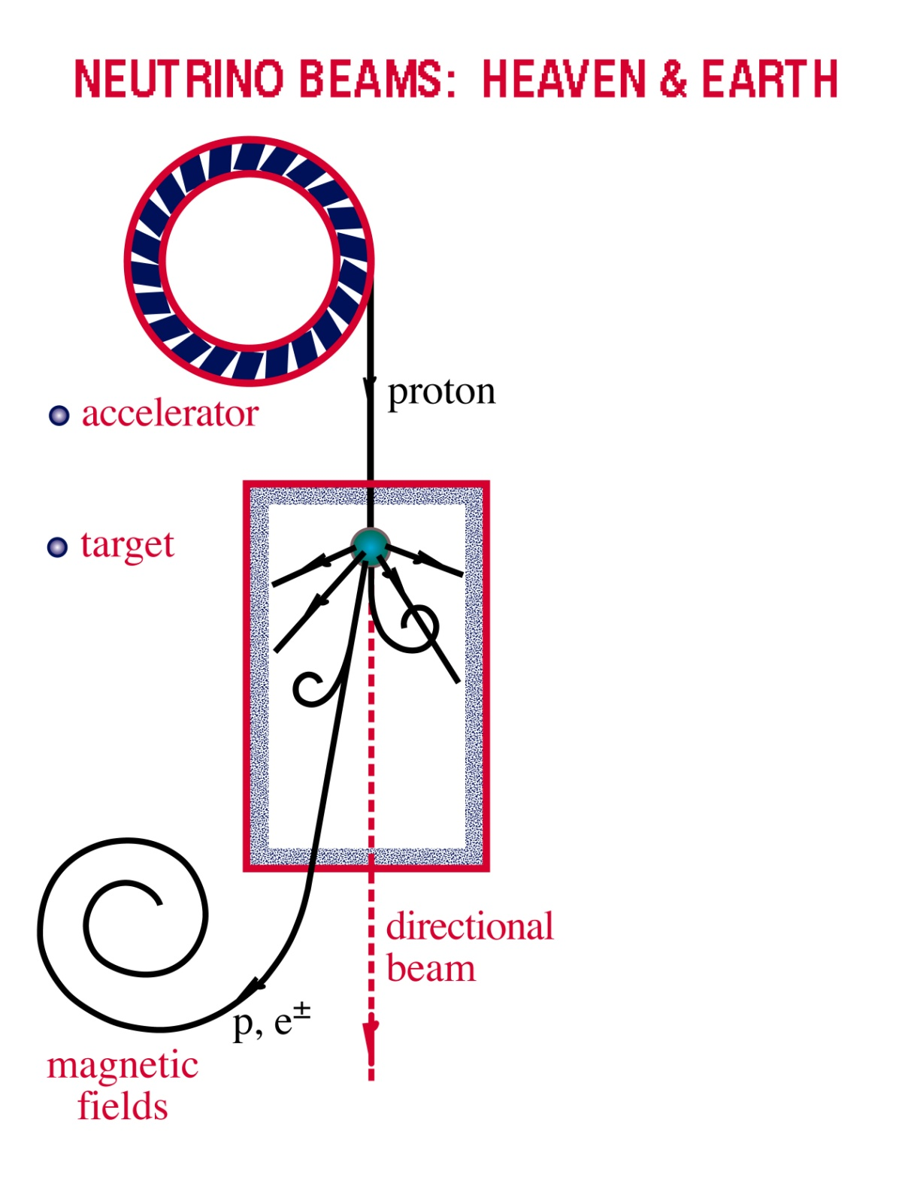
Neutrino Beams: Heaven & Earth
ν and γ beams : heaven and earth
NEUTRINO BEAMS: HEAVEN & EARTH
black hole
radiation
and dust
p + γ → n + π⁺
^{~ cosmic ray + neutrino}
→ p + π⁰
^{~ cosmic ray + gamma}

Slide 25
Beyond IceCube
francis halzen
the discovery of high-energy cosmic neutrinos
where do they come from?
neutrino stars?
cosmogenic neutrinos
beyond IceCube
low threshold frontier (PINGU)
IceCube.wisc.edu

Slide 26
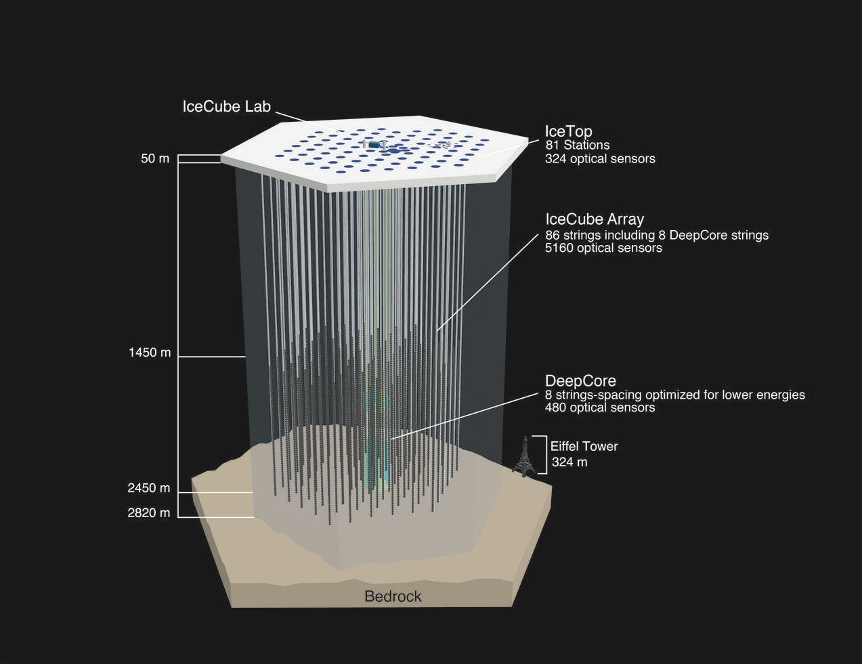
IceCube: transforms 1 km3 of natural
Antarctic ice into a Cherenkov detector

Slide 27
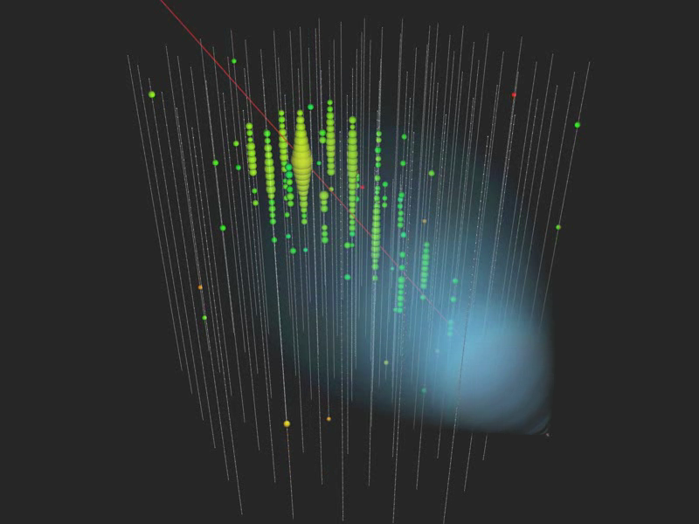
Notes:
cherenkov.mp4

Slide 28
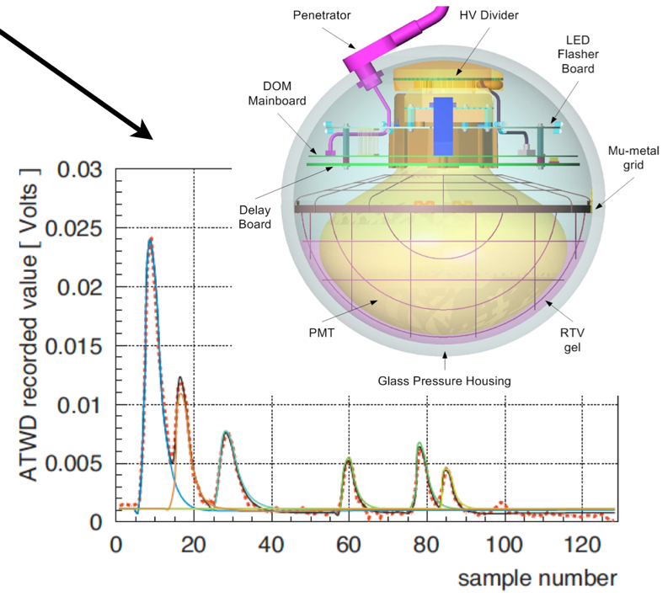
… each Digital Optical Module independently collects light signals like this, digitizes them,
…time stamps them with 2 nanoseconds precision, and sends them to a computer that sorts them events…
Notes:
28

Slide 29
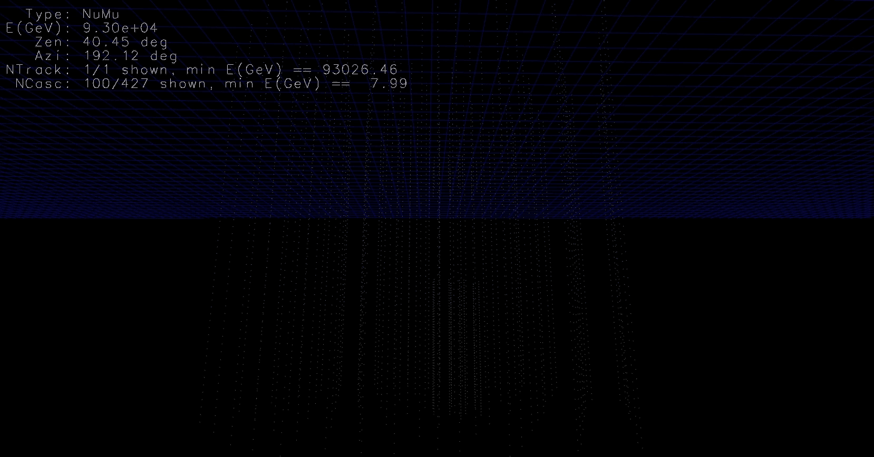
93 TeV muon

Slide 30
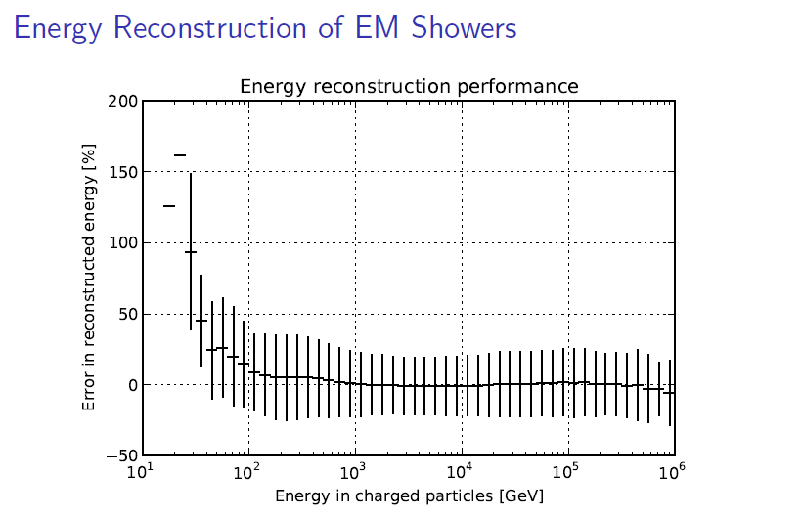
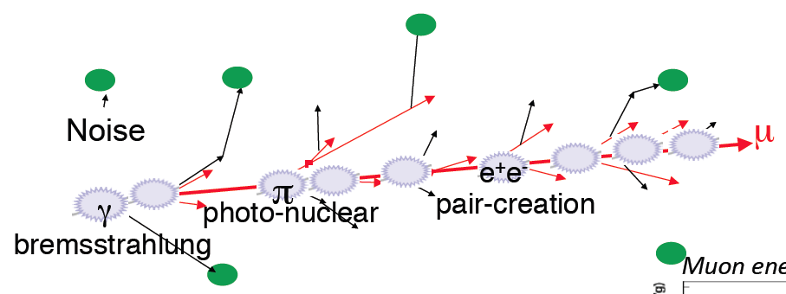
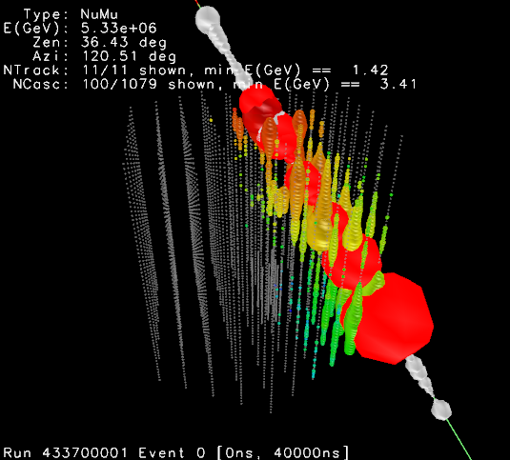
energy measurement ( > 1 TeV )
convert the amount of light emitted
to measurement of the muon
energy (number of optical modules,
number of photons, dE/dx, …)

Slide 31
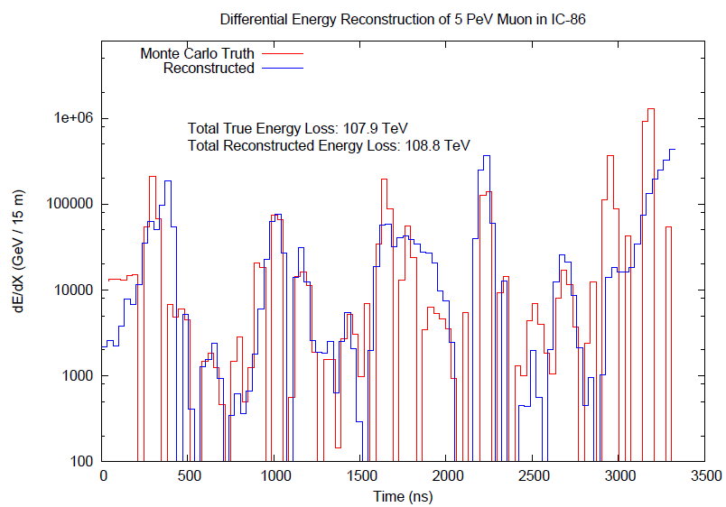
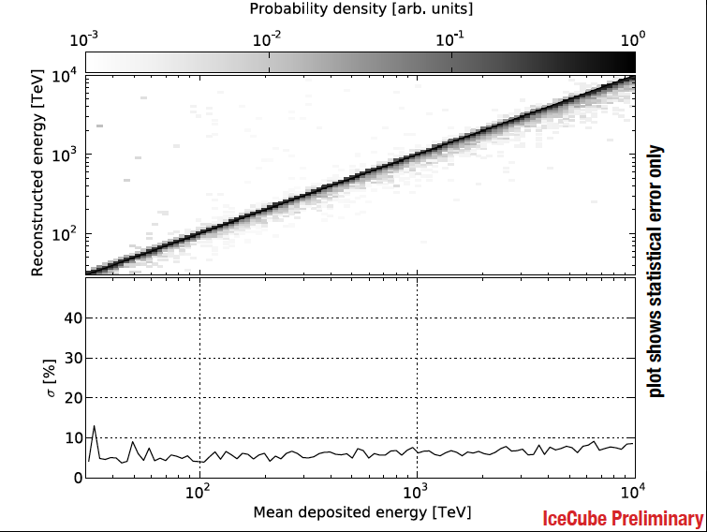
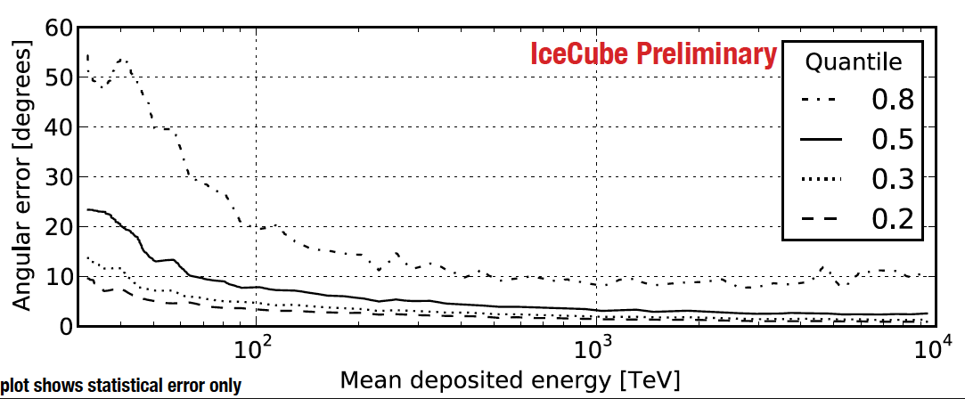
improving angular and energy resolution

Slide 32
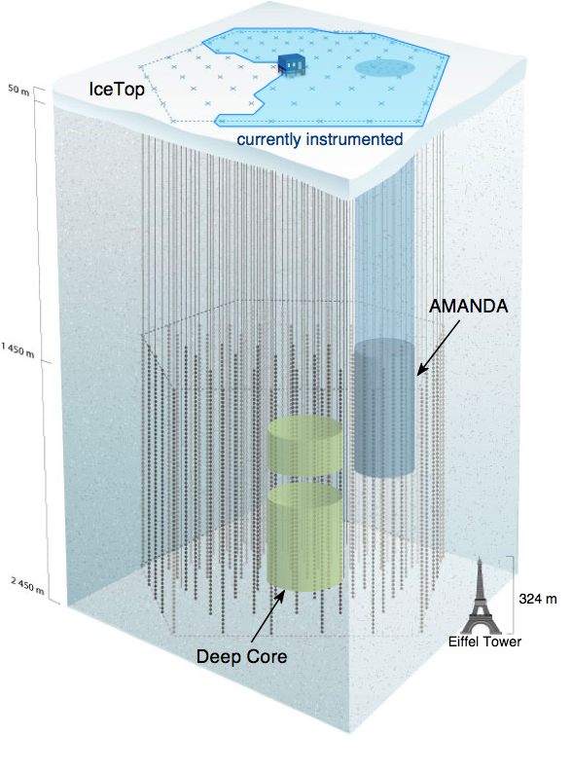
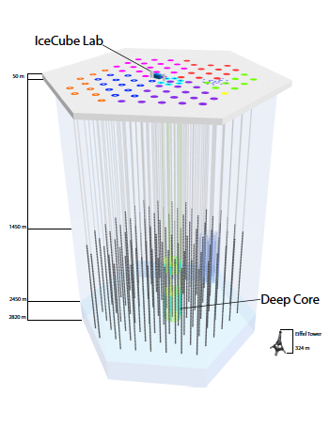
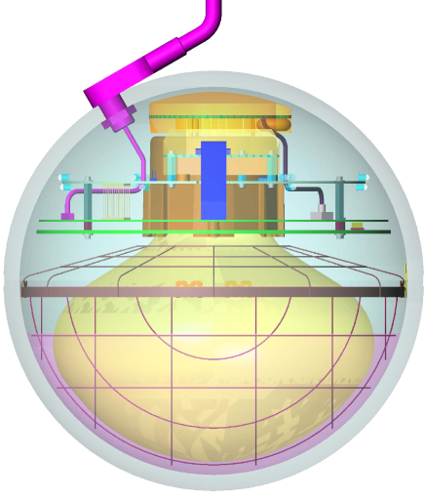
IceCube performance
completed December 2010
5160 optical sensors
between 1.5 ~ 2.5 km
10 GeV to infinity
< 0.5 degree on-line
< 0.3 degree off line
for muon tracks
(10~15 degrees for
showers)
< 15% energy resolution
Digital Optical Module (DOM)

Slide 33
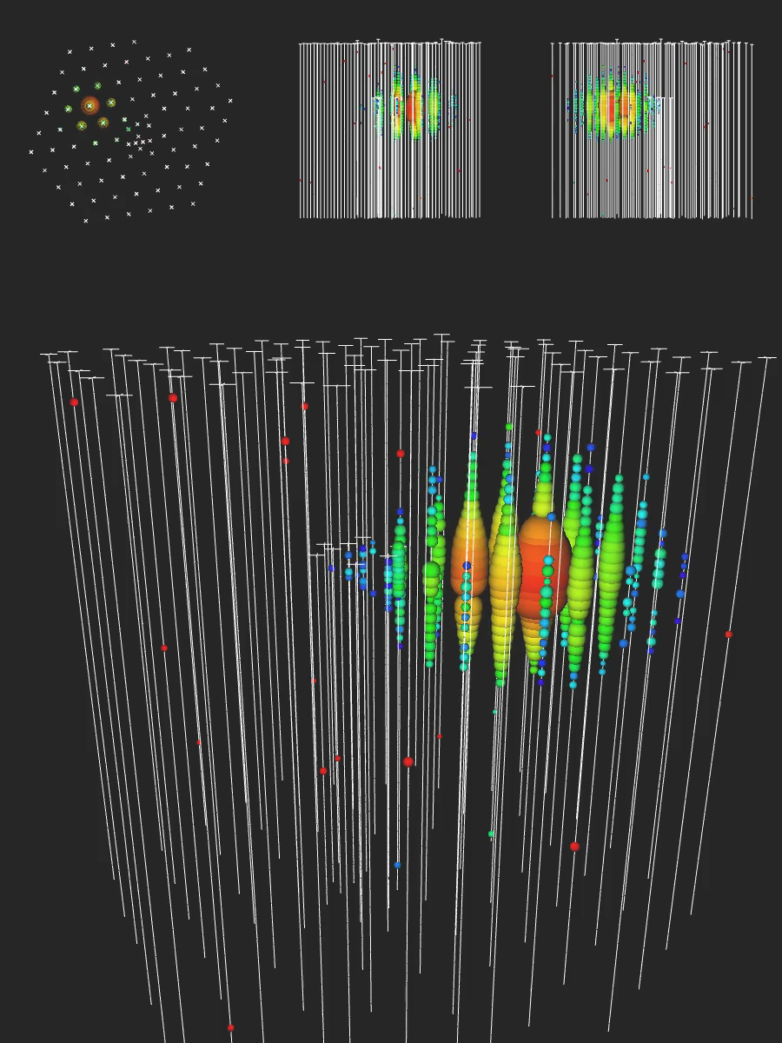

Slide 34
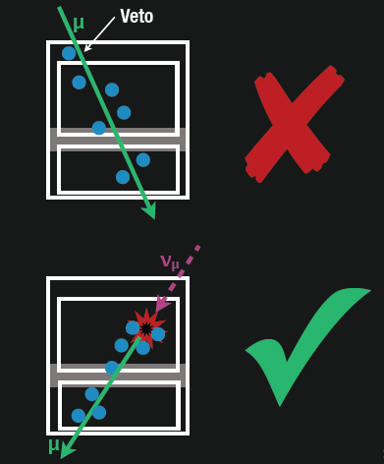
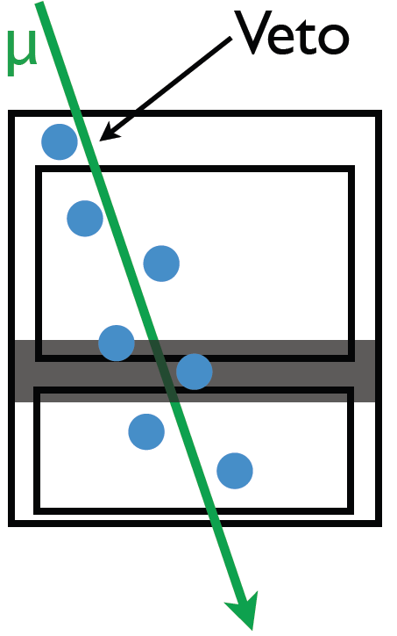
find contained
events (420 Mton)
total calorimetry
complete sky coverage
flavor determined
some will be muon
neutrinos with good
angular resolution
loss in statistics is compensated by event definition

Slide 35
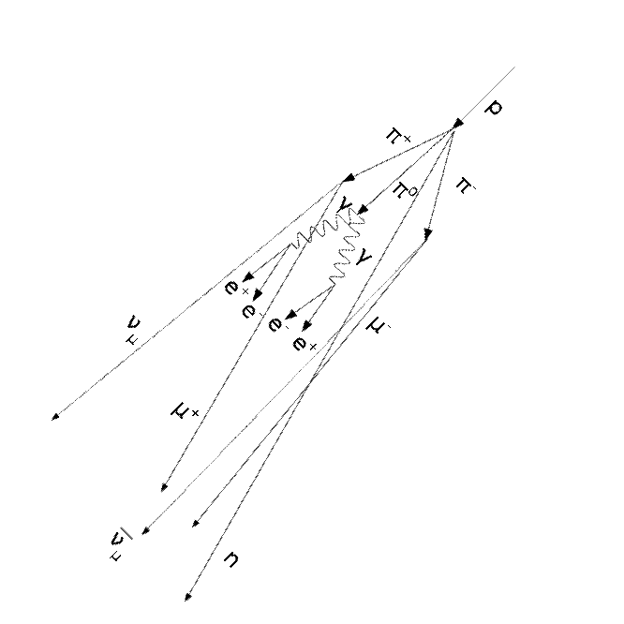
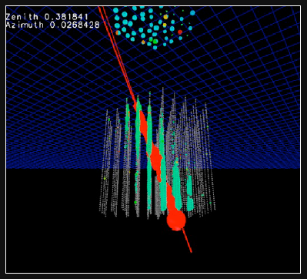
atmospheric neutrinos are
accompanied by muons from
the shower that produced them:
none seen
(no signals in IceTop)

Slide 36
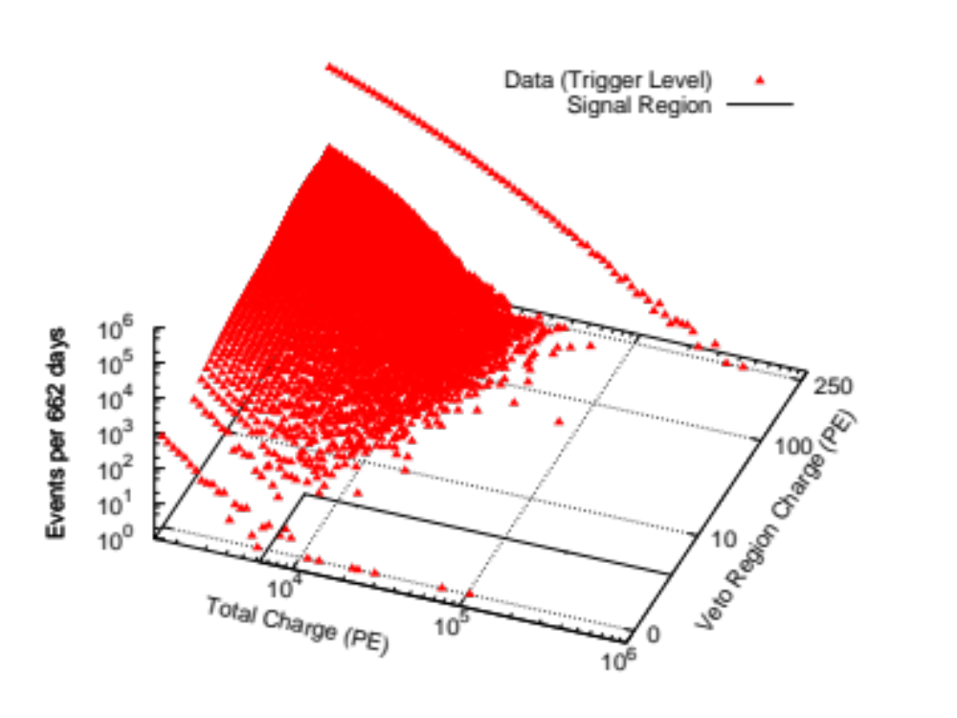
…and then there
were 26 more…
data: 86 strings one year

Slide 37
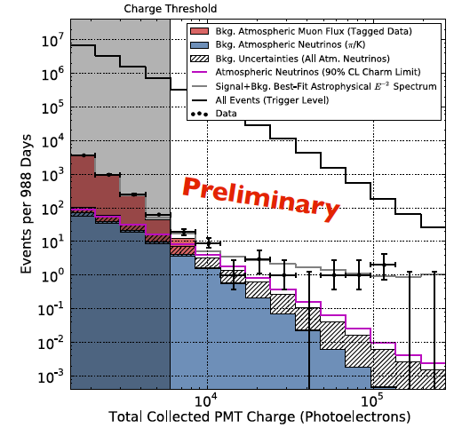
total charge collected
by PMTs of events with
interaction inside the
detector
E²Φ(E) =
(3.6±1.2)·10⁻⁸ GeVcm⁻²s⁻¹sr⁻¹
atmospheric ν
and μ

Slide 38
cosmic
neutrinos:
energy
> 100 TeV
atmospheric
background:
1~2 events
per year
atmospheric neutrino cosmic

Slide 39
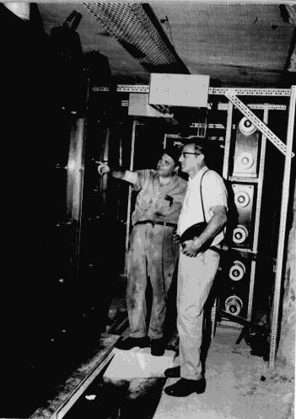
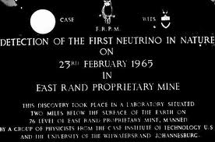
Discovery of atmospheric neutrinos
February 23, 1965
East Rand Proprietary Mine, South Africa, Depth = 3200 meters
Case-Witwatersrand Collaboration
(later Case-Wits-Irvine)
F. Reines et al.
(J.Sellshop, U. Witwatersrand)
Fred Reines
CWI experiment
Long liquid
scintillation
counters
Nearly horizontal track

Slide 40
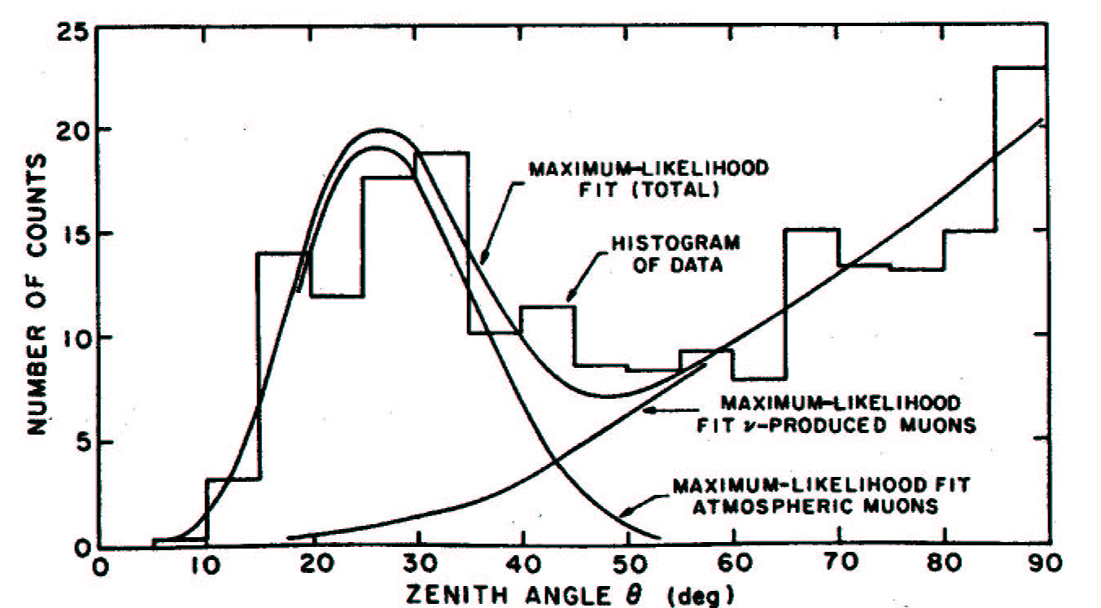
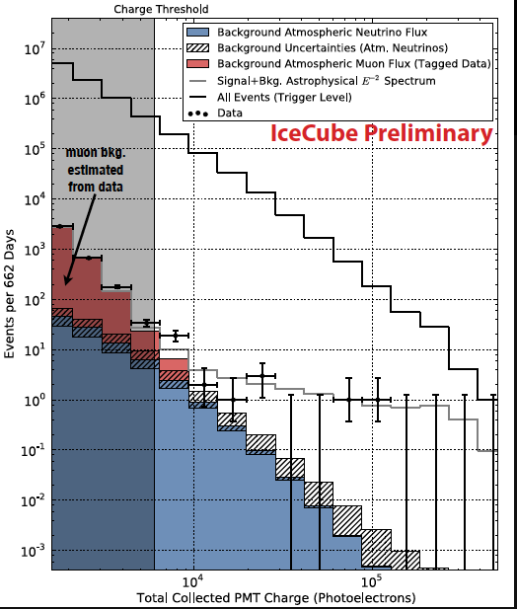
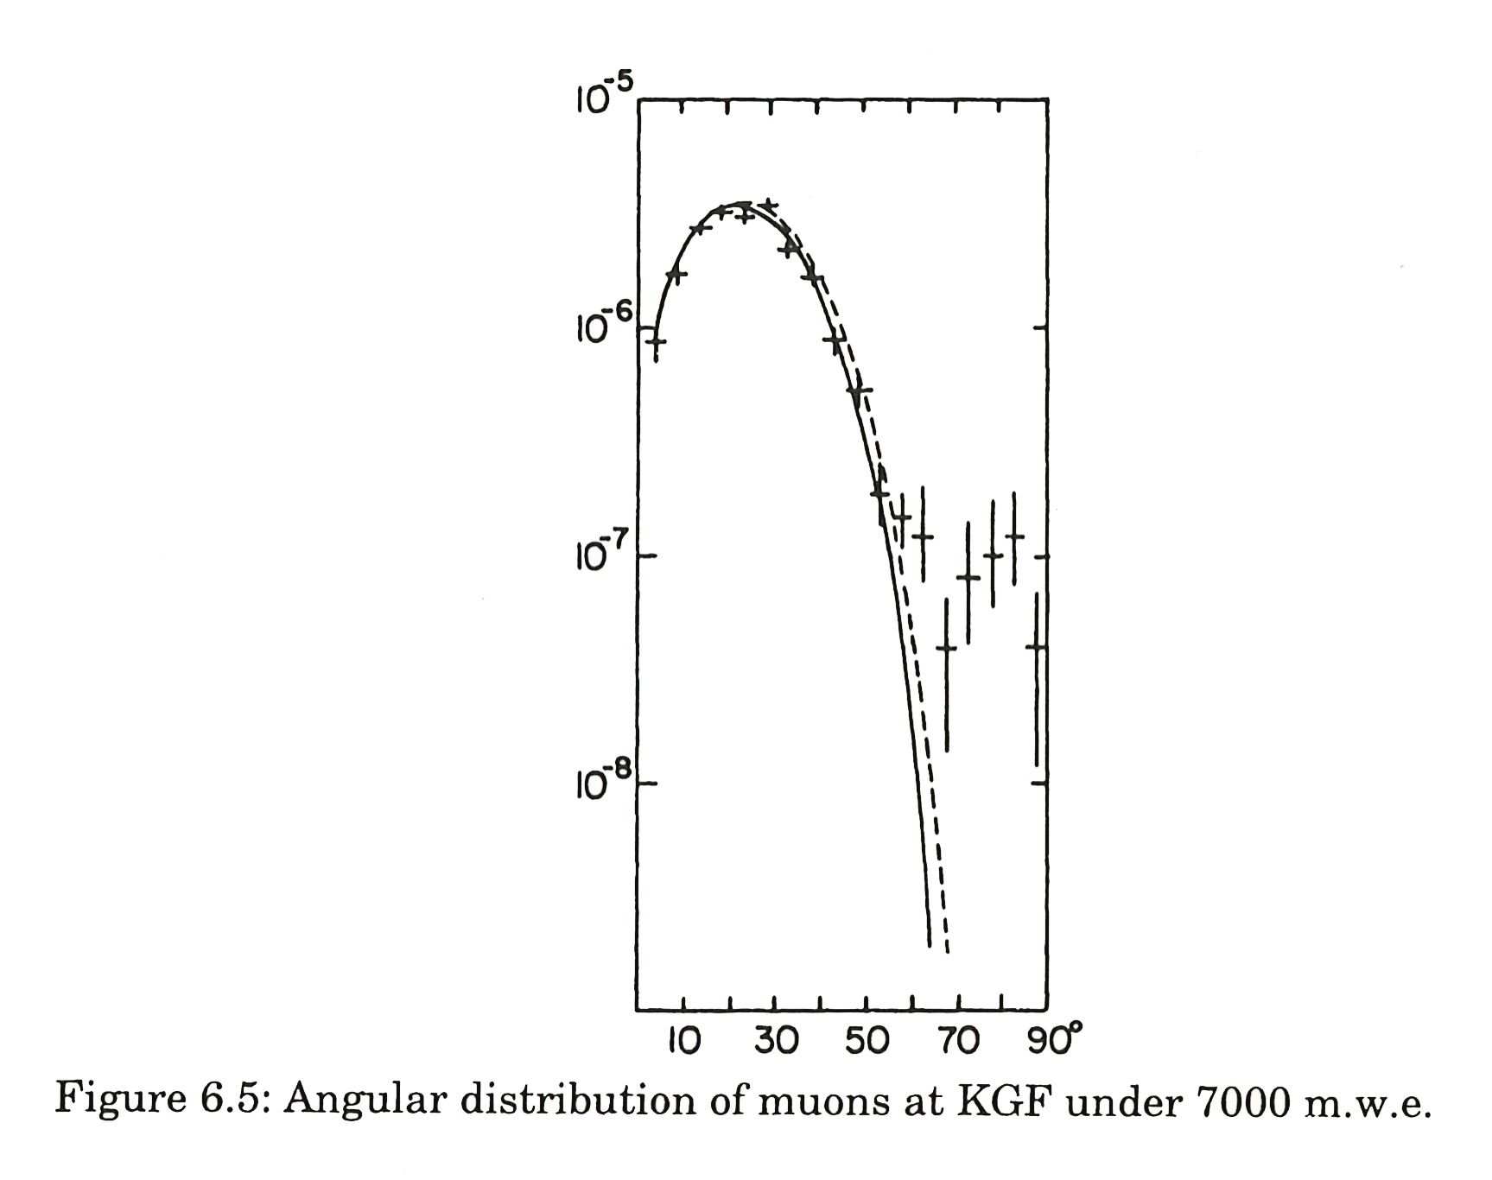
2013 atmospheric and
cosmic neutrinos
CWI
1965
cosmic ray
muons
and
atmospheric
neutrinos
KGF

Slide 41
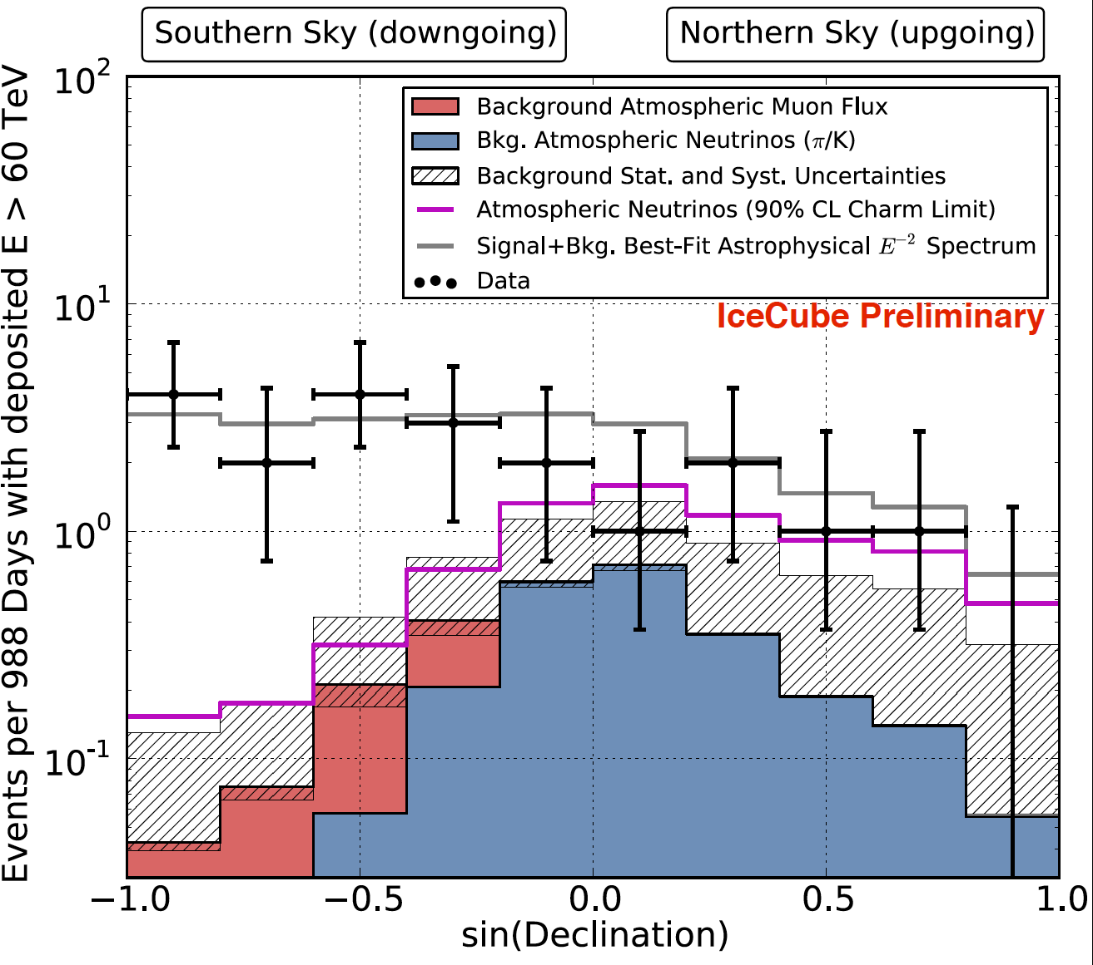
3 years
←Earth absorption→

Slide 42
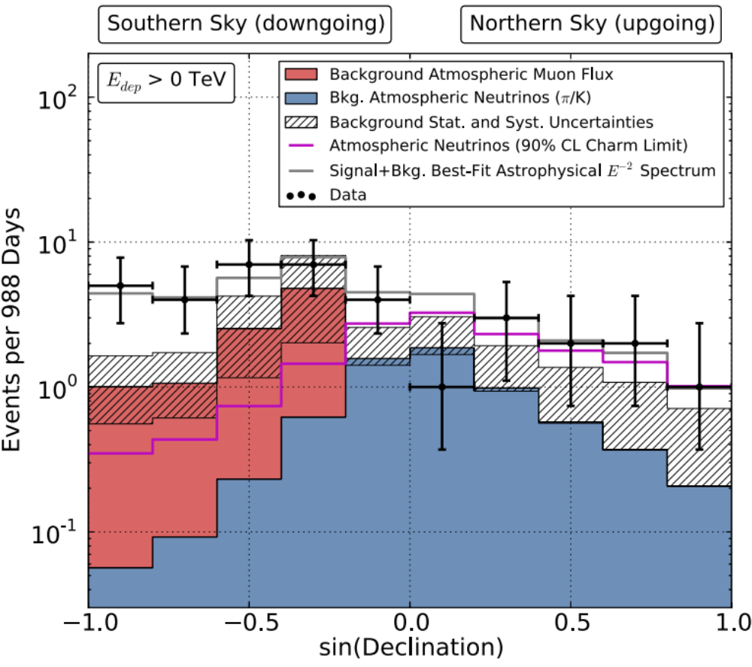
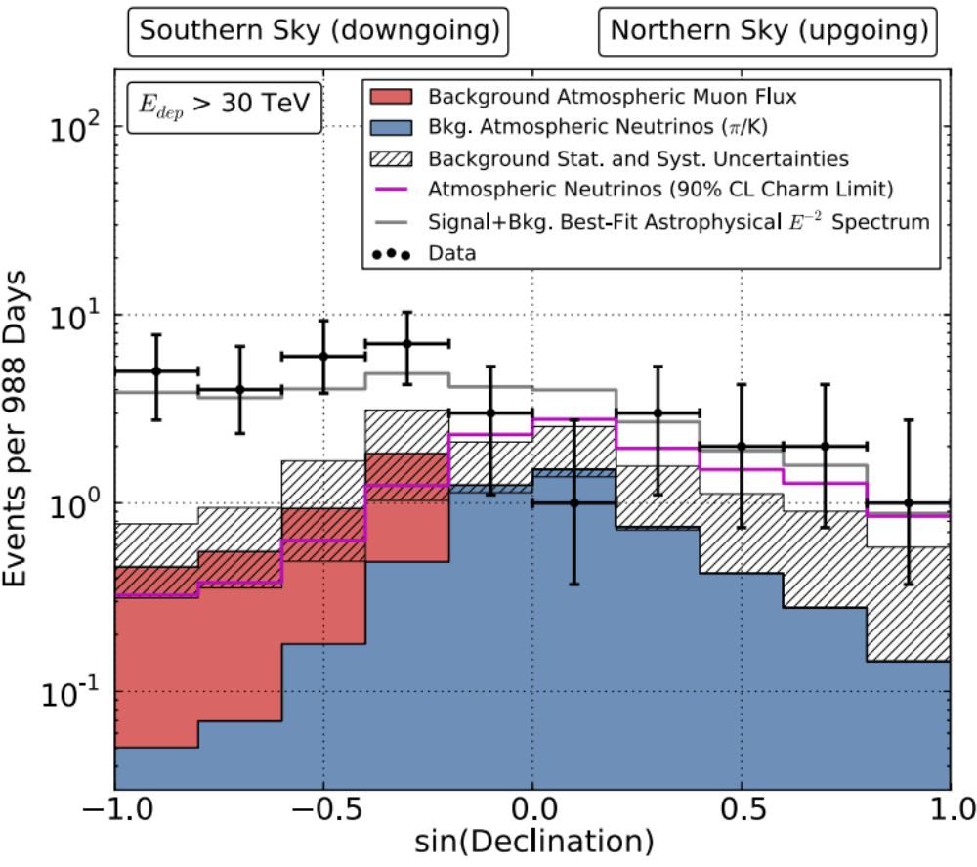
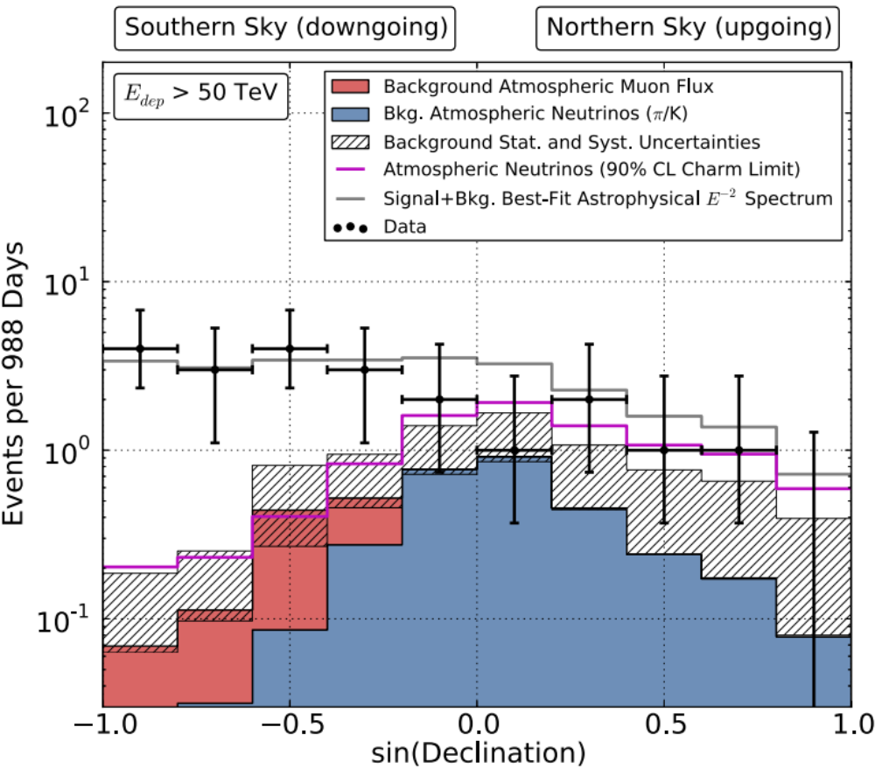


























Slide 43

Notes:
IceCube has allowed scientists to launch a hunt for some of the most elusive particles in our universe, neutrinos. These high-energy neutrinos give us an exclusive way to study powerful cosmic engines like exploding stars and black holes. This illustration shows one of the highest energy neutrino events ever measured super-imposed on the Mendota lakefront to give a sense of the enormous size of the IceCube detector.

Slide 44

Notes:
Photons from an electromagnetic shower in South Pole ice [1080p]-2.mp4

Slide 45


Slide 46

… for science and for the experimental accomplishment of building IceCube …

Slide 47
Beyond IceCube
francis halzen
the discovery of high-energy cosmic neutrinos
where do they come from?
neutrino stars?
cosmogenic neutrinos
beyond IceCube
low threshold frontier (PINGU)
IceCube.wisc.edu

Slide 48

sources that
accommodate
the observed
energy budget
solar
Galactic:
supernova
remnants?
extragalactic:
gamma ray
bursts??
active
galaxies?

Slide 49

where do they come from?

Slide 50

where do they come from (3 year data)?

Slide 51

Galactic

Slide 52

Galactic coordinates
arXiv 1309.4077
boundary with no gamma ray
observations in Southern sky
PeV events
hottest spot in IceCube
PeV gamma ray map
c.o.g of 5-event cluster

Slide 53

the energy range of cosmic accelerators producing PeV neutrinos
Galactic or extragalactic?

Slide 54

starburst galaxies

Slide 55

expect surprises: produced by Galactic dark matter halo?

Slide 56
where do they come from?
not all Galactic
structure of the spectrum applies directly to the accelerator, no cascading like for photons
where are the PeV photons?
we may be surprised, it happened before
need more events with better angular resolution

Slide 57
Beyond IceCube
francis halzen
the discovery of high-energy cosmic neutrinos
where do they come from?
neutrino stars?
cosmogenic neutrinos
beyond IceCube
low threshold frontier (PINGU)
IceCube.wisc.edu

Slide 58

shielded and optically
transparent medium
muon travels from 50 m
to 50 km through the
water at the speed of light
emitting blue light along
its track
muon
interaction
lattice of photomultipliers
neutrino

Slide 59

search for point sources of neutrinos

Slide 60

nearest star forming region in Cygnus
also, 8-year AMANDA data: 2.3 sigma

Slide 61

nearest star forming region in Cygnus
also, 8-year AMANDA data: 2.3 sigma

Slide 62

nearest star forming region in Cygnus

Slide 63


confirmation!
flux of muon neutrinos
through the Earth
neutrinos of all flavors
interacting inside
IceCube

Slide 64

highest energy muon energy observed: 560 TeV

Slide 65
what if ???
a next-generation IceCube with a volume of 10 km³
and an angular resolution of 0.3 degrees will
identify the sources of a “diffuse” flux in several years
and guarantee astronomy.

Slide 66



auto correlation: detect association with known sources
total number of events required to observe
n-events multiplets from the closest sources is
for a observed diffuse cosmic flux and 0.4 degrees
angular resolution
examples of local source densities (per Mpc³):

Slide 67

cross correlation with catalogues:
for 100 local sources (e.g. Auger and TA)
a total of 20~50 events are required
time dependence for flaring sources!

Slide 68
this is where astronomy starts!
flux of muon neutrinos
through the Earth
neutrinos of all flavors
interacting inside
IceCube

Slide 69
Beyond IceCube
francis halzen
the discovery of high-energy cosmic neutrinos
where do they come from?
neutrino stars?
cosmogenic neutrinos
beyond IceCube
low threshold frontier (PINGU)
IceCube.wisc.edu

Slide 70
energy (eV)
ν
Radio
CMB
flux
Visible
TeV sources
cosmic
rays
GeV γ-rays
particle flux
in the Universe

Slide 71

energy (eV)
ν
Radio
CMB
flux
Visible
cosmic
rays
GeV γ-rays

Slide 72




cosmic rays interact with the microwave background
cosmic rays disappear, neutrinos with
EeV (10¹⁸ eV) energy appear
1 event per cubic kilometer per year
...but it points at its source!

Slide 73

cosmic rays: protons
neutrinos produced in
interactions with
microwave photons
~1 event per year in
IceCube, PAO and ARA

Slide 74


cosmogenic neutrinos: an event

Slide 75

Livingston plot :
energy versus year
(Salzberg)
~ 5 events per year in next-generation IceCube
ARA - IceCube
coincidences
joint PeV-EeV
search
ultimate beyond the SM measurement

Slide 76


Slide 77
Beyond IceCube
francis halzen
the discovery of high-energy cosmic neutrinos
where do they come from?
neutrino stars?
cosmogenic neutrinos
beyond IceCube
low threshold frontier (PINGU)
IceCube.wisc.edu

Slide 78

absorption length ← 220m →
most transparent solid
in Nature...or laboratory

Slide 79

scattering length ← 47m →

Slide 80

we are limited by computing, not the optics of the ice
Toba eruption

Slide 81

measured optical properties → twice the string spacing
(increase in threshold not important: only eliminates energies where atmospheric background dominates)
NGIceCube (1/2/3)
IceCube
DeepCore
Spacing 1 (120m): IceCube (1 km³)
+ 98 strings (1,3 km³)
= 2,3 km³
Spacing 2 (240m):
IceCube (1 km³)
+ 99 strings (5,3 km³)
= 6,3 km³
Spacing 3 (360m):
IceCube (1 km³)
+ 95 strings (11,6 km³)
= 12,6 km³

Slide 82

instrumented volume: x 10
angular resolution: 0.3 degrees

Slide 83

arXiv:0904.1309
arXiv:0904.1309

Slide 84
combined next-generation IceCube + radio window

Slide 85
Atmospheric
neutrinos:
AMANDA, IceCube
Galactic neutrino
flux model:
(Ingelman & Thunman)
cosmogenic
neutrino flux
cosmic neutrino flux

Slide 86
Next-Generation IceCube
capitalize on discovery
astronomy guaranteed
~ 120 strings: more sensors per string with higher
quantum efficiency
proven techniques, low risk
flexibility of deployment per seasons: optimization
cost similar to original detector

Slide 87
Beyond IceCube
francis halzen
the discovery of high-energy cosmic neutrinos
where do they come from?
neutrino stars?
cosmogenic neutrinos
beyond IceCube
low threshold frontier (PINGU)
IceCube.wisc.edu

Slide 88









neutrinos: the sun and the Earth
Symmetry Magazine
3
◉
◉
◉
◉
1

Slide 89

Vertical
Horizontal

Slide 90


Slide 91

neutrino oscillations in Deep Core
hierarchy
sin²(2θ₁₃)=0.1
ν_{τ} appearance
ν_{μ} disappearance
resonance in effective θ13 angle traversing the Earth diameter at 10 GeV

Slide 92
hierarchy: sign Δ₁₃?

Slide 93



Slide 94

~ 8 GeV : hierarchy revealed by
“large” matter effects in the Earth
(mostly) neutrino + antineutrino -
sign Δ₁₃ : hierarchy !

Slide 95

low energy infill:
PINGU

Slide 96


PINGU:
low-mass dark matter

Slide 97


Slide 98
Overflow slides

Slide 99







3+1 neutrinos?
without oscillations
with oscillations
~20σ
IceCube
science

Slide 100


Slide 102
WB bound

Slide 103
gamma ray bursts

Slide 104

Combining point source limits with flux measurement constrains source population
J. Feintzeig,
APS spring meeting 2014
ICECUBE PRELIMINARY
Southern Sky
Northern Sky
PeV - EeV
TeV - PeV

Slide 105
Combining point source limits with flux measurement constrains source population
J. Feintzeig,
APS spring meeting 2014
Many caveats:
- E⁻² spectrum
- No cutoff
- No source extension
ICECUBE PRELIMINARY
Astrophysical flux (high-energy contained events)
~2 sources at this level add up to the astrophysical flux
~20 sources at this level add up to the astrophysical flux
Southern Sky
Northern Sky
PeV - EeV
TeV - PeV

Slide 106

you have one guess: starburst galaxies ?
astro-ph/0601695

