Slide 1

cosmic rays, gamma rays and neutrinos II
neutrino telescopes
neutrinos from beam dumps
energy in cosmic rays ~ gamma rays ~ neutrinos
the Waxman-Bahcall bound (→ signal)
example: agn, GRB
neutrinos produced by cosmic ray on interstellar backgrounds
example: cosmogenic neutrinos
examples: supernova remnants, starbursts

Slide 2
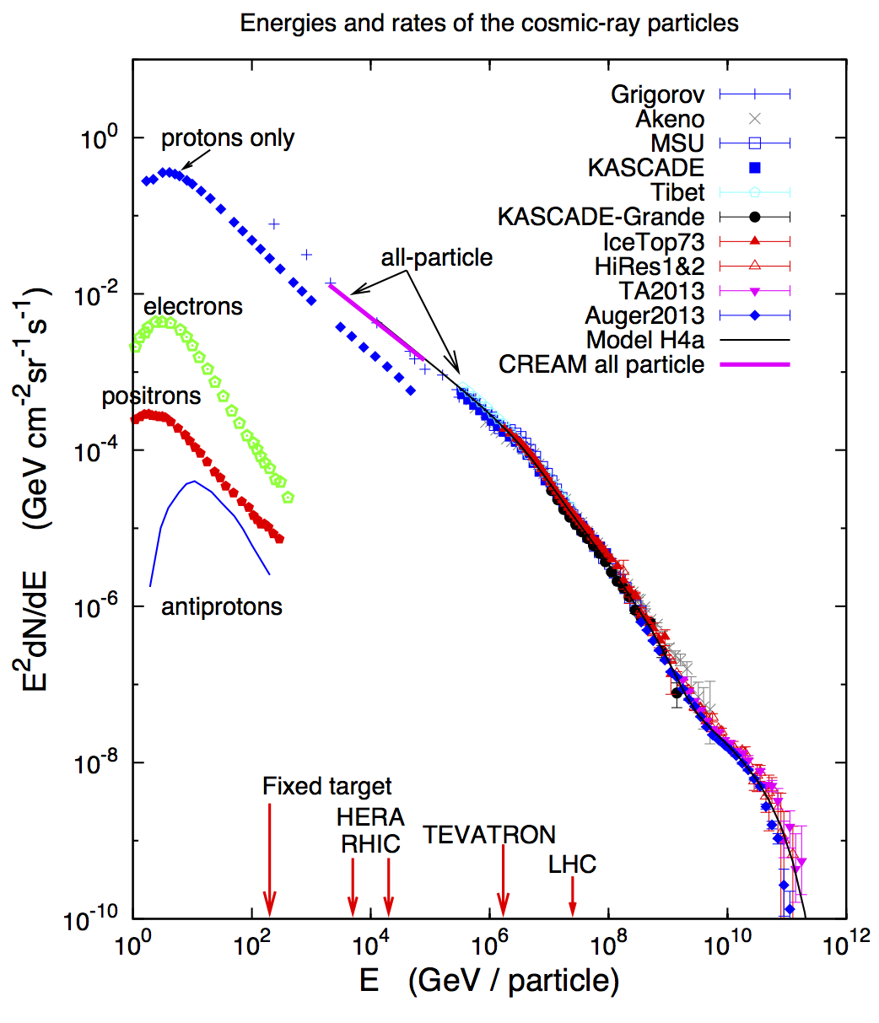
Atmospheric
neutrinos:
AMANDA, IceCube
Galactic neutrino
flux model:
(Ingelman & Thunman)
cosmogenic
neutrino flux
cosmic neutrino flux

Slide 3

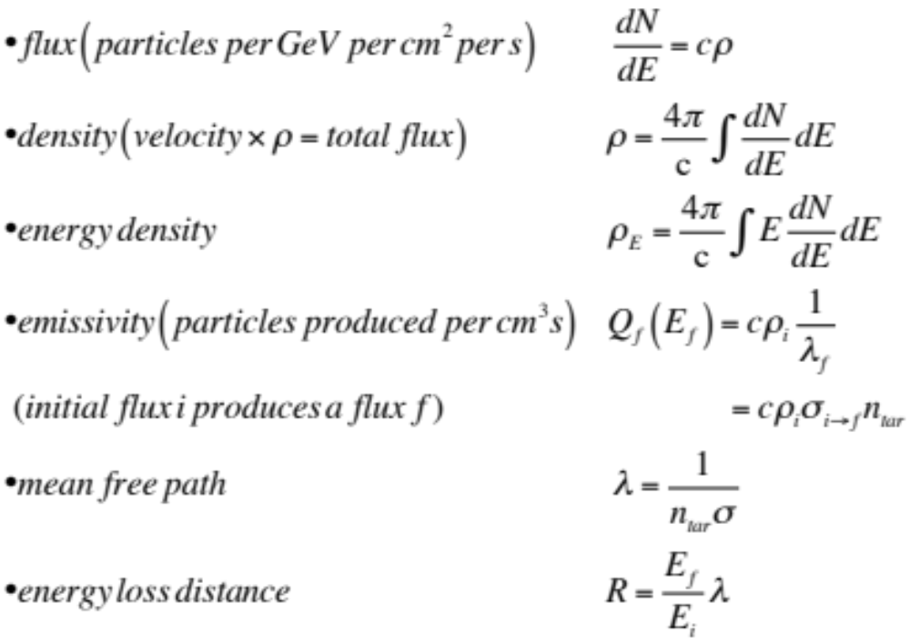
definitions

Slide 4
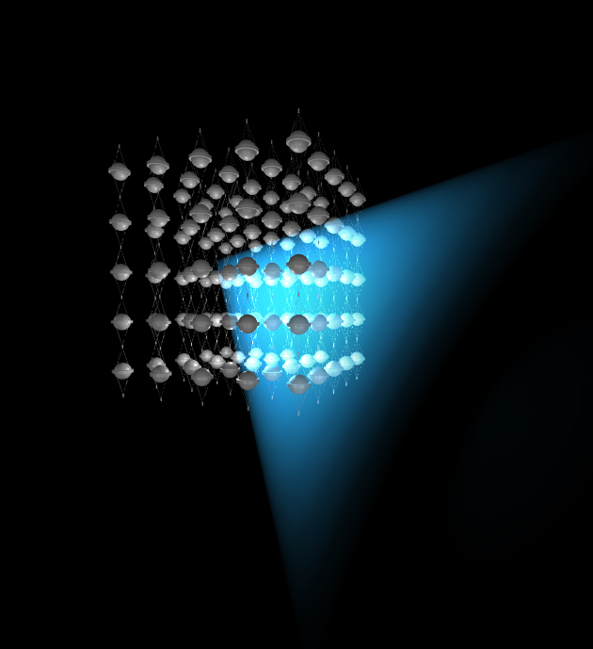
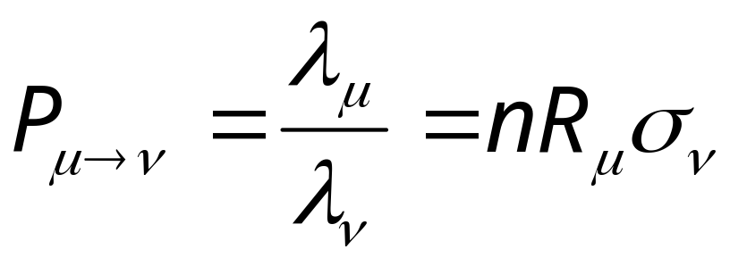
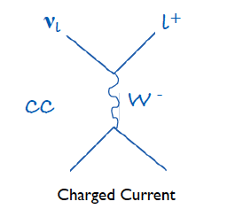
shielded and optically
transparent medium
μ
ν
lattice of photomultipliers

Slide 5

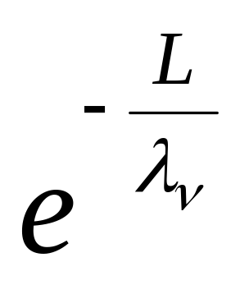
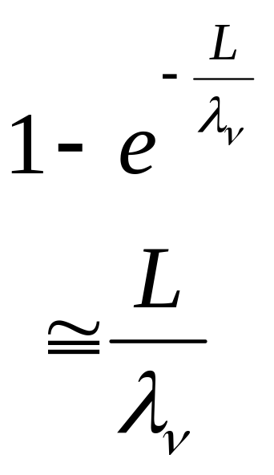
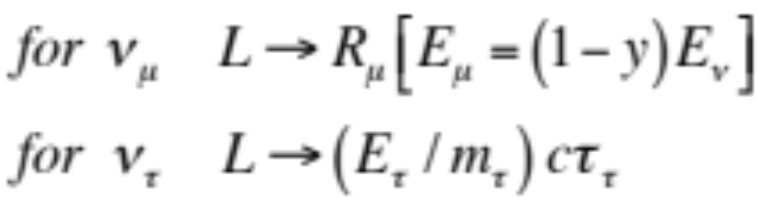
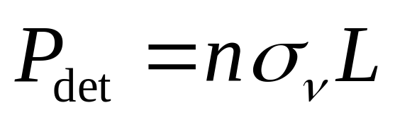
neutrino detection probability
neutrino
survives
neutrino
detected
L
~
_
ν_{e}
μ
τ
ν_{μ}
ν_{τ}

Slide 6
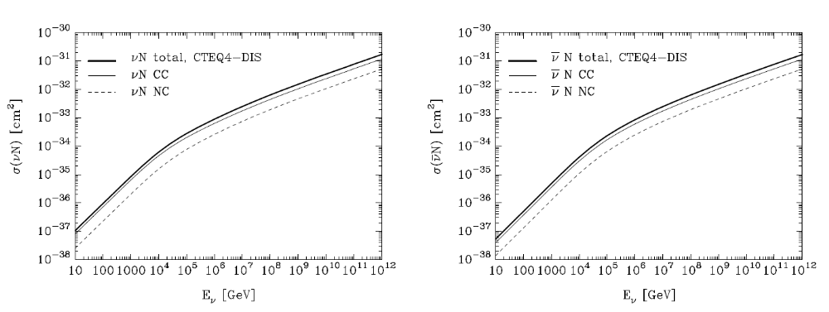
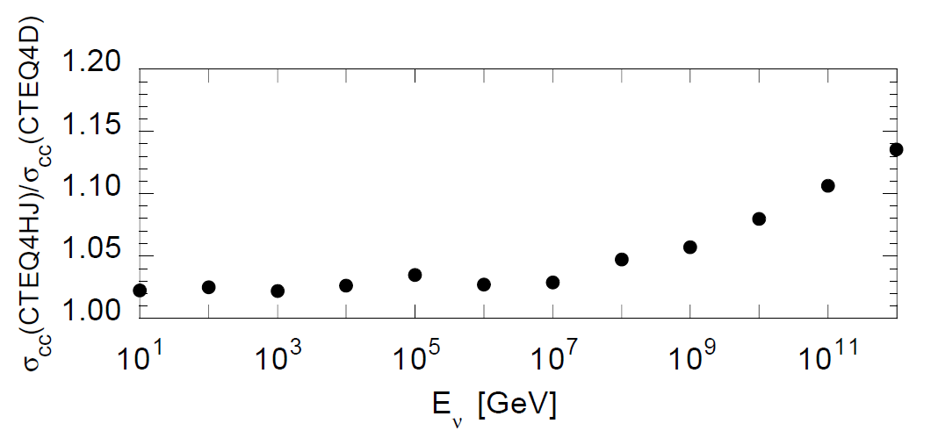

Slide 7

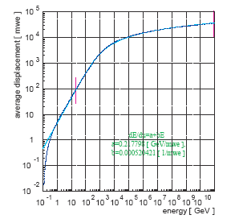
muon range

Slide 8
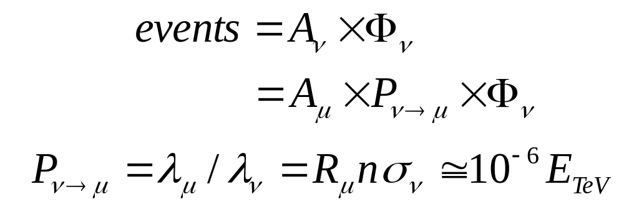
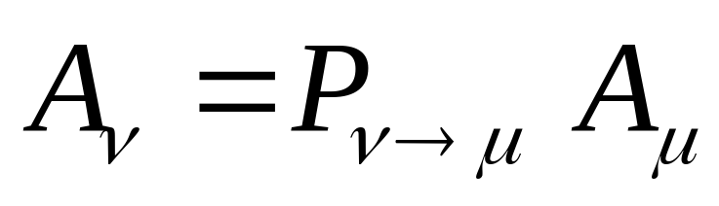
neutrino and muon area
correct for Earth absorption
hep-ph/0502223

Slide 9
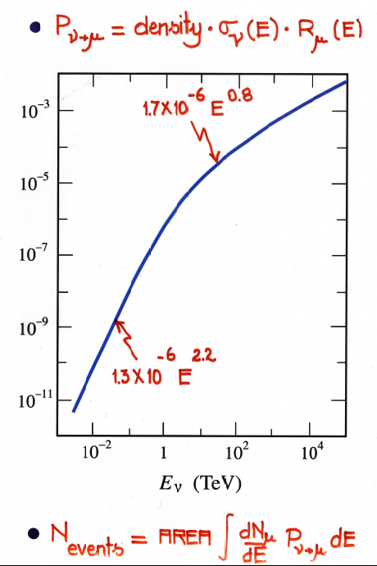

Slide 10
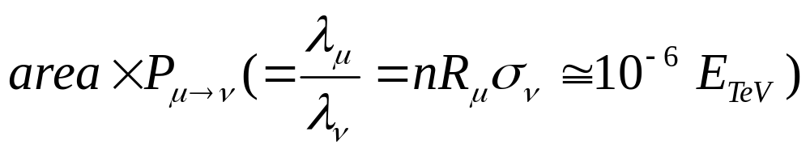
effective telescope area at 100 TeV
AMANDA ~ ANTARES ~ (1- 5) m²
IceCube 22 strings 30 m²
IceCube 80 strings 100 m²

Slide 11
definitions

Slide 12
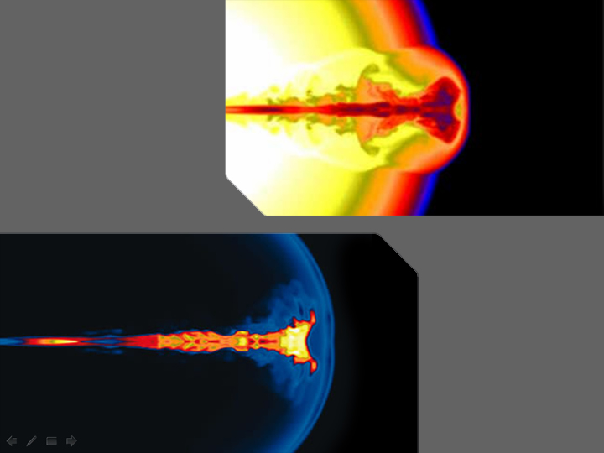
collapse of massive
star produces a
gamma ray
burst
spinning black hole
shocks produced
in the outflow of
the spinning
black hole:
electrons (and
protons ?)

Slide 13
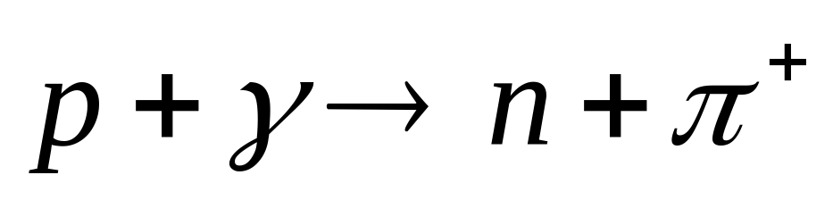
neutrinos and neutrons are
produced in the
interactions of
fireball protons
(trapped in the magnetic field)
with synchrotron
photons
decays to a PeV neutrino
decays to cosmic ray
GRB: one neutrino per cosmic ray observed
ruled out by IceCube

Slide 14
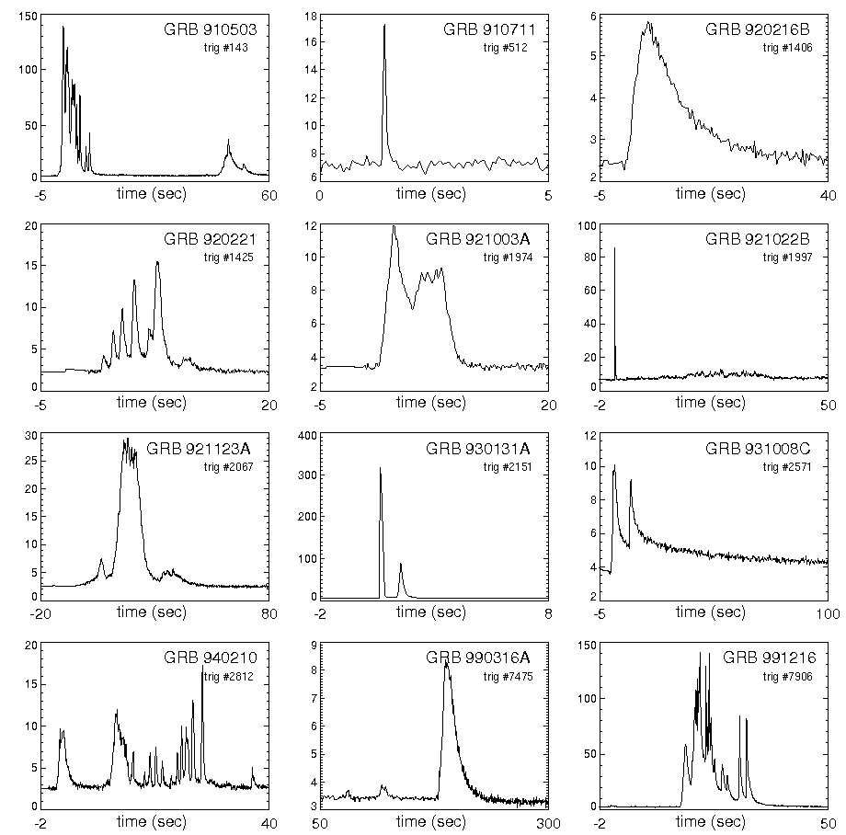
speed of light
size of grb ?
characteristic
time Δt ?
1-10 msec
(not duration!)
size of the
accelerator
ΔR < c Δt
~ 100 km

Slide 15
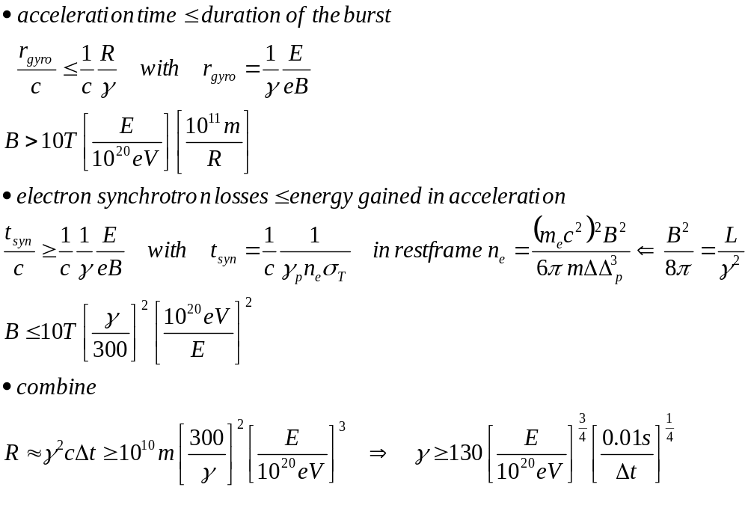
GRB: γ =300 → 10²⁰eV

Slide 16
fireball
fireball frame
at t=0
observer frame at time t
ΔR
R(t)
1 MeV
10 msec
γ ~ 10² - 10³
E = γ E'
R = γ⁻² R'
R₀ = R(t=0) = ΔR = c Δt

Slide 17
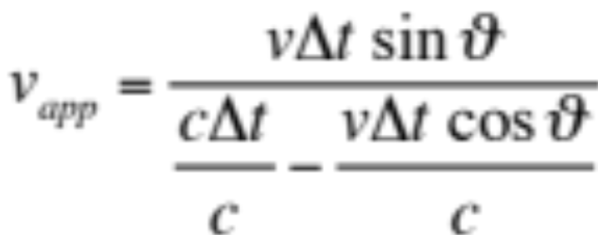
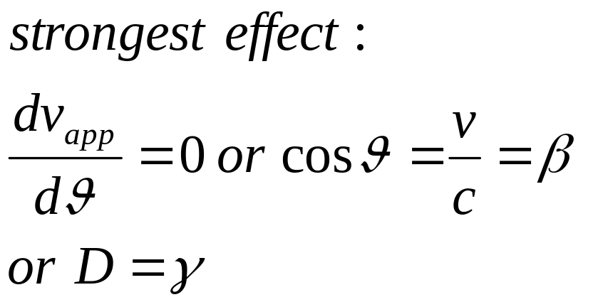
superluminal motion: boosted accelerators
E_{obs} = γ E'
Δt_{obs} = γ⁻¹ Δt'
θ
cΔt
vΔt
γ
v_{app}
β = v/c γ = (1-β²)^{-1/2}
D⁻¹= (1+z) (1 - β cosθ) γ
Notes:
17

Slide 18
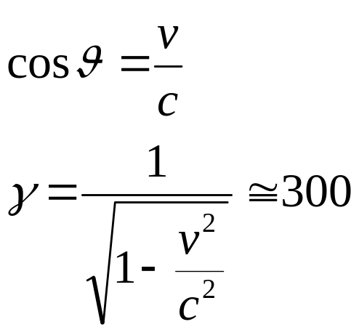

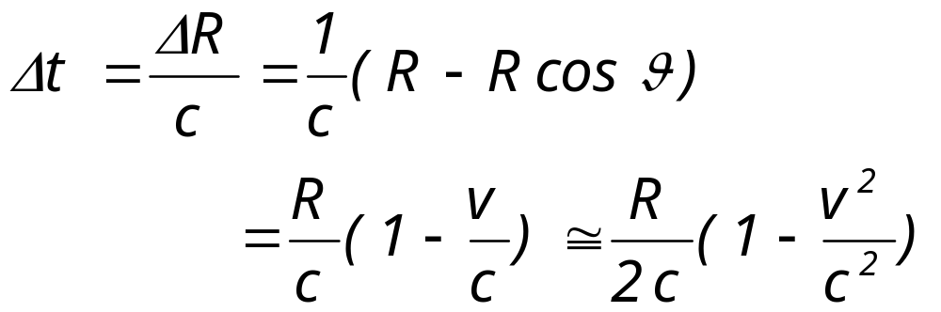
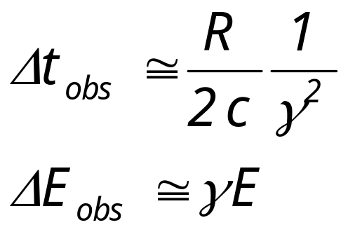
grb kinematics
expanding shell
R
θ
v
θ
c

Slide 19
photon density in the fireball
L_{γ}Δt/γ
______
4πR'²ΔR'
U'_{γ}
___
E'_{γ}
n_{γ} = =
E_{γ}
___
γ
R' = γ²cΔt
ΔR' = γcΔt
note: for γ = 1 (no fireball) the optical depth of photons in the fireball is →
τ_{opt} = = R₀n_{γ}σ_{Th} ~ 10¹⁵ for 10⁵² erg in R₀~10 km
R₀
__
λ_{Th}

Slide 20
pion (neutrino) production when
protons and photons coexist
pγ nπ⁺
neutrinos
pπ⁰
gamma rays
(challenging!)
E'_{p} >
m²_{Δ} - m²_{p}
_________
4E'_{γ}
E_{p} > 1.4 x 10⁴ TeV
~
_
~
_
E_{ν} = 1/4 < x_{p π} > E_{p} 1/20 E_{p} 700 TeV

Slide 21
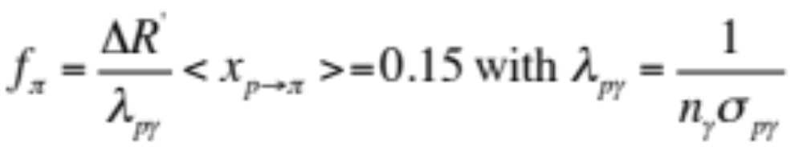
fraction of GRB energy converted into pion (neutrino) production
GRB4
e
γ (L_{γ})
GRB
synchrotron
p
pions
ν
(L_{CR})

Slide 22
numerology
L_{γ} = 10⁵¹--10⁵² erg/s
R₀ = 100 km (Δt = 1-10 msec)
E_{γ} = 1 MeV
= 300
dE/dt = (1-4)x10⁴⁴ erg Mpc⁻³yr⁻¹
t_{H} = 10¹⁰ years
P_{det} = 10⁻⁶ E_{ν}^{0.8} (in TeV)
σ_{pγ} = 10⁻²⁸ cm² for p+γ→n+π
x_{p → π} = f_{π} = 0.2

Slide 23
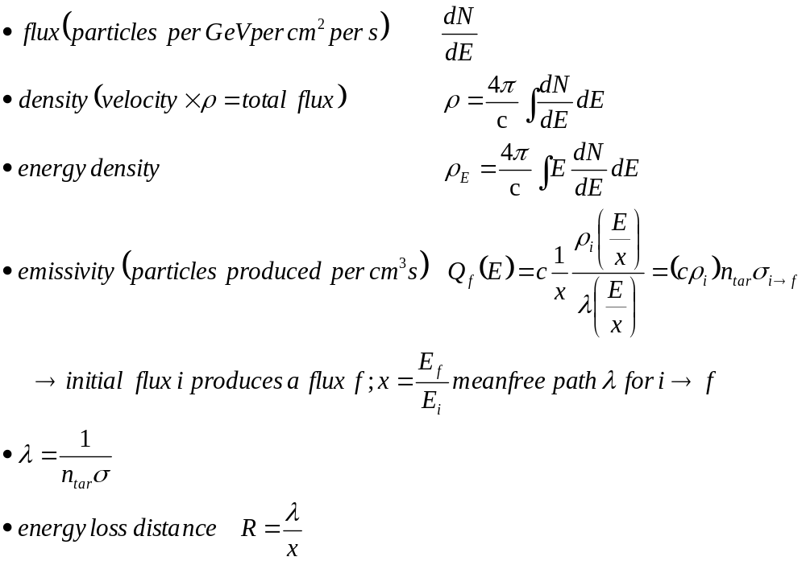
definitions

Slide 24
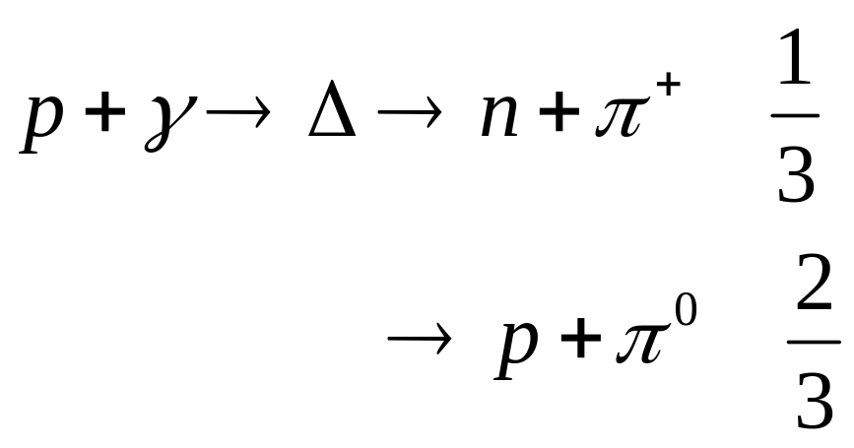
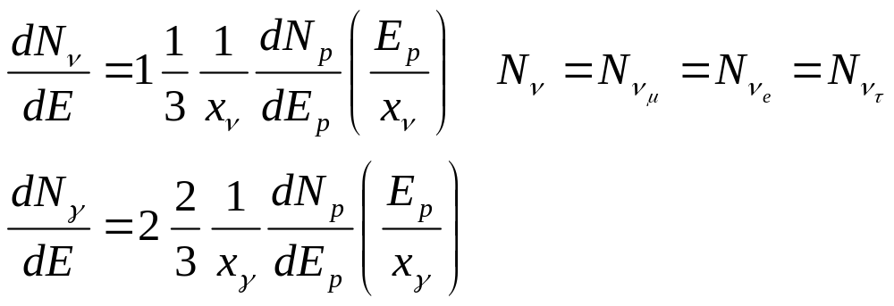
neutrinos from p + γ

Slide 25
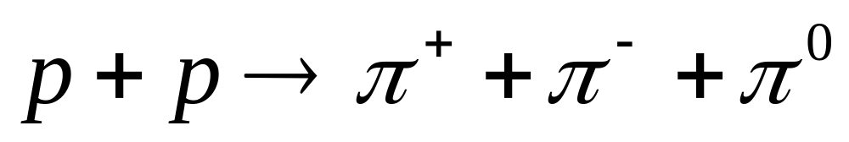
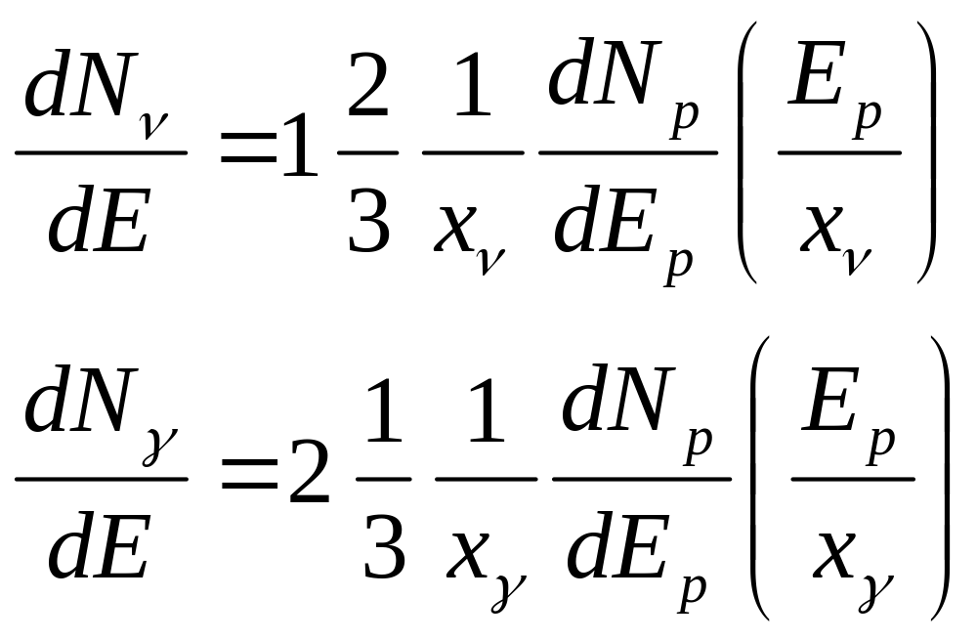

Slide 26
relation between pionic
gamma rays and neutrinos
robust

Slide 27
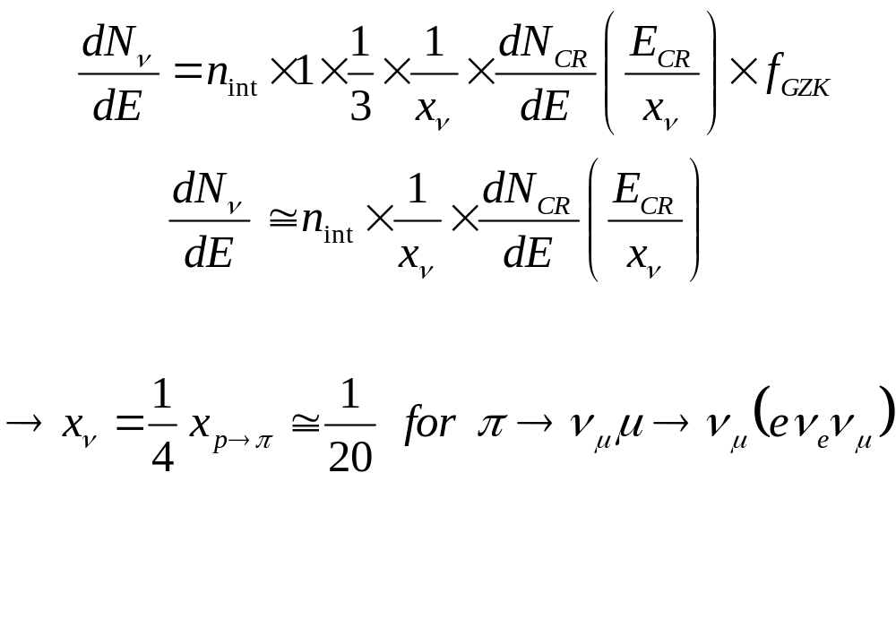
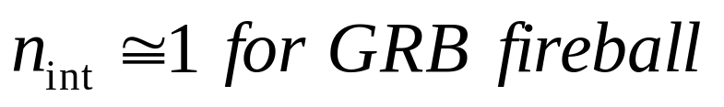
GRB neutrinos from p + γ → n + π⁺

Slide 28
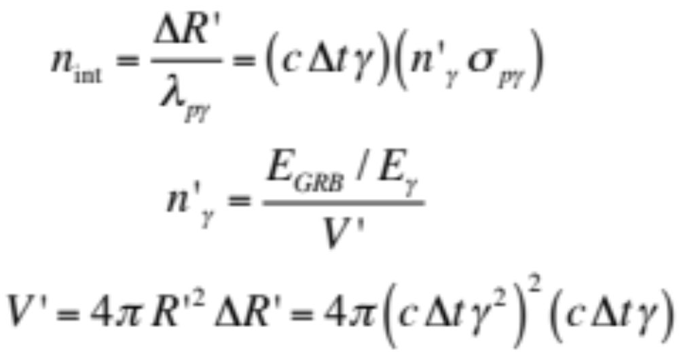
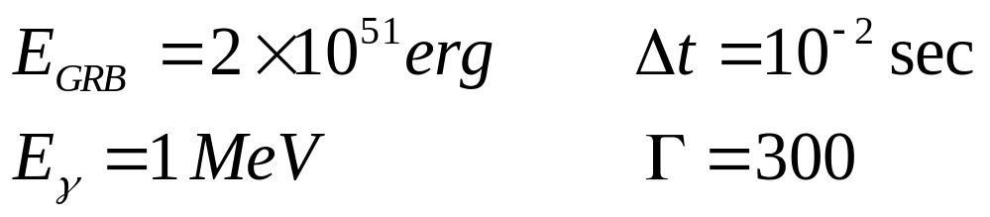
GRB neutrinos from p + γ → n + π⁺
ΔR
R

Slide 29
we here assumed that each proton interacts once;
i.e. one neutron and one charge pion produced
by every observed cosmic ray
number of times n_{int} the cosmic rays interact in the
source depends on the optical depth:
λ_{int} = [ σ_{pγ} n_{γ} ] ⁻¹
their estimate for GRB pγ optical depth is
n_{int} = ( γ cΔt ) / λ_{int} ~ 1
If the protons are trapped in the accelerator, neutrons
escape to decay into the observed cosmic rays. This
increases the neutrino and photon fluxes by a factor of 6.

Slide 30
we here assumed that each proton interacts once;
i.e. one neutron and one charge pion produced
by every observed cosmic ray
number of times n_{int} the cosmic rays interact in the
source depends on the optical depth:
λ_{int} = [ σ_{pγ} n_{γ} ] ⁻¹
the source flux is in general
Φ_{ν} = n_{int} x x_{ν} x Φ_{cr}
Waxman-Bahcall bound: n_{int} < 1 because σ_{γγ} at TeV
~ σ_{pγ} at EeV -- WB used x_{p→π} = 1 and called is a limit

Slide 31
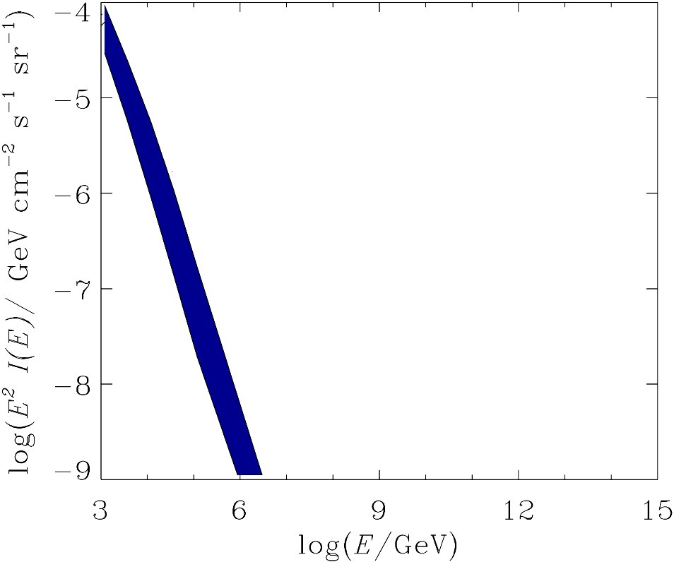
neutrinos associated with extragalactic cosmic rays
atmospheric
neutrino flux
IceCube-40
anticipated
AMANDA
CR flux
GRB
IceCube

Slide 32
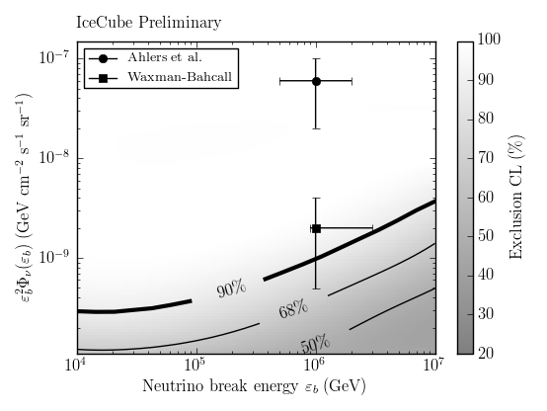

Slide 33

origin of galactic cosmic rays
supernova remnants: still no conclusive evidence
free propagation
confined
to accelerator
CR
γ
Target
near accelerator
VHE gamma rays from secondary interactions:
p: πº production and decay
e: Inverse Compton scattering and bremsstrahlung
trace beam density x target density

Slide 34

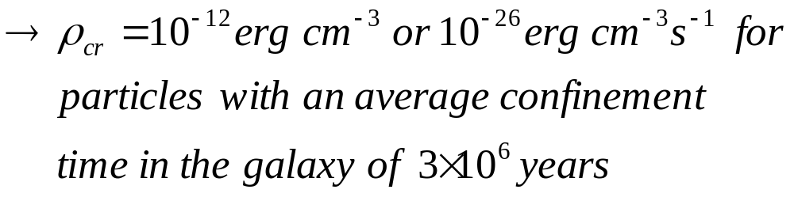
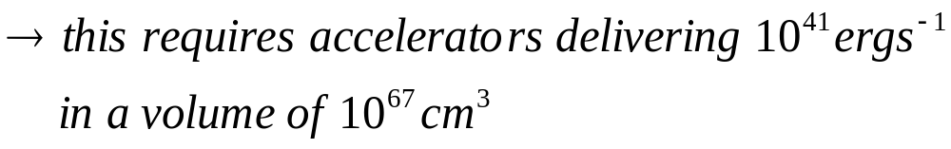
Steady state cosmic ray flux in the Galaxy
1 solar mass (10⁵³ erg) x 0.01 (lost to ν’s) x 0.1 efficiency

Slide 35

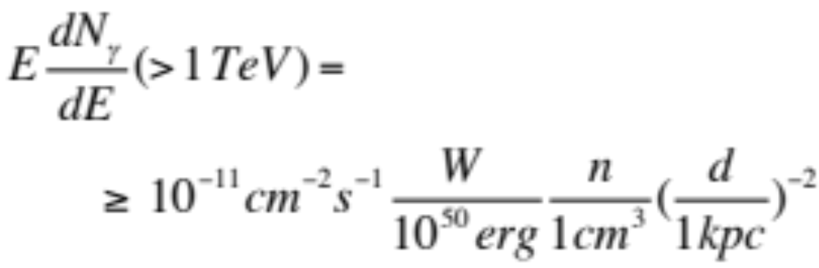
γ, ν flux of galactic cosmic rays
a SNR at d = 1 kpc transferring W = 10⁵⁰ erg to cosmic
rays interacting with interstellar gas (or molecular clouds) with density n > 1 cm⁻³ produces a gamma-ray flux of
should be observed by present
TeV gamma-ray telescopes
Milagro sources ?
RX J1713.7-3946?

Slide 36
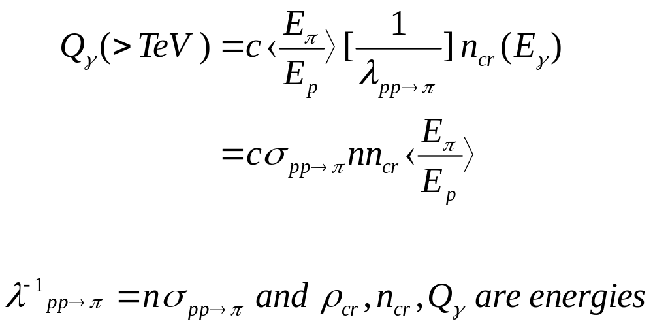
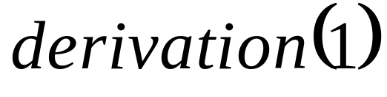
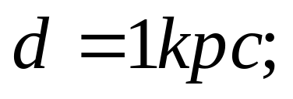
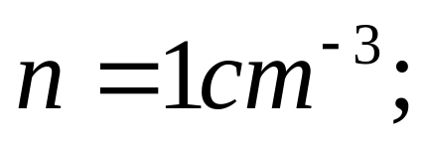
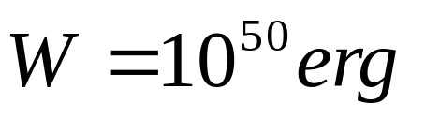
emissivity (TeV per cm³ per second) in photons produced by cosmic rays interacting with a
target density n per cm³ per second

Slide 37
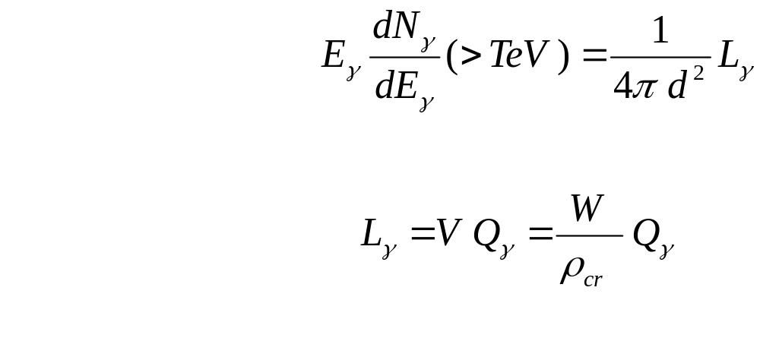
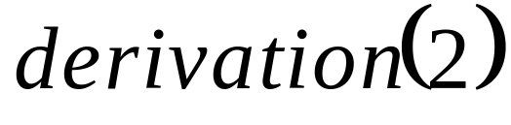
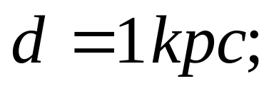

volume of the remnant
energy in >TeV photons produced by cosmic rays per cm³ per sec

Slide 38
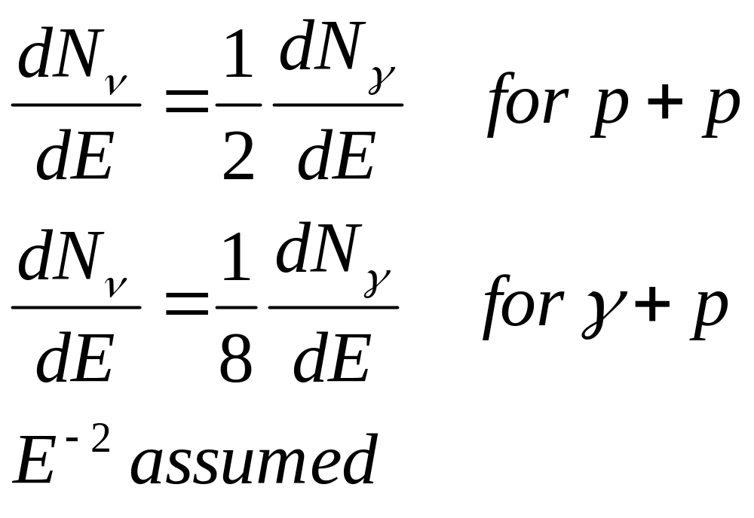
relation between pionic
gamma rays and neutrinos
robust

Slide 39
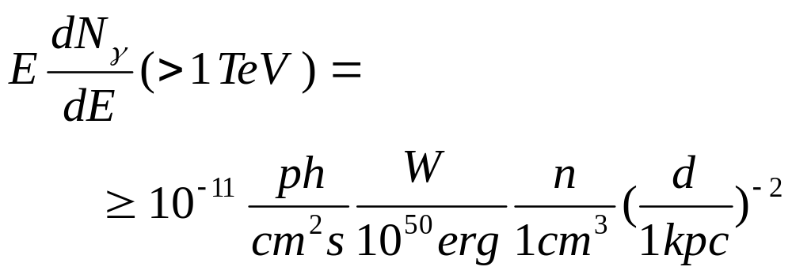
γ, ν flux of galactic cosmic rays
a SNR at d = 1 kpc transferring W = 10⁵⁰ erg to cosmic
rays interacting with interstellar gas (or molecular clouds) with density n > 1 cm⁻³ produces a gamma-ray flux of
should be observed by present
TeV gamma-ray telescopes
Milagro sources ?
RX J1713.7-3946?

Slide 40

neutral pions
are observed as
gamma rays
charged pions
are observed as
neutrinos
π⁰
π⁺
π⁻
γ
γ
ν_{μ} μ⁺
ν μ⁻
e⁺ e⁻
e⁺
γ
e⁻
μ⁺
e⁺
γ
e⁺
ν_{e}
ν_{μ}
Notes:
40

Slide 41



^{ν flux accompanying TeV gammas}

Slide 42


^{ν flux accompanying TeV gammas}

Slide 43


cygnus region : Milagro
Milagro
translation of
TeV gamma rays
into
TeV neutrinos
3 ± 1 ν per year in IceCube per source

Slide 44

you have one guess: starburst galaxies ?
astro-ph/0601695

