Slide 1
Status of JSNS²
(J-PARC Sterile Neutrino Search at
J-PARC Spallation Neutron Source)
Takasumi Maruyama (KEK) for the JSNS² collaboration

Slide 2
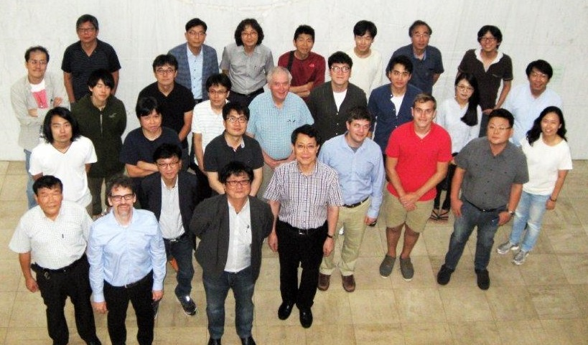




JSNS² collaboration
JAEA
KEK
Kitasato
Kyoto
Osaka
Tohoku
Soongsil
Dongshin
GIST
Seoyeong
Chonnam Nati’
Seoul Nati’
Chonbuk Nat’
Kyungpook
Sungkyunkwan
Seoul Nat’ of
sci and tech
Alabama
BNL
Florida
Michigan
Sussex
21 institutions
54 members

Slide 3
indication of the sterile neutrino (Δm²~1eV²) ?
Anomalies, which cannot be explained by standard neutrino oscillations for ~20 years are shown;
Excess or deficit does really exist?
The new oscillation between active and inactive (sterile) neutrinos?
Experiments | Neutrino source | signal | significance | E(MeV),L(m)
LSND | μ Decay-At-Rest | ν_{μ} → ν_{e} | 3.8σ | 40,30
MiniBooNE | π Decay-In-Flight | ν_{μ} → ν_{e} | 3.4σ | 800,600
 |  | ν_{μ} → ν_{e} | 2.8σ
 |  | combined | 3.8σ
Ga (calibration) | e capture | ν_{e} → ν_{x} | 2.7σ | <3,10
Reactors | Beta decay | ν_{e} → ν_{x} | 3.0σ | 3,10-100
Now it is time to
recheck LSND
results directly

Slide 4
Appearance
c
1998
600μs 120Hz
target+beam stop
configuration
DIF, n bkg.
π → μ + νμ
μ→ e + νe + νμ
νe
π⁻, μ⁻ absorbed before decay into ν’s
there should not be νe at the level of 7x10⁻⁴
Signal : νe p→e⁺n np→d γ(2.2MeV)
Notes:
600 micro-sec 120 Hz 10 micro-sec 50Hz
Signal : prompt + delayed gamma
Target – dump Decay in flight - detector in the forward direction
LINAC - fast neutrons with beam
no separation of pion decay at rest and muon decay

Slide 5
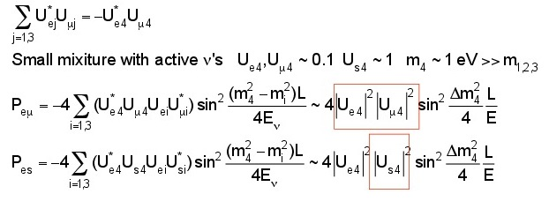
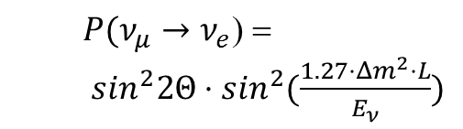
Neutrino oscillations with Δm²~1eV² region
Matrix elements,
which are considered
in 3x3 mixing
framework.
(3+1) model
Notes:
ニュートリノフロンティアの融合という意味では
ステライルの効果は LBL
ベータ、ダブルベータ cosmology PLANCK
mixingが無くても、cosmology では重力を通して影響 ただし、多くの仮定
質量、数は自由ーDM、CPV

Slide 6
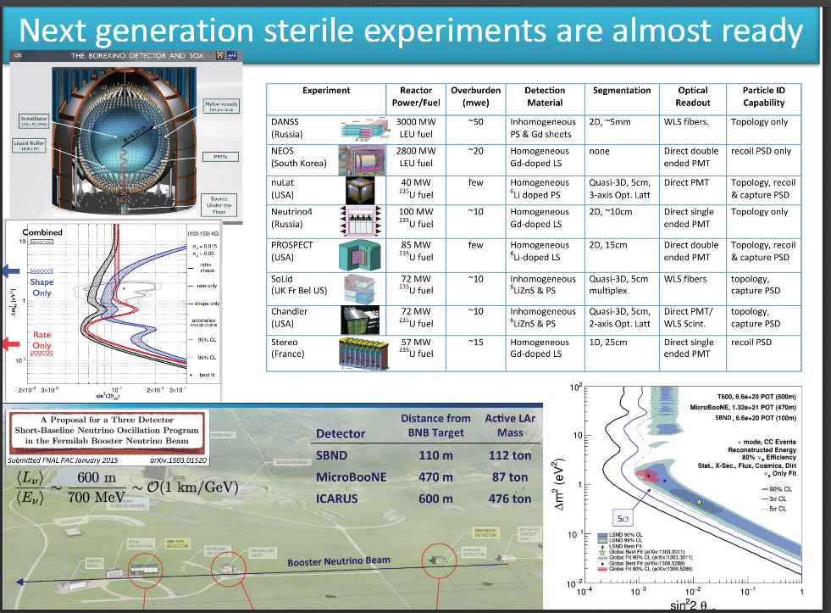
ν_{e} ◊ ν_{e}
ν_{e} ◊ ν_{e}
Mauro Mezzetto’s
(experimental summary)
talk in Neutrino2016
ν_{μ} ◊ ν_{e} (horn focused beam)

Slide 7
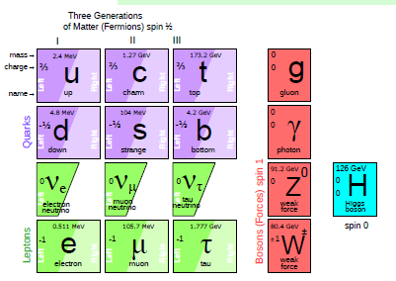
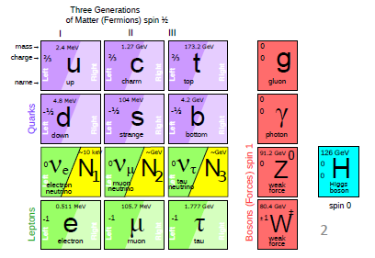
Steile: creates SeeSaw/Dark matter ?
HINT2016
Alain Blondel
Since 1998 it is established that neutrinos have mass
and this very probably implies new degrees of freedom
➔ «sterile», very small coupling to known particles
completely unknown masses (eV to ZeV), nearly impossile to find.
.... but could perhaps explain all: DM, BAU,ν-masses

Slide 8
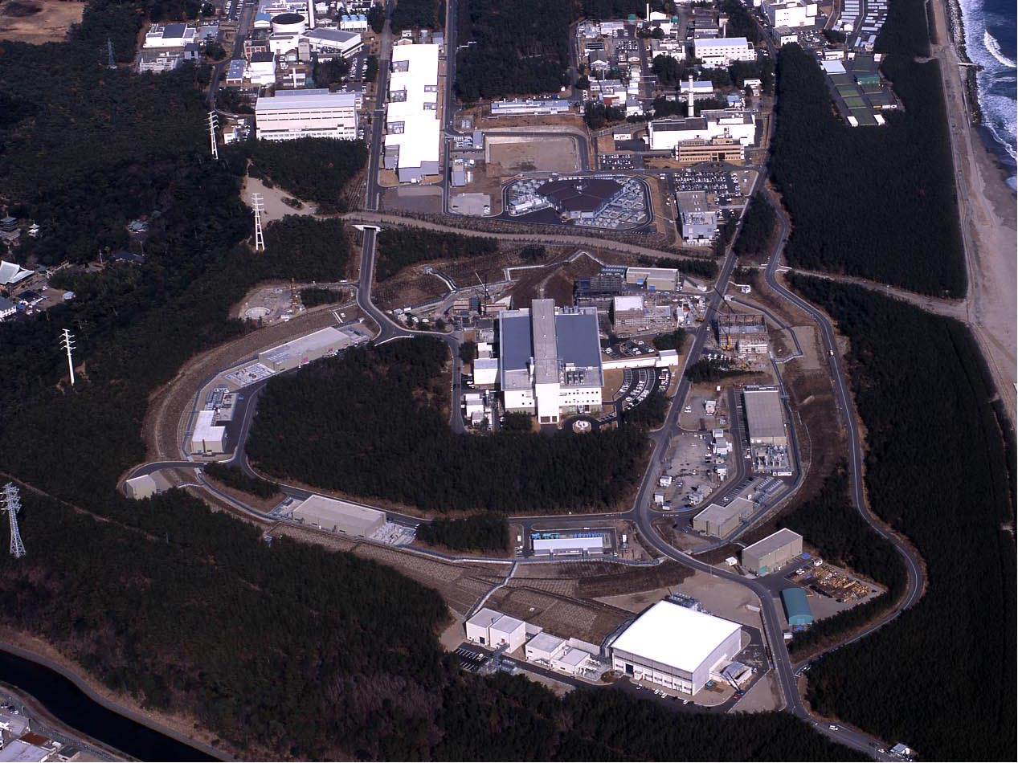
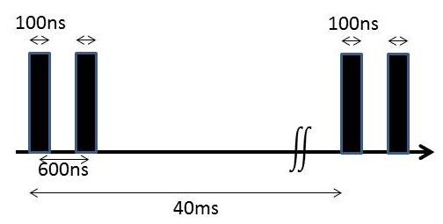
JSNS²: J-PARC E56
Sterile ν search
@MLF
http://research.kek.jp/group/mlfnu/eng
J-PARC Facility
(KEK/JAEA）
400MeV
South to North
3 GeV RCS
Neutrino Beams (to Kamioka)
25Hz, 1MW (design)
Materials and Life Science Experimental Facility (MLF)
30GeV MR
CY2007 Beams
Hadron hall
JFY2008 Beams
JFY2009 Beams
Bird’s eye photo in January of 2008
Notes:
この夏リナックupgrade

Slide 9
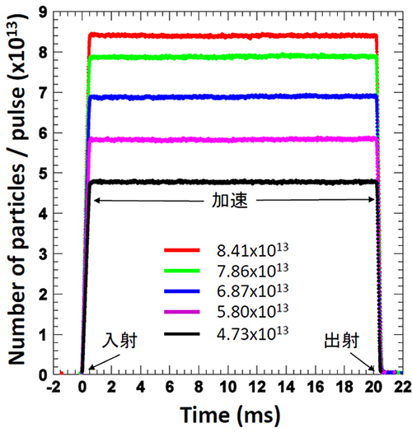
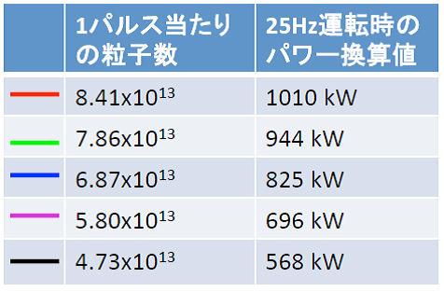
RCS/MLF beam
Current best beam power so far is 500kW.
1MW trial during the very short period was succeeded. (bottom plot) http://j-parc.jp/ja/topics/2015/Pulse150206.html
The mercury target had trouble in 2015, but a new mercury target which has small # of welding was installed in this summer.
Number of
Particles / pulse
Corresponding
Power in 25 Hz
acceleration
injection
extraction

Slide 10
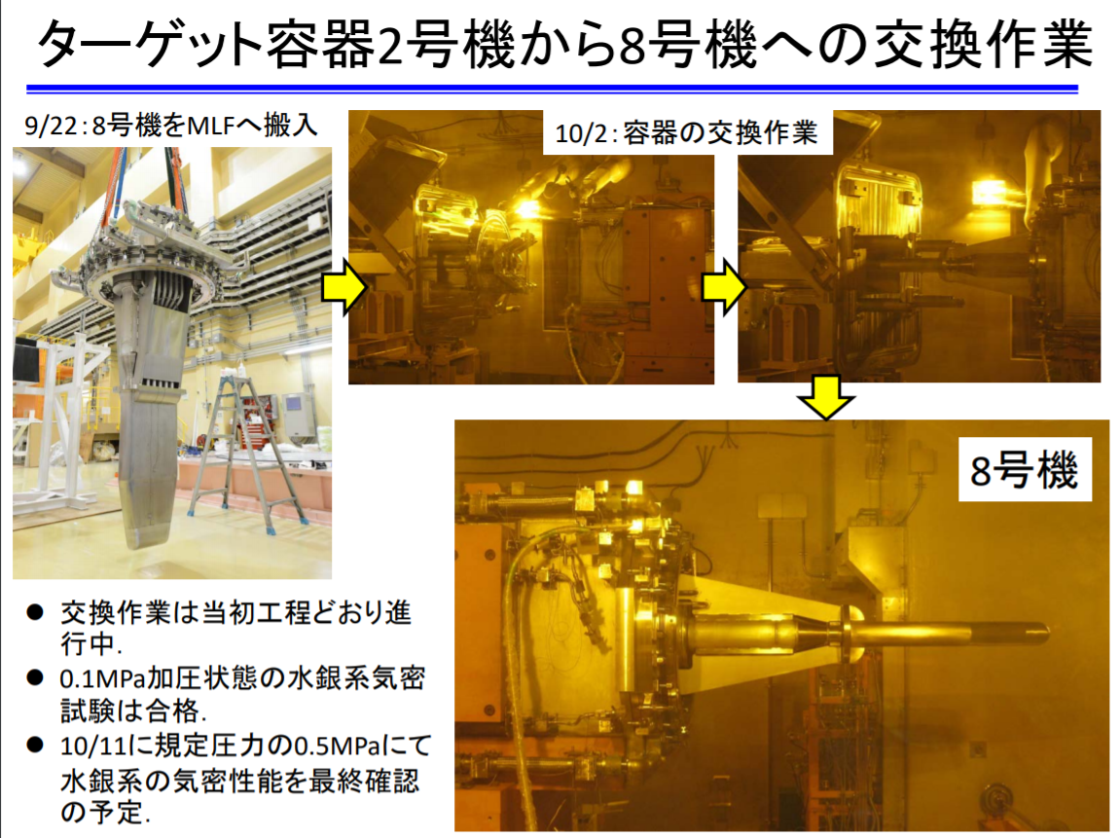
Mercury target / beam intensity plan
New mercury target (#8) is exchanged from old one (#2) on Oct-2.
This is the recovery from the trouble which is occurred in 2015 Fall. (small # of welding / bolt-buts scheme)
This #8 target is stood up to 700kW in principle.
Target #10 which stands up to (or more than 1MW due to no weldings) will be placed in near future.

Slide 11
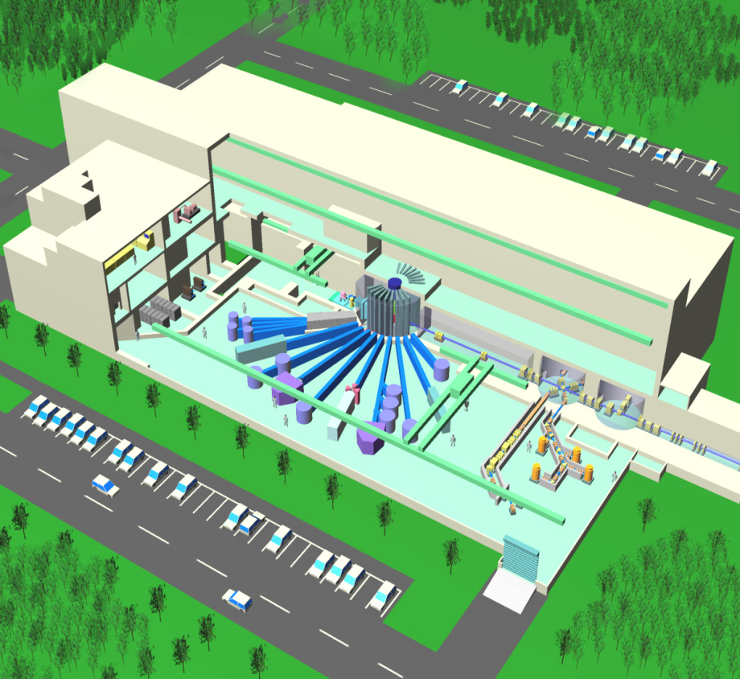
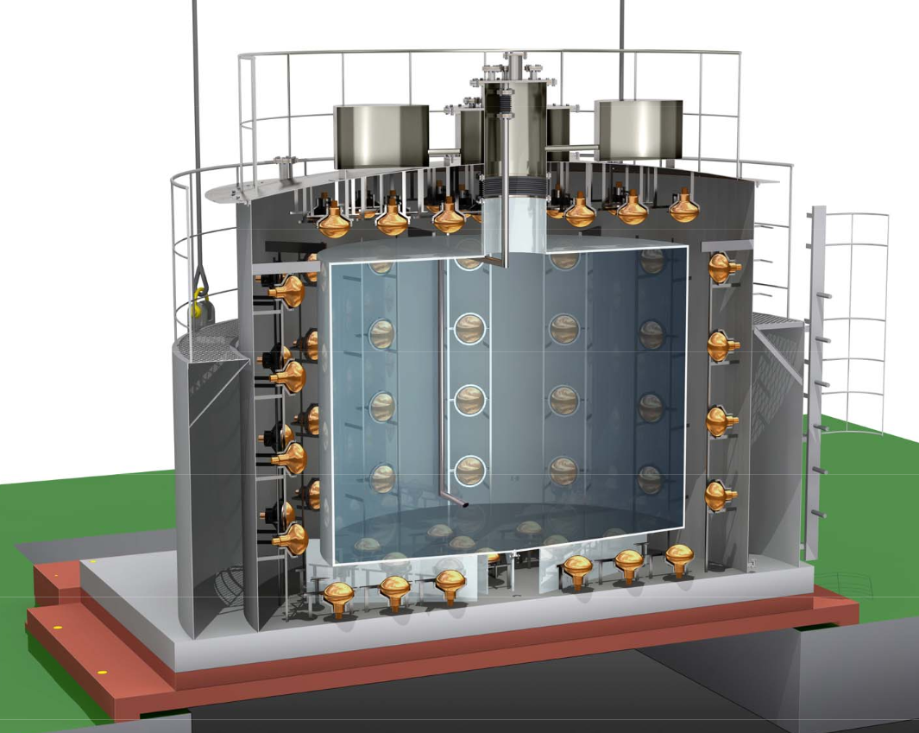
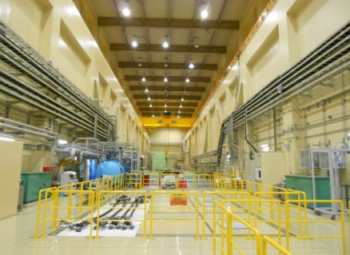
Sterile Neutrino Search at J-PARC MLF (JSNS²)
MLF building (bird’s view)
Detector @ 3rd floor
(24m from target)
Hg target = Neutron
and Neutrino source
17t Gd-loaded liquid scintillator / detector (total 50tons/detector)
(4.5m diameter x 4.0m height)
193PMTs
image
3GeV pulsed proton
beam
Searching for neutrino oscillation : ν_{μ} → ν_{e} with baseline of 24m.
no new beamline, no new buildings are needed → quick start-up

Slide 12
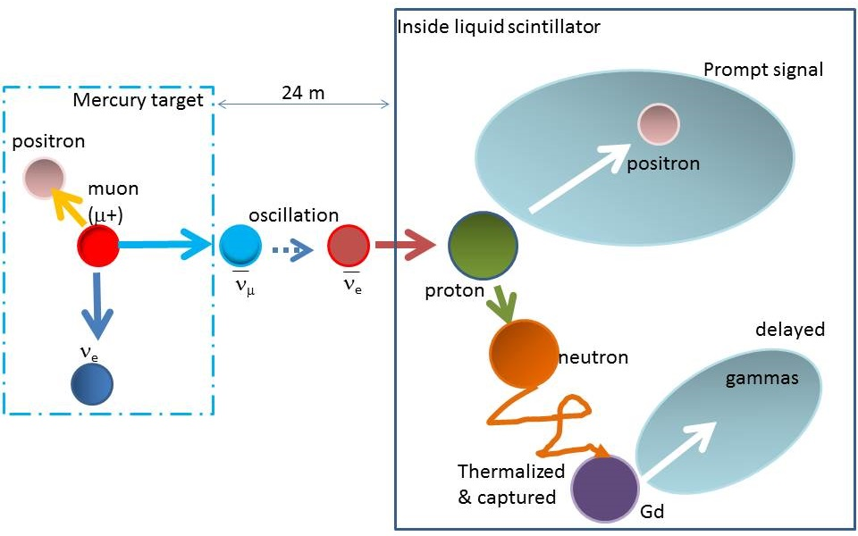
Production / Detection
Large amount of parent μ+ in Hg target → ν_{μ} are produced.
If sterile ν exist, ν_{μ} → ν_{e} oscillation is happened with 24m.
Oscillated ν_{e} is detected by Inverse Beta Decay (IBD): ν_{e} + p → e⁺ + n w/ well
established detector technique
(E resolution = 15%/sqrt(E))
Most of them
are same as
the LSND.
Direct ultimate
tests for LSND.
But we use much
better beam and
Gd loaded LS.
Much better
S/N
Much better
systematics
3GeV
pulsed
proton
beam
(Decay
-at-Rest)
Scintillation light
π⁺
IBD criteria | Timing | Energy
Prompt | 1<T_{p}<10μs | 20<E<60MeV
Delayed | T_{p}<T_{d}<100μs | 7<E<12MeV
<T>~30μs
Scintillation light
(~ 8MeV In total)

Slide 13
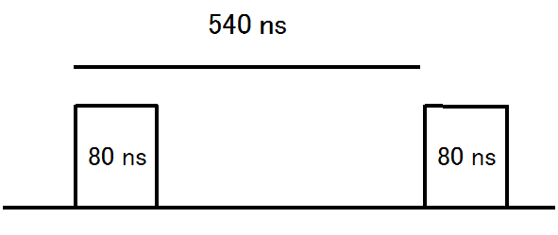
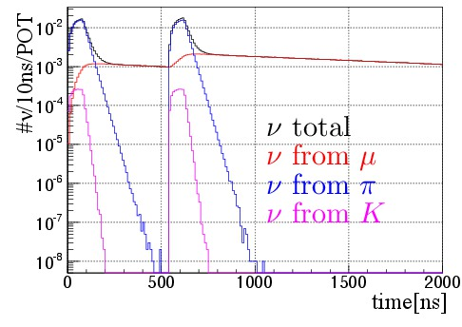
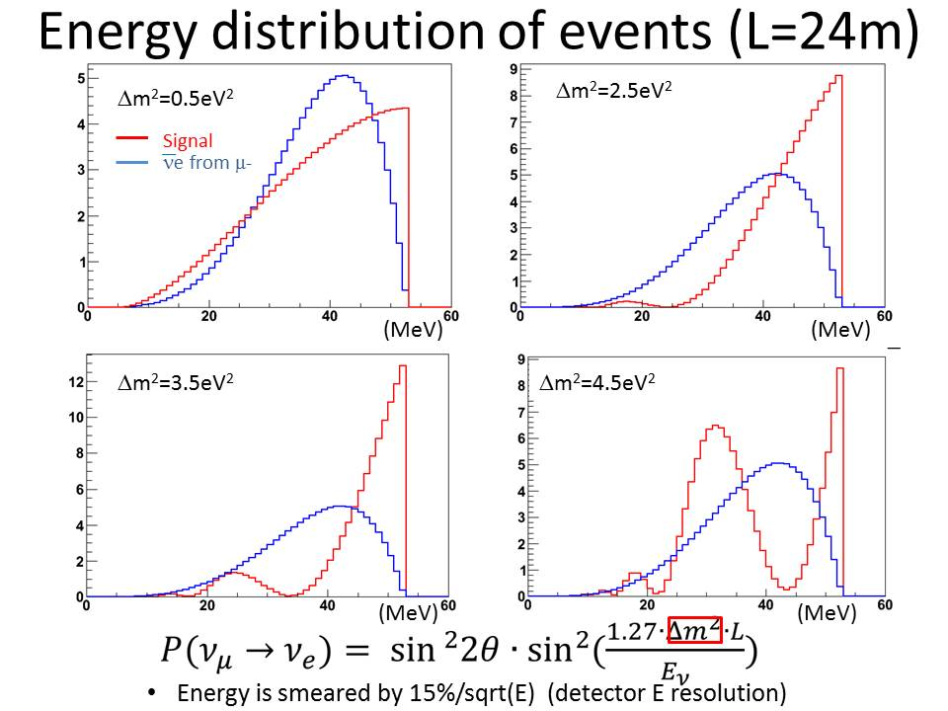
Timing and Energy
M. Harada et al, arXiv:1310.1437
Next beam is 40ms later
p timing
Selecting muon decay
(ε~74%)
Timing and Energy are good friends of JSNS²
Timing: Ultra-pure ν from μ⁺ Decay-at-Rest
  ν from π and K -> removed with timing
  Beam Fast neutrons -> removed w/ time
  Cosmic ray BKG -> reduced by 9μs time window.
Energy: signals / BKG separation by energy.
  ν from μ has well-known spectrum.
  Energy reconstruction is very easy at the IBD. (Eν ~ Evis + 0.8MeV)
  ν from μ- is high suppressed.

Slide 14
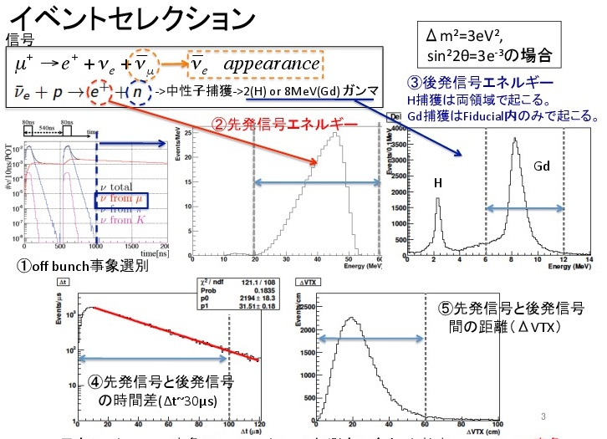
IBD event selection
case
n capture
3. Delayed gamma E cut
2; Prompt signal E cut
4. Distance cut between prompt vertex and delayed vertex
4. Δt cut between prompt and delayed
(~30μs lifetime for n )
Selection ε
~ 38%

Slide 15
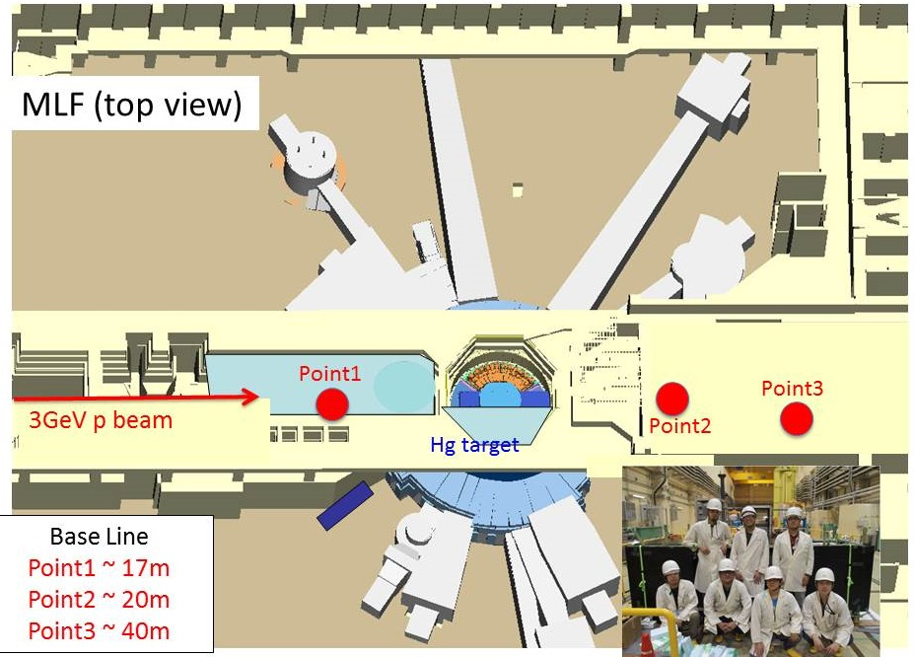
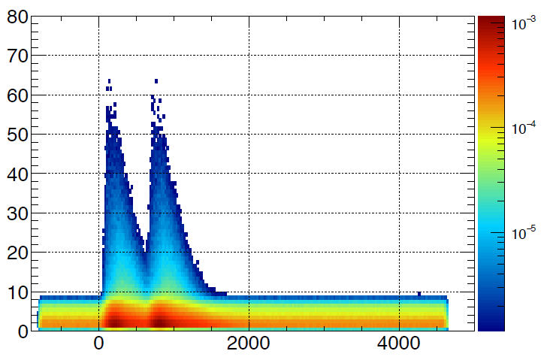
Achievements so far
2013 Sep; A proposal was submitted to the J-PARC PAC
2014 Apr-Jul; We measured the BKG rate on 3rd floor. -> manageable beam /cosmic BKGs to perform JSNS² PTEP 2015 6, 063C01 / arXiv:1502.02255
2014-Dec; The result was reported to J-PARC PAC. → the stage-1 status was granted from J-PARC /KEK
The performance check of detector and safety discussions are being performed.
2016-June: The grant-in-aid was approved for one detector construction
2017-May: Technical Design Report was submitted to J-PARC PAC and arXiv (arXiv:1705.08629 [physics.ins-det] )
We aim to start JSNS² in JFY2018
2014BU1301 experiment (@MLF 3rd floor)
Proton beam
Signal region for
prompt signal
BKG ~ 0
Energy (MeV, vertical) vs timing (ns, horizontal)

Slide 16
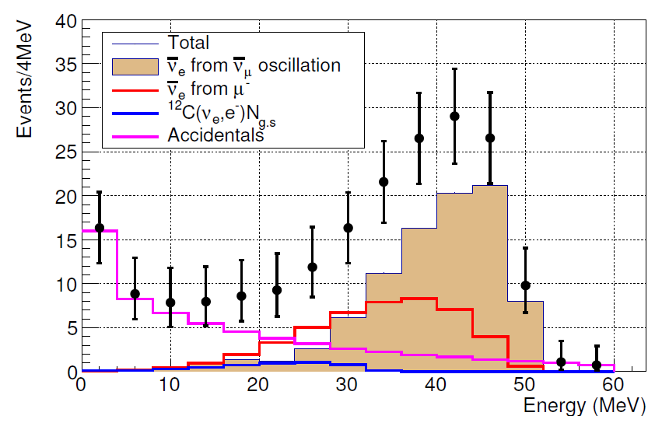
#events (1MW x 3 years x 1 detector (17tons))
Source | contents | #ev.(17tons x 3years) TDR | Reference : SR2014 (50tons x 5 years) | comments
background | ν_{e} from μ- | 43 | 237 | Dominant BKG
 | ¹²C(ν_{e},e-)¹²N_{g.s.} | 3 | 16
 | Beam fast neutrons | Consistent with 0 < 2 (90%CL UL) | <13 | Based on real data
 | Fast neutrons (cosmic) | ~0 | 37
 | Accidental | 20 | 32 | Based on real data
signal |  | 87 | 480 | Δm²=2.5, sin²2θ=0.003
 |  | 62 | 342 | Δm²=1.2, sin²2θ=0.003
Accidental BKG is calculated by;R acc = ΣR_{prompt} x ΣR_{delay} x Δ_{VTX} x N _{spill}
  ΣR_{prompt}, ΣR_{delay} are probability of accidental BKG for prompt and delayed.
  Δ_{VTX} ; BKG rejection factor of 50.
  N_{spill}(#spills / 5 years) = 1.9x10⁹
MLF best Δm²
(2.5eV²)

Slide 17
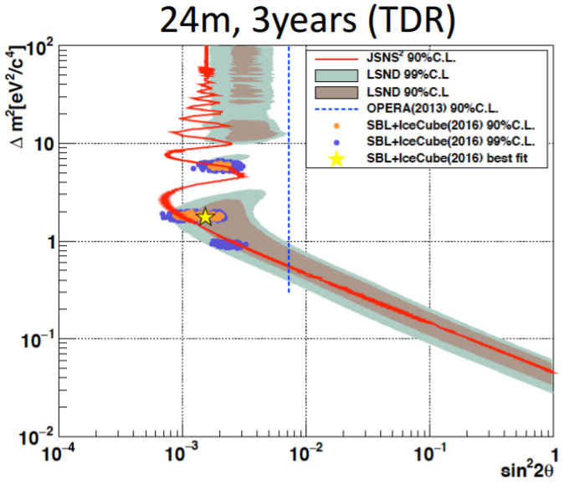
Sensitivity / Upgrade
To have a good international competition capability, we want to start the experiment with one detector (17tons fiducial volume).
Even with one detector, we have a good 90% C.L constraints for 3 years. Left plot
Meanwhile, we are making effort to obtain the budget to build the 2nd detector. (and enlarged acrylic tanks). This upgrade can make 5σ significance test for LSND region.
IceCube+SBL allowed (90%)
99% from arXiv 1607.00011v2
5 years x MW x 50 tons
3 years x MW x 17 tons

Slide 18
Schedule for 1st detector construction
 | JFY2017 |  |  |  |  |  | JFY2018
item | 10 | 11 | 12 | 1 | 2 | 3 | 4 | 5 | 6 | 7 | 8 | 9 | 10 | 11 | 12 | 1 | 2 | 3
Stainless tank
Acrylic tank
PMTs
GdLS/LS
installation
Dry Run
Filling
Data taking
SBN far detector (IACRUS) is now at FNAL.
Details will be shown in the next talk (by J.S.Park)

Slide 19
Approval Process (J-PARC PAC, etc)
Based on the TDR, J-PARC PAC discussed the feasibility of the JSNS² experiment. (TDR contents will be described by Jungsic)
J-PARC PAC has two stages of the approvals (stage-1 status: motivation of physics is recognized, and real approval (stage-2))
Lots of discussions are on-going to grant the stage-2:
  Safety issues at J-PARC MLF (including a big earthquake).
  Detector movement during the maintenance period (July-Oct). Note the 3rd floor is the maintenance space of the MLF
    We have to bring the detector to outside of MLF at that time to avoid the interference.
    Effects of quality of GdLS/LS degrade, PMT tilting during the movement were checked.
  Calibration (Michel e + Gd captured gammas + radio-active sources)
  Possible systematic uncertainties.
Revised TDR including these discussions will be submitted on the middle of Nov-2017, and contents will be discussed at the next PAC.

Slide 20
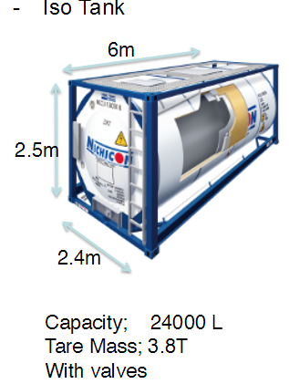


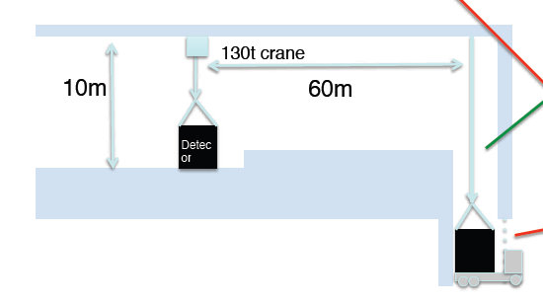


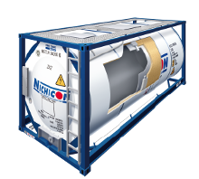
LS transportation / operation
Production
Grand
transportation
J-PARC
Grand
transportation
shipping
We will use iso-tank for the transportation and the storage.
Cost estimation to purchase iso-tanks and LS storage was already done.
LS operation / transportation in Japan
J-PARC
(HENDEL building?)
empty
detector
Storage Place
in company
Transportation
tank
Exp. site at MLF
Filling
Extracting

Slide 21
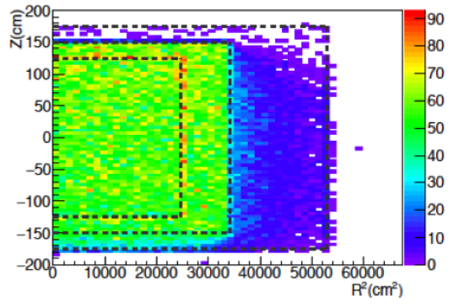
Michel e calibration
One of most important calibration sources is to use Michel electrons from stopped cosmic ray muons.
  Energy range / shape are almost same as interested samples finally.
MC simulation said O(a few 100) Hz of stopped muon events are available because our detector is over the ground.
  Good statistics to check the stability and position dependence of light yield.
  Pre-scale is needed.
Right plot shows the relative event rate of stopped muons vertex points. A rate in R²-Z is flat.

Slide 22
Beauty of JSNS²: Small systematic uncertainties
The systematic uncertainties of the JSNS²’s are small in principle.
  Uncertainties from energy spectrum.
    Energy spectrum of neutrinos from decay-at-rest muon is quite well understood. (gives negligible error)
    IBD cross section is also very well known. (both for energy dependence and for absolute number. → provides negligible uncertainties).
    Expected uncertainty on the detector energy scale is ~1% level because we have a good calibration sources including Michel e. (stability, position dependence, quenching effects are source of error)
  Uncertainties from normalization
    We fit the number of intrinsic νe bar background (profile fitting)
    Number of μ⁺ at the mercury target can be estimated by number of C12(ν_{e},e)Ngs reactions. → number of νμbar (before oscillation) can be known within 10%.
    Accidental background will be estimated by no beam data period.

Slide 23
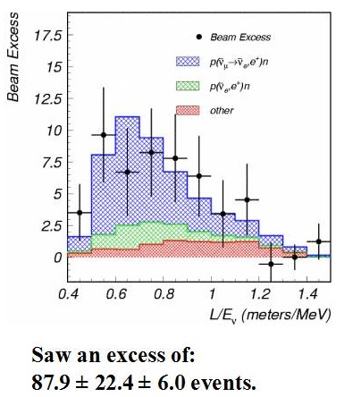
Pros compared to LSND
vs LSND; → direct test without any excuses (e.g.: ν type, Eν, detector target material) w/ better S/N
  Narrow pulsed beam at MLF → timing
    LSND has no beam timing cut (Linac → large duty factor)
    Pure muon decay at rest at MLF.
    No Decay-In-Flight source in MLF
    No beam fast neutrons BKG at MLF.
    Tighter timing window (~9μs) for
    cosmic ray rejection at MLF.
As mentioned before
  Detector has many improvements;
    Gd-LS improves S/N ratio at MLF → time window of coincidence (factor 6) and delayed Energy. (2.2 → 8MeV)
    Faster sampling rate of electronics and improved LS make PID easy at MLF.
vs KARMEN → JSNS² has more
intense ν flux by >10 times + Gd-LS

Slide 24
Complementarity
to reactor / radiation source experiments
  Disappearance measurement vs appearance (JSNS²)
to ν_{μ} disappearance
  Disappearance vs appearance
to FNAL SBN programs (LAr TPCs + horn focused beam)
  ν_{μ} → ν_{e} oscillation vs ν_{μ} → ν_{e} oscillation (JSNS²)
  JSNS² aims a complete test for the LSND anomaly with much better S/N and without any excuses.
  Intrinsic background rate is smaller and energy reconstruction is much cleaner. (Eν ~ Evis + 0.8MeV in IBD)

Slide 25
Other physics at JSNS²

Slide 26
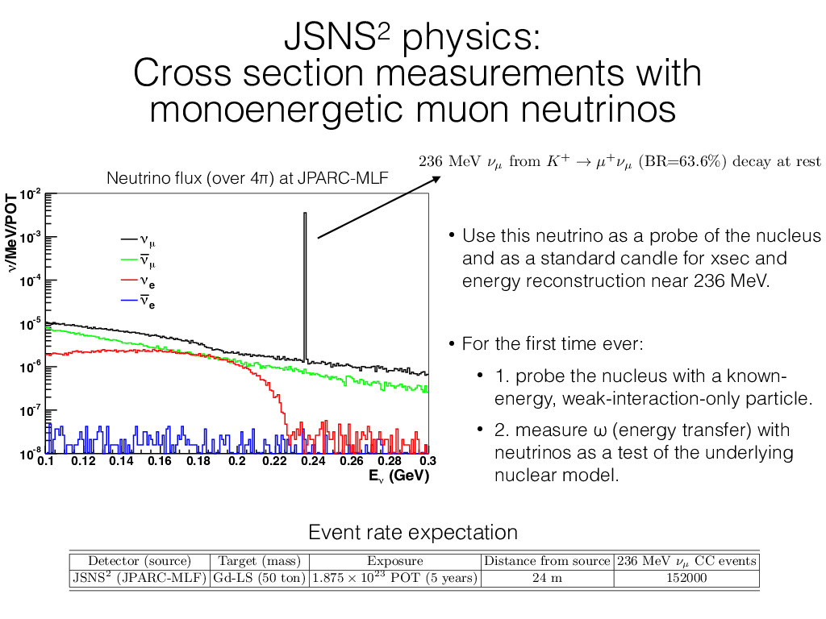

Slide 27
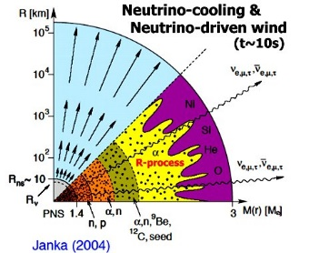
Neutrino-nucleus interaction in Type-II SN
ν-A interactions are important in
core-cooling by ν-emission
ν-heating on shock wave
ν-process of nucleosynthesis
efficiency of neutrino detectors
Reaction rates are to be known
with accuracy better than ~10%!
Experiment | σ(¹²C(ν_{e},e⁻)¹²N_{g.s.}) (10⁻⁴² cm²)
KARMEN (PLB332, 251 (1994)) | 9.1±0.5±0.8 (10.4%)
LSND (PRC64, 065501 (2001)) | 8.9±0.3±0.9 (10.7%)
JSNS² (arXiv:1601.01046) | (~3%(stat.) expected in 5yrs)

Slide 28
Summary
Sterile neutrino: One of most exciting topics in neutrino community (for 20 years!)
JSNS² stands at a good position to confirm or refute the existence:
  Direct test (w/o excuses) for the LSND results.
  MLF and their short pulsed beam gives the best environment.
  GdLS reduces the accidental background by order of magnitudes compared to the LSND.
At the end of JFY2018, we aim to start data taking.
Toward the data taking, the collaboration is making best effort on both approvals and construction.

