Slide 1
Spectral Decomposition of Missing Transverse Energy at Hadron Colliders
Tae Hyun Jung (IBS-CTPU)
arXiv : 1706.04512
In collaboration with Kyu Jung Bae and Myeonghun Park

Slide 2
Signals with Missing (Transverse) Energy at Colliders
Motivation : Once we see signals, we can extract many information of DM.
(e.g. mass, spin, interaction)
My talk is about how to extract those information of dark sector at hadron colliders.
DM Production mechanism at the early universe.

Slide 3
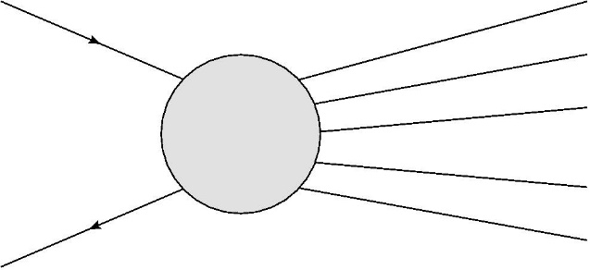
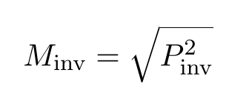
Strategy at linear colliders
At linear colliders, we know incoming momenta of electron and positron.
By momentum conservation, we can reconstruct invisible momentum and the invariant mass of invisible particles, event by event.
e⁻
visible
invisible
e⁺

Slide 4
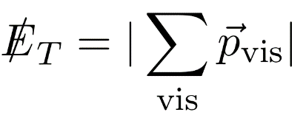
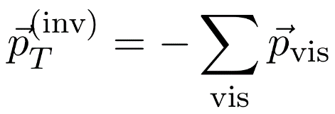
Hadron colliders
At linear collider, we know incoming momenta of electron and positron.
By momentum conservation, we can reconstruct the invisible momentum and the invariant mass of invisible particles, event by event.
q/g
visible
invisible
q’/g
At hadron colliders, we do not know incoming momenta of partons, event by event.
Instead, what we know is that transverse momentum is always zero.
Thus, the alternative variable is missing transverse energy.
T
T
Unfortunately, it is not an useful variable.

Slide 5
Hadron colliders
What we will see at hadron collider is…

Slide 6
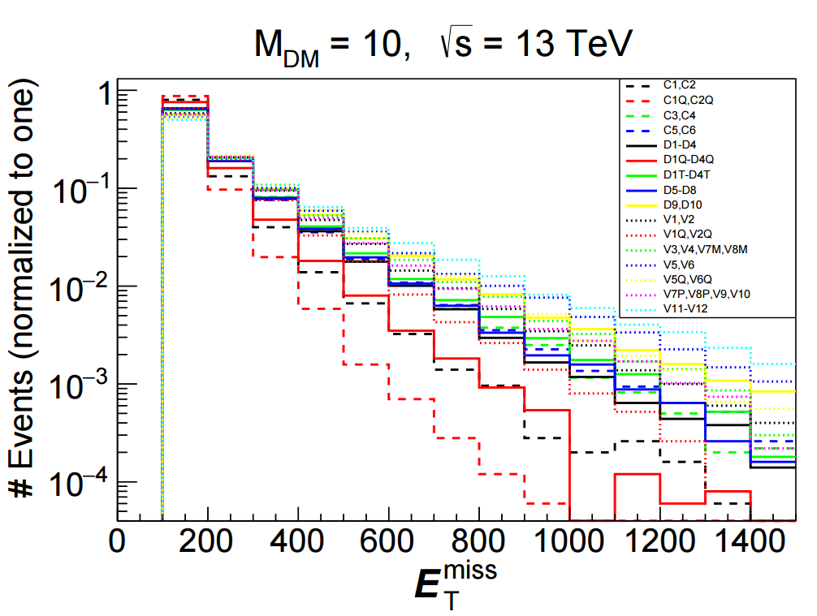
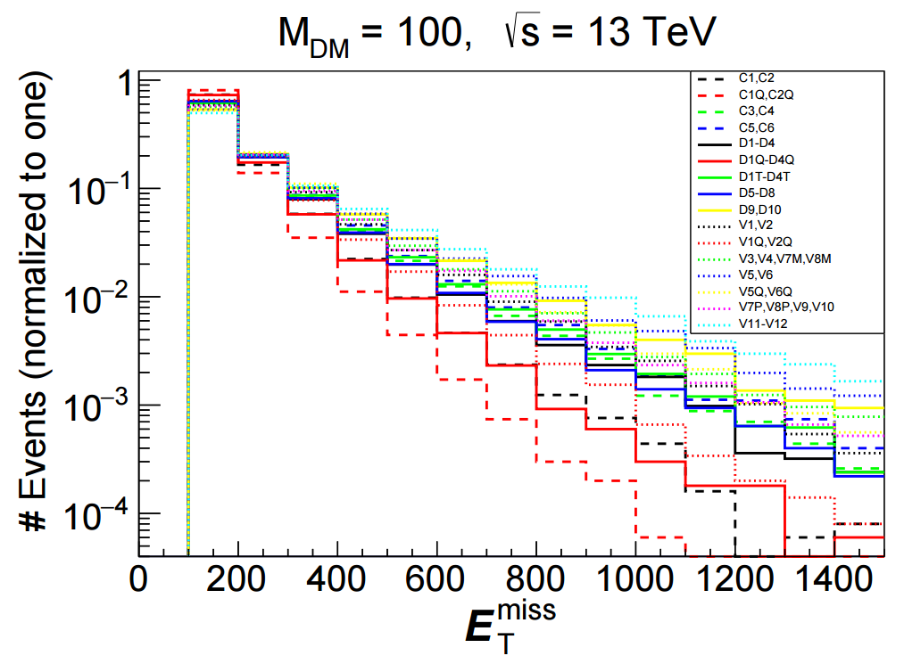
Hadron colliders
What we will see at hadron colliders is…
A. Belyaev, L. Panizzi, A. Pukhov, M. Thomas, arXiv:1610.07545

Slide 7
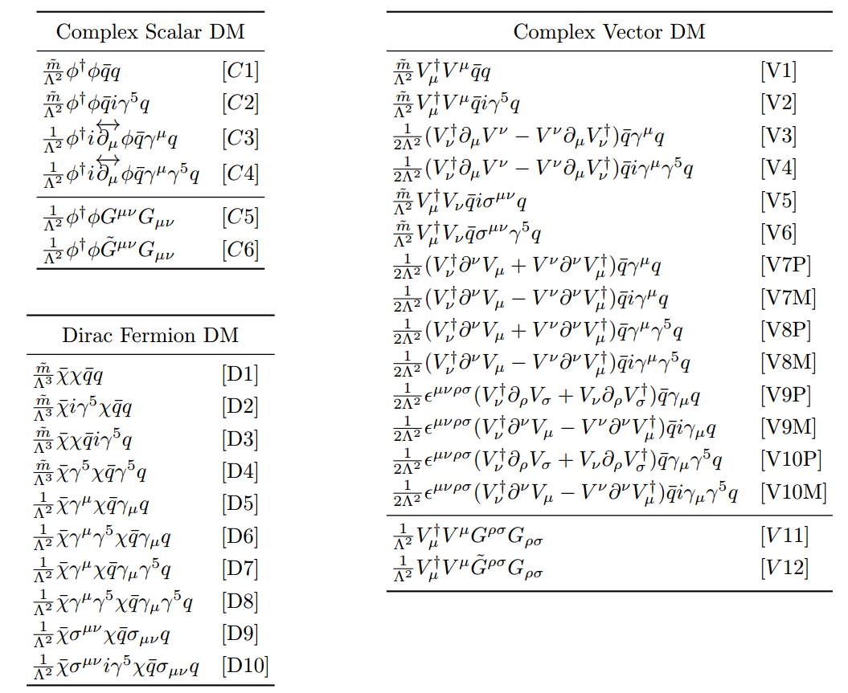
Hadron colliders
What we will see at hadron collider is…
A. Belyaev, L. Panizzi, A. Pukhov, M. Thomas, arXiv:1610.07545

Slide 8
Hadron colliders
What we will see at hadron collider is…
A. Belyaev, L. Panizzi, A. Pukhov, M. Thomas, arXiv:1610.07545
Usual method
We need to generate this kind of templates for every DM models with scanning DM mass parameters.
Then, find the model giving the best fitting.

Slide 9
Hadron colliders
What we will see at hadron collider is…
A. Belyaev, L. Panizzi, A. Pukhov, M. Thomas, arXiv:1610.07545
Usual method
We need to generate this kind of templates for every DM models with scanning DM mass parameters.
Then, find the model giving the best fitting.
This complexity of analysis is due to the lack of DM invariant mass reconstruction!!

Slide 10
Spectral Decomposition
as a method to extract DM invariant mass distribution at hadron colliders

Slide 11
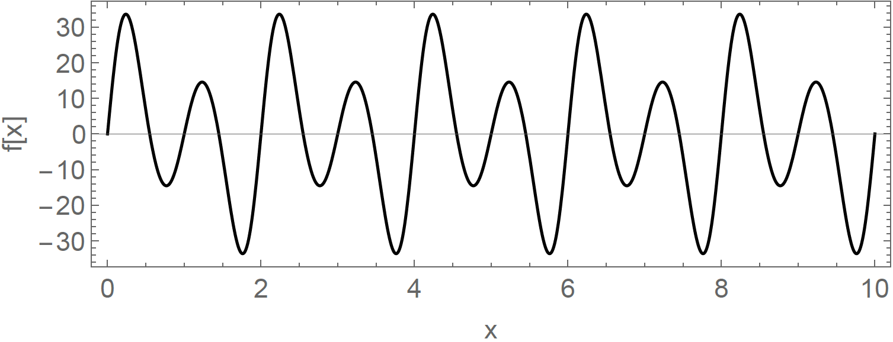
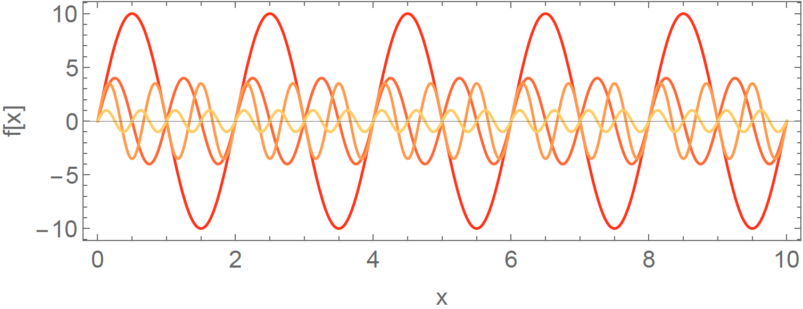
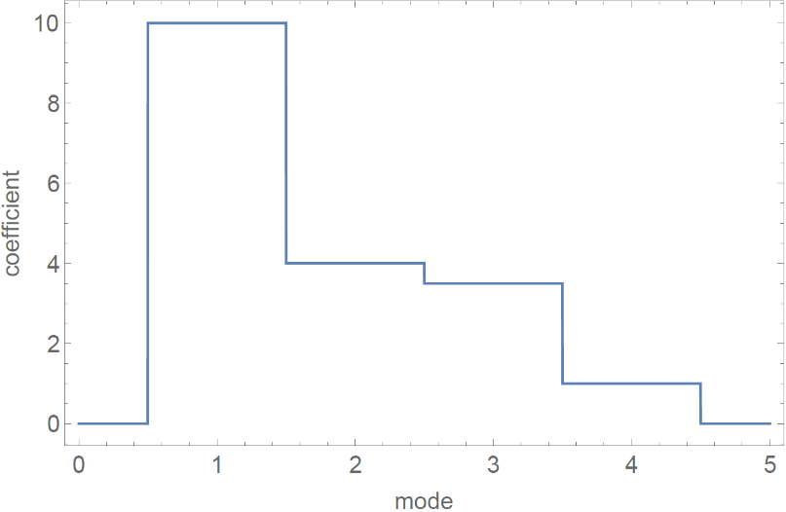
Spectral Decomposition
Fourier transformation is a good example of spectral decomposition.
Basis functions : sin(nπx/L) w/ n= integer
Coefficients : amplitude of each mode

Slide 12
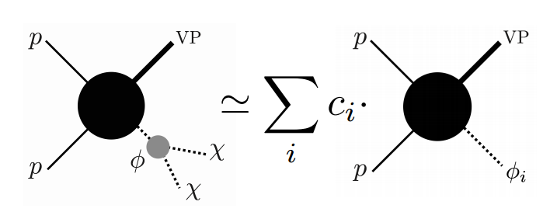
Spectral Decomposition
cf. Fourier transformation
X is a set of collider observable (e.g., MET, pT of lepton, jet or photon, rapidity, etc.).
Physical mediator with mass
Virtual Mediator with fixed mass
Specific values of { } will be given by hand.
(e.g. {100 GeV, 200 GeV, 300 GeV, …})

Slide 13
Spectral Decomposition
By using the data (from experiment) and basis functions (from calculation), we obtain coefficients by minimizing chi square,
where are binned basis functions for a given integrated luminosity L
Then, what is the physical meaning of coefficients?

Slide 14
Physical meaning of is the DM invariant mass distribution.
I will skip the proof.

Slide 15
Or equivalently, can be related to Kallen-Lehmann spectral density.
Theoretically, the spectral density can be calculated by
There are some merits when we use the spectral density :
Universality in the sense that it does not change whatever X is taken, whatever their cuts are taken. And it does not change even when we go to the detector level calculation from parton level.
Easy to characterize dark sector.

Slide 16
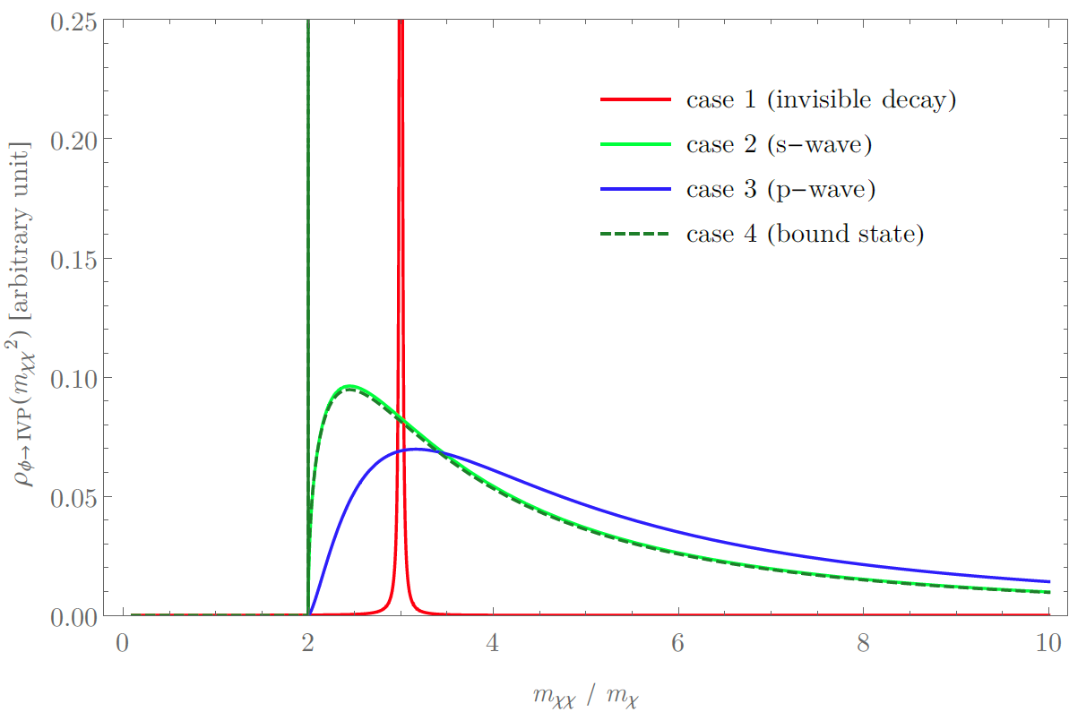
Spectral Density (characterization)
 | Mediator | Interaction
Case 1 | On-shell( ) | Resonance
Case 2 | Off-shell( ) | S-wave
Case 3 | Off-shell( ) | P-wave
Case 4 | Off-shell( ) | S-wave + bound state (long range force)

Slide 17
Summary of our method
Let us consider DM model whose Lagrangian can be written as
Then, our method can be described by three steps:
Fix and calculate basis functions.
Obtain coefficients by fitting the signal (from experiment).
Find that matches with obtained in step 2.

Slide 18
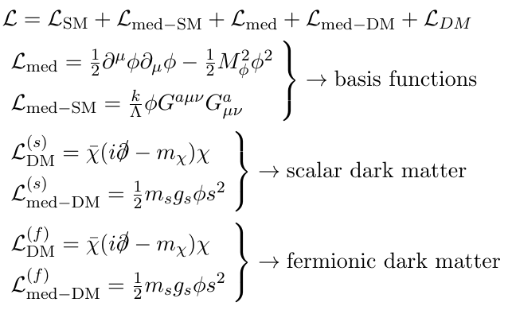
Numerical Example
(Mono-jet channel w/ Simplified Model)
Simplified DM model
(i.e. differential cross section of virtual mediator production)
: Information we will obtain from data

Slide 19
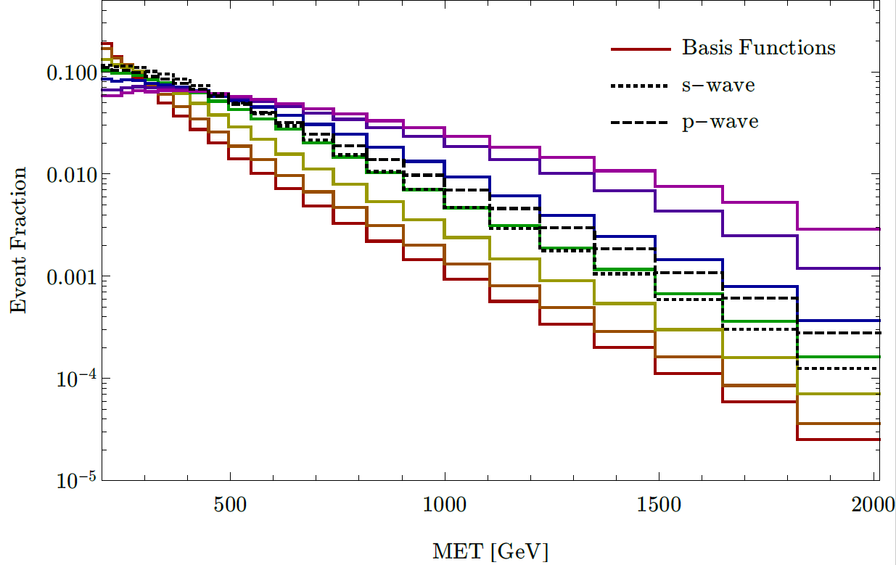
Example (step 1 : calculate basis functions)
Colored curves: basis functions (differential cross section of virtual mediator production)
Black dotted and dashed curves: examples of signal distribution
Choice of { ’s}={10, 200, 400, 700, 1100, 2000, 5000} GeV.

Slide 20
Example (step 2 : obtain coefficients by fitting)
DM mass= 200 GeV
Basis functions (shaded by gray colors) are piled up and they compose the signal distribution (dotted line).
Coefficients of the linear combination are obtained by chi square fitting.
Area of each shaded region corresponds to the coefficient (i.e. the DM invariant mass distribution).

Slide 21
Example (step 3 : the interpretation of results)
Obtained by our method
Parton level calculation
Location of threshold = 2m_{x}>M_{mediator}
From the slope at the threshold ⇒ interaction between DM and mediator
Peak position (red): On-shell mass of mediator which decays invisibly
And the existence of bound state changes the first bin.
 | Interaction
Case 1 | Resonance ( )
Case 2 | S-wave ( )
Case 3 | P-wave ( )
Case 4 | bound state ( )

Slide 22
Conclusion
We can obtain DM invariant mass distribution at hadron colliders by using the spectral decomposition.
From the obtained DM invariant mass distribution, we can easily extract DM information at hadron colliders.

Slide 23
Thank you!

Slide 24
Back Up

Slide 25
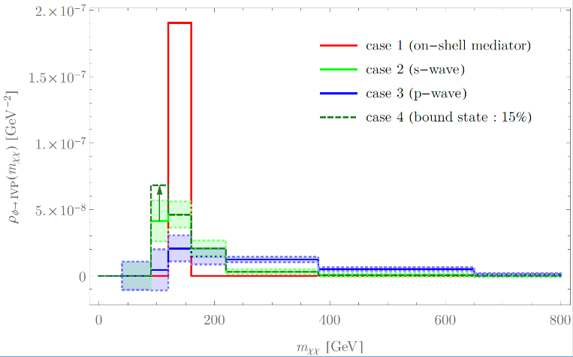
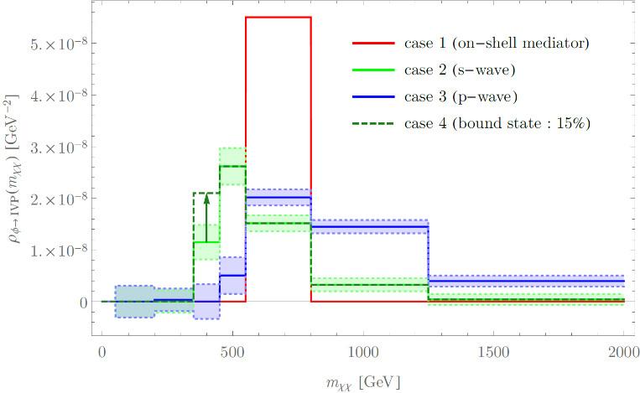
Example (step 3 : the interpretation of results)
 | Interaction
Case 1 | Resonance ( )
Case 2 | S-wave ( )
Case 3 | P-wave ( )
Case 4 | bound state ( )
Location of threshold = 2m_{x}>M_{mediator}
From the slope at the threshold ⇒ interaction between DM and mediator
Peak position (red): On-shell mass of mediator which decays invisibly
And the existence of bound state changes the first bin.
M_{x}=50 GeV
L=3 ab⁻¹ ,
SM background : pp to jvv
(If the current significance < 2 @ 30 fb⁻¹,
then final reach would be <20 for HL-LHC)
m_{xx}
M_{x}=200 GeV

Slide 26
More examples of spectral densities

Slide 27
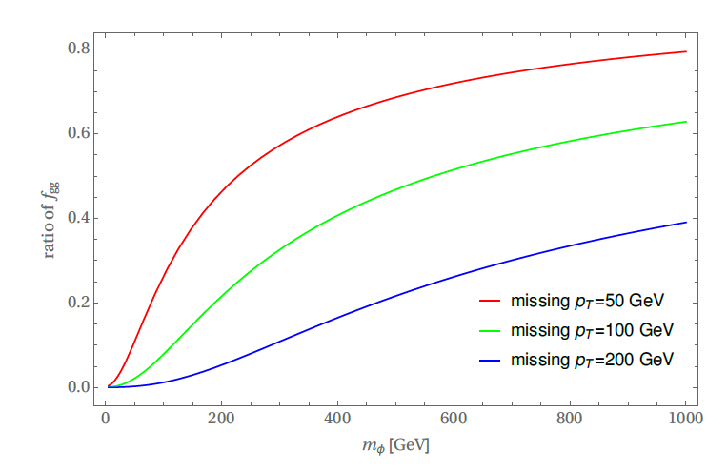
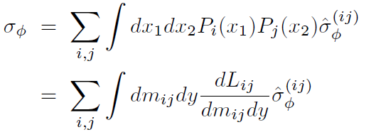
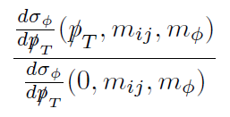
luminosity function
~

Slide 28
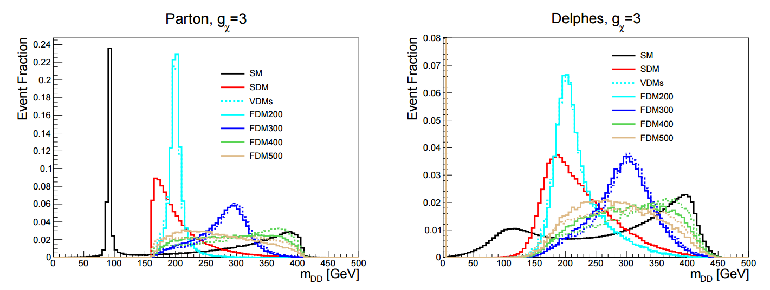
Strategy at linear colliders
Example : mono-Z(to jj) channel
T. Kamon, P. Ko, J. Li, arXiv:1705.02149
BW Peak : On-shell mediator is produced and decays invisibly.
Location of threshold = 2m_{x}>M_{mediator}
Slope at the threshold ⇒ interaction between DM and mediator

Slide 29
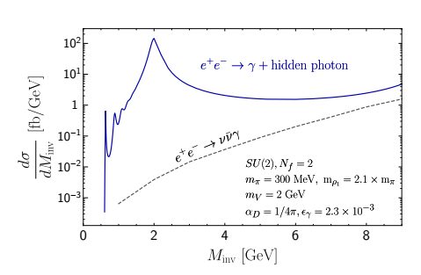
Strategy at linear colliders
Y. Hochberg, E. Kuflik, H. Murayama,
arXiv:1512.07917, 1706.05008
Example : mono-photon w/ confining dark sector
Peak position : On-shell Mediator decays to dark matter particles.
Many bumps near the threshold indicates confinement of dark sector. (e.g. SIMP)
Threshold : Mediator is lighter than 2m_{DM}.
Location of the threshold = 2m_{DM}
Slope at the threshold ⇒ interaction between DM and mediator

