Slide 1
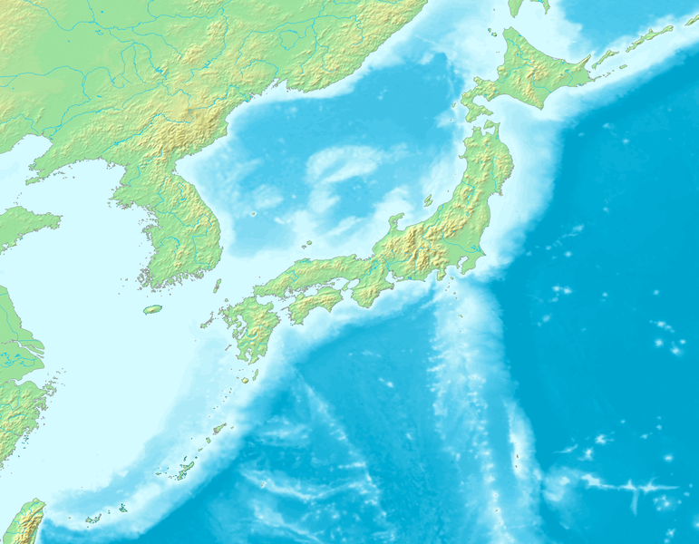
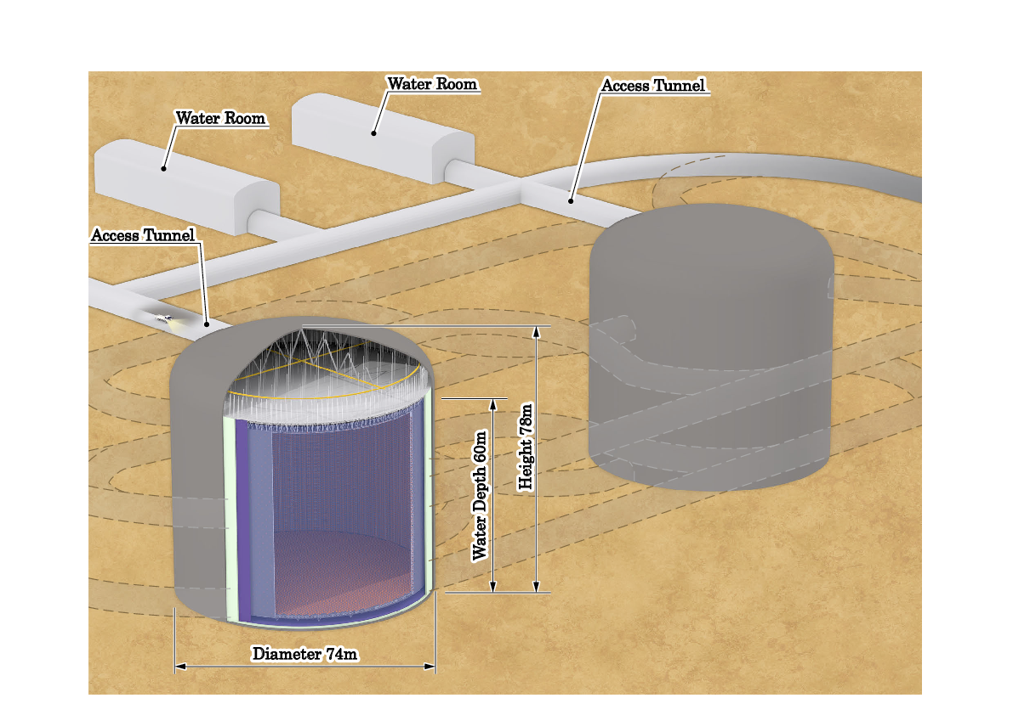
Carsten Rott
Sungkyunkwan University, Korea
rott@skkudonoti.edu
June 23, 2017
Thanks to Akimichi Taketa (ERI, Tokyo)
Dark Matter and Neutrino Geophysics
with the KNT
KNT Meeting 2017

Slide 2
Overview
Motivation
Dark Matter Search
Benefits for KNT
Neutrino Geophysics
Benefits for KNT
Discussions and Conclusions
Notes:
November 2009: The Design Study terminated 31th October 2009. The resulting Technical Design Report (TDR) will be published early 2010. The consortium proceeds with the Preparatory Phase to prepare the construction of the KM3NeT telescope.
Absorption length: 55-65m (water) 110m (ice)
Scattering length: >200m (water) 20m (ice) 40m (deep ice/ DeepCore), 220m absorption in deep core
Deep underwater neutrino telescopes
Nestor – Greece (Pylos):
- Towers of rigid titanium “stars”, Connections made at surface
- project since 1991
- 1 floor deployed in 2004
- took data for a few weeks, then cable defect
- waiting for repair
- 4 floors ready for deployment
- Plans for 4 floors surrounded by autonomous stations
ANTARES – France (near Toulon) 1st deployment in Feb 2006 (first data taking now)
2007: 7 lines deployed (525 PMTs)
In December 07 we connected five lines, so we have 10 lines taking data since then. In May we will connect the last two lines.
5 lines connected and taking data
Atumn/Jan/Feb: deploy &connect the rest
Nemo – Italy - Neutrino Mediterranean Observatory
DUMAND (Deep Undersea Muon And Neutrino Detector)
Baikal (first operational neutrino telescope 1993 NT-36) … (Taking data since 1998 with NT-200)

Slide 3
Motivation

Slide 4
Motivation
Hyper-K is a multipurpose experiment with an extremely broad science spectrum
Solar, Supernova, Reactor neutrinos
Non standard neutrino interactions
Neutrino geophysics
Dark matter searches
Nucleon decays
Astrophysical neutrino sources
….
Notes:
November 2009: The Design Study terminated 31th October 2009. The resulting Technical Design Report (TDR) will be published early 2010. The consortium proceeds with the Preparatory Phase to prepare the construction of the KM3NeT telescope.
Absorption length: 55-65m (water) 110m (ice)
Scattering length: >200m (water) 20m (ice) 40m (deep ice/ DeepCore), 220m absorption in deep core
Deep underwater neutrino telescopes
Nestor – Greece (Pylos):
- Towers of rigid titanium “stars”, Connections made at surface
- project since 1991
- 1 floor deployed in 2004
- took data for a few weeks, then cable defect
- waiting for repair
- 4 floors ready for deployment
- Plans for 4 floors surrounded by autonomous stations
ANTARES – France (near Toulon) 1st deployment in Feb 2006 (first data taking now)
2007: 7 lines deployed (525 PMTs)
In December 07 we connected five lines, so we have 10 lines taking data since then. In May we will connect the last two lines.
5 lines connected and taking data
Atumn/Jan/Feb: deploy &connect the rest
Nemo – Italy - Neutrino Mediterranean Observatory
DUMAND (Deep Undersea Muon And Neutrino Detector)
Baikal (first operational neutrino telescope 1993 NT-36) … (Taking data since 1998 with NT-200)

Slide 5
Site Benefits

Slide 6
Sites Benefits
Japan
Hyper-K detector candidate site, located 8km south of Super-K, is in the Tochibora mine of the Kamioka Mining and Smelting Company, near Kamioka town in Gifu Prefecture, Japan
The detector will located under the peak of Nijuugo-yama, with an overburden of 650m of rock (1,750 m.w.e.)
Notes:
November 2009: The Design Study terminated 31th October 2009. The resulting Technical Design Report (TDR) will be published early 2010. The consortium proceeds with the Preparatory Phase to prepare the construction of the KM3NeT telescope.
Absorption length: 55-65m (water) 110m (ice)
Scattering length: >200m (water) 20m (ice) 40m (deep ice/ DeepCore), 220m absorption in deep core
Deep underwater neutrino telescopes
Nestor – Greece (Pylos):
- Towers of rigid titanium “stars”, Connections made at surface
- project since 1991
- 1 floor deployed in 2004
- took data for a few weeks, then cable defect
- waiting for repair
- 4 floors ready for deployment
- Plans for 4 floors surrounded by autonomous stations
ANTARES – France (near Toulon) 1st deployment in Feb 2006 (first data taking now)
2007: 7 lines deployed (525 PMTs)
In December 07 we connected five lines, so we have 10 lines taking data since then. In May we will connect the last two lines.
5 lines connected and taking data
Atumn/Jan/Feb: deploy &connect the rest
Nemo – Italy - Neutrino Mediterranean Observatory
DUMAND (Deep Undersea Muon And Neutrino Detector)
Baikal (first operational neutrino telescope 1993 NT-36) … (Taking data since 1998 with NT-200)

Slide 7
Candidate Sites in Korea
Site candidates for a 2nd osc. maximum detector in Korea
-- Baselines with 1,000 ~ 1,200 km
-- 1.3 ~ 3º off axis beam directions
-- >1,000 m high mountains with hard granite rocks
Site | OAB | Baseline [km] | Height [m]
Mt. Bisul | ~1.3º | 1088 km | 1084 m
Mt. Hwangmae | ~1.8º | 1140 km | 1113 m
Mt. Sambong | ~1.9º | 1180 km | 1186 m
Mt. Bohyun | ~2.2º | 1040 km | 1126 m
Mt. Minjuii | ~2.2º | 1140 km | 1242 m
Mt. Unjang | ~2.2º | 1190 km | 1125 m

Slide 8
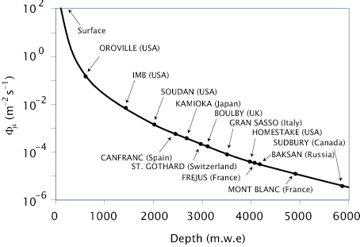
Benefits
Two main benefits
Geological separation between two detectors
Systematics, Operations, …
Deeper detector site
Reduction of muon flux and isotope production from spallation
Notes:
November 2009: The Design Study terminated 31th October 2009. The resulting Technical Design Report (TDR) will be published early 2010. The consortium proceeds with the Preparatory Phase to prepare the construction of the KM3NeT telescope.
Absorption length: 55-65m (water) 110m (ice)
Scattering length: >200m (water) 20m (ice) 40m (deep ice/ DeepCore), 220m absorption in deep core
Deep underwater neutrino telescopes
Nestor – Greece (Pylos):
- Towers of rigid titanium “stars”, Connections made at surface
- project since 1991
- 1 floor deployed in 2004
- took data for a few weeks, then cable defect
- waiting for repair
- 4 floors ready for deployment
- Plans for 4 floors surrounded by autonomous stations
ANTARES – France (near Toulon) 1st deployment in Feb 2006 (first data taking now)
2007: 7 lines deployed (525 PMTs)
In December 07 we connected five lines, so we have 10 lines taking data since then. In May we will connect the last two lines.
5 lines connected and taking data
Atumn/Jan/Feb: deploy &connect the rest
Nemo – Italy - Neutrino Mediterranean Observatory
DUMAND (Deep Undersea Muon And Neutrino Detector)
Baikal (first operational neutrino telescope 1993 NT-36) … (Taking data since 1998 with NT-200)

Slide 9
Dark Matter Searches with Neutrinos

Slide 10
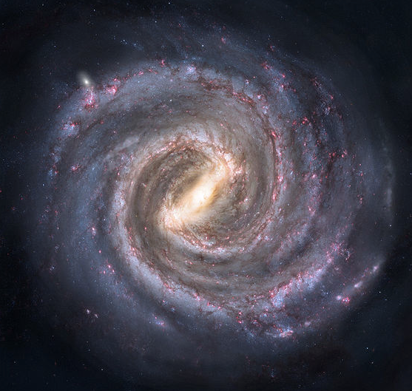
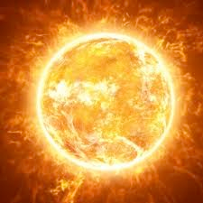
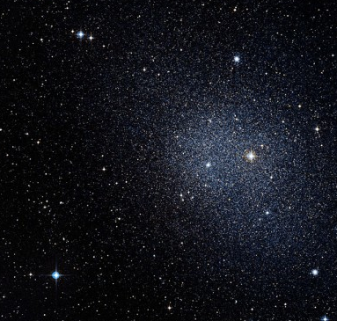
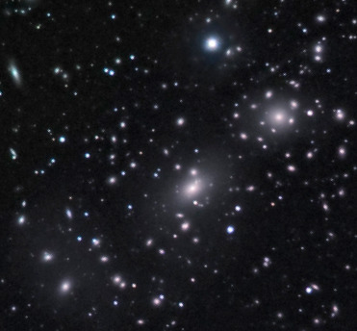
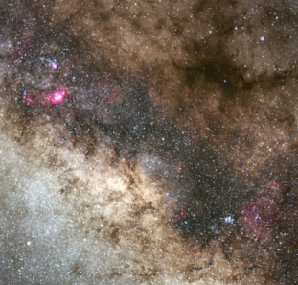
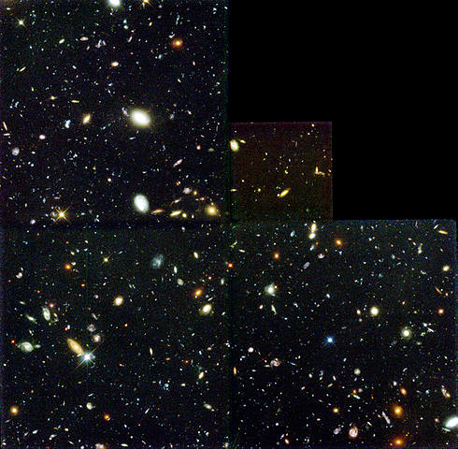
Dark Matter Signals at KNT
Milky Way Halo
Solar WIMPs
Dwarf Spheroidal
Clusters of Galaxies
Coma Cluster
Galactic Center
Extra-galactic
Earth WIMPs
HDF - Hubble Deep Field

Slide 11
Dark Matter Sensitivities for Hyper-K
C. Rott, J. Siegal-Gaskins, J.F.Beacom Physical Review D 88, 055005 (2013)(arXiv1208.0827)
C.Rott, S.In, J.Kumar, D.Yaylali JCAP11(2015)039

Slide 12
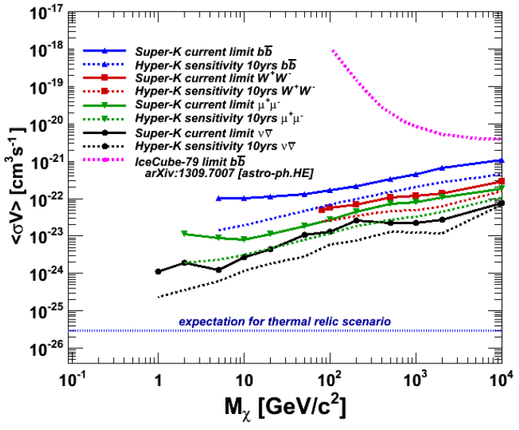
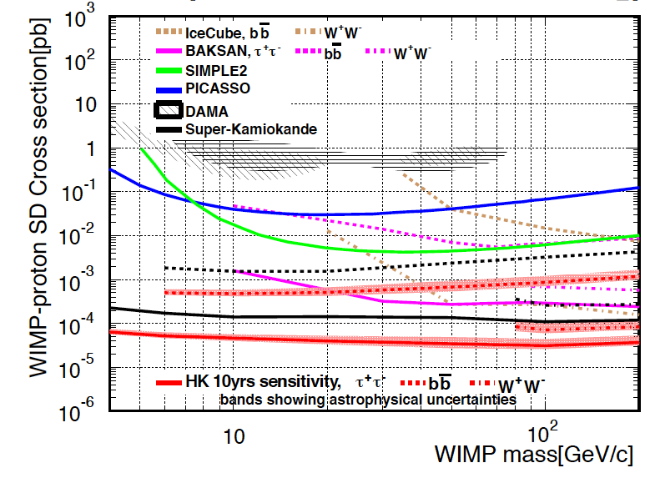
Super-K bounds / Hyper-K Sensitivity
Galactic Halo
Solar Dark Matter
Self-annihilation cross section
Spin-dependent scattering
Main background atmospheric neutrinos
Benefits for Korean Neutrino Detector
Reduced systematic uncertainties on atm. neutrino background ( but already same / off-source method)
Improved detector acceptance uncertainty with two detectors ?
Potential to increase effective volume, relaxed fiducial cut at deeper site ?

Slide 13
Neutrinos from stopped meson decay in the Sun
C. Rott, J. Siegal-Gaskins, J.F.Beacom Physical Review D 88, 055005 (2013)(arXiv1208.0827)
C.Rott, S.In, J.Kumar, D.Yaylali JCAP11(2015)039

Slide 14
Low-Energy Neutrinos from the Sun
π⁺
Possible annihilation channels:
qq,gg,cc,ss,bb,tt,W⁺W⁻, ZZ, τ⁺τ⁻,μ⁺μ⁻, νν, e⁺e⁻,γγ
π⁻
π⁻
few neutrinos
K⁺
some “high energy” neutrinos in decays
⇒ basis of present day searches
π⁺
K⁻
dominant decay into hadrons
π⁺
π⁺
π⁻
π⁺
π⁺
Charged pions and kaons decay at rest producing mono-energetic neutrinos
γ
π⁻
π⁰
π⁺
γ
π⁺
π⁺
π⁺
Eν= 29.8MeV
π⁻
Eν=235.5MeV
π⁰
Lifetime too short to interact
π⁻
Interaction length short compared to losses
Produces secondary particles in collision with protons
Dominant energy loss term is π⁰ production

Slide 15
Neutrino signals - Example W-Boson
π⁺
Neutrinos from pion decay at rest
~ 20-50MeV
W⁺
e⁺νe , μ⁺νμ , τ⁺ντ
~33%
qq
~67%
Let’s have a closer look at this:
K⁺
e⁺νe
1 high energy ν + em shower
μ⁺νμ
1 high energy ν + muon
Neutrinos from decay of annihilation final states
~10GeV - 10TeV
τ⁺ντ
1 high energy ν + tau decay
qq
hadronic shower
MeV
GeV
TeV

Slide 16
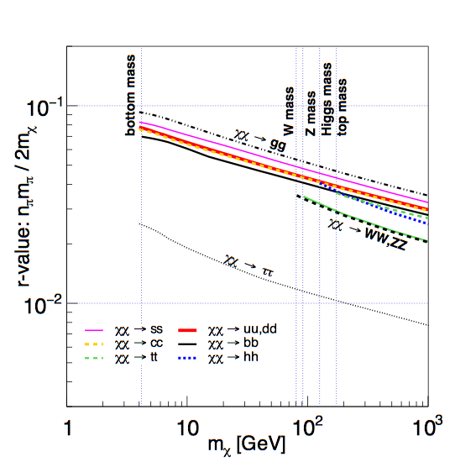
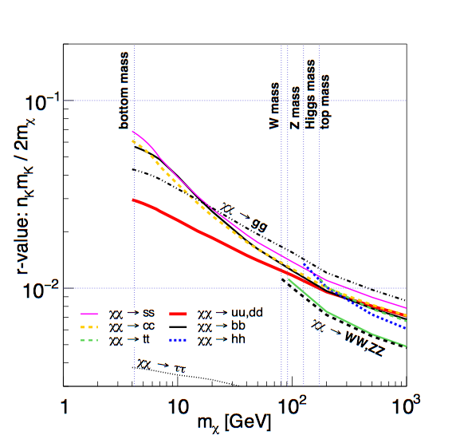
Pion and Kaon yields
π⁺ r-value - fraction of center‐of‐mass energy which goes into π⁺
K⁺ r-value - fraction of center‐of‐mass energy which goes into K⁺
For low dark matter masses difference between flux from stopped pion and kaon decay at rest can be used to disentangle annihilation final states

Slide 17
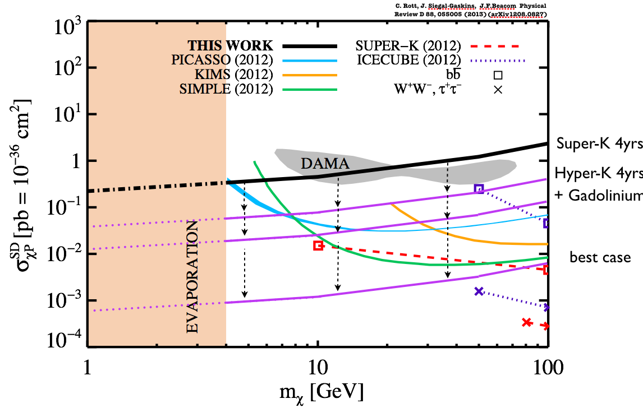
Sensitivity Super-K/Hyper-K
C. Rott, J. Siegal-Gaskins, J.F.Beacom Physical Review D 88, 055005 (2013)(arXiv1208.0827)
Previous searches relied on high energy neutrinos directly from the decays of annihilation products
Model the full hadronic shower in the Sun
DM sensitivity continues to improve for low masses
Minimal dependence on annihilation channels
New key detection channel to compliment other searches
Super-K data can already be used to test DAMA/Libra
C. Savage et al.
JCAP 0904 (2009) 010
Full study to be done for KNT. Results for Hyper-K representative

Slide 18
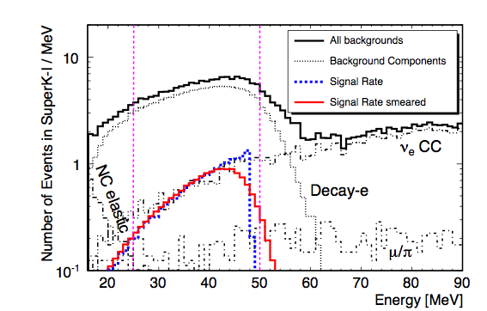
Spallation backgrounds
Takatomi Yano (Kobe)
Spallation cut reduced
signal efficiency
Spallation backgrounds have been investigated for DSNB neutrino analysis (see presentation from Takatomi Yano)
Small improvement in sensitivity due increased signal efficiency at deeper site
Impact on signal small in energy region 25-50MeV.

Slide 19
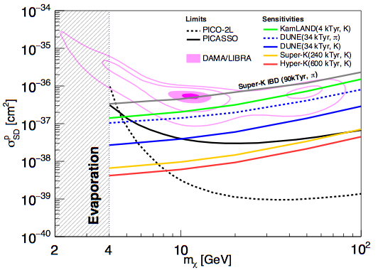
Sensitivity
C.Rott, S.In, J.Kumar, D.Yaylali JCAP11(2015)039
Sensitivity to kaon line expected to be better than neutrino from pion decay at rest
Dominant background atm. neutrinos
Benefits from Korean detector, potential to reduced atm. flux uncertainties and detector acceptance understanding ?
Full study to be done for KNT. Results for Hyper-K representative

Slide 20
Neutrino Geophysics
C. Rott, J. Siegal-Gaskins, J.F.Beacom Physical Review D 88, 055005 (2013)(arXiv1208.0827)
C.Rott, S.In, J.Kumar, D.Yaylali JCAP11(2015)039

Slide 21
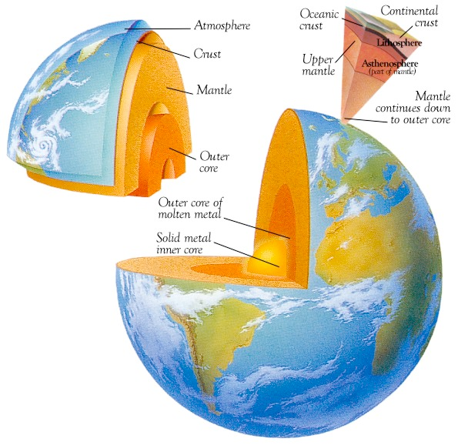
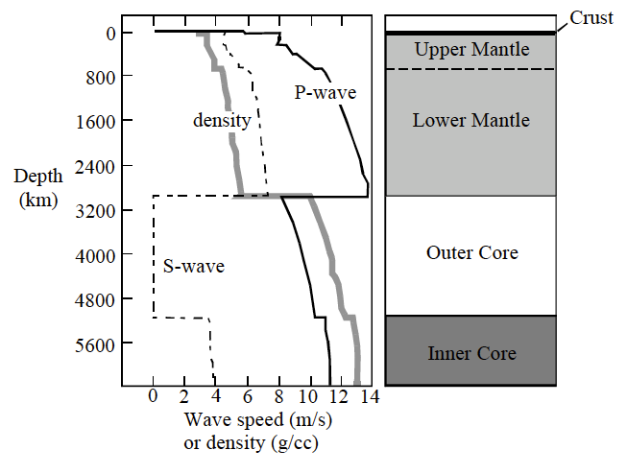
Seismological profile of the Earth
William F. McDonough “The Composition of the Earth”
Upper Mantle
Lower Mantle
http://www.phys.hawaii.edu/~sdye/hnsc.html
silicate earth =
crust + mantle
6371 km
Outer Core
The core
3483 km
Inner Core
1220 km
Density relatively well described through seismic measurements (⇒PREM)
... but whats the composition ?

Slide 22
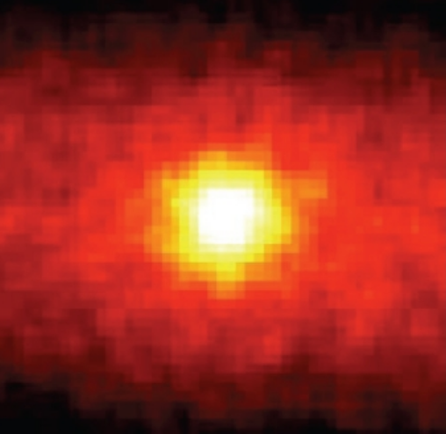
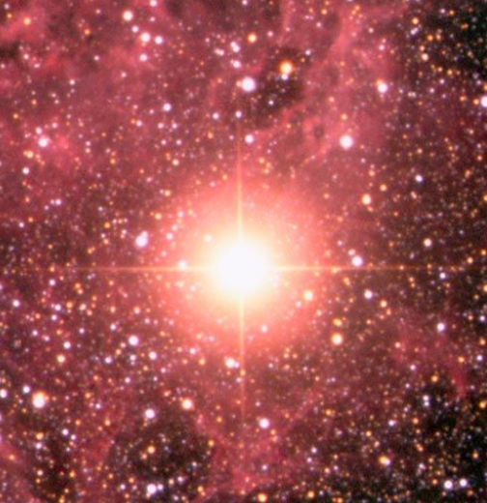
Searches at Hyper-K
Neutrino Tomography with
Atmospheric Neutrinos
Solar Neutrinos
Galactic Supernova Burst Neutrinos

Slide 23
Motivation - Methodology
The Earth matter density profile can be determined from seismic measurements
Matter induced neutrino oscillation effects however dependent on the electron density
Given a matter density profile the composition (or Z/A) along the neutrino path can be determined using neutrino signals (Oscillation tomography)
corresponding zenith angles for boundaries
inner core θν <169º (cos θν < -0.98)
outer core θν <147º (cos θν < -0.84)
Electron density in core Yc=electron/nucleons

Slide 24
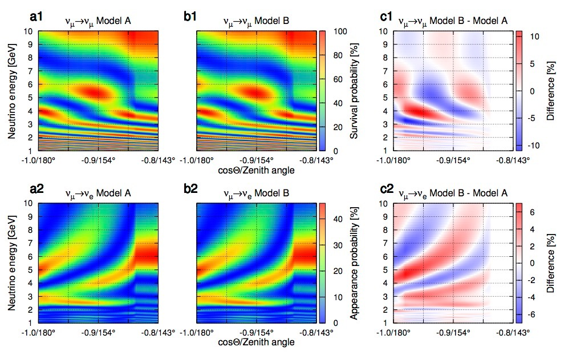
Neutrino Tomography (atm. neutrinos)
Pure Fe
Fe + 2wt% H

Slide 25
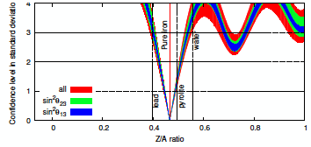
Neutrino Oscillation Tomography
Neutrino oscillation tomography offers the potential to measure the Earth interior composition
High sensitivity to hydrogen
Z/A (Fe) ~0.47
Z/A (O) ~ 0.50
Z/A (H) ~1.00
Hyper-K will be the first experiment that can measure the Earth core composition

Slide 26
Benefits Neutrino Oscillation Tomography - Atmospheric Neutrinos
Atmospheric neutrino flux needs to be well known
Two sites will help to reduce systematic uncertainties on the neutrino flux
Status
Jonghyun Kim is redoing oscillation tomography study
Using Mark’s package for Hyper-K detector response
Atmospheric Neutrino flux for Korean site needs to be obtained for full study
Previous studies used Honda 2013 @ Super-K site
Atmospheric Neutrino flux for Korean site needs to be obtained for full study
Previous studies used Honda 2013 @ Super-K site
(contact Honda-san)

Slide 27
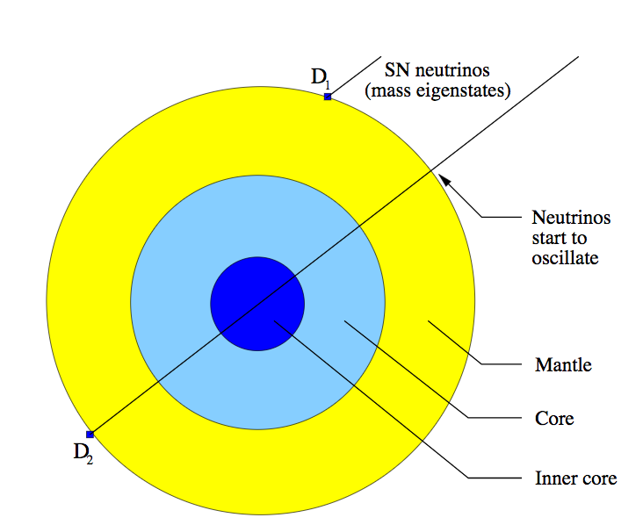
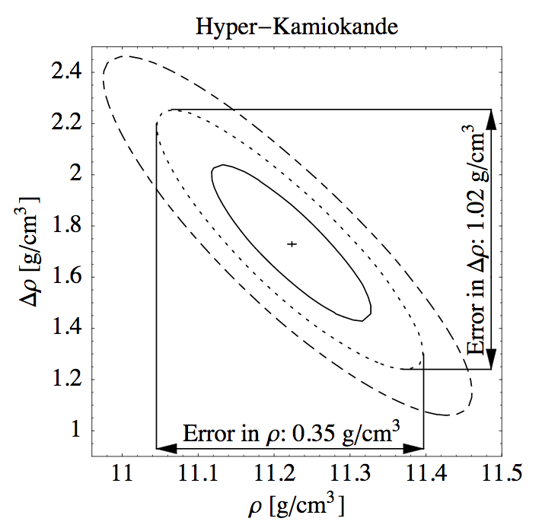
Benefits Neutrino Oscillation Tomography - Supernova Neutrinos
Started discussions with SN theorists
Perform dedicated study for two identical detectors with T2HKK separation length
Previous works related to Supernova burst neutrino tomography
Borriello et al. 2012 https://journals.aps.org/prd/pdf/10.1103/PhysRevD.86.083004
Lindner et al 2003 https://arxiv.org/abs/hep-ph/0207238
Lindner et al (2003)
10kpc / 3*10⁵³erg
Papers conclude matter effects will be visible for nearby supernova, but we need detailed study on composition

Slide 28
Benefits Neutrino Oscillation Tomography - Solar Neutrinos
Super-K observed day-night asymmetry (matter effects)
Sensitivity to Earth models needs to be determined for KNT
Sun is a point source, different baselines can be explored with two detectors
Site benefits for Solar neutrinos also directly apply to this study
Increased efficiency due to lower spallation backgrounds

Slide 29
Summary
Dark Matter Sensitivity expected to improve marginally due to deeper site
reduced spallation
Tomography improves with deeper site
Solar Neutrinos - directly translates into improvements for tomography as well
Atmospheric Neutrinos - benefits due to reduced systematics
Supernova Neutrinos - Two baselines, but separation is small, and requires nearby Supernova

Slide 30
Thanks !

