Slide 1
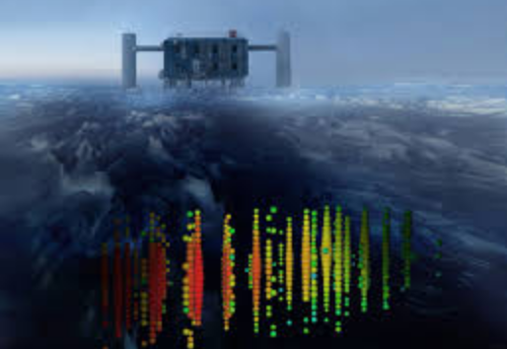
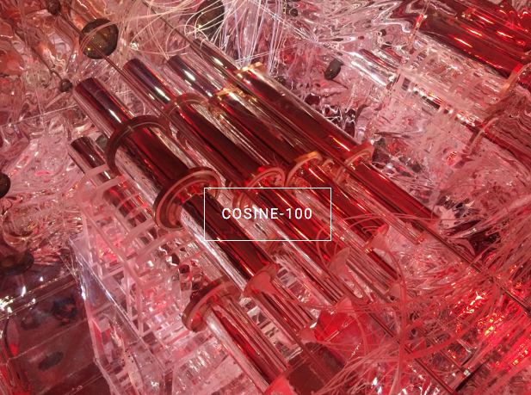
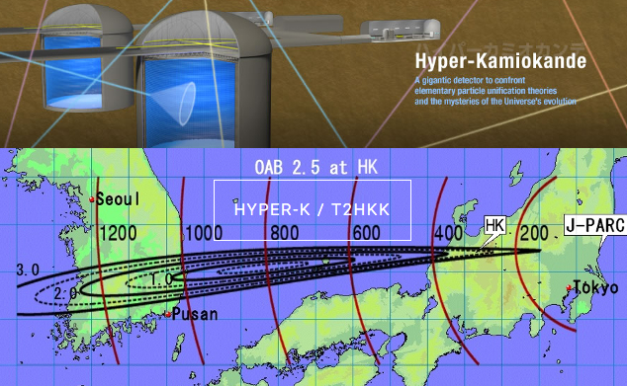
NAPPL - Research
The IceCube Neutrino Telescope
JSNS²
COSINE
Hyper-K/KNO

Slide 2
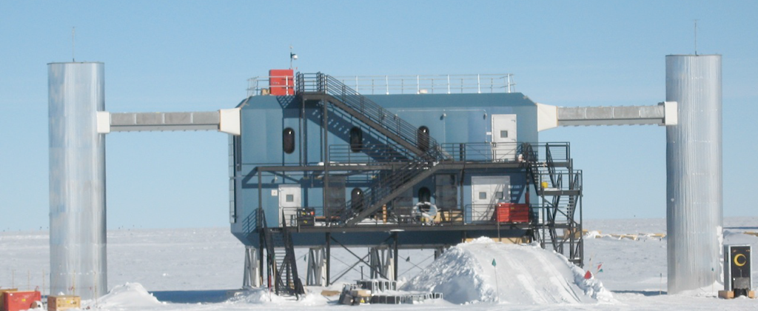
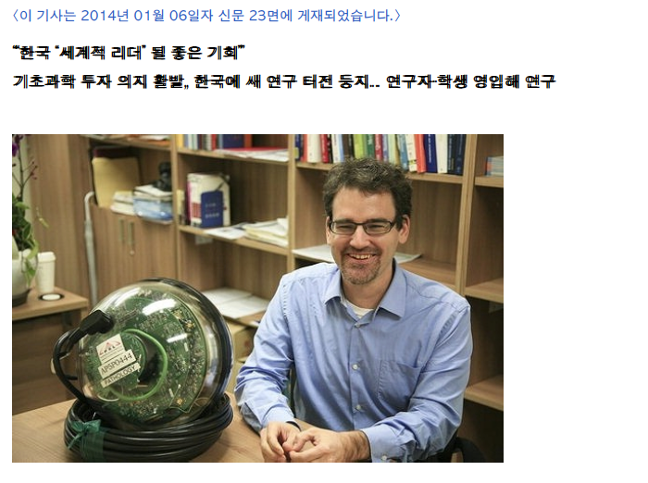
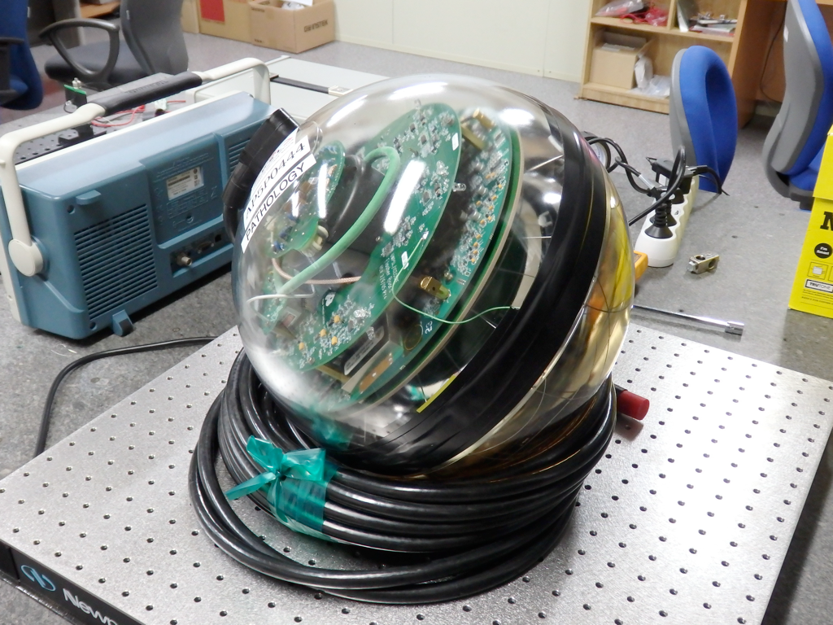
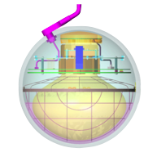
The IceCube Neutrino Telescope
Gigaton Neutrino Detector at the Geographic South Pole
5160 Digital optical modules distributed over 86 strings
Detector completed in December 2010 after 7 years construction
Neutrinos are identified through Cherenkov light emission from secondary particles produced in the neutrino interaction with the ice
EThr ~ 100 GeV
Sensor module in my lab
EThr ~ 10 GeV
μ
νμ

Slide 3
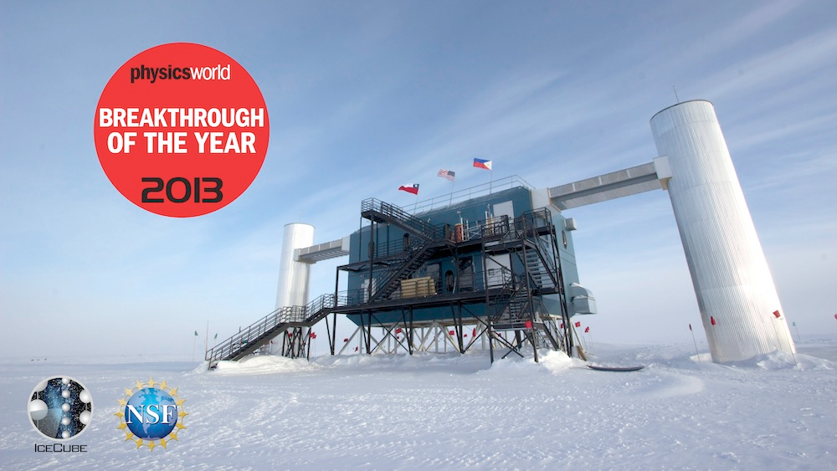
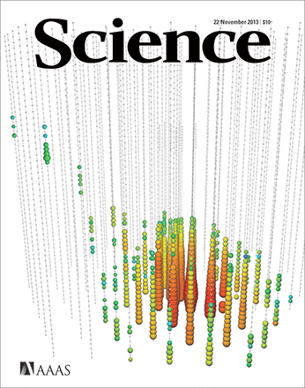
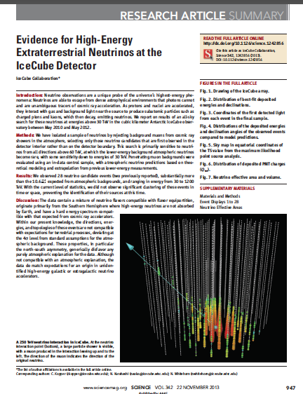
IceCube Observations
Scientific Scope
ASTROPHYSICS
point sources of ν’s (SNR, AGN … ), extended sources
transients (GRBs, AGN flares …)
diffuse fluxes of ν’s (all sky, cosmogenic, galactic plane …)
COSMIC RAY PHYSICS
energy spectrum around ”knee”, composition, anisotropy
DARK MATTER
indirect searches (Earth, Sun, Galactic center/halo)
EXOTICS
magnetic monopoles
PARTICLE PHYSICS
ν oscillations, sterile ν’s
charm in CR interactions
violation of Lorentz invariance
SUPERNOVAE (galactic/LMC)
GLACIOLOGY & EARTH SCIENCE
Very diverse science program, with neutrinos from 10GeV to EeV, and MeV burst neutrinos

Slide 4
IceCube in Korea
SKKU Group (Spring 2018)
Rott group at Sungkyunkwan University, IceCube Member since Summer 2013
SKKU Group:
Carsten Rott
Dongyoung Jeong
Hrvoje Dujmovic
Jonghyun Kim
Woosik Kang
Christoph Toennis
Seongjin In
Seokmin Choi
Gyunho Yu
Minjin Jeong
Hyoungku Jeon
Beyond the Standard Model and Dark Matter Searches
Solar WIMPs, Secluded Dark Matter, Galactic Dark Matter annihilation and decay, …
Solar Atmospheric Neutrinos
Ice Camera system development for IceCube Upgrade
Study refrozen ice in drill holes
Reduce largest remaining sources of systematic uncertainties for analyses
300 scientists
from 12 countries

Slide 5
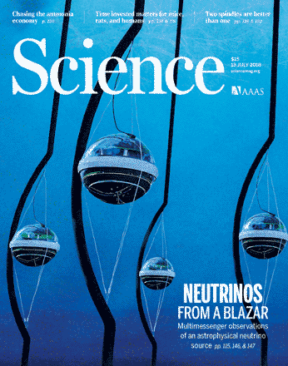
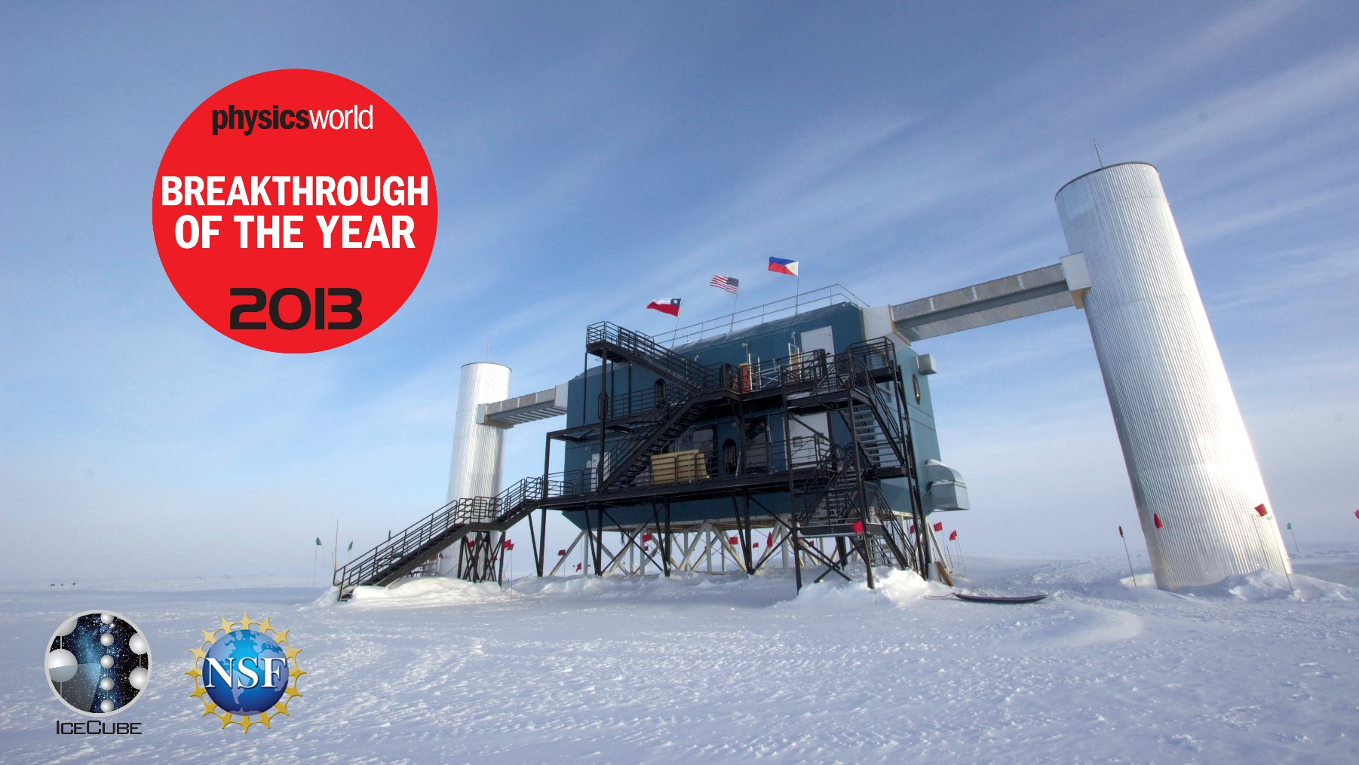
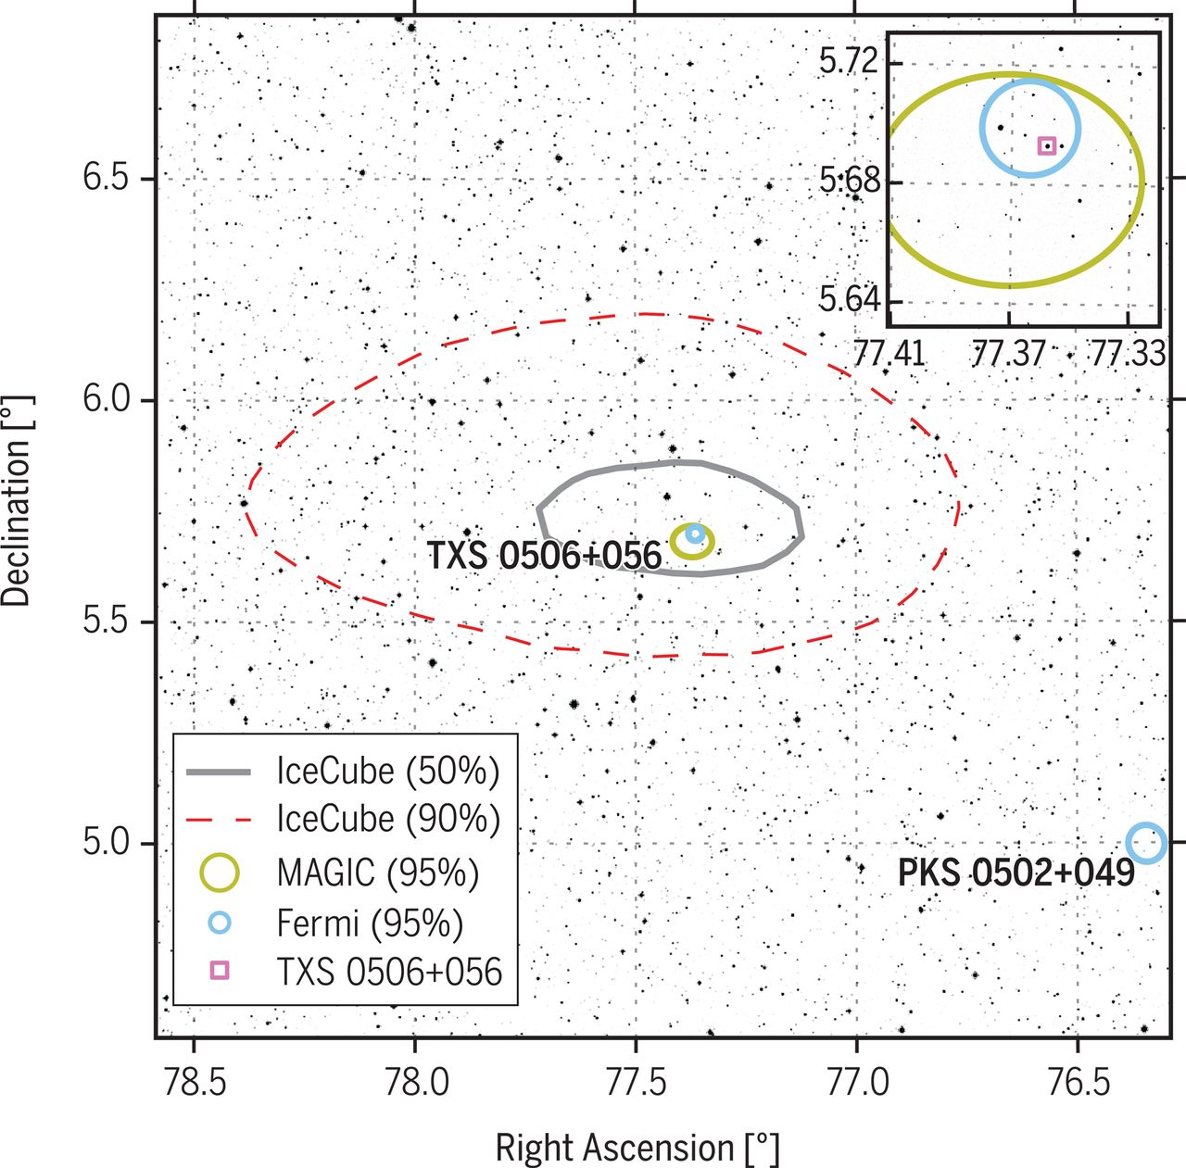
New Window to the Universe !
2013
Discovery of diffuse astrophysical neutrino flux
2018
Neutrino multi-messenger astronomy
New window to the Universe !

Slide 6
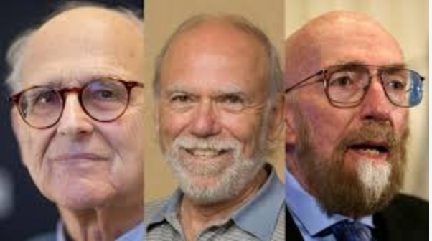
Observing the Universe in Fundamentally new Ways
NSF 10 big ideas for future investment
Rainer Weiss, Barry Barish, Kip Thorne

Slide 7
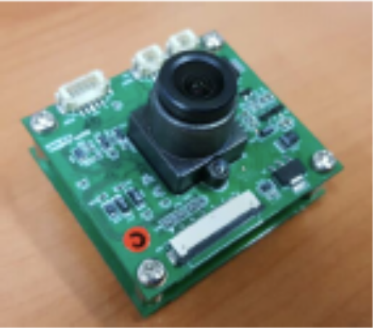
Sungkyunkwan Ice Camera System
Special device Swedish Camera
Ice properties dominant source of sys. uncertainties for most analyses
Solution: Ice camera system
Monitor freeze in
Hole ice studies
Local ice environment
Position of the sensor in the hole
Geometry calibration
Survey capability
Camera system key to comprehensive understanding of the detector medium
—> Retroactively analyze more than 10 years of IceCube data with substantially improved angular and energy resolution

Slide 8
SKKU SpiceCore Camera System
SKKU graduate student Hrvoje Dujmovic @ South Pole
In water test
SPICE Core camera system was successfully deployed in January 2019 (one 7h deployment to the maximal depth of 1695m)
Several hundred images taken - image analysis on-going
Platform to test camera systems for integration into next-generation optical sensor modules

Slide 9
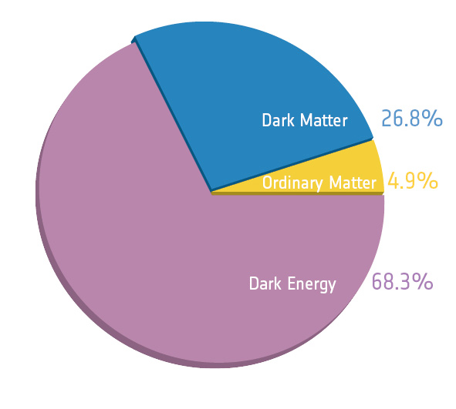
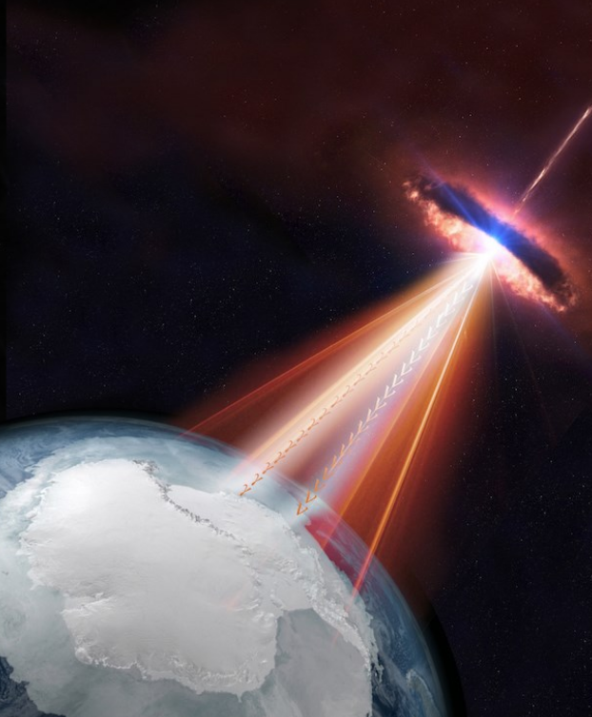
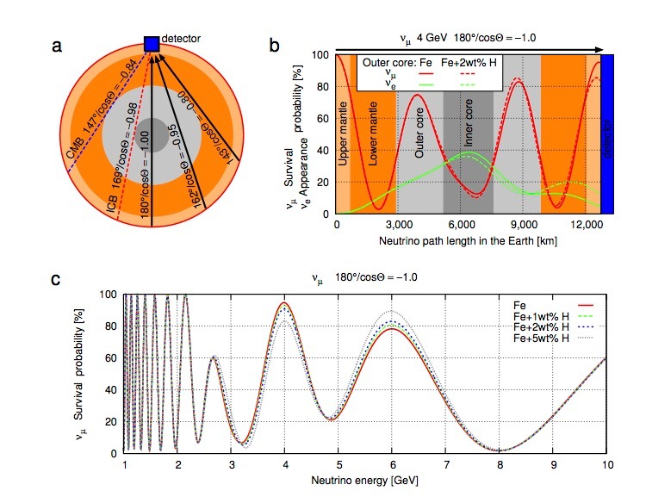
The Questions - We want to answer at NAPPL ?
http://neutrino.skku.edu/
What is dark matter ?
What are the most energetic processes in the Universe ? (What are the sources of the high-energy cosmic rays ?)
What are the properties of the neutrinos ?
Is there any new physics “beyond the standard model of particle physics” ?
Can we use particle physics to study the Earth interior ?
What can multi-messenger astroparticle physics tell us about the Universe ?
Rott & Taketa 2015

