Slide 1
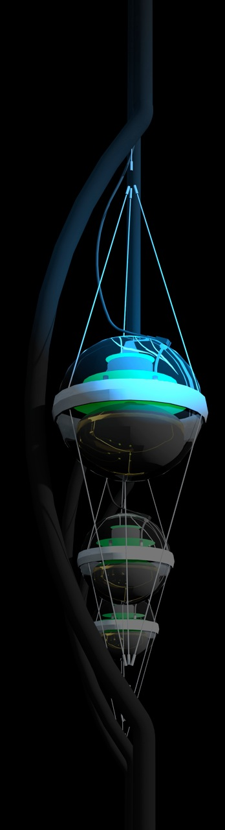
neutrino astronomy: overview
francis halzen
cosmogenic neutrinos
the energetics of cosmic ray sources
neutrinos associated with cosmic rays
a cubic kilometer detector
evidence for extraterrestrial neutrinos
conclusions
IceCube.wisc.edu

Slide 2
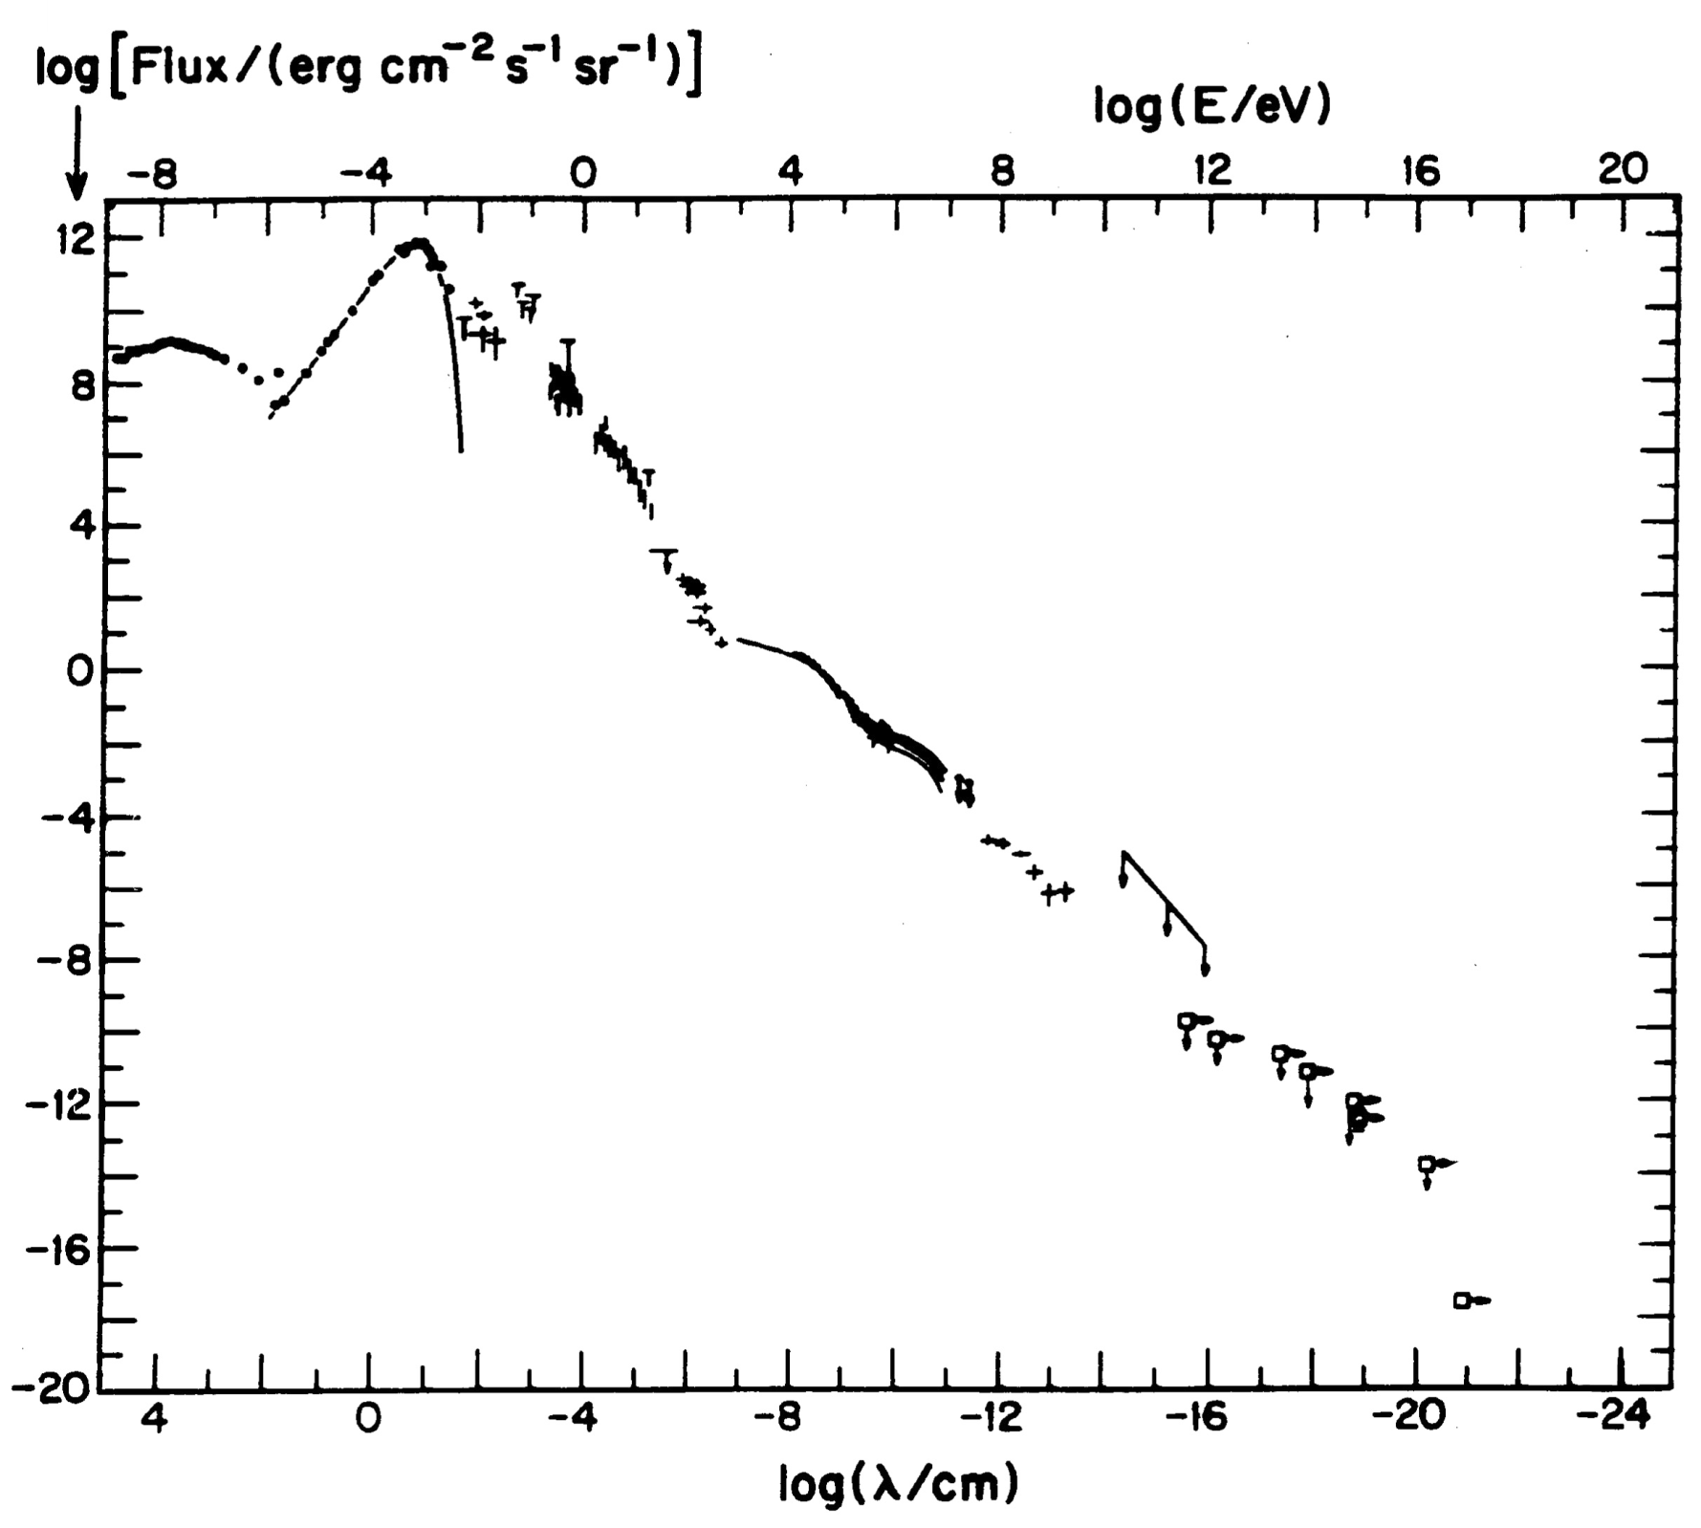

energy (eV)
ν
Radio
CMB
flux
Visible
TeV sources
cosmic
rays
GeV γ-rays
particle flux
in the Universe

Slide 3
energy (eV)
ν
Radio
CMB
flux
Visible
cosmic
rays
GeV γ-rays

Slide 4

cosmic rays interact with the microwave background
cosmic rays disappear, neutrinos with
EeV (10¹⁸ eV) energy appear
1 event per cubic kilometer per year
...but it points at its source

Slide 5
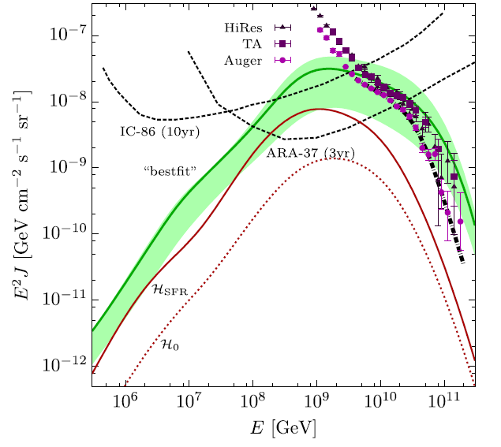
cosmic rays
neutrinos produced in
interactions with
microwave photons

Slide 6
neutrino astronomy
francis halzen
cosmogenic neutrinos
the energetics of cosmic ray sources
neutrinos associated with cosmic rays
a cubic kilometer detector
evidence for extraterrestrial neutrinos
conclusions
IceCube.wisc.edu

Slide 7
Hillas formula :
accelerator must contain the particles
dimensional analysis, difficult to satisfy

Slide 8
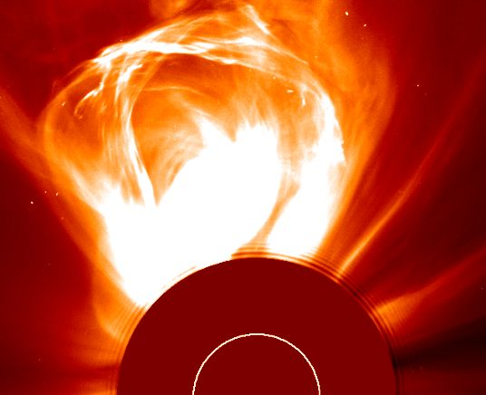
the sun constructs an accelerator
coronal mass
ejection
09 Mar 2000

Slide 9
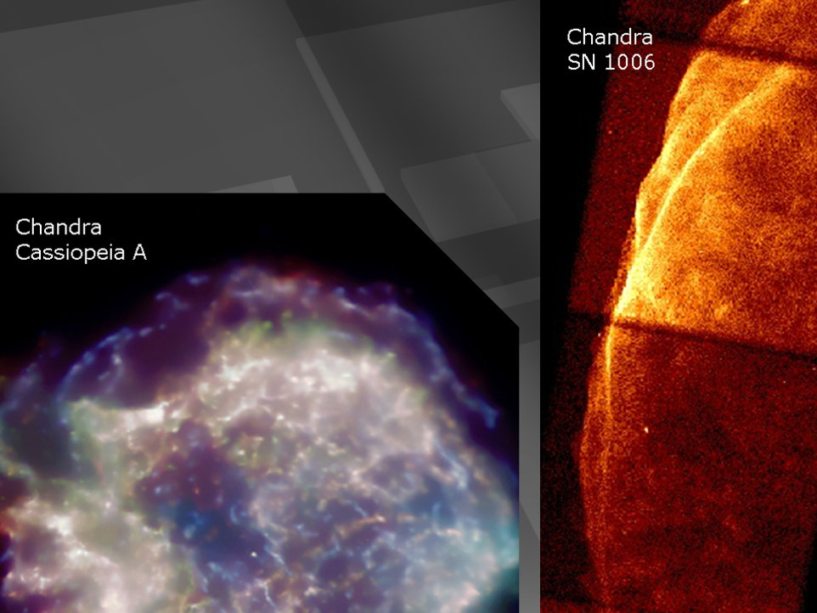
supernova remnants

Slide 10
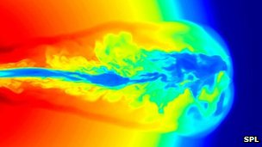
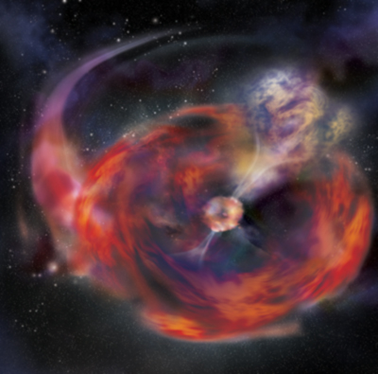
…and if the star collapses to
a black hole…
gamma ray burst
happens in seconds
not thousands of year
beamed along the spin
axis of the black hole
simulation not image

Slide 11
galactic
cosmic rays
10-41 erg/cm3
energy (eV)
galactic
cosmic rays
10⁻¹² erg cm⁻³
Radio
CMB
Visible
extragalactic
cosmic rays
3x10⁻¹⁹ erg cm⁻³
flux
410 photons
of 2.7 K per cm³
or
10⁻¹² erg cm⁻³
~ 0.5 eV cm⁻³
GeV γ-rays

Slide 12
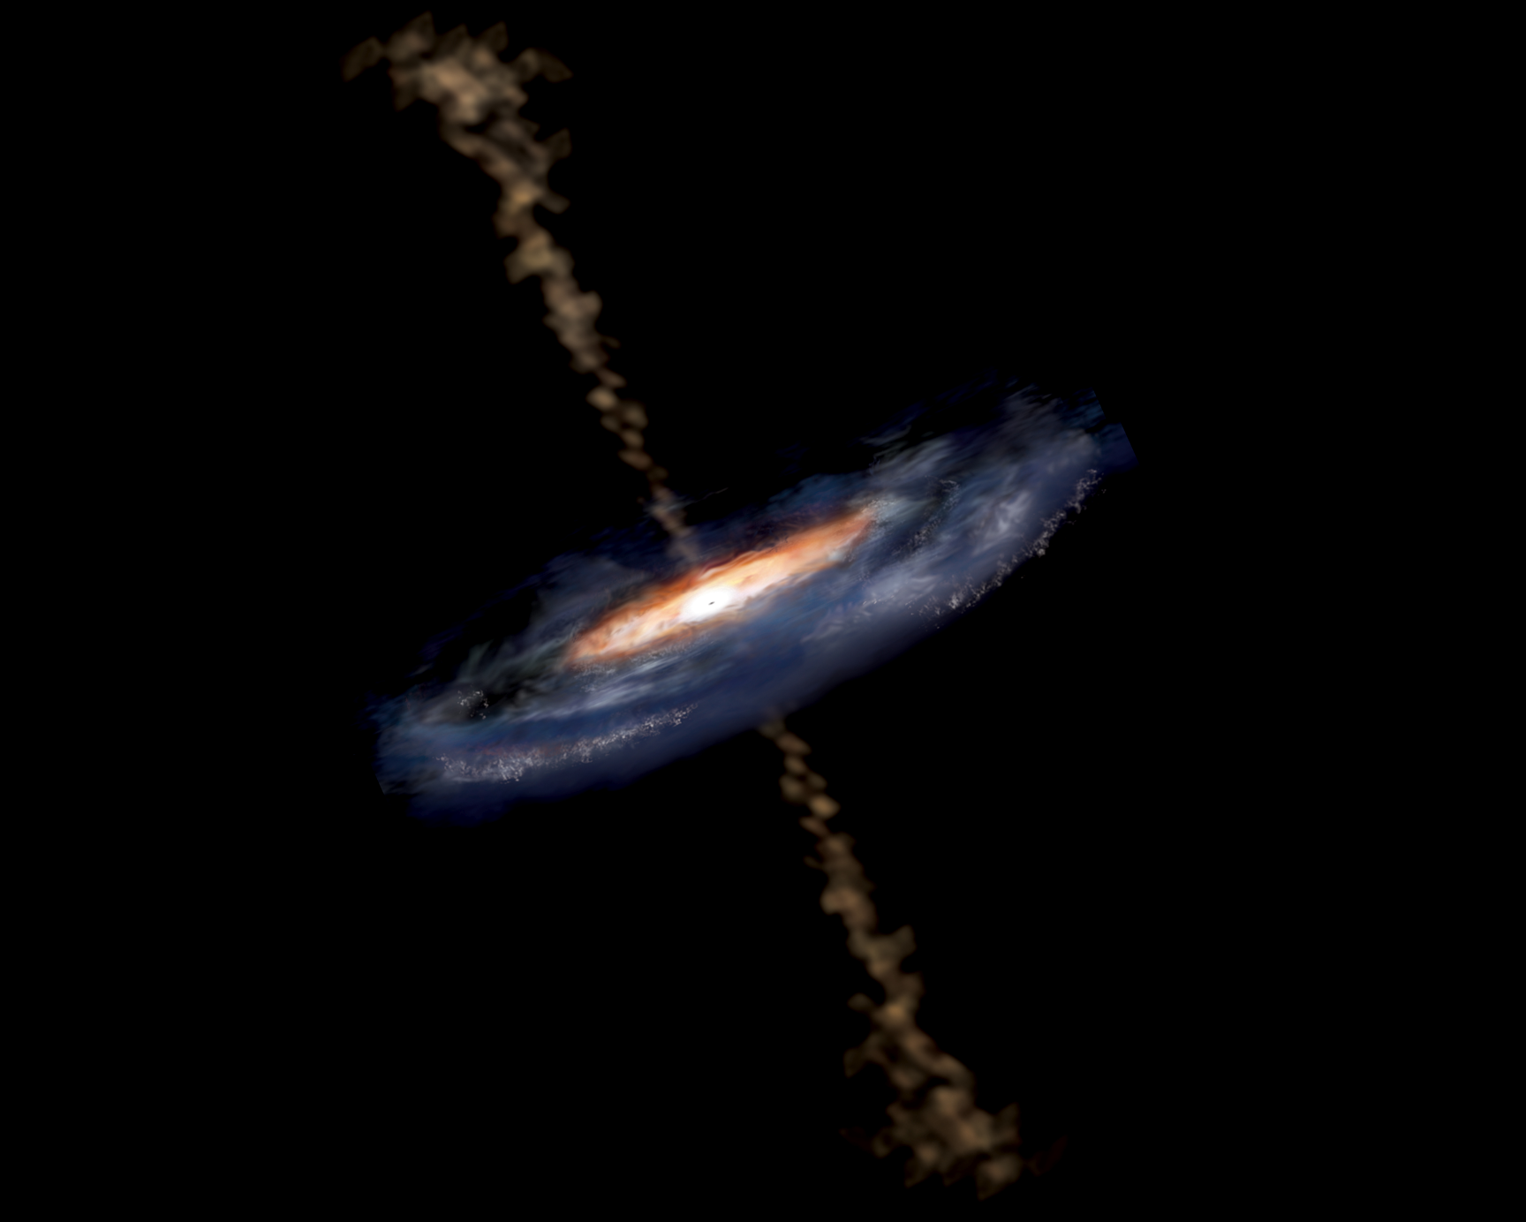
active galaxy particle flows near supermassive black hole

Slide 13
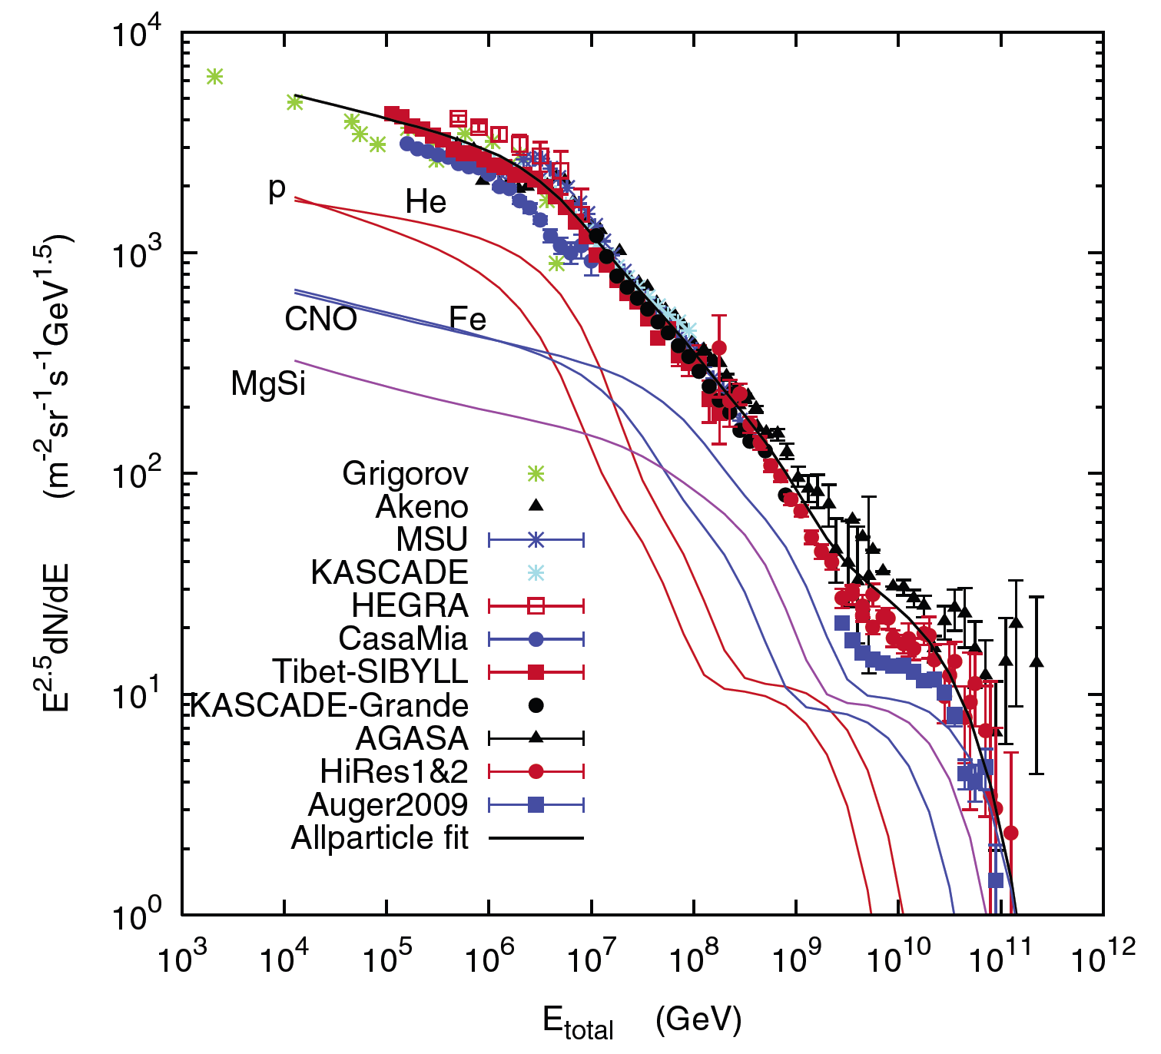
sources accommodating the observed energy budget
Galactic:
supernova
remnants?
extragalactic:
gamma ray
bursts??
active
galaxies?

Slide 14

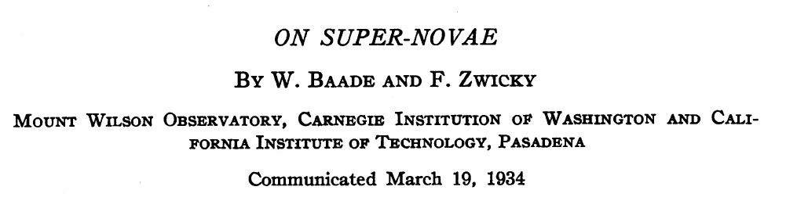
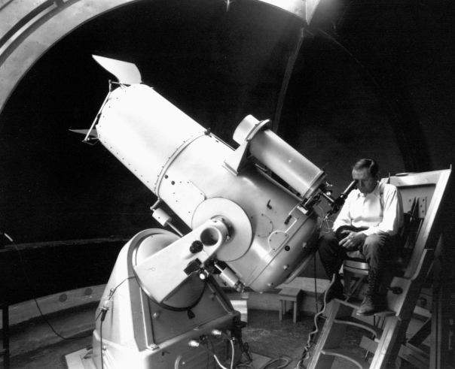
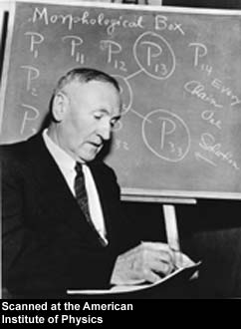


Slide 15
neutrino astronomy
francis halzen
cosmogenic neutrinos
the energetics of cosmic ray sources
neutrinos associated with cosmic rays
a cubic kilometer detector
evidence for extraterrestrial neutrinos
conclusions
IceCube.wisc.edu

Slide 16
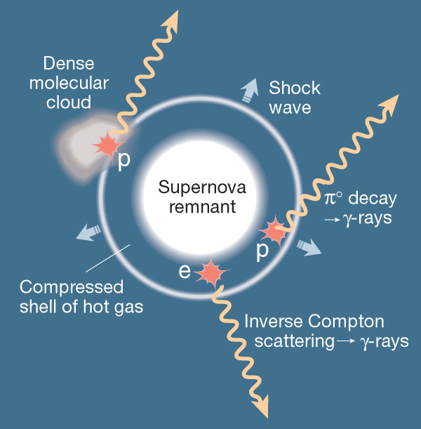
neutrinos
from supernova
remnants :
molecular
clouds in star-forming regions where super-nova explode: beam dumps!

Slide 17
neutral pions
are observed as
gamma rays
charged pions
are observed as
neutrinos
π⁰
π⁺
π⁻
γ
γ
ν_{μ} μ⁺
ν μ⁻
e⁺ e⁻
e⁺
γ
e⁻
μ⁺
e⁺
γ
e⁺
ν_{e}
ν_{μ}
Notes:
17

Slide 18
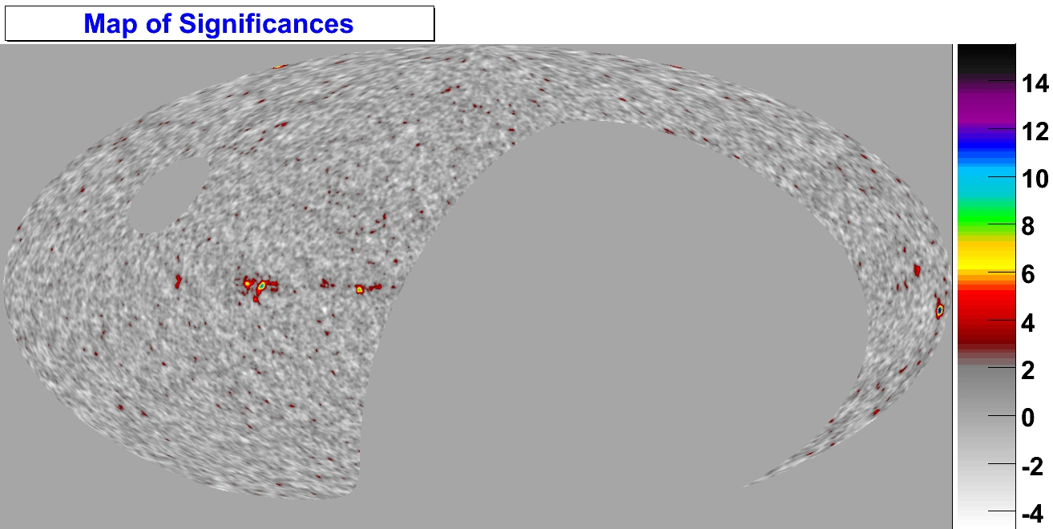
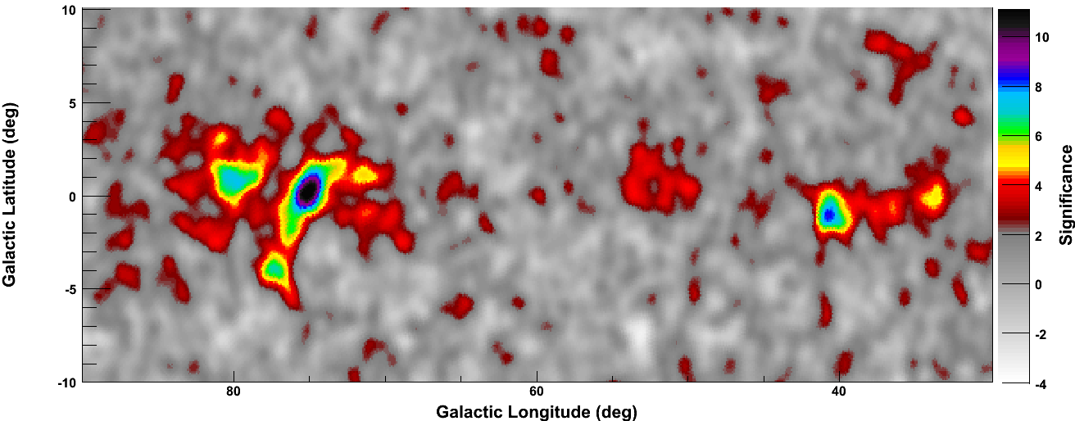
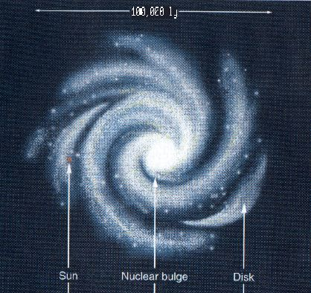
Galactic plane in 10 TeV gamma rays : supernova remnants in star forming regions
Southern
Hemisphere
Sky
Standard Deviations
90°
65°
30°
210°
milagro
Notes:
Replace with Aitoff plot

Slide 19
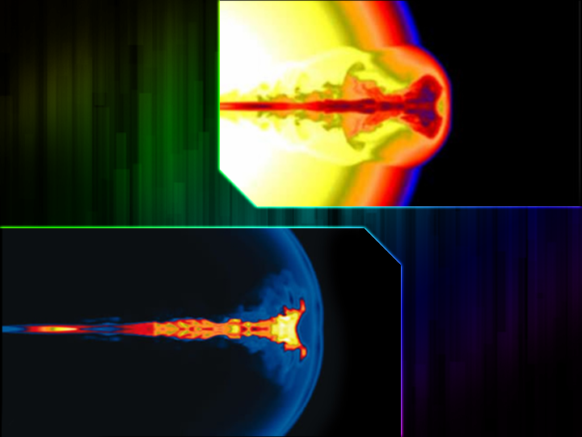
collapse of massive
star produces a
gamma ray
burst
spinning black hole
neutrinos are
produced in the
interactions of
fireball protons
(cosmic rays)
with synchrotron
photons

Slide 20
GRB fireball model
decays to PeV neutrino
decays to cosmic ray
one neutrino per cosmic ray observed
ruled out by IceCube

Slide 21
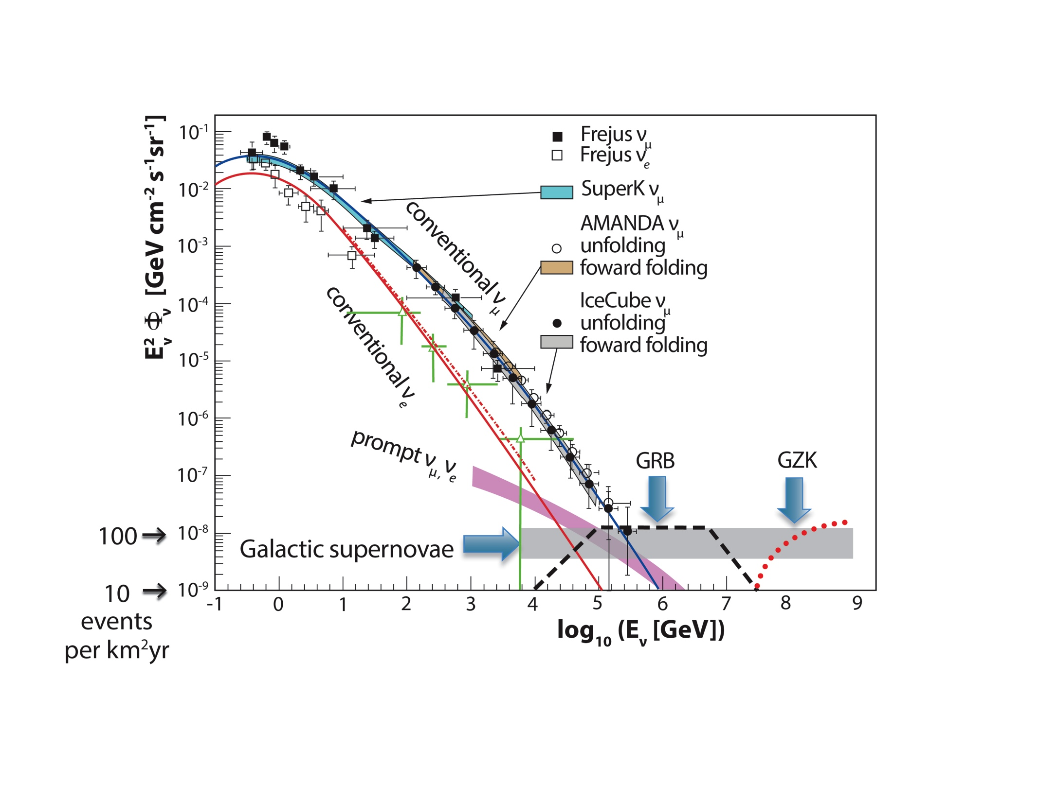

Slide 22
neutrino astronomy
francis halzen
cosmogenic neutrinos
the energetics of cosmic ray sources
neutrinos associated with cosmic rays
a cubic kilometer detector
evidence for extraterrestrial neutrinos
conclusions
IceCube.wisc.edu

Slide 23
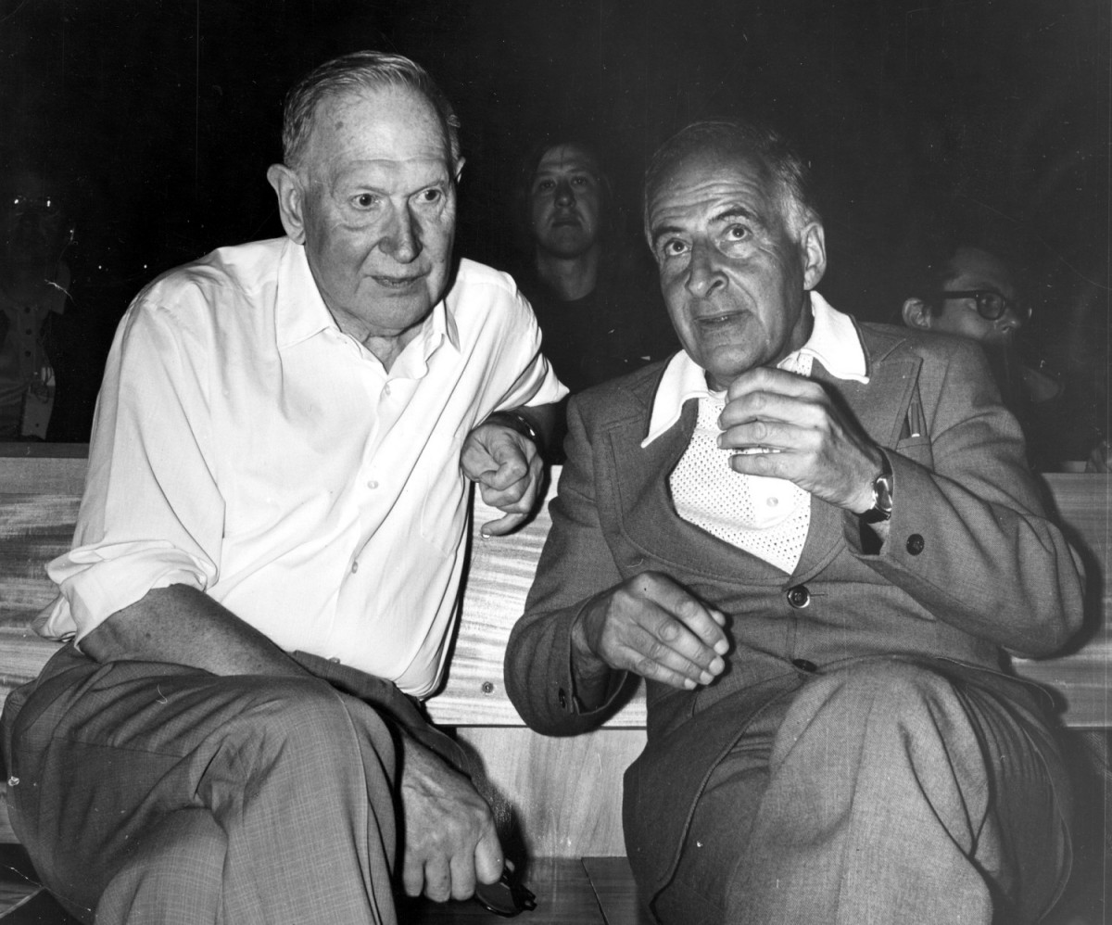
M. Markov
1960
B. Pontecorvo
M.Markov :
we propose to install detectors
deep in a lake or in the sea and
to determine the direction of
charged particles with the help
of Cherenkov radiation.

Slide 24
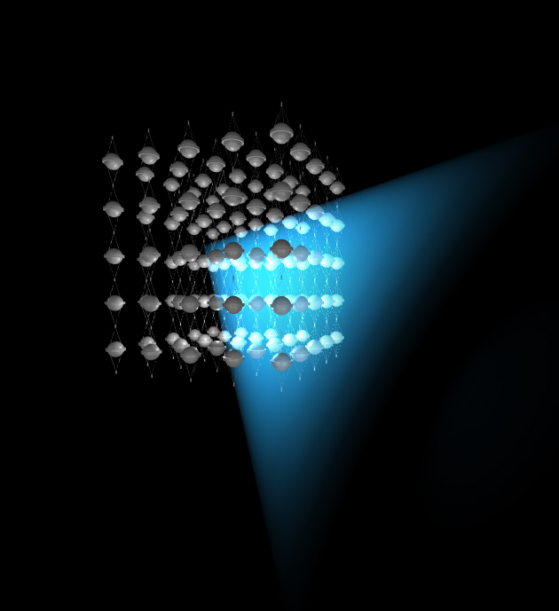
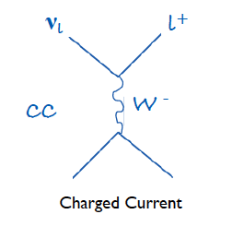
shielded and optically
transparent medium
μ
ν
lattice of photomultipliers

Slide 25
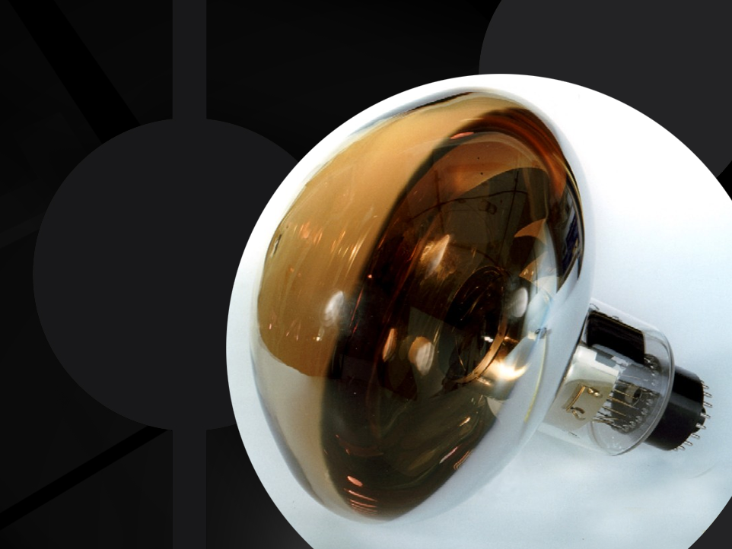
photomultiplier
tube

Slide 26
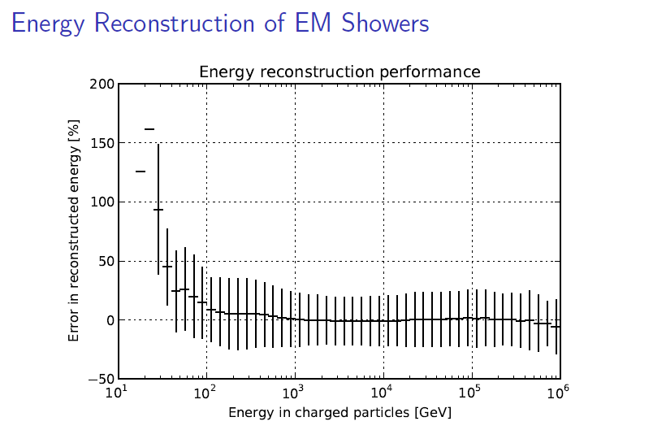
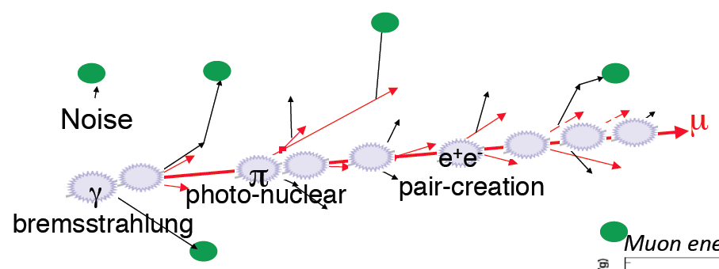
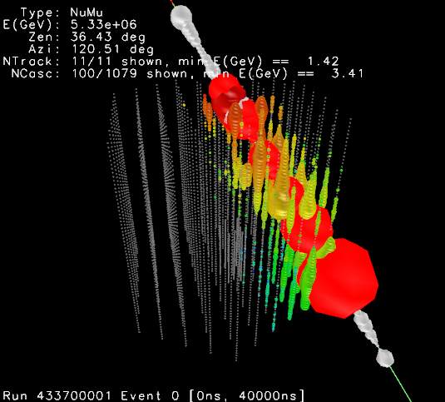
energy measurement ( > 1 TeV )
convert the amount of light emitted
to measurement of the muon
energy (number of optical modules,
number of photons, dE/dx, …)

Slide 27
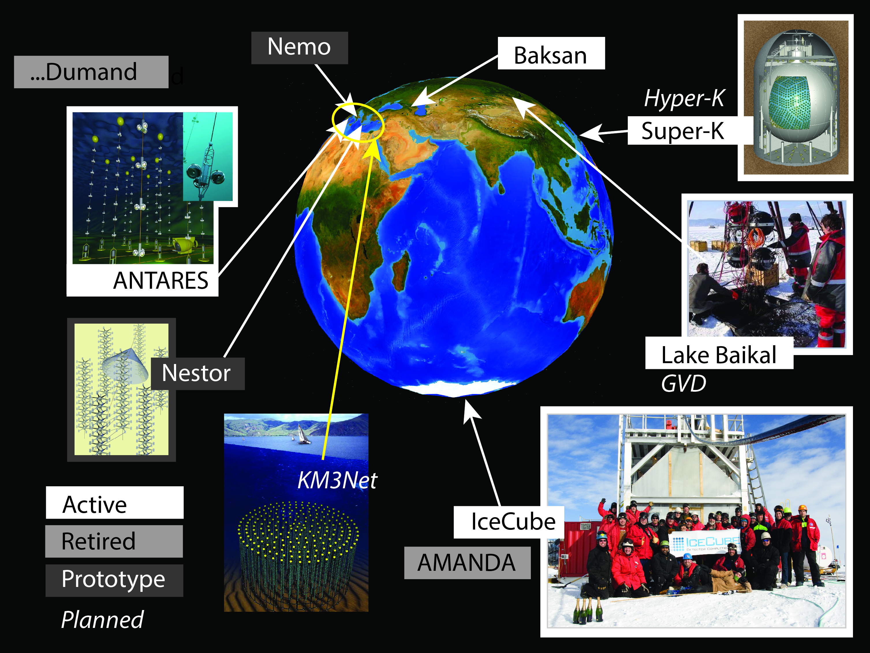

Slide 28
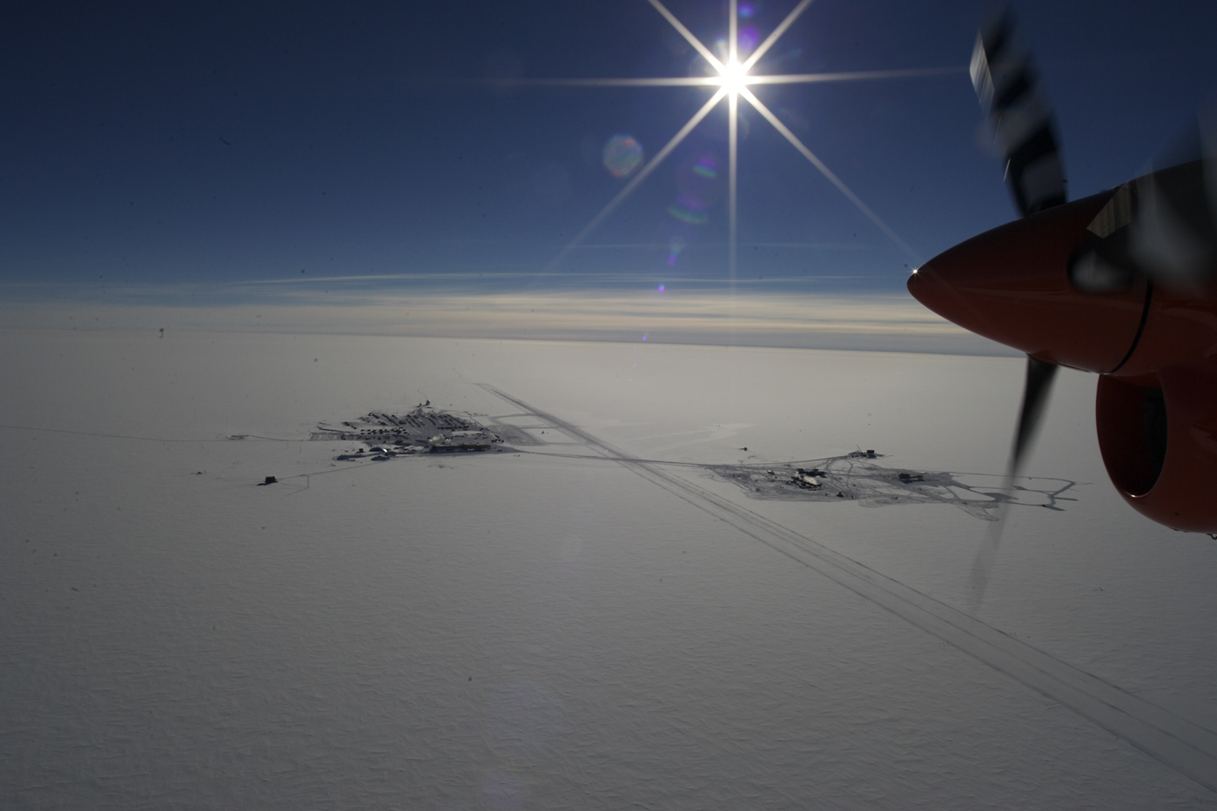
why did it take so long ?

Slide 29
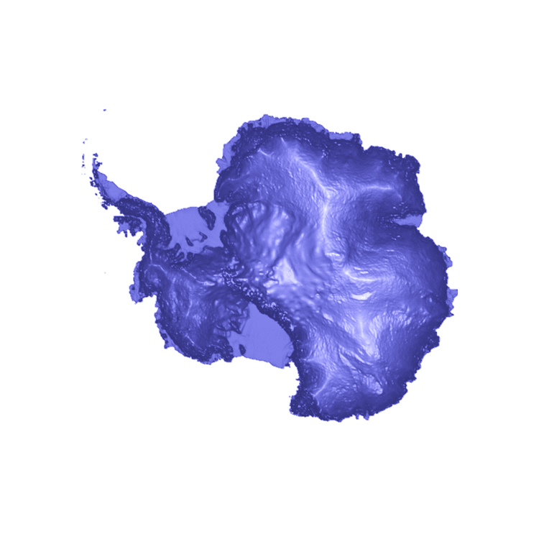
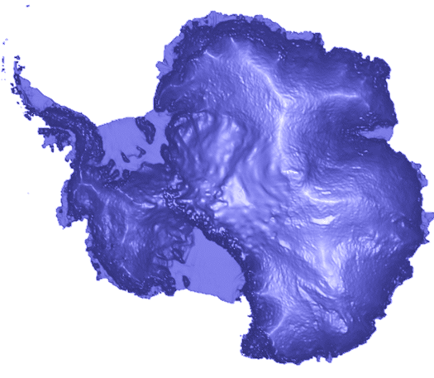
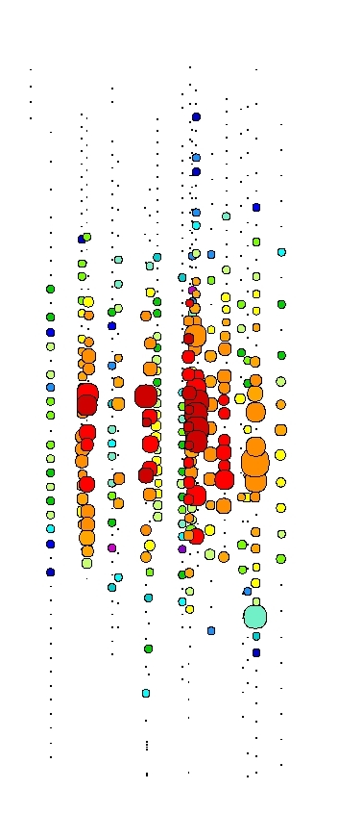
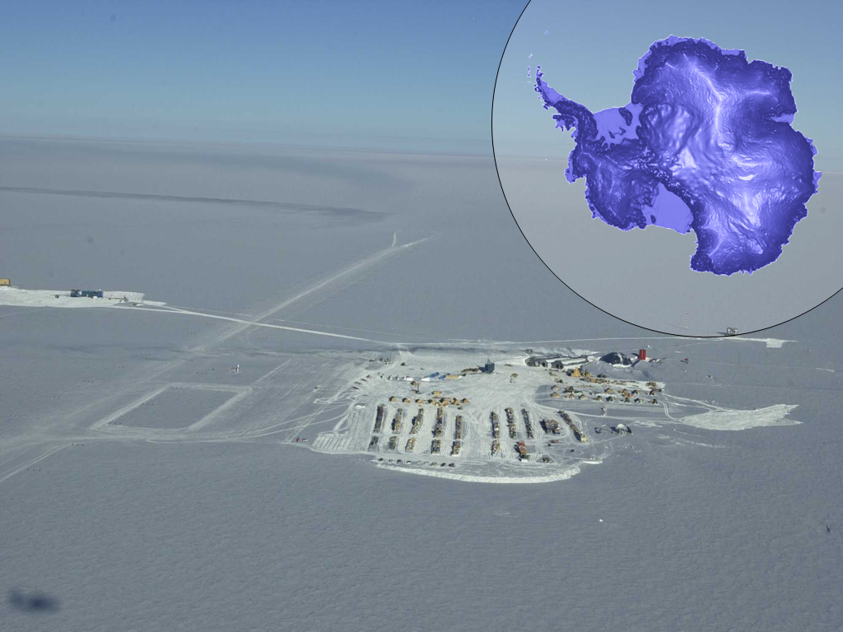
2000
AMANDA
South Pole
Dome
1500 m
2000 m
Amundsen-Scott South Pole station
[not to scale]

Slide 30
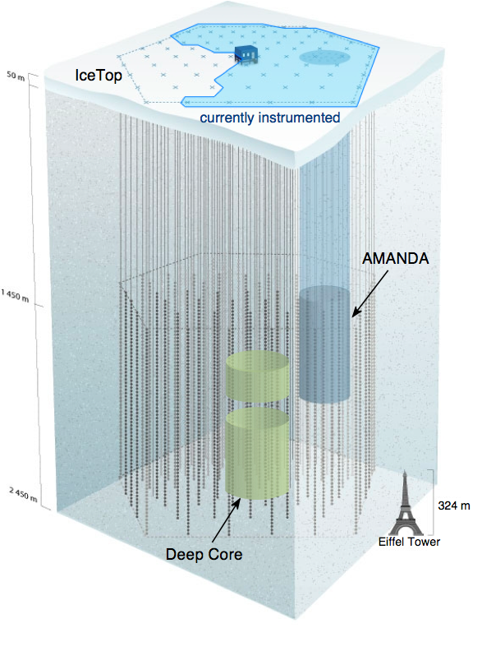
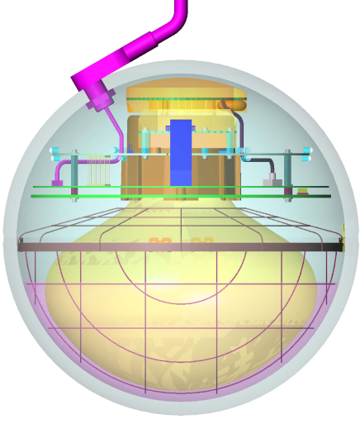
IceCube / Deep Core
completed December 2010
5160 optical sensors
between 1.5 ~ 2.5 km
10 GeV to infinity
< 0.5 degree on-line
< 0.3 degree off line
for muons
(10~15 degrees for
showers)
< 15% energy resolution
Digital Optical Module (DOM)

Slide 31
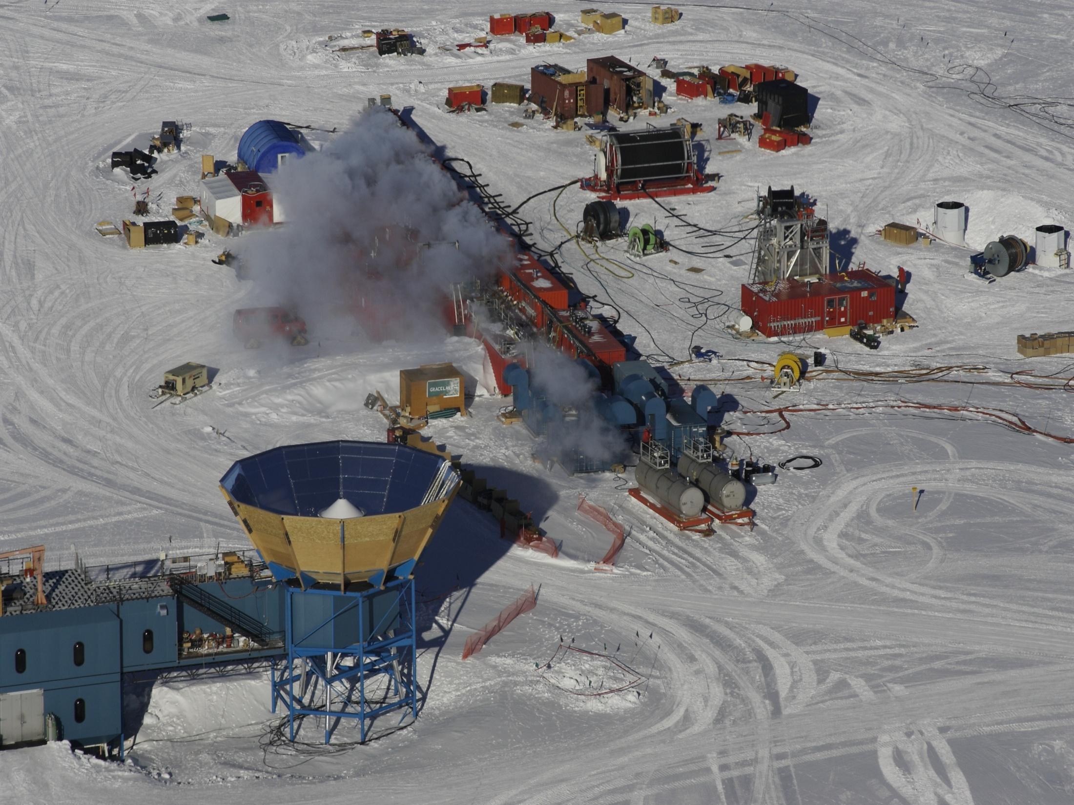
IceCube Site
nozzle delivers →
  200 gallons per minute
  7 Mpa
  90 degree C
  → 4.8 megawatt heating plant

Slide 32
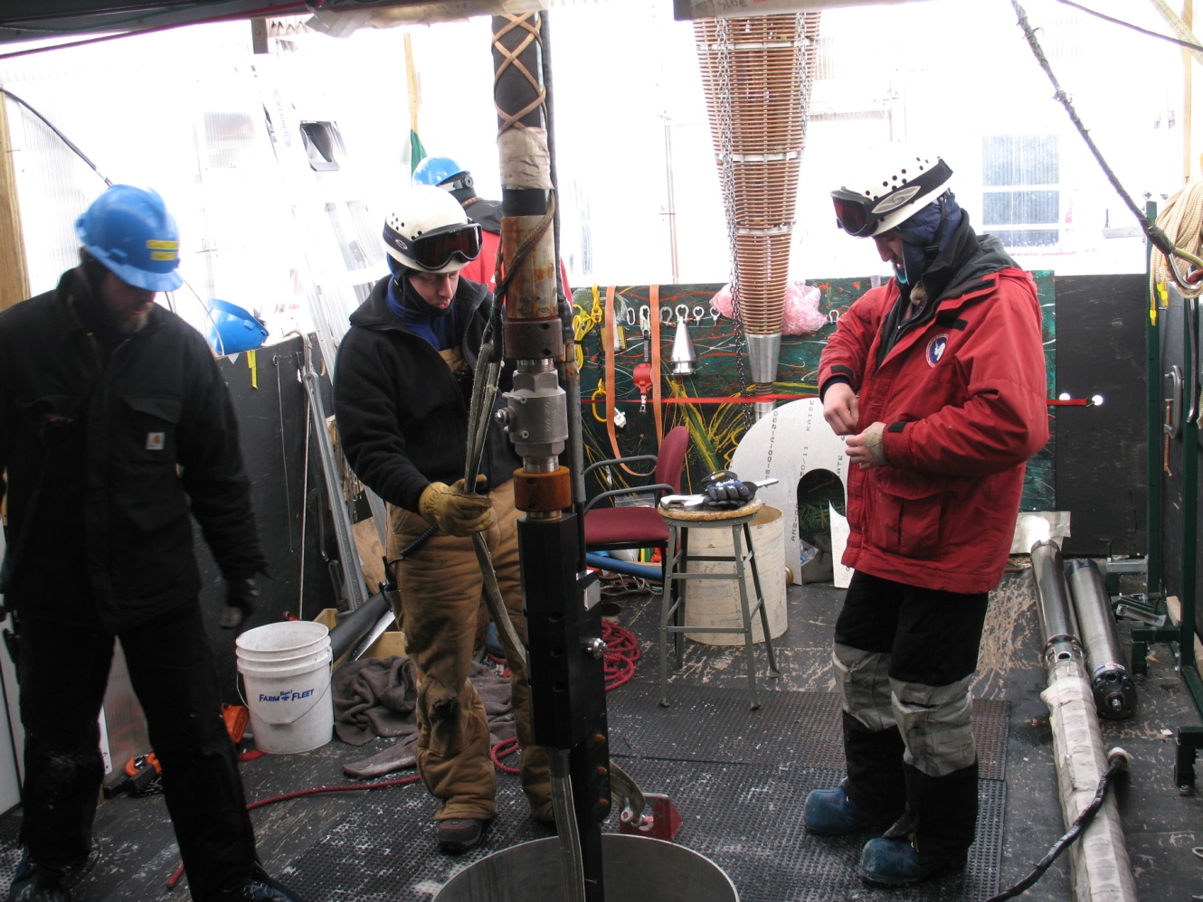
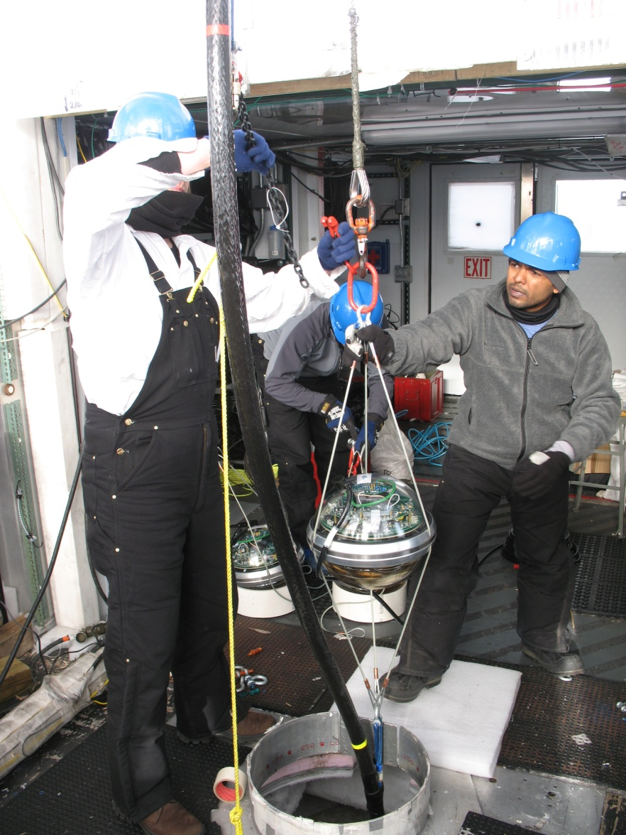
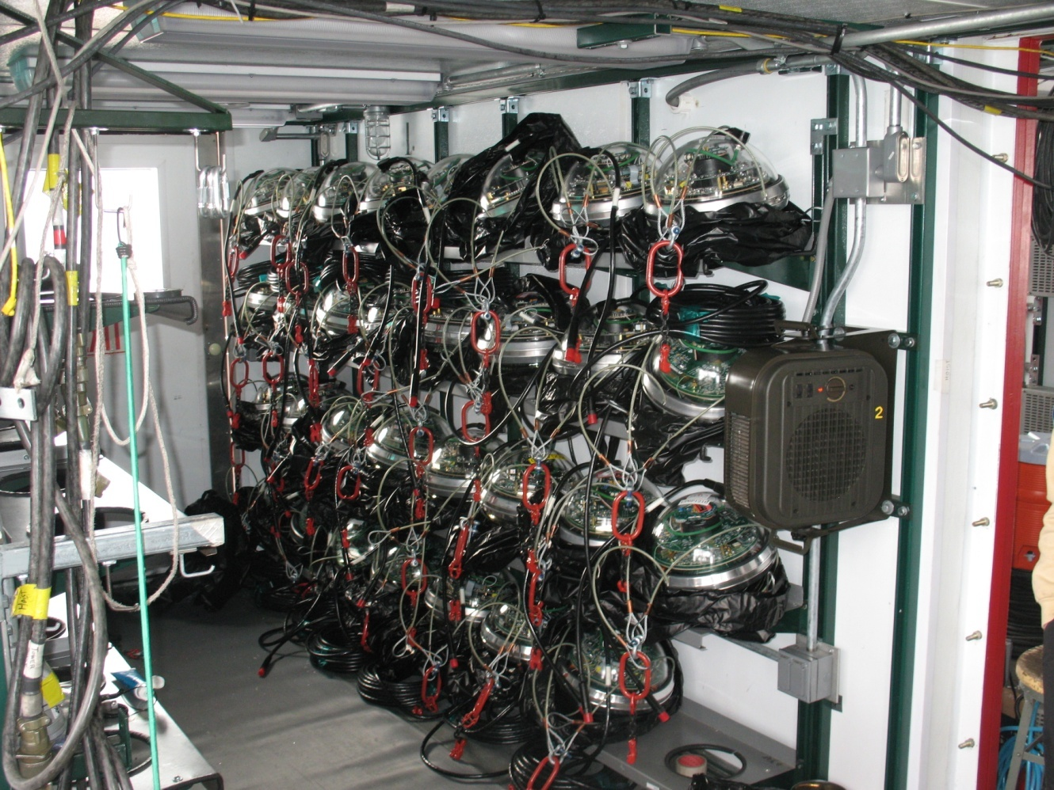
drilling and deployment
2 days per hole
3.5 cm/second
32

Slide 33
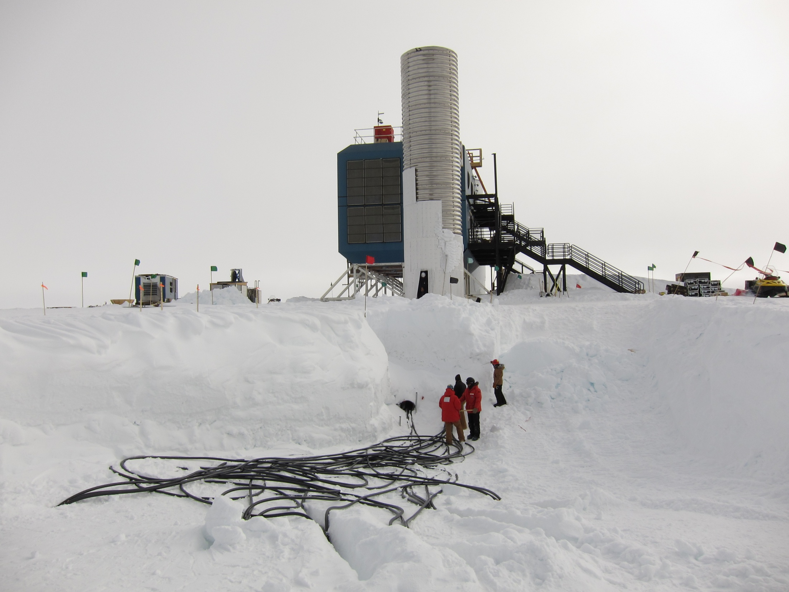

Slide 34
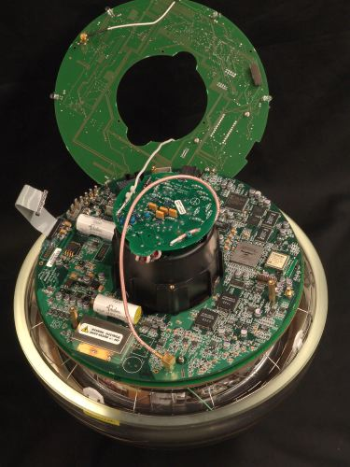
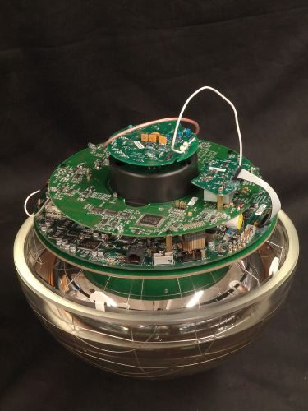
architecture of independent DOMs
LED flasher board
HV board
main board

Slide 35
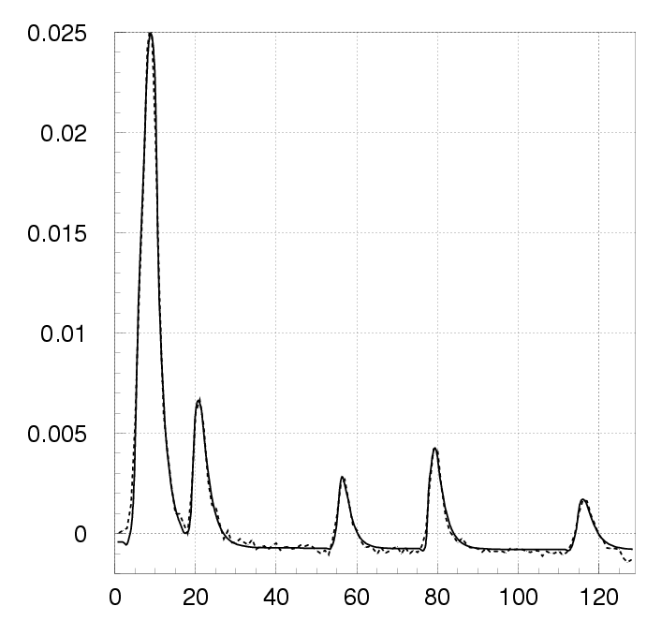
Digital Optical Module (DOM)
… each DOM independently collects light signals like this…
…time stamps them with 2 nanoseconds precision and sends them to a computer that sorts them into muon and neutrino events…
Digitized Waveform
Notes:
35

Slide 36
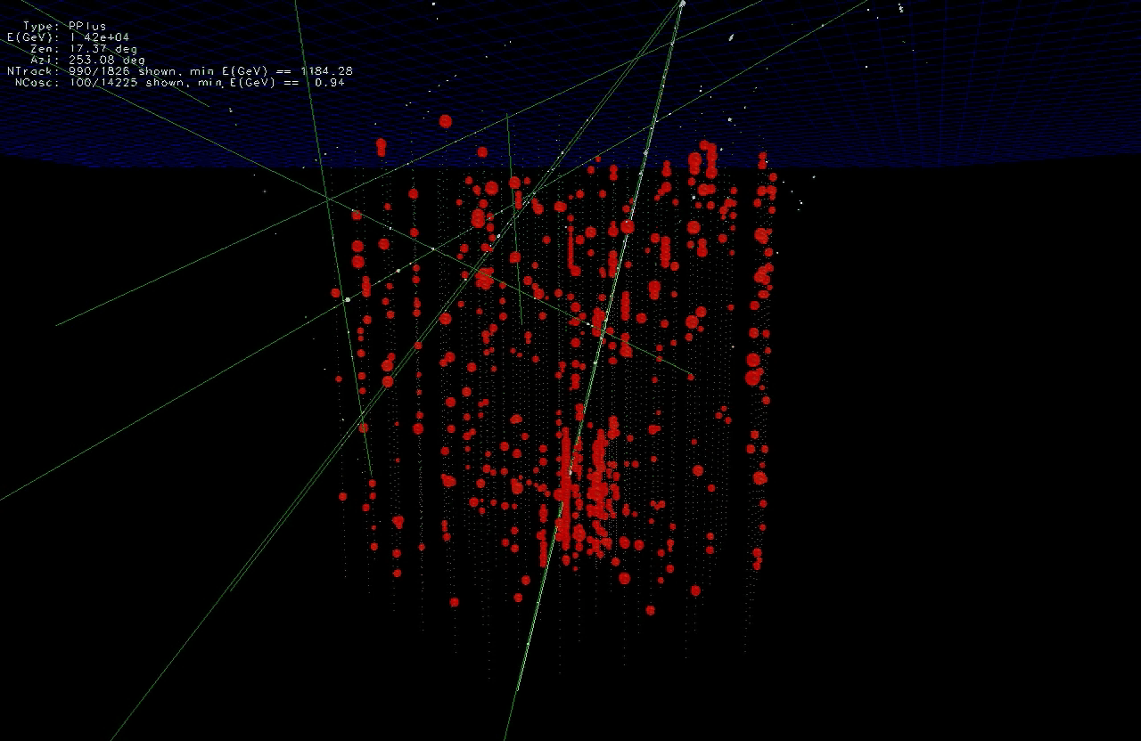

Slide 37
… you looked at 10msec of data !
muons detected per year:
atmospheric* μ ~ 10¹¹
atmospheric** ν → μ ∼ 10⁵
cosmic ν → μ ∼ 10
* 2700 per second ** 1 every 6 minutes

Slide 38
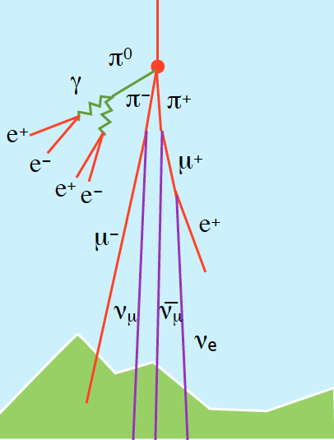
cosmic ray

Slide 39
… you looked at 10msec of data !
muons detected per year:
atmospheric* μ ~ 10¹¹
atmospheric** ν → μ ∼ 10⁵
cosmic ν → μ ∼ 10
* 2700 per second ** 1 every 6 minutes

Slide 40
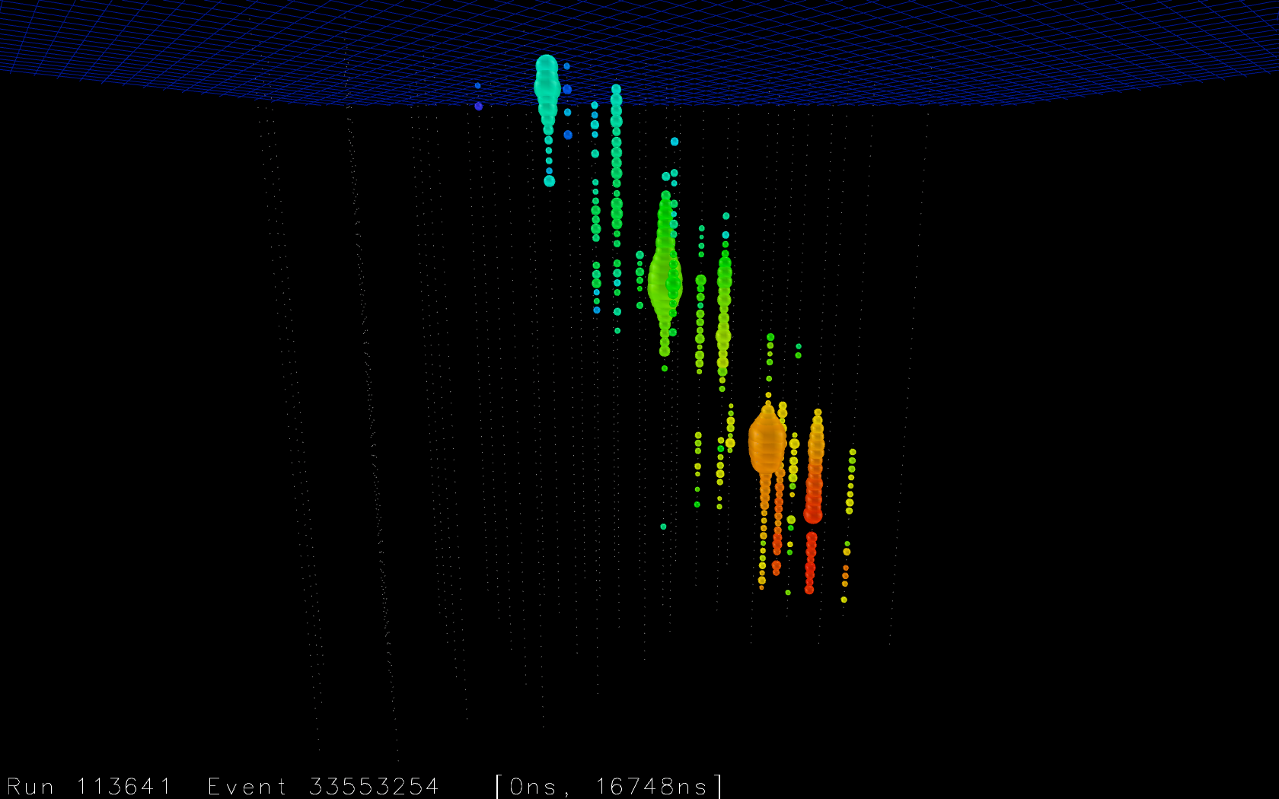

Slide 41
neutrino astronomy
francis halzen
cosmogenic neutrinos
the energetics of cosmic ray sources
neutrinos associated with cosmic rays
a cubic kilometer detector
evidence for extraterrestrial neutrinos
conclusions
IceCube.wisc.edu

Slide 43
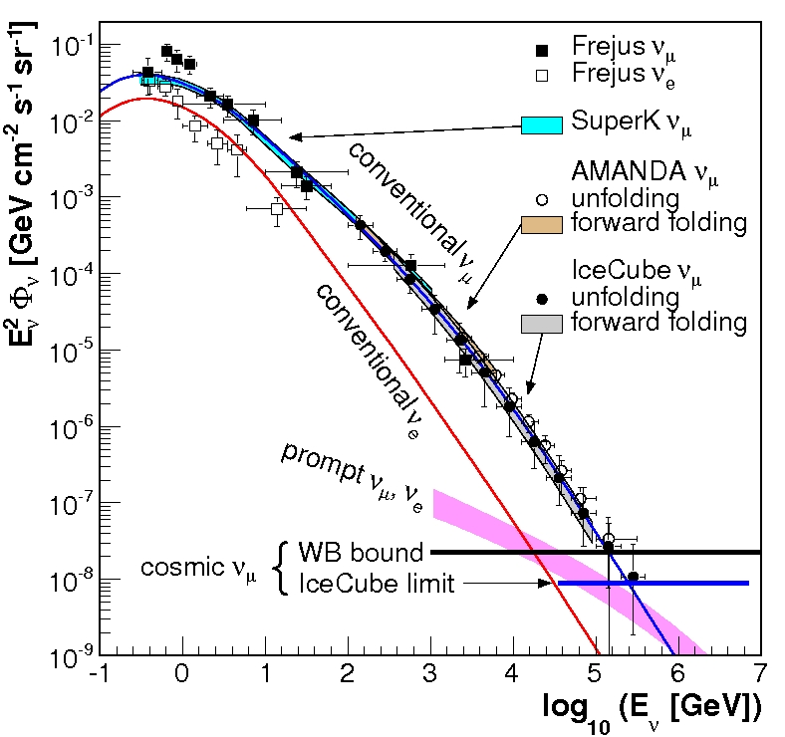
cosmic
neutrinos:
energy
> 100 TeV
atmospheric
background:
1~2 events
per year
atmospheric neutrino spectrum

Slide 44
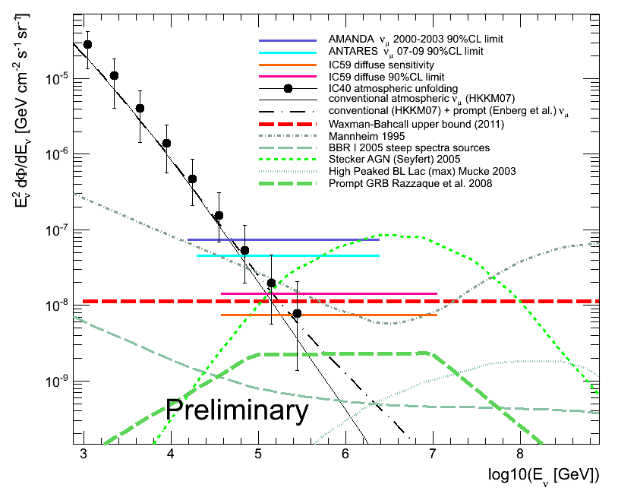
before
AMANDA
59 strings, 1 year
sensitivity
“limit”

Slide 45
cosmic rays interact with the microwave background
cosmic rays disappear, neutrinos with
EeV (10¹⁸ eV) energy appear
1 event per cubic kilometer per year
...but it points at its source

Slide 46
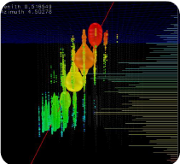
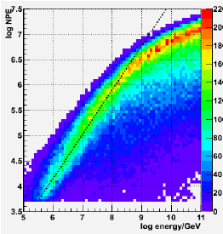
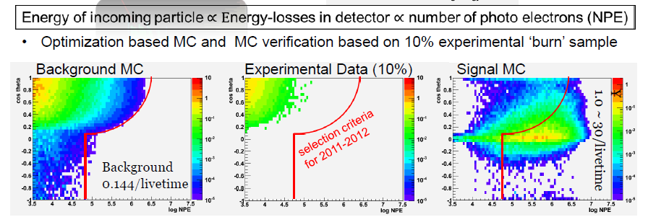
GZK neutrinos: > 41,000 photons near the horizon
number of
channels
> 300
unblinding: 2 events in the signal region

Slide 47
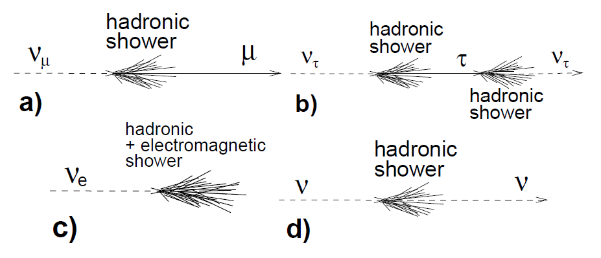
neutrino flavors
a muon track is relatively rare

Slide 48



tracks and showers

Slide 49



Slide 51

digital optical module 44 on string 20 only

Slide 52

energy
1,041 TeV
1,141 TeV
(15% resolution)
not atmospheric:
probability of
no accompanying
muon is 10⁻³ per
event
→ flux at present
level of diffuse
limit

Slide 53


find more contained
events (420 Mton)
total calorimetry
complete sky coverage
flavor determined
some will be muon
neutrinos with good
angular resolution
loss in statistics is compensated by event definition

Slide 54


atmospheric neutrinos are
accompanied by muons from
the shower that produced them:
none seen
(no signals in IceTop)

Slide 55

what we found

Slide 56

showers
tracks

Slide 57

data: 86 strings one year

Slide 58


total charge collected
by PMTs of events with
interaction inside the
detector
E²Φ(E) =
(3.6±1.2)·10⁻⁸ GeVcm⁻²s⁻¹sr⁻¹
atmospheric ν
and μ

Slide 59

preliminary
> 100 TeV (50 em equivalent): 18 events
28 events
significance > 4 sigma
atm. Background
:
up
down

Slide 60

some interesting events

Slide 61
events have properties of a cosmic flux
atmospheric background:
mostly from North (through the Earth, insufficient target to produce neutrinos from the South)
mostly muons (muon neutrinos and cosmic ray muons)
cosmic flux:
mostly from the South (PeV neutrinos absorbed by the Earth)
mostly showers (1:1:1 flavor composition and only CC muon neutrinos produce a track)

Slide 62
atmospheric muon (blue) + neutrino (red) background
+ astrophysical E²Φ(E) =(3.6±1.2)·10⁻⁸ GeVcm⁻²s⁻¹sr⁻¹
energy deposited in the detector
zenith angle

Slide 63


Slide 64
Galactic coordinates
arXiv 1309.4077
boundary with no gamma ray
observations in Southern sky
PeV events
hottest spot in IceCube
PeV gamma ray map
c.o.g of 5-event cluster

Slide 65

the energy range of cosmic accelerators producing PeV neutrinos
Galactic or extragalactic?

Slide 66
conclusions
first evidence for cosmic neutrinos
origin not revealed yet, but…
one more year of data ready for
unblinding, more being taken
better and different analyses soon
IceCube.wisc.edu

Slide 67

10% of data taken during year 2 of IceCube unblinded

Slide 68

IceCube & PINGU collaborations

