Slide 1
Dynamics with 2 macroscopic time dimensions
James N. Bellinger
University of Wisconsin at Madison
25-July-2005
James N. Bellinger, U Wisconsin at Madison
January 26, 2022

Slide 2
Why??
Personal Amusement: In one of his speculative moods, Eddington wrote about interfaces between (3,1), (2,2), and (1,3) spaces; and the notion fascinated me ever since.
Dark Matter: It seems intuitive that different timelines might make matter hard to observe
String Theory: Bars, Vongehr, and Gogberashvili have been looking at systems with 2 time dimensions.
James N. Bellinger, U Wisconsin at Madison
January 26, 2022

Slide 3
Macroscopic Dimensions
I want to eventually include dark matter or quintessence discussions.
Everyday experience doesn't obviously require more than 1 time dimension.
I don't want to get into quantum effects just yet.
James N. Bellinger, U Wisconsin at Madison
January 26, 2022

Slide 4
Approach
I take the approach of asking what you will see if you use light as a probe of some other object evolving on different timelines.
There are several important questions about visibility and causality that don't have obvious answers, so I repeat the same analysis with different assumptions.
James N. Bellinger, U Wisconsin at Madison
January 26, 2022

Slide 5
Questions
Can you directly measure time dimensions orthogonal to your own? Probably not, but check both ways.
Can we preserve causality? Let's try.
Do objects on different timelines interact? I'd think yes: more weakly when the angle between timelines is greater.
Does light always seem to move at the same speed? Good question!
James N. Bellinger, U Wisconsin at Madison
January 26, 2022

Slide 6
More Questions
Can a particle have negative energy? It sounds odd, but as long as things add up at the end of the day I'm not too worried.
Is it enough to intersect only one time component? Not if the second time dimension means anything.
James N. Bellinger, U Wisconsin at Madison
January 26, 2022

Slide 7
Still More Questions
If an object can measure the angle of the timeline of another object, will that angle vary with the speed? We'll have to check and see.
If object A measures B's relative timeline angle as , will B measure A's relative timeline angle as ? Presumably.
James N. Bellinger, U Wisconsin at Madison
January 26, 2022

Slide 8
Timelines
Assume that the two time directions can be treated as a Euclidean plane.
An undisturbed object will not change the direction of its timeline, but continue to evolve in time along a straight line in the 2-time plane.
James N. Bellinger, U Wisconsin at Madison
January 26, 2022

Slide 9
Timelines
T2
C
T2
B
A
T1
T1
James N. Bellinger, U Wisconsin at Madison
January 26, 2022

Slide 10
Causality
It isn't enough to have relatively positive time coordinates. B has positive time coordinates wrt A, but not wrt C. We can create a causality-violating chain of events.
C
T2
B
A
T1
James N. Bellinger, U Wisconsin at Madison
January 26, 2022

Slide 11
Causality
Therefore if we want to preserve causality, the time axes T1 and T2 have to have some physical significance.
An object with a timeline close in angle to one of the axes has less time-phase space to emit a photon into than one whose timeline is farther away from an axis.
James N. Bellinger, U Wisconsin at Madison
January 26, 2022

Slide 12
Ahem?
Just because it isn't comfortable to try to figure out what these time axes might be doesn't mean they aren't possible. It certainly doesn't make the theory more probable.
Of course we can give up on perfect causality and rely on the presumably low interaction rate at large time angles to keep the world polite.
James N. Bellinger, U Wisconsin at Madison
January 26, 2022

Slide 13
Some notation
Define a point in spacetime by the coordinates (x,y,z; t1,t2) or if we only look at the x dimension, (x; t1, t2)
Use the corresponding conventions for momentum (Px, Py, Pz; E1, E2)
James N. Bellinger, U Wisconsin at Madison
January 26, 2022

Slide 14
Does Einsteinian Formalism Work?
Assume this is invariant.
Assume that a transformation to a different frame of reference will be linear.
For simplicity, ignore y and z.
James N. Bellinger, U Wisconsin at Madison
January 26, 2022

Slide 15
Solving for the transform
James N. Bellinger, U Wisconsin at Madison
January 26, 2022

Slide 16
Einsteinian Formalism: Boost in 2 time dimensions
James N. Bellinger, U Wisconsin at Madison
January 26, 2022

Slide 17
Einsteinian Formalism: Does it actually work?
One of the assumptions on an earlier slide isn't
easy to justify: “a transformation to a different
frame will be linear.”
We need to try to model what an observer can
actually measure. The most logical probe is a
photon.
What will you see if you emit a photon which
reflects off an object on a different timeline to
be reabsorbed by you?
Obviously, you can measure the time it seems
to take to travel.
James N. Bellinger, U Wisconsin at Madison
January 26, 2022

Slide 18
The usual picture, only one time dimension.
James N. Bellinger, U Wisconsin at Madison
January 26, 2022

Slide 19
The usual picture, only one time dimension (2)
James N. Bellinger, U Wisconsin at Madison
January 26, 2022

Slide 20
If you can measure orthogonal time components, and the speed of light is always c.
Assume that object B (the emitter) sees A receeding at speed β. A's timeline is
B emits a photon at time τ with the same timeline as A. The photon intersects A at , so the invariant distance B measures is
James N. Bellinger, U Wisconsin at Madison
January 26, 2022

Slide 21
If you can measure orthogonal... continued
Now let A view B receeding with speed . After a time B reaches and emits a photon with direction . After a time A absorbs the photon, at position Iff these timelines intersect, and the invariant distance is
James N. Bellinger, U Wisconsin at Madison
January 26, 2022

Slide 22
If you can measure orthogonal... more yet
We can equate the invariant distances, writing the result as ,where
and and remembering that
James N. Bellinger, U Wisconsin at Madison
January 26, 2022

Slide 23
If you can measure orthogonal... more yet
So if you can measure orthogonal timeline components, you can find a relatively simple relationship between the times measured in each frame of reference.
The probing photon's timeline is measured differently by the emitter and the absorber.
James N. Bellinger, U Wisconsin at Madison
January 26, 2022

Slide 24
If you cannot measure orthogonal times, but the speed of light is always measured as c
Both are at rest, with parallel timelines.
WLOG we let A emit the photon at (0;0,0) along and B evolve along
A
B
James N. Bellinger, U Wisconsin at Madison
January 26, 2022

Slide 25
If you can't measure orthogonal times, but c is always c, continued
If B absorbs the photon, it is at
Thus
And the distance is timelike and the photon won't be observed if
A
B
James N. Bellinger, U Wisconsin at Madison
January 26, 2022

Slide 26
If you can't measure orthogonal times, but c is always c, continued (2)
Let B reflect the photon back to A, with direction
A absorbs it at
A infers that B's distance is
A
B
James N. Bellinger, U Wisconsin at Madison
January 26, 2022

Slide 27
If you can't measure orthogonal times, but c is always c, continued (3)
So if two objects have parallel timelines but different initial “orthogonal” times, each will perceive the other to be closer than it really is. This is a consequence of the requirement that the speed of light is always c.
If their separation is timelike, with the orthogonal time difference larger than their real physical separation, they won't be able to interact using photons.
James N. Bellinger, U Wisconsin at Madison
January 26, 2022

Slide 28
If you can't measure orthogonal times, but c is always c, continued (4)
So one prediction of this model is that distant objects can appear arbitrarily close if their orthogonal time difference is great enough. This isn't as easy to arrange as you might hope, since if objects have been evolving from the Big Bang, the most obvious way to get a large orthogonal time difference is to start with substantially non-parallel timelines.
James N. Bellinger, U Wisconsin at Madison
January 26, 2022

Slide 29
If c is always c, non-parallel not measureable, parallel timelines but one object is in motion
Consider the same model as before, execpt that B is in motion. Sparing you the gory details, we now have
James N. Bellinger, U Wisconsin at Madison
January 26, 2022

Slide 30
If c is always c, non-parallel not measureable, non-parallel timelines with object in motion
Using the same methods, except that the second object evolves along we find that for A at (0;T,0)
James N. Bellinger, U Wisconsin at Madison
January 26, 2022

Slide 31
If c is always c, non-parallel not measureable, non-parallel timelines with object in motion 2
This has solutions when
James N. Bellinger, U Wisconsin at Madison
January 26, 2022

Slide 32
If c is always c, non-parallel not measureable, non-parallel timelines with object in motion 3
One lesson we can take away from this exercise is that the transformation from one frame to another is not linear.
Another is that objects along other timelines are not always visible. In particular, an object at rest on a different timeline will eventually vanish.
James N. Bellinger, U Wisconsin at Madison
January 26, 2022

Slide 33
If c is always c, non-parallel not measureable, non-parallel timelines with object in motion 4
Observer A can estimate the speed of B using repeated measurements of the time of flight for a reflected photon, in the same way you can do this in ordinary 4-space.
James N. Bellinger, U Wisconsin at Madison
January 26, 2022

Slide 34
If c is always c, non-parallel not measureable, non-parallel timelines with object in motion 5
It isn't immediately obvious, but the estimated speed increases with increasing , and at least initially decreases with increasing angle between the timelines ( ).
James N. Bellinger, U Wisconsin at Madison
January 26, 2022

Slide 35
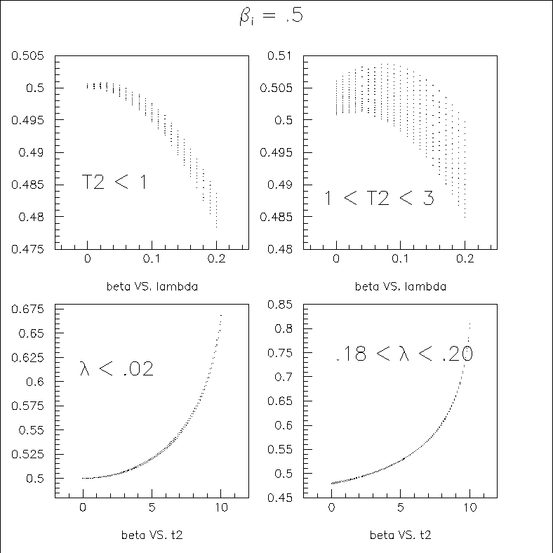
If c is always c, non-parallel not measureable, non-parallel timelines with object in motion 6
James N. Bellinger, U Wisconsin at Madison
January 26, 2022

Slide 36
If c is always c, non-parallel not measureable, non-parallel timelines with object in motion 7
If Observer A is an extended object with the capability of observing simultaneously at points y=0 and y !=0, the difference in distance traveled effects the measured time of flight. But since the “y” appears in a non-linear way it turns out that we can use this to determine an independent estimate for the speed of B.
James N. Bellinger, U Wisconsin at Madison
January 26, 2022

Slide 37
Measuring Energy
Ideally we can measure the number of wavelengths of a probing photon. If we measure the distance by time, as described earlier, the wavelength we infer is shorter, and thus the energy is higher for photons on different timelines than our own. This blueshift is no weirder than a redshift in special relativity—in both cases we are looking at something in a different reference frame.
James N. Bellinger, U Wisconsin at Madison
January 26, 2022

Slide 38
Decays
In its local reference frame a particle has momentum (0; M,0). So long as the timeline angles aren't too large we can describe the decay particles as and
James N. Bellinger, U Wisconsin at Madison
January 26, 2022

Slide 39
James N. Bellinger, U Wisconsin at Madison
January 26, 2022

